Slide 1





Team Details
Team Name : V4CATALYST
Leader Name : Ishika Dubey
Domain Chosen : Web & Product Development
Problem Statement : Digital Handoff & Continuity Management Platform
Thread — no complaint left hanging.
Live: v4-catalyst.vercel.app

Slide 2

Problem Analysis
When a complaint changes hands, its context usually doesn't.
Leave, escalation, a team rebalancing work: every transfer is a chance to lose what the last person knew.
01
02
03
04
Context is scattered
Half-done handoffs
Ownership is ambiguous
Deadlines slip silently
Emails, chats, spreadsheets and personal notes. The new owner rebuilds the case from fragments.
Nothing stops a case moving with unassigned tasks, missing documents or unanswered questions.
A case is "sent", but nobody confirms they understood it. Accountability falls into the gap.
Overdue actions surface only when the customer complains again, or the regulator asks.
WHAT A BAD HANDOFF COSTS
WHO FEELS IT
— The customer explains everything again
— Work is repeated, decisions are reversed
Customers · front-line employees
Team leads · compliance & audit
— Statutory and SLA deadlines are missed
— No record of who owned what, and when

Slide 3
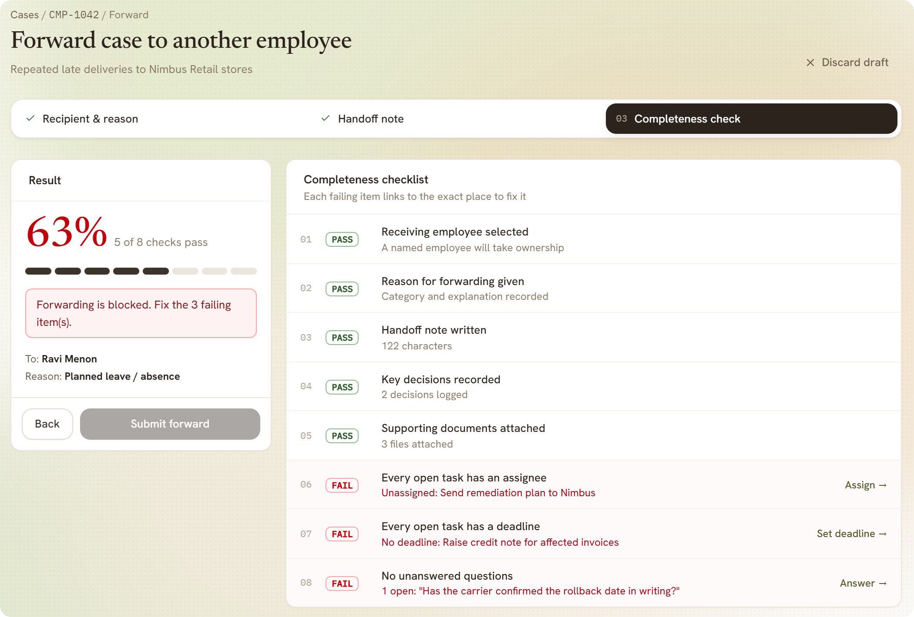
Proposed Solution & Key Features
Thread makes a handoff impossible to do badly.
A case moves only when it is complete, and the receiver owns it only after confirming they understood it.
THE BRIEF ASKS FOR
THREAD DELIVERS
Case creation & ownership
✓ One named owner at every stage
Context & documents
✓ Summary, decisions, files, tasks in one workspace
Pending actions & deadlines
✓ Every open task has an assignee and a due date
Structured handoff
✓ Recipient & reason → note → check
Completeness verification
✓ 8-point gate, re-run on the server
New-owner acknowledgement
✓ 5 sections confirmed + Q&A, or send back
Completeness check. Forwarding stays blocked until all 8 checks pass; every failure links straight to where it is fixed.
Activity & responsibility history
✓ Append-only audit log, ownership chain
AI handoff assistant
Alerts & escalation
PDF reports
Overdue notifications
✓ Alerts, reminders, escalation at 48 h

Slide 4
Technical approach & Innovation
ARCHITECTURE
WHAT'S NEW HERE
Web app
Vercel
Rules live on the server
React · TypeScript · Vite · Tailwind · three.js
The browser mirrors the gate for instant feedback, but cannot skip it. Stage moves, acceptance and visibility are enforced by the API.
HTTPS · JSON · bearer token
API
Render
Accountable acceptance
Python · FastAPI · SQLAlchemy · Pydantic
Ownership transfers only when all 5 sections are acknowledged and every question is answered.
Rules engine
Audit log
Deadline watcher
AI with guardrails
Reports · reportlab + matplotlib
AI · Groq LLM
Draft with AI writes the handover note; Brief me prepares the receiver. Replies are schema-checked, with a template fallback.
Database
Neon
PostgreSQL (SQLite locally) · Alembic migrations
Audit-grade by default
Append-only log, per-case visibility, lockout after 5 failed sign-ins, refused access recorded.
35 automated tests · full handoff flow, every error code, migrations on SQLite and PostgreSQL · deployed and live · timezone-aware reports (IST)

Slide 5
Impact & Future Scope
IMPACT
FUTURE SCOPE
Customers
→
Inbound channels
Never repeat their story; every promise made to them travels with the case.
Email, WhatsApp and web forms open cases automatically
→
Single sign-on & MFA
SAML / OIDC with the organisation's identity provider
Employees
Pick up a case and act on it, without chasing the previous owner.
→
Breach prediction
Flag cases likely to miss their deadline before they do
Team leads
→
Integrations
Overdue work surfaces itself, escalations are automatic, and monthly/annual reports are one click.
CRM and helpdesk sync (Zendesk, Salesforce), Slack / Teams alerts
→
Mobile + multilingual
Push notifications; AI briefings in regional languages
Compliance & audit
A complete, tamper-evident trail of who owned what, what they knew, and when.
WHO IT'S FOR
Banks & NBFCs
Telecom
Insurance
E-commerce
Grievance cells

Slide 6
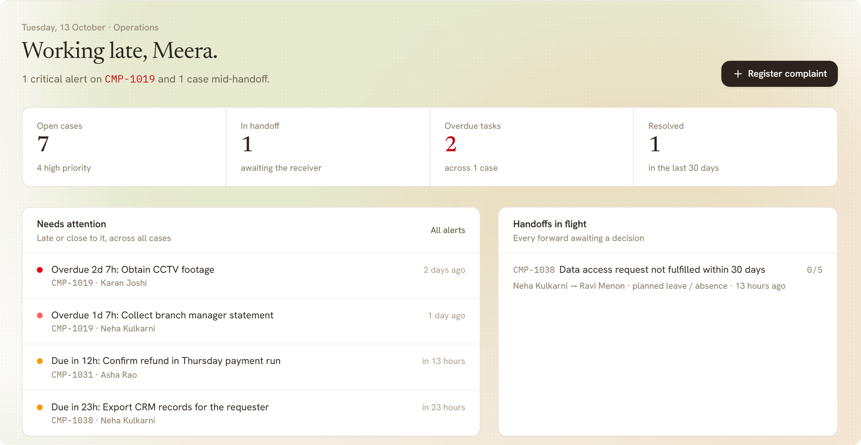
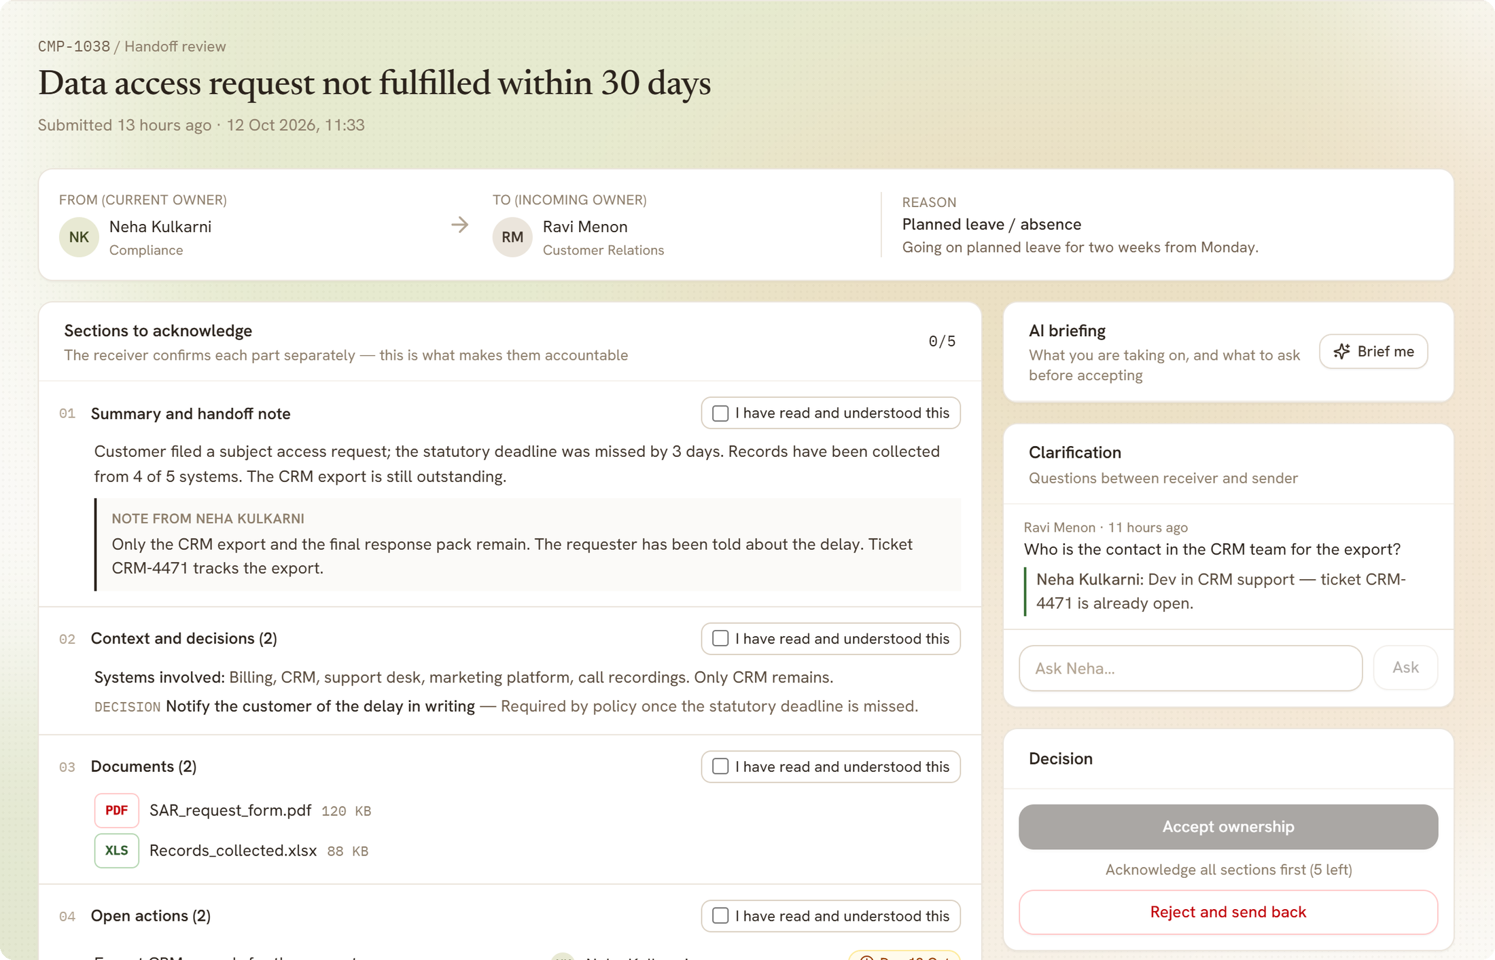
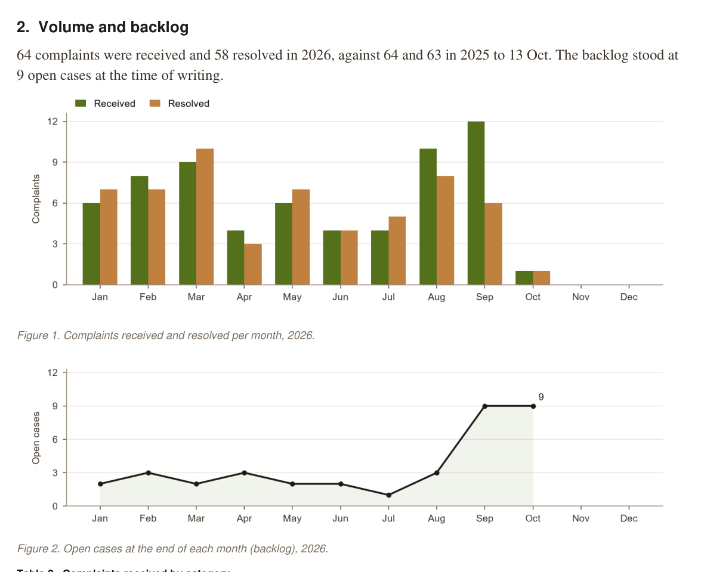
Supporting Information (workflow, architecture, wireframes, research, references)
CASE WORKFLOW
Received
Investigation
Action
Handoff
Resolved
logged & owned
facts, documents
tasks with deadlines
8-point check · 5 acks
closed, reported
Dashboard: what needs attention
Handoff review: acknowledge, ask, accept
Generated PDF report (Python)
Live v4-catalyst.vercel.app Code github.com/ishikadubey1105/V4CATALYST Demo one-click sign-in as any sample employee

