Slide 1





Team Details
Team Name: V4catalyst
Leader Name: Ishika Dubey
Domain Chosen: Web & Product Development
Problem Statement: PS3: Digital Handoff & Continuity Management Platform
Thread: no complaint left hanging

Slide 2

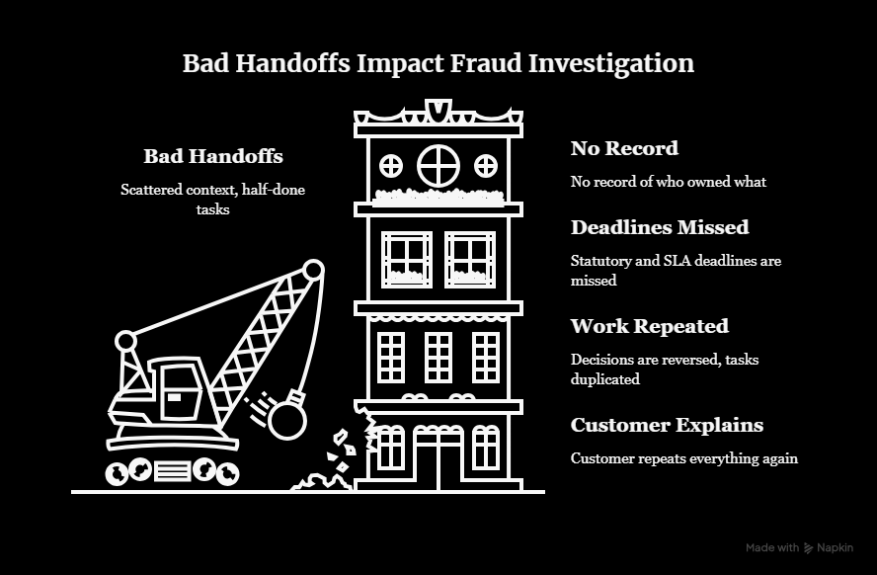
Problem Analysis
The Problem
  When a case changes hands (leave, escalation, team rebalancing), context is scattered across emails, chats, tickets and personal notes.
  The new owner repeats work, misses deadlines, and the customer has to explain everything again.
  Handoffs happen with no check that the information is complete, and no proof the receiver understood it.
Who is affected?
  Employees taking over cases, managers, and customers
waiting for resolution.
Gap in today’s tools
  Ticket systems store cases but don’t stop an incomplete handoff
and don’t record acceptance

Slide 3
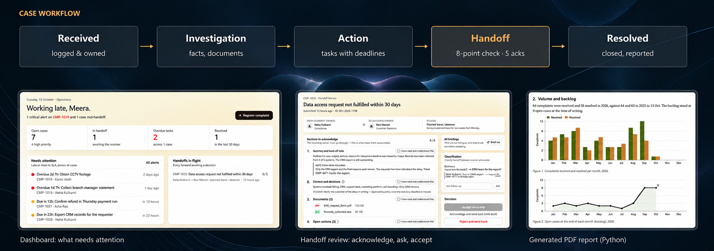
Proposed Solution & Key Features

Slide 4
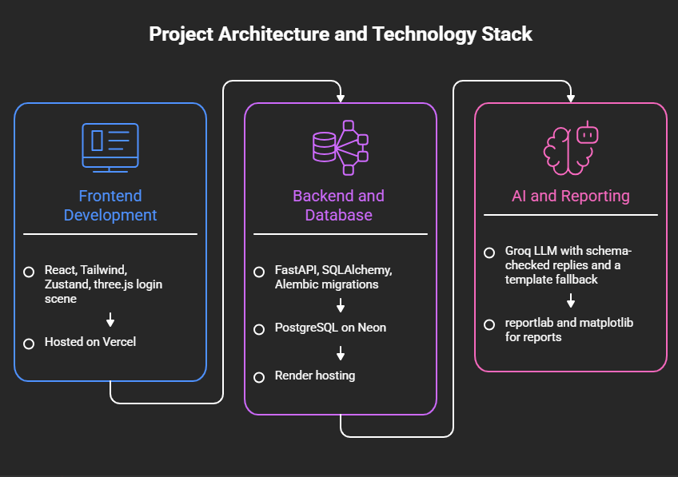
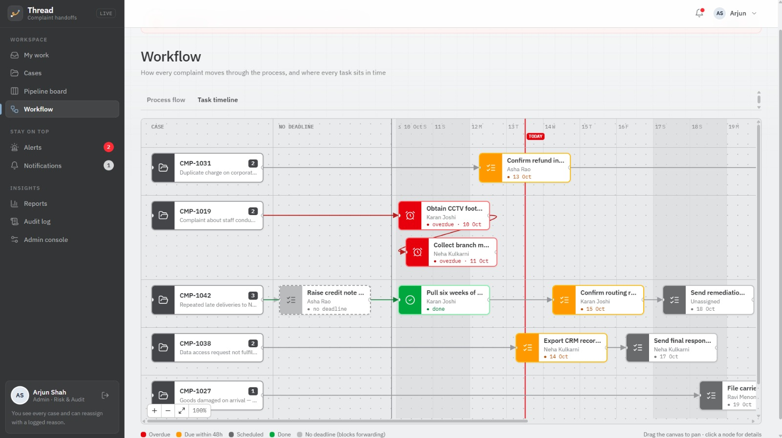
Technical approach & Innovation
The project follows a modular architecture integrating frontend development, backend APIs, database management, and AI-powered reporting for efficient and scalable case handling.
Novel n8n styled workflow that displays tasks according to their respective stages and timeline

Slide 5
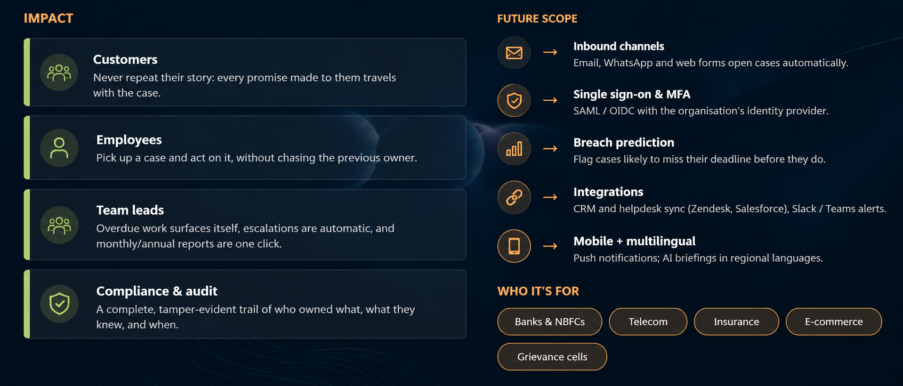
Impact & Future Scope

Slide 6
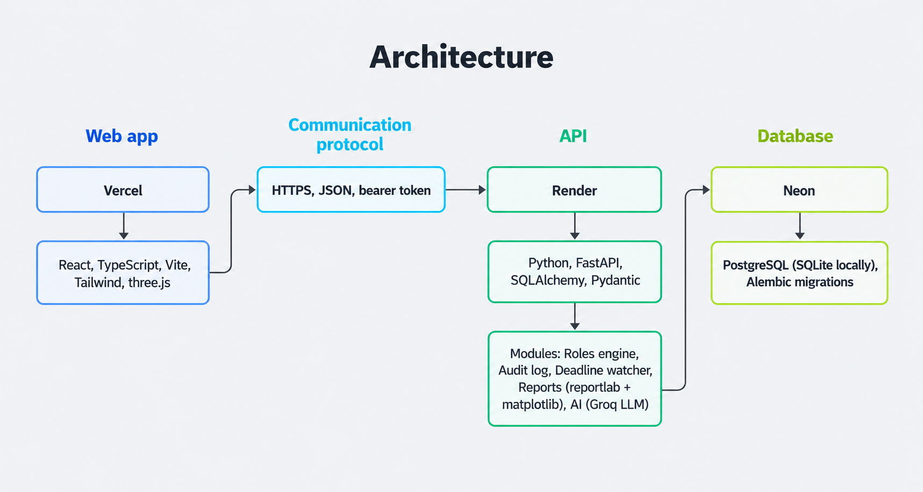
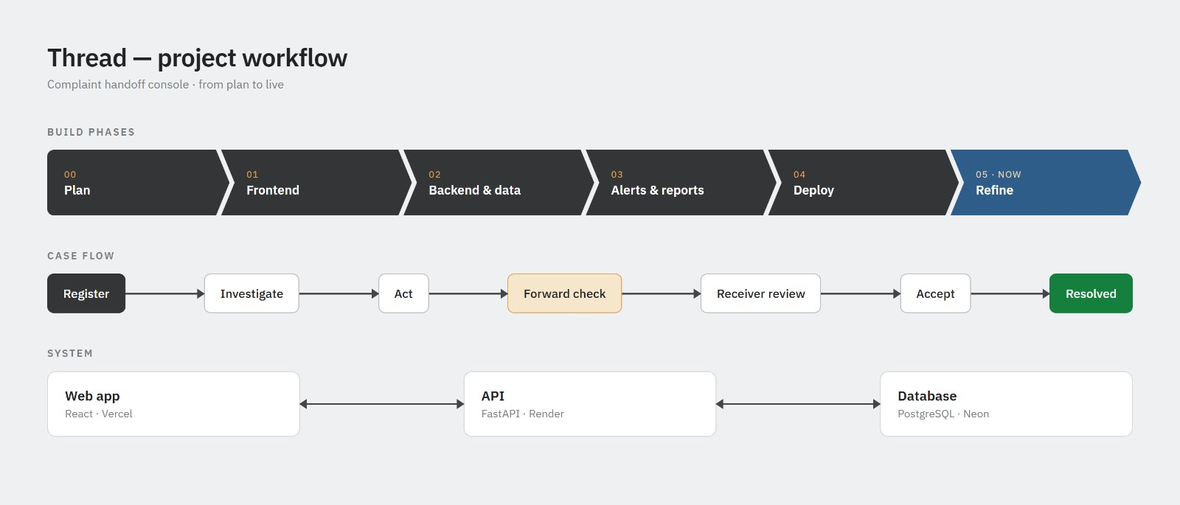
Supporting Information(workflow, architecture, wireframes, research, references)
References:
[1] Atlassian.
[2] Salesforce Trailhead.
[3] Oracle. Overview of Case Management (Fusion Service).
[4] SAP Community. Case Management in SAP Hybris Service Cloud.
[5] Newgen OmniFlow iBPS (EdgeVerve Finacle App Center listing).

