Slide 1
ALGORITHMIC TRADING USING REINFORCEMENT LEARNING
CS3103
GROUP ID: 25SM03
TEAM MEMBERS
1. ISHIKA GUPTA(2301AI10)
2.SAKSHI SAXENA(2301CS45)
3.MANSHI PRAJAPATI(2302CS08)
4.SHIWANI SHRIVASTAVA(2301CS67)

Slide 2

ROLES AND RESPONSIBILITIES
Name | Roll No. | Roles and Responsibilities
Sakshi Saxena | 2301CS45 | Handled data preprocessing and dataset preparation for both algorithms. Worked on DQN training and tuning for stable performance. Wrote the Introduction and Related Work sections of the report.
Ishika Gupta | 2301AI10 | Designed the DQN architecture and implemented the training loop. Developed and refined the reward function for model learning. Contributed to the Methodology and Block Diagram sections of the report.
Manshi Prajapati | 2302CS08 | Implemented and fine-tuned the PPO algorithm with its mathematical model. Worked on policy optimization and performance stability for PPO. Created Algorithm and Flowchart slides for the presentation.
Shiwani Shrivastava | 2301CS67 | Conducted testing and evaluation of PPO and compared it with DQN results. Assisted in performance analysis and visualization of outcomes. Prepared Results and Conclusion slides for the presentation.
Thynk Unlimited

Slide 3
PROBLEM STATEMENT
MOTIVATION
In today’s dynamic financial markets, trading decisions must adapt quickly to fluctuating data, which creates difficulties for traditional rule-based or statistical models. This project focuses on developing Reinforcement Learning (RL)-based trading agents capable of learning optimal strategies through market interaction. The objective is to design, train, and compare the performance of two RL algorithms — Deep Q-Network (DQN) and Proximal Policy Optimization (PPO) — to evaluate their effectiveness in making adaptive and profitable trading decisions.
Financial markets are highly dynamic and difficult to model using fixed strategies. Reinforcement Learning (RL) offers an automated way to learn trading decisions through experience and feedback. This project is motivated by the need to understand how different RL algorithms manage uncertainty and optimize rewards. By comparing DQN and PPO, we aim to identify which algorithm delivers better performance, stability, and adaptability in real-world trading. environments.

Slide 4
INTRODUCTION
OBJECTIVES
The goal of this project is to build and compare two RL-based trading agents — Deep Q-Network (DQN) and Proximal Policy Optimization (PPO). We will train both agents on market data and evaluate how well they adapt to changing conditions, maximize profits, and maintain stable performance. By comparing these two algorithms, we aim to find out which one is more effective and reliable for real-world trading environments.

Slide 5
Enhancing Stock Trading Strategies , 2024
https://www.worldscientific.com/doi/10.1142/S0218126624502761
LITERATURE REVIEW
01
From the 2024 study, we incorporated the concept of defining the reward as the proportional change in portfolio value, consistent with our formulation (new_val - prev_val) / (prev_val + 1e-6). We also adopt their methodology of computing portfolio value as cash + shares × price,
Deep Q Network
Quantitative Trading using Deep Q Learning
Sarkar, arXiv:2304.06037 (v2), 2025
https://arxiv.org/abs/2304.06037
02
From the paper, we applied their approach of using a deque-based replay buffer with random batch sampling, which aligns with our ReplayBuffer design. We also adopt their method of pre-filling the buffer with random actions before training.
03
Epsilon-Greedy Exploration in DQN Trading(2025)
https://www.mdpi.com/2673-2688/6/8/183
From the paper, we applied their epsilon-greedy exploration strategy, where epsilon decays from 1.0 to 0.01—matching our exponential decay formula. We also follow their use of γ = 0.99 as the discount factor.

Slide 6
Reinforcement Learning for Portfolio Management - Jiang et al., AAAI 2024
https://ojs.aaai.org/index.php/AAAI/article/view/28456
LITERATURE REVIEW
04
Reward in our model is calculated using log(new_val / prev_val) plus an activity term to encourage balanced trading. For evaluation, We also use Sharpe Ratio and Total Return, matching the metrics highlighted in the paper.
Proximal Policy optimization
05
Ticker Embeddings in Multi-Stock RL - Li et al., NeurIPS 2023
https://ojs.aaai.org/index.php/AAAI/article/view/28456
We used learnable ticker embeddings so each stock has its own small vector. This embedding is created with nn.Embedding. It helps the model recognize which ticker it is trading and improves multi-stock learning.
06
“Proximal Policy Optimization Algorithms” — John
Schulman et al. (2017), with GAE updates in 2023
https://arxiv.org/abs/1707.06347
We applied the clipped PPO objective for stable policy updates. Generalized Advantage Estimation (GAE, λ = 0.95) is used exactly as described in the paper. The training includes value-function loss and an entropy bonus to improve exploration.

Slide 7
METHODOLOGY- DATASET
Data Source
Time Period Split
Data Fields & Storage Format
  Source: Yahoo Finance historical CSV dataset.
  Companies: Microsoft (MSFT), Google (GOOGL), Tesla (TSLA), Meta (META), Netflix (NFLX).
  The dataset captures real-world stock price fluctuations, suitable for training an RL trading agent.
Training: 2015 – 2020
Validation: 2021 – 2022
Testing: 2023 – 2024
This split ensures the model learns from past patterns and is evaluated on unseen market conditions.
Fields used: Open, High, Low, Close, Adjusted Close, Volume.
Format: Each company's data is stored in a separate CSV file for easy preprocessing and feature extraction.

Slide 8
DATA PREPROCESSING
Handling Missing Values
Feature Selection and Feature Generation
Missing entries in stock prices and indicators were identified, then either removed or filled using forward/backward fill to maintain data consistency, avoid bias, and ensure the model learns from complete, reliable inputs.
  Removed unnecessary columns like stock ticker names and empty fields.
  Computed the following indicators for each stock:
    Returns and Log Returns
    Moving Averages (MA5, MA10), Exponential MA (EMA10)
    Volatility (Standard Deviation over 5 days)
    RSI (Relative Strength Index)
    MACD and Signal Line
    Momentum and Volume
Normalisation
Features were scaled using standardization to keep values comparable, stabilize training, speed convergence, and improve model accuracy.

Slide 9


FLOWCHART
Data Sourcing
Data Preprocessing
Data Splitting
5 Tickers: MSFT, GOOGL, TSLA, META, NFLX
yfinance 2015-2024 OHLCV
Missing Values Fill
Feature Engineering:
RSI, MACD, MA, BB
StandardScaler per ticker
Train: 2015-2020
Val: 2021-2022
Test: 2023 and 2024
PPO Setup & Training
DQN Setup & Training
Policy Actor + Value Critic
Rollout: 4096 steps,
Horizon: 128
Multi-stock sampling
GAE: λ=0.95, γ=0.99
300K steps, 4 Epochs
Clipped Loss, Batch: 64
Policy + Target Network
+ Replay Buffer
Prefill 5000 steps
ε-greedy: 1.0→0.18
300K steps, Batch: 64
Target update: 800 steps
Validation: 10K steps
Evaluation
Results and Validation
Load Model + Test Split
Greedy Action Selection
Metrics: Return, Sharpe Ratio
PPO Outperforms DQN
Per-Ticker Returns &
Sharpe Ratio
Performance Summary

Slide 10
DEEP Q-NETWORK FOR STOCK TRADING: ARCHITECTURE & TRAINING FLOW
State Representation
Reward Function
  30-day sliding window of features (Close, MA, RSI, BB, MACD, Momentum, etc.)
  StandardScaler applied per ticker
  State = Flattened Window + Current Shares Held
  Reward = percentage change in portfolio value
  reward = (new_val − prev_val) / prev_val
  Encourages profitable trades while penalizing bad ones
Model Architecture
Training Strategy
  Replay buffer (100k) + random prefill (5k)
  ε-greedy exploration (1 → 0.18)
  Target network update every 800 steps
  Trained for 300,000 steps
  Validation after every 10,000 steps to prevent overfitting
  0: Hold, 1: Buy, 2: Sell (Action States)
  Embedding Layer for ticker identity (16-dim)
  Input = state vector + ticker embedding
  3 × 512-unit fully-connected layers
  Output = Q-values for 3 actions

Slide 11
PERFORMANCE EVALUATION AND RETURNS
Evaluation Method
Metrics Used
  Tested on unseen test data (2023–2024)
  20 episodes per ticker with stochastic starting points
  Final value = cash + (shares × last price)
  Total Return (%) = (final_value / initial_cash − 1) × 100
  Sharpe Ratio (annualised) using episode-level daily returns
Final Results
Insights
  MSFT: 3.79%, Sharpe 11.88
  GOOGL: 6.67%, Sharpe 26.00
  TSLA: 21.79%, Sharpe 37.87
  META: 19.79%, Sharpe 21.29
  NFLX: 38.68%, Sharpe 32.94
  Average Eval Return: 18.14%
  Model learns strong momentum-based behaviour (best on TSLA & NFLX)
  High Sharpe ratios show consistent reward signals
  Ticker embedding allows one DQN to trade multiple stocks

Slide 12
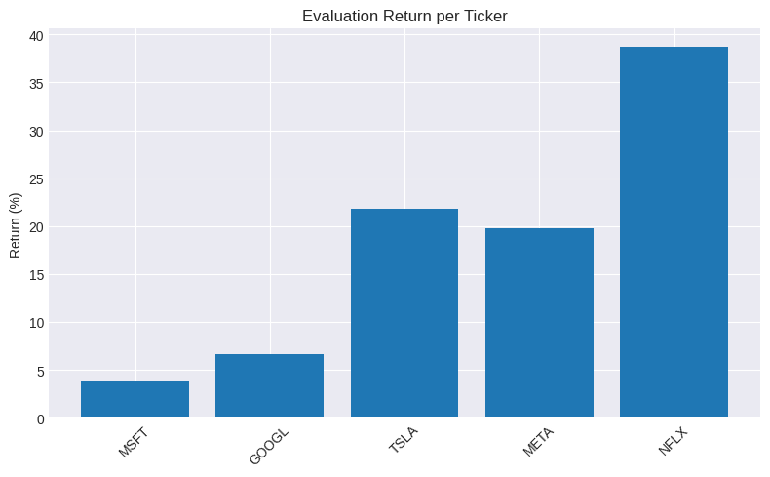
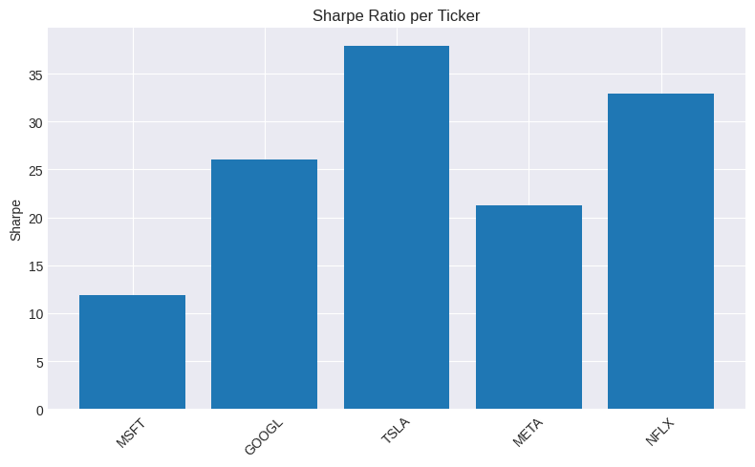
DQN STATISTICS:
Evaluation return per ticker
Sharpe ratio per ticker

Slide 13
PROXIMAL POLICY OPTIMIZATION (PPO): ARCHITECTURE & TRAINING FLOW
State Representation
Reward Function
  30-day window of engineered features (Close, MA, RSI, MACD, BB, etc.)
  Ticker Embedding (32-dim) to allow one policy to trade multiple stocks
  Final State Vector = Window Features + Cash + Shares
  Reward = log-return + 0.02 × activity bonus
  log-return: log(new_val / prev_val)
  activity bonus: encourages meaningful position changes
  Promotes risk-adjusted growth, not just raw profit
Model Architecture
Training Strategy
  Policy Network (Actor):
    3 layers, 512- unit network
    LayerNorm + Tanh after every layer
  Value Network (Critic):
    3-layer, 512-unit deep network
    Tanh used. Critic predicts state value
  Rollout Size: 8192 steps
  GAE-λ: 0.95
  Clipped PPO Objective: ε = 0.15
  Minibatches: 128
  Epochs: 6 updates per rollout
  Optimiser used: Adam

Slide 14
PERFORMANCE EVALUATION AND RETURNS (PPO)
Evaluation Method
Metrics Used
  Tested on unseen test data (2023-2024)
  Run 10 independent episodes
  Compute daily returns, total return percentage and final Sharpe ratio
  Total Return (%) = (final value / initial cash − 1) × 100
  Sharpe Ratio = (mean(daily_ret) / std(daily_ret)) × √252
  Graphs plotted:
    Return per ticker
    Sharpe ratio per ticker
Final Results
Insights
  MSFT: 5.90%, Sharpe 4.88
  GOOGL: 22.49%, Sharpe 21.24
  TSLA: 90.46%, Sharpe 35.39
  META: 19.25%, Sharpe 10.70
  NFLX: 36.10%, Sharpe 38.33
  Average Eval Return: 34.84%
  PPO learns strong high-volatility exploitation (best on TSLA & NFLX).
  Cash & share normalisation stabilises training across high/low-priced stocks.
  Entropy decay keeps the agent exploring so it doesn’t get stuck in a bad strategy early.

Slide 15
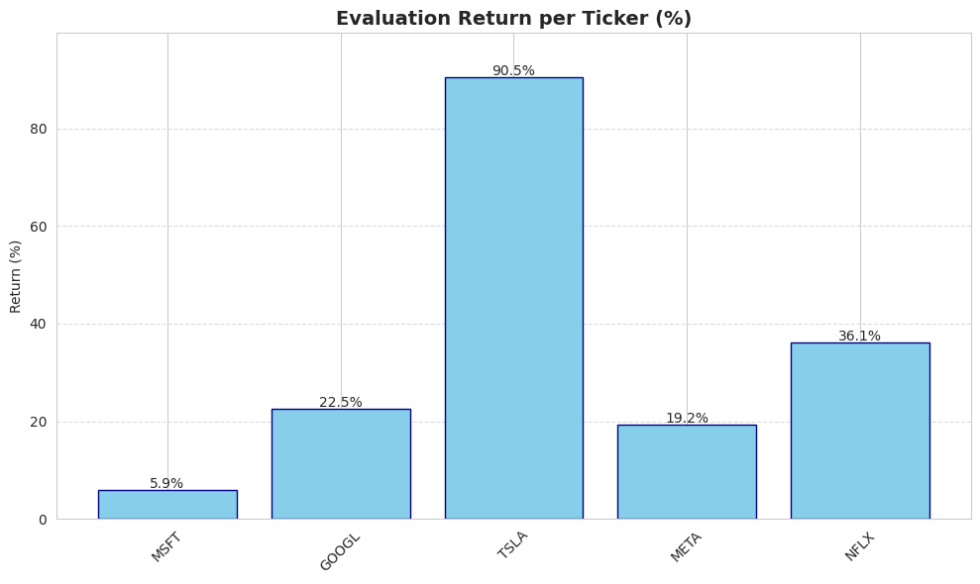
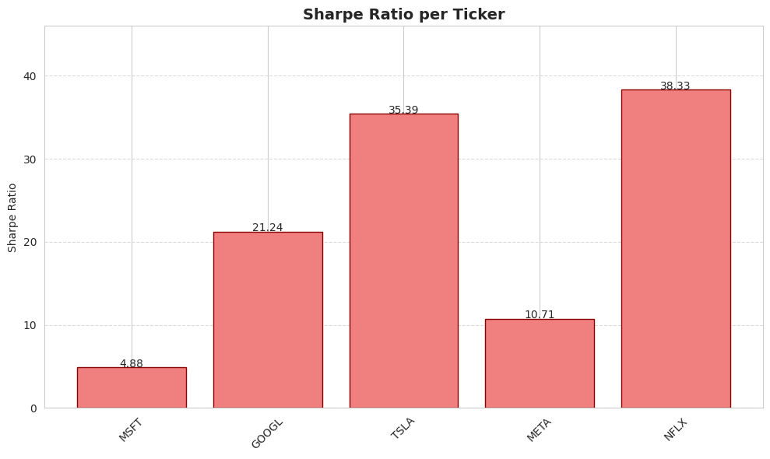
PPO STATISTICS:
Evaluation return per ticker
Sharpe ratio per ticker

