Slide 1
Project Presentation of Full Stack Engineering Project (FSE) (22CS037)
On
AirBnb
Ishika Goel(2210991690)
Ishneet kaur(2210991691)
Supervised By Mr. Rahul Sir
Department of Computer Science and Engineering, Chitkara University, Punjab

Slide 2
Introduction
Airbnb is a streamlined and efficient property booking platform designed to simplify the process of managing bookings, guest interactions, and property availability. It helps property owners and guests efficiently handle reservations, track booking statuses, and manage stay schedules. Airbnb provides an intuitive interface that ensures ease of use, even for users who are new to online booking platforms, without requiring complicated setup. In addition to managing bookings, Airbnb generates clear, easy-to-understand reports based on specific time periods, such as daily, monthly, or custom date ranges. These reports assist in tracking booking trends, understanding property utilization, and making informed decisions about pricing and availability. With Airbnb, property owners can efficiently manage their listings, reduce administrative workload, and provide a seamless experience for their guests, contributing to better organization and enhanced guest satisfaction.

Slide 3
Key Features
1.
User Authentication & Security: Secure guest registration and login with JWT-based authentication, ensuring authorized access to the platform.
2.
Guest Management: Guest registration, profile updating, and booking management for stays
3.
Property Management: Comprehensive property details displayed, including availability, pricing,
amenities, and location.
4.
Booking Reports Generation: Generate detailed reports for booking trends, property availability, guest bookings, and revenue over time (e.g., daily, monthly, or yearly).
5.
Responsive User Interface (UI): Built with React.js to ensure smooth performance and accessibility across desktops, tablets, and mobile devices, providing a seamless user experience for guests.

Slide 4
User Authentication
Secure Login/Registration : - Users can securely sign up and log in using their email and password, ensuring protected access to the system.
JWT Authentication : - The system uses JSON Web Tokens for secure authentication, allowing users to maintain a safe session throughout their interaction.
Password Security : - Passwords are encrypted, enhancing security and protecting user privacy within the system.

Slide 5
Report Generation
Predefined Time Periods: Generate reports for standard timeframes such as the past month, quarter, half-year, or year, to analyze booking trends, revenue, and property performance over specific periods.
Custom Date Range: Users can define a custom date range (e.g., from a specific date
to today) to review and assess booking activities, guest stays, and property utilization.
Exportable Reports: Users can download detailed reports in PDF format, making it easy to store, share with stakeholders, or present in meetings for review.

Slide 6
Tech Stack
Frontend: Built with React.js, providing a fast, dynamic, and responsive user interface that ensures a smooth experience across both desktop and mobile devices. React enables seamless updates and real-time interactions with minimal performance overhead, enhancing the user experience for property search and booking.
Backend: The backend is powered by Node.js and Express.js, offering a robust RESTful API that
supports core functionalities like property listings, booking management, and report generation.
Database: MongoDB is used for flexible and scalable data storage. It efficiently handles data related to properties, bookings, and user profiles, allowing for easy expansion as the platform grows.
Authentication: JWT (JSON Web Tokens) is used for secure user authentication, ensuring that only authorized users can access their accounts and sensitive data. This token-based authentication system is scalable and manages sessions securely.
PDF Generation: The jsPDF library is integrated to generate downloadable PDF reports for bookings, revenue, and property analytics, providing users with easy access to offline records.

Slide 7
UI/UX Design
Responsive and Interactive UI: The UI is designed for simplicity and ease of navigation, ensuring accessibility across all devices for both guests and property managers.
Minimalistic Design: The platform features a clean and user-friendly design that focuses on essential functions like property browsing and booking management, avoiding unnecessary complexity.
Booking Filtering: Users can easily filter bookings by categories such as “All Bookings,” “Confirmed,” “Pending,” and “Canceled” for efficient management.
Visual Feedback: Real-time visual updates track booking status changes, allowing
users to stay informed about confirmations, cancellations, and rescheduling.

Slide 8
User Flow
Login and Authentication: The guest logs in using their credentials (email and password).
Guest Dashboard Overview: Quick access to the guest’s upcoming bookings and personalized recommendations for stays.
Search and Book Stays:Browse listings based on location, dates, and preferences (e.g.,
price, amenities).Book a stay or send inquiries to hosts for specific properties.
View and Manage Bookings:Check upcoming bookings with details like check-in/check- out dates and property information.Cancel or modify bookings if necessary, following platform policies.
Logout: Once bookings are completed or information is reviewed, the guest logs out.

Slide 9
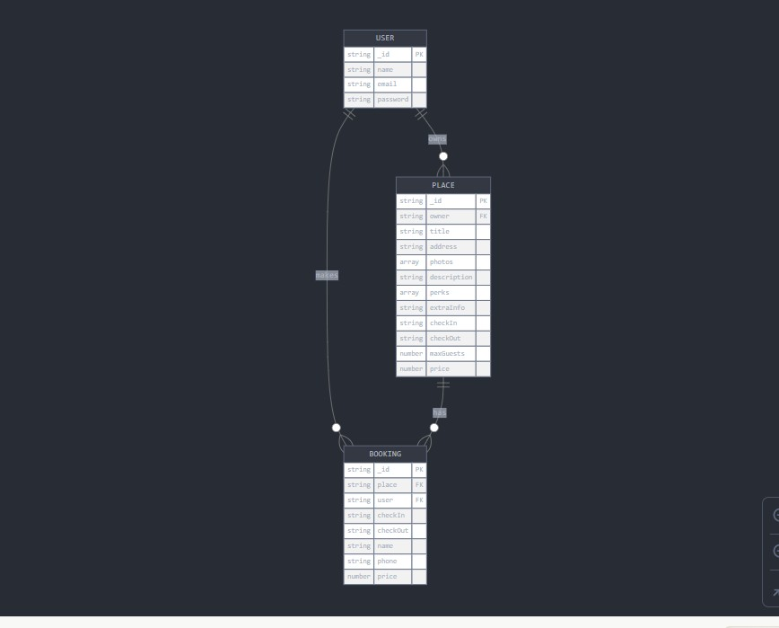
ER Diagram

Slide 10
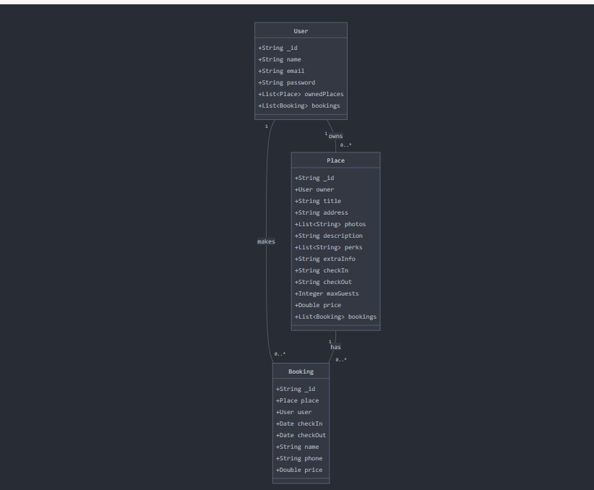
UML Diagram

Slide 11
Conclusion
Airbnb provides a comprehensive and efficient solution for managing property bookings and guest experiences.
Its intuitive interface and essential features, such as property search, booking
management, and report generation, make it an excellent tool for both travelers and property managers.
The platform is built on a solid foundation, with potential for future improvements, including enhanced collaboration tools, advanced analytics, and expanded functionality to further streamline the booking and travel experience.

Slide 12
Thank You
12

