Slide 1
Title: Travel Assistant Web Application
Subtitle: Simplifying Travel Planning with Integrated Solutions
Name: Ishika Sheth
Course/Year: ICT Engineering Capstone – 2025-2026
Department: Information and Communication Technology

Slide 2
Problem Statement
Travelers often face difficulties in:
Finding suitable tour packages
Searching hotels efficiently
Planning trips based on city-specific recommendations
Lack of a single platform that integrates all travel planning features
Objective: Provide an easy-to-use solution that saves time and improves travel experience

Slide 3
Project Objectives
Build a user-friendly web application for travel planning
Integrate:
Tour Packages for multiple cities
Hotel Listings with search and filter options
Ensure fast, reliable, and secure access to travel information
Demonstrate real-world impact for travelers

Slide 4
Technical Solution
Front-end: HTML, CSS, JavaScript, Bootstrap for responsive UI
Back-end: Python Django framework for rapid development
Database: SQLite for storing tours, hotels, and user data
Features:
Search and filter destinations and hotels
Hotel and tour listing pages
City recommendation system
Responsive and intuitive UI

Slide 5
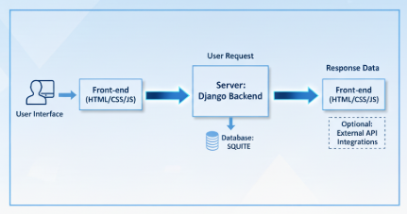
System Architecture Diagram

Slide 6
Key Functionalities
Find tours and hotels quickly
Detailed view with images, price, and availability
Tour packages: Description, duration, and suggestions
User Experience: Intuitive navigation, responsive design, and fast loading

Slide 7
Outcomes
Fully functional Travel Assistant web application
Efficient search and filter system for hotels and tours
Enhanced user experience with responsive design
Demonstrates integration of front-end, back-end, and database
Aligns with ICT goals: improving efficiency, accessibility, and usability

