Slide 1
Team 2: Predictive Webserver
Members:
Kate Xie, Lindsey Tucker, Ishika Verma, Lee Ellen Mullins, Brendon Cara

Slide 2
Why a web server?
GUI presentation for easier access for non-technical people
Take in large amounts of data and visualize only the key aspects
Simplifies data interpretation for easier understanding of the data

Slide 3
Task Delegation
Pipeline: Automating the scripts using bash and/or Nextflow
Brendon
Lee Ellen
Web development: creating the UI and deploying the app on the server
Kate
Lindsey
Ishika

Slide 4
Main Pipeline
Take in input files – paired .fastq/.fq files
Trim fastq files with trimmomatic
Run assembly with megahit
Use prodigal to get CDS from assembly
Annotate with diamond blastp
Antibiotic resistance genes with CARD
Virulence factors with VFDB
Results:
Quast quality report
Display annotations with integrative genomics viewer (IGV)
Output list of annotated antibiotic resistance genes and virulence factors

Slide 5
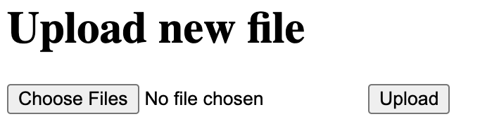
Webpage format
Main page: Brief explanation of what the pipeline does, with a form with file upload and basic options
Submission page: After form submission, confirming upload and displays job ID and optional email for results
Results page: Displaying the results of the workflow

Slide 6
Web Frameworks
Flask
Django
Streamlit

Slide 7
Flask
Python-based lightweight and minimalist framework
Well-documented with a variety of extensions
Can choose between different packages, ex. SQLAlchemy and sqlite3
Low complexity ideal for small projects
Easy to install
conda install –c anaconda flask
But…
Less built-in features
Steep learning curve for complex applications

Slide 8
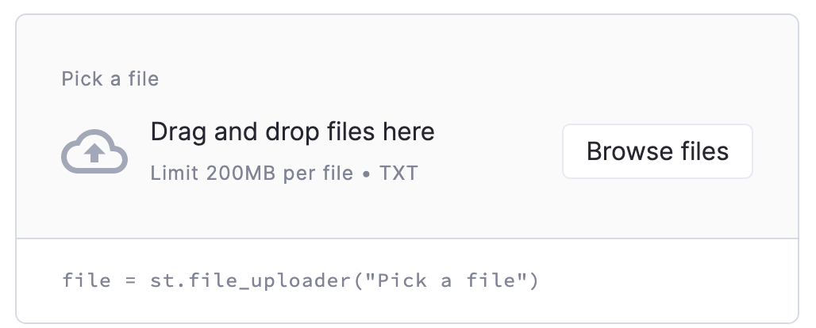
Streamlit
Open-source python library
Easy to use in “just a few minutes”
Easily add built-in widgets by declaring variables
Notes:
Released in 2019
Multi-page apps

Slide 9
Streamlit
Open-source python library
Easy to use in “just a few minutes”
Easily add built-in widgets by declaring variables
Streamlit community for troubleshooting: 84.6K posts
Compatible with many other packages and extensions
Example:
Rascore: A tool for analyzing RAS protein structures, created by Mitchell Parker and Roland Dunbrack Fox Chase Cancer Center
Notes:
Multi-page apps
Released in 2019 – not as well-established as flask/django

Slide 10
Django
A python-based web framework
Full stack framework:
Complete set of tools for front end, back end, security, database management, etc.
Third party package available for additional features
Object-Relational mapping
Can be installed through conda or pip
Pros-
Lots of built-in functions
In the market for a longtime, large community, complete documentation
Cons-
Runtime might be longer
Might be harder to learn for beginner

Slide 11
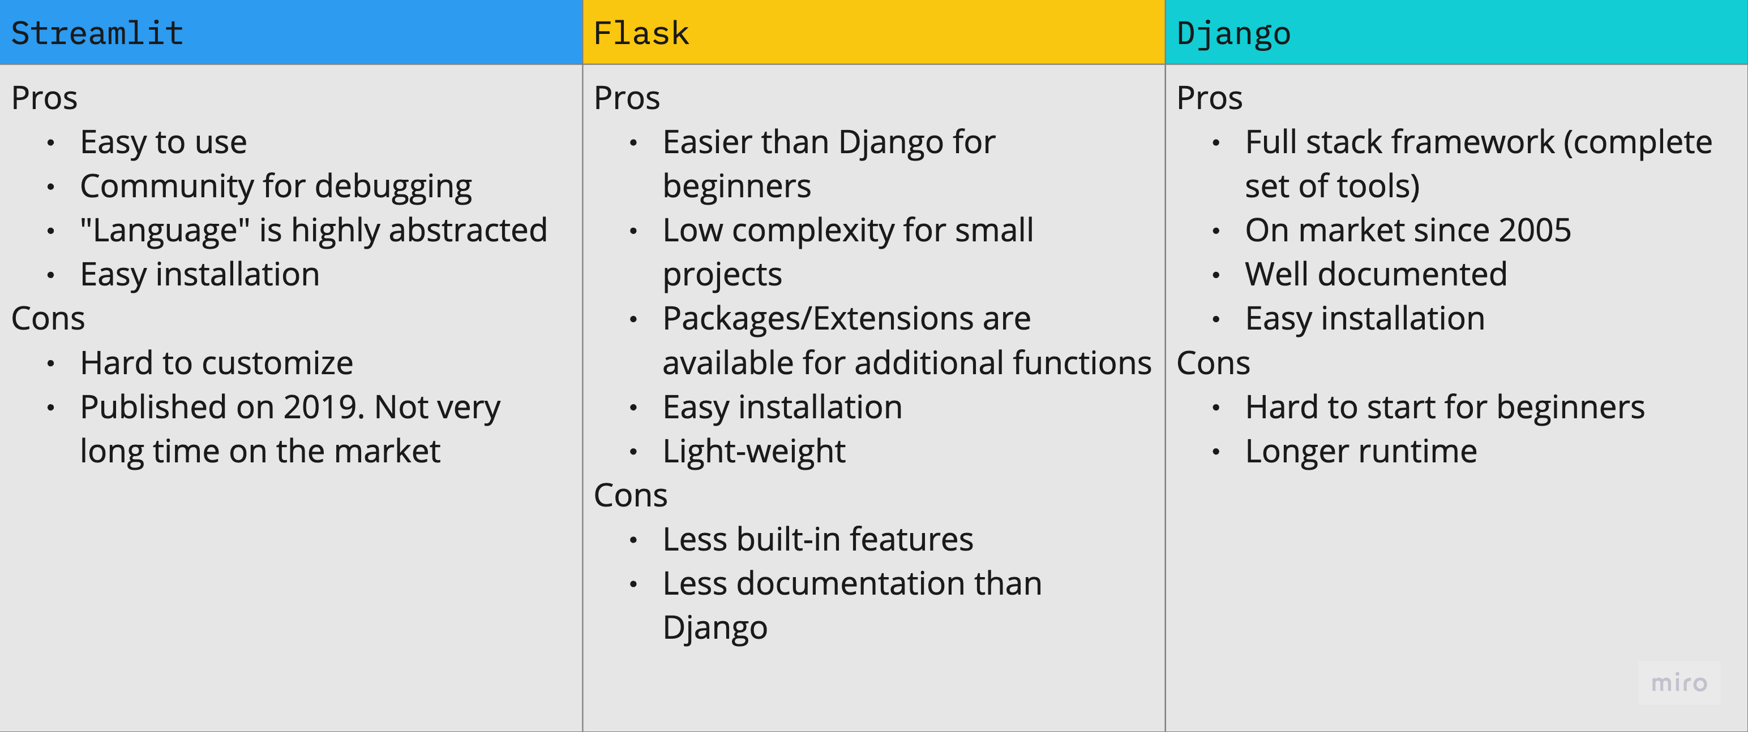
Tool Comparison

Slide 12
Frontend to backend
Other computers and routers
Our
server
Browser
(HTML file?)
Our code
(.py)

Slide 13
Frontend to backend
Other computers and routers
Our
server
Server config file
Browser
(HTML file?)
Our code
(.py)

Slide 14
Frontend to backend
Other computers and routers
Our
server
Options
Django
Flask
Streamlit
FastAPI
Server config file
Browser
(HTML file?)
Our code
(.py)

Slide 15
Backend
The backend will be responsible for several important tasks
Handles the input files once uploaded
Attempts to connect the smaller pipelines process their intermediate outputs into one larger pipeline workflow

Slide 16
Overall pipeline workflow process
Gene Prediction
Functional Annotation
Genome Assembly
Contigs.fasta
Gff, fna, faa files
Annotated Gff
Raw FASTQ Pairs
QUAST Report
Comparative Genomics
Integrative
Genome
Viewer
Phylogenetic Tree

Slide 17
Nextflow
It has several benefits when creating large pipelines
It can be much better at creating reproducible pipelines
It can be portable across many devices meaning that no matter if the pipeline is made on a local machine vs a server it should run the same
It can be scalable by enabling parallelization of tasks without hard-coding the architecture of the system it is running on
Its flexibility makes possible to cache intermediate processes as needed
It generates workflow reports for better evaluation of the how the pipeline runs
It is modular, meaning that if one of the components of the pipeline are updates it is easy to integrate that into the larger nextflow based pipeline
Can be installed with conda
conda install -c bioconda nextflow

Slide 18
Frontend
Frontend will be responsible for creating the creating the user interface for our web server
Create pages for uploading the input file and for displaying the results

Slide 19
HTML
HTML is a combination of Hypertext and Markup language. Hypertext defines the link between web pages
HTML describes the structure of a web page
Web browsers receive HTML documents from a web server or from local storage and render documents into multimedia web pages
Notes:
Some advantages of using HTML- It is easy to learn and use, hence Useful for beginners in web design. It is free to use.
Some disadvantages of HTML- We need to create a lot of code for a simple webpage. the webpages created are not that aesthetically pleasing.

Slide 20
Bootstrap
Bootstrap is a free front-end framework for faster and easier web development
Bootstrap includes HTML and CSS based design templates for typography, forms, buttons, tables, navigation, and many others
Bootstrap also gives you the ability to easily create responsive designs
Notes:
Easy to use: Anybody with just basic knowledge of HTML and CSS can start using Bootstrap
Responsive features: Bootstrap's responsive designs adjust to phones, tablets, and desktops
Bootstrap is compatible with all modern browsers (Chrome, Firefox, Internet Explorer, Edge, Safari, and Opera)
Disadvantages- It might be a little difficult for beginners. A lot of customization might be needed otherwise all the webpages would look the same

Slide 21
References
https://docs.streamlit.io/
https://flask.palletsprojects.com/en/2.2.x/quickstart/
https://www.nextflow.io/blog/2022/learn-nextflow-in-2022.html

