Slide 1

Notes:
PAGE 1 : COVER

Slide 2
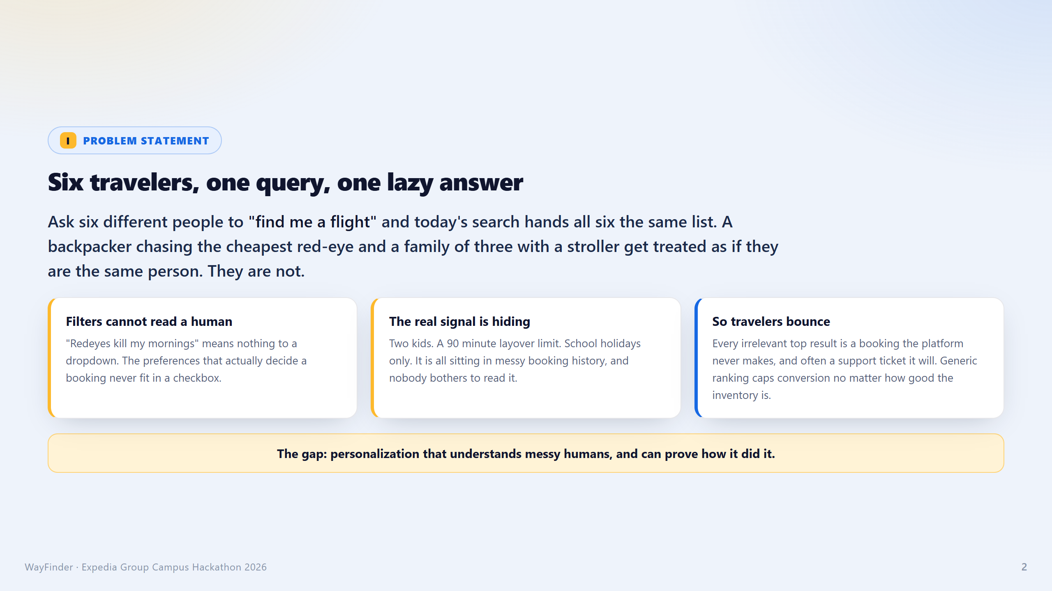
Notes:
PAGE 2 : PROBLEM STATEMENT

Slide 3
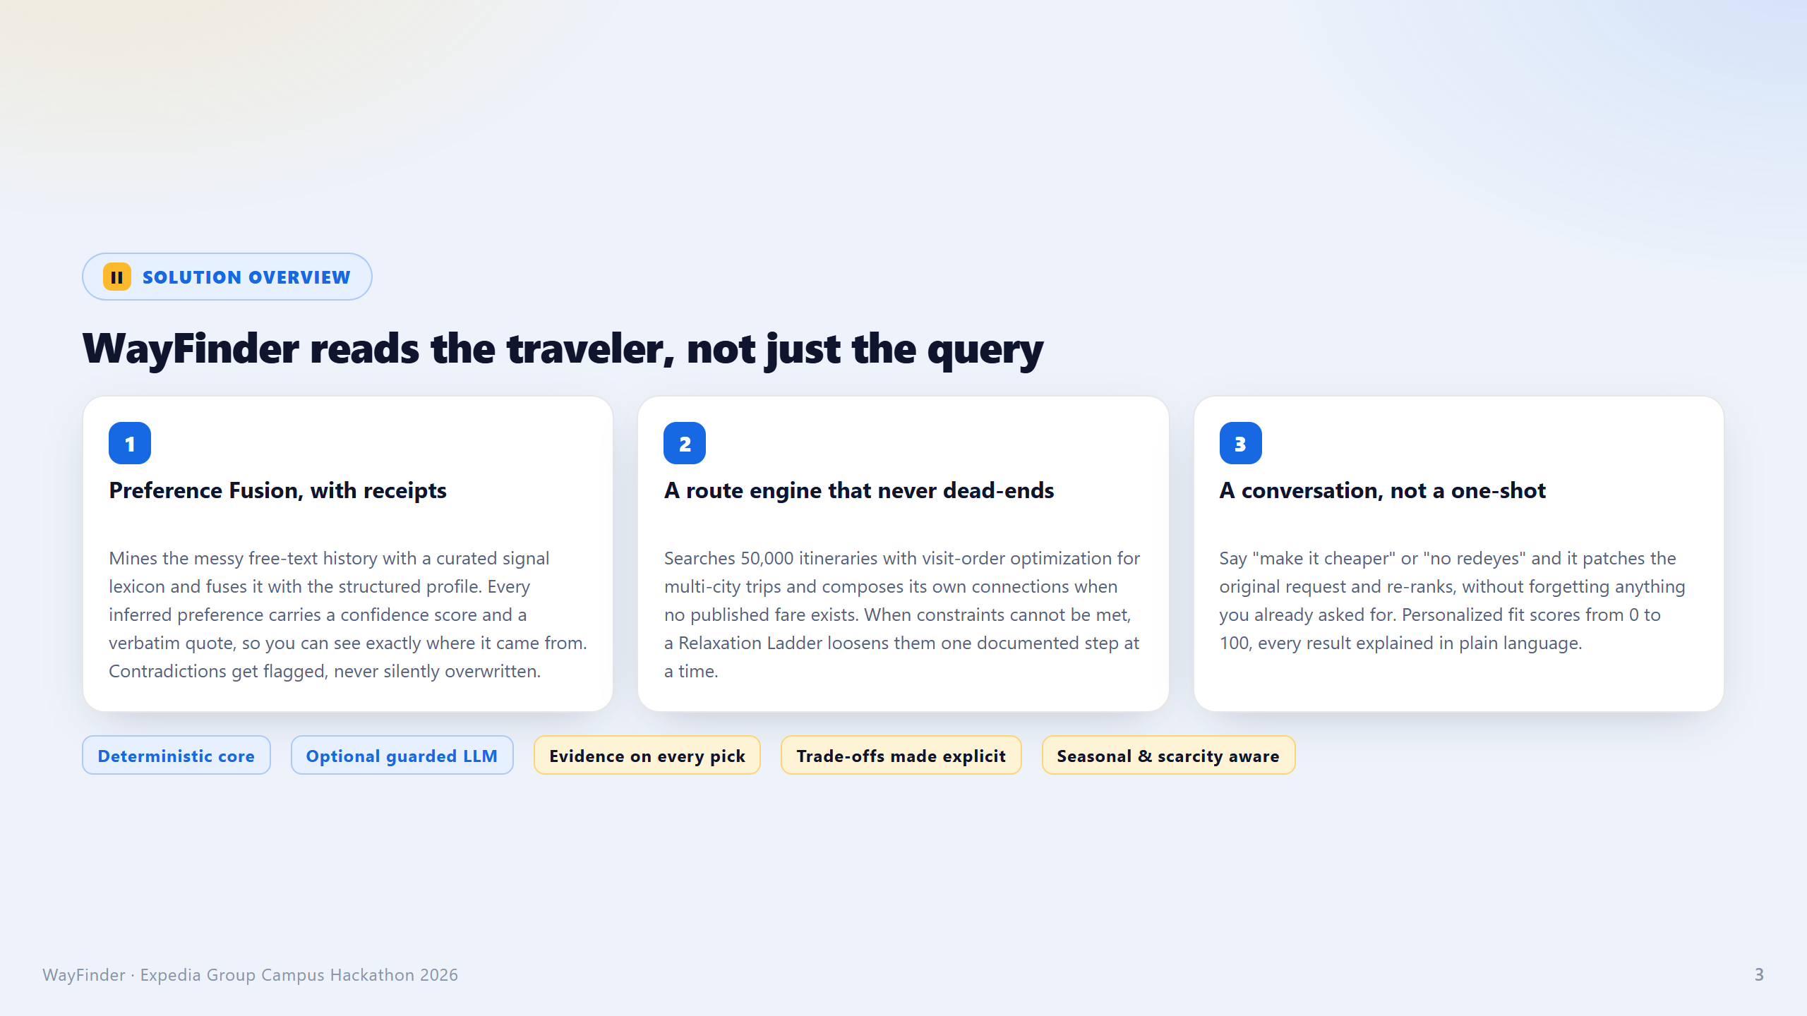
Notes:
PAGE 3 : SOLUTION OVERVIEW

Slide 4
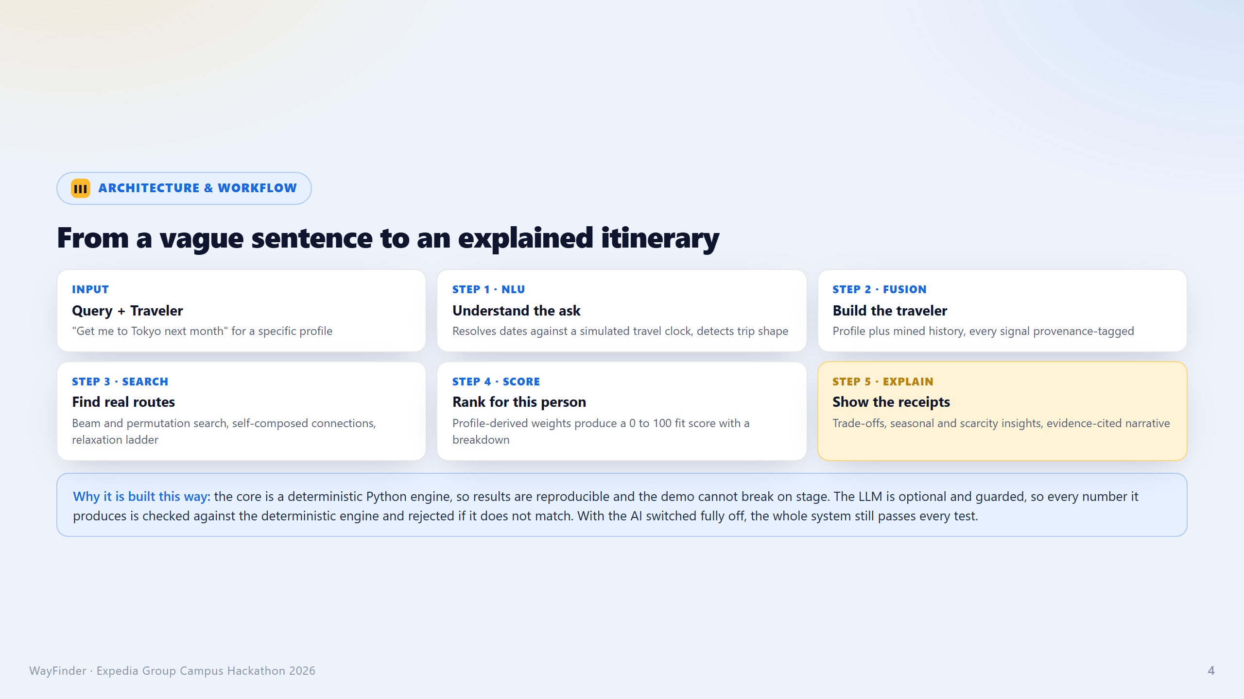
Notes:
PAGE 4 : ARCHITECTURE / WORKFLOW

Slide 5
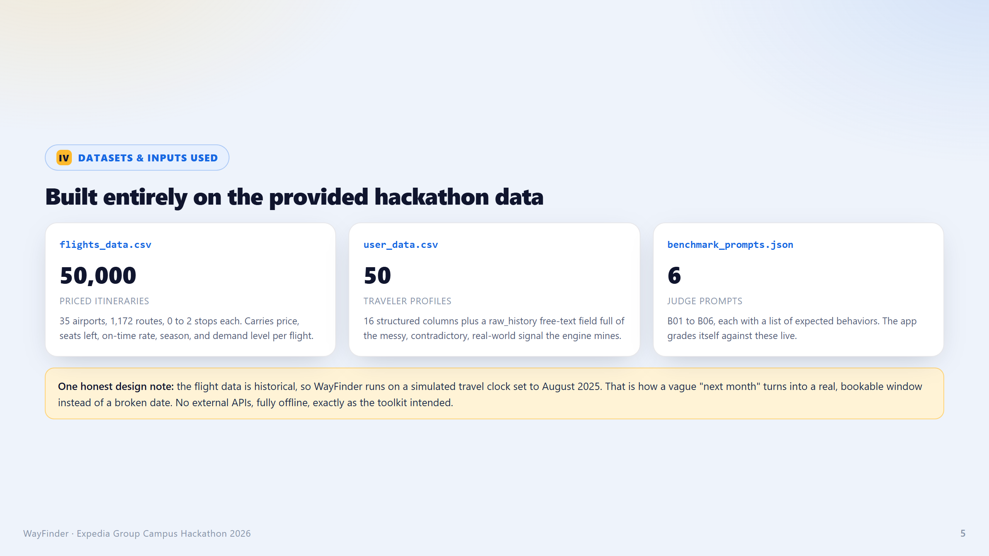
Notes:
PAGE 5 : DATASETS / INPUTS

Slide 6
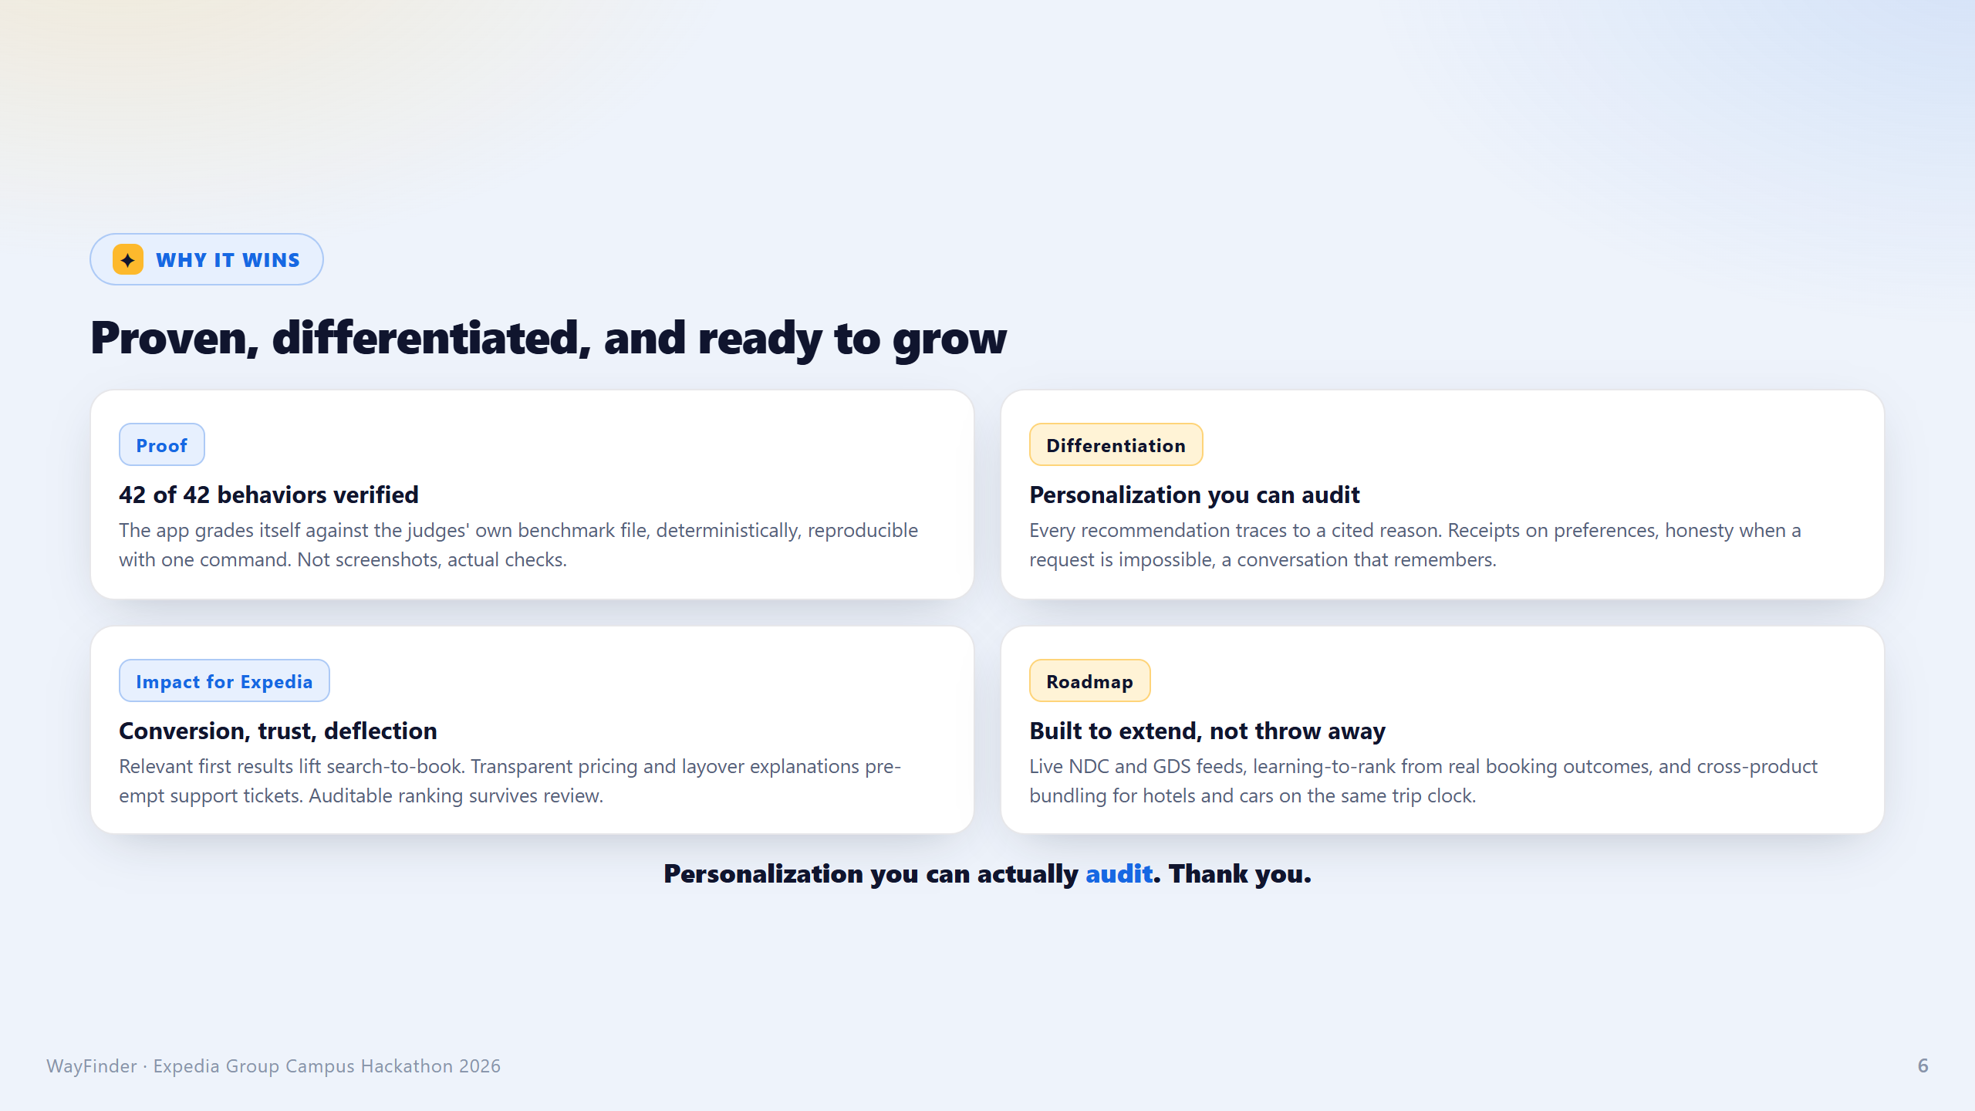
Notes:
PAGE 6 : IMPACT & CLOSE

