Slide 1
Selection Sort
5 | 1 | 3 | 4 | 6 | 2
Comparison
Data Movement
Sorted

Slide 2
Selection Sort
5 | 1 | 3 | 4 | 6 | 2
Comparison
Data Movement
Sorted

Slide 3
Selection Sort
5 | 1 | 3 | 4 | 6 | 2
Comparison
Data Movement
Sorted

Slide 4
Selection Sort
5 | 1 | 3 | 4 | 6 | 2
Comparison
Data Movement
Sorted

Slide 5
Selection Sort
5 | 1 | 3 | 4 | 6 | 2
Comparison
Data Movement
Sorted

Slide 6
Selection Sort
5 | 1 | 3 | 4 | 6 | 2
Comparison
Data Movement
Sorted

Slide 7
Selection Sort
5 | 1 | 3 | 4 | 6 | 2
Comparison
Data Movement
Sorted

Slide 8
Selection Sort
5 | 1 | 3 | 4 | 6 | 2
•
Largest
Comparison
Data Movement
Sorted

Slide 9
Selection Sort
5 | 1 | 3 | 4 | 2 | 6
Comparison
Data Movement
Sorted

Slide 10
Selection Sort
5 | 1 | 3 | 4 | 2 | 6
Comparison
Data Movement
Sorted

Slide 11
Selection Sort
5 | 1 | 3 | 4 | 2 | 6
Comparison
Data Movement
Sorted

Slide 12
Selection Sort
5 | 1 | 3 | 4 | 2 | 6
Comparison
Data Movement
Sorted

Slide 13
Selection Sort
5 | 1 | 3 | 4 | 2 | 6
Comparison
Data Movement
Sorted

Slide 14
Selection Sort
5 | 1 | 3 | 4 | 2 | 6
Comparison
Data Movement
Sorted

Slide 15
Selection Sort
5 | 1 | 3 | 4 | 2 | 6
Comparison
Data Movement
Sorted

Slide 16
Selection Sort
5 | 1 | 3 | 4 | 2 | 6
•
Largest
Comparison
Data Movement
Sorted

Slide 17
Selection Sort
2 | 1 | 3 | 4 | 5 | 6
Comparison
Data Movement
Sorted

Slide 18
Selection Sort
2 | 1 | 3 | 4 | 5 | 6
Comparison
Data Movement
Sorted

Slide 19
Selection Sort
2 | 1 | 3 | 4 | 5 | 6
Comparison
Data Movement
Sorted

Slide 20
Selection Sort
2 | 1 | 3 | 4 | 5 | 6
Comparison
Data Movement
Sorted

Slide 21
Selection Sort
2 | 1 | 3 | 4 | 5 | 6
Comparison
Data Movement
Sorted

Slide 22
Selection Sort
2 | 1 | 3 | 4 | 5 | 6
Comparison
Data Movement
Sorted

Slide 23
Selection Sort
2 | 1 | 3 | 4 | 5 | 6
•
Largest
Comparison
Data Movement
Sorted

Slide 24
Selection Sort
2 | 1 | 3 | 4 | 5 | 6
Comparison
Data Movement
Sorted

Slide 25
Selection Sort
2 | 1 | 3 | 4 | 5 | 6
Comparison
Data Movement
Sorted

Slide 26
Selection Sort
2 | 1 | 3 | 4 | 5 | 6
Comparison
Data Movement
Sorted

Slide 27
Selection Sort
2 | 1 | 3 | 4 | 5 | 6
Comparison
Data Movement
Sorted

Slide 28
Selection Sort
2 | 1 | 3 | 4 | 5 | 6
Comparison
Data Movement
Sorted

Slide 29
Selection Sort
2 | 1 | 3 | 4 | 5 | 6
•
Largest
Comparison
Data Movement
Sorted

Slide 30
Selection Sort
2 | 1 | 3 | 4 | 5 | 6
Comparison
Data Movement
Sorted

Slide 31
Selection Sort
2 | 1 | 3 | 4 | 5 | 6
Comparison
Data Movement
Sorted

Slide 32
Selection Sort
2 | 1 | 3 | 4 | 5 | 6
Comparison
Data Movement
Sorted

Slide 33
Selection Sort
2 | 1 | 3 | 4 | 5 | 6
Comparison
Data Movement
Sorted

Slide 34
Selection Sort
2 | 1 | 3 | 4 | 5 | 6
•
Largest
Comparison
Data Movement
Sorted

Slide 35
Selection Sort
1 | 2 | 3 | 4 | 5 | 6
Comparison
Data Movement
Sorted

Slide 36
Selection Sort
1 | 2 | 3 | 4 | 5 | 6
DONE!
Comparison
Data Movement
Sorted

Slide 37
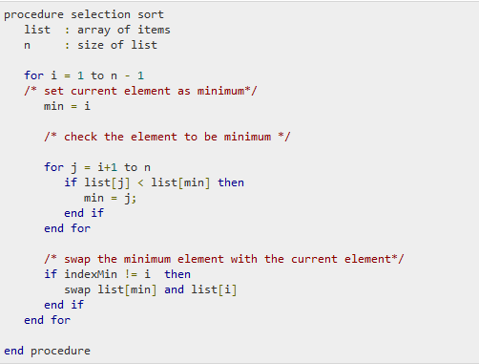
ALGORITHM

