Slide 1
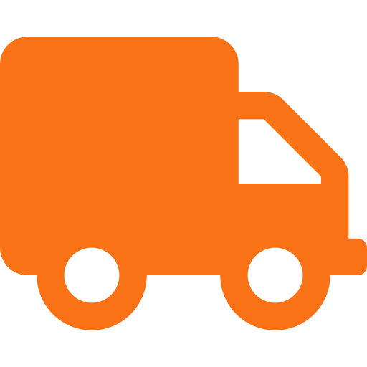
DELIVERY DELAYS
Causes, Impact & Solutions
A comprehensive analysis of internal & external factors
that affect delivery performance and customer satisfaction
Business Operations | Supply Chain Management | Customer Experience

Slide 2
THE BIG PICTURE
Delivery delays are one of the most damaging operational failures a business can face. They stem from two broad categories of causes — those within the business's control, and those driven by external forces.
69%
13%
40%
of consumers are LESS likely to shop with a retailer after a late delivery
of customers never return after a single poor delivery experience
of supply chain disruptions originate from external, uncontrollable events

Slide 3






INTERNAL FACTORS
Within Business Control
Inventory Management
Order Processing Systems
Stockouts, inaccurate records and overstocking create fulfillment gaps before shipment begins.
Manual workflows and outdated software create bottlenecks at picking, packing and dispatch.
Workforce Planning
Supplier Management
Understaffing during peak seasons or high turnover slows throughput and creates backlogs.
Single-source reliance means any supplier hiccup directly stalls production and dispatch.
Real-Time Visibility
Quality Control
Without tracking systems, businesses can't identify delays proactively, becoming reactive.
Late-stage QC failures force rework or replacement, restarting fulfillment timelines entirely.

Slide 4
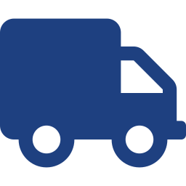





EXTERNAL FACTORS
Outside Business Control
Carrier & Logistics Disruptions
Weather & Natural Disasters
Third-party partner breakdowns, capacity crunches and route inefficiencies beyond direct control.
Storms, floods and wildfires shut down highways, ports and airports in affected regions.
Geopolitical Instability
Global Events & Pandemics
Tariffs, sanctions, border closures or political unrest disrupt international supply chains.
Health crises trigger simultaneous demand surges and supply contractions, overwhelming networks.
Port Congestion & Customs
Fuel Price Volatility
Bureaucratic bottlenecks or documentation errors hold shipments for days or weeks.
Sharp fuel increases cause carriers to reduce fleet operations and extend timelines.

Slide 5
IMPACT ON CUSTOMER SATISFACTION
How delivery delays ripple across the customer relationship
Trust Erosion
88%
Negative Reviews
72%
Customer Churn
65%
Support Overload
58%
Refund & Dispute Costs
45%
Lost Repeat Business
78%
* Percentage indicates relative impact severity on customer satisfaction metrics

Slide 6
MITIGATION STRATEGIES
01
02
03
Diversify Suppliers
Invest in Visibility Tools
Safety Stock Buffers
Eliminate single points of failure by qualifying multiple suppliers per critical category.
Deploy real-time tracking and predictive analytics across the entire supply chain.
Maintain buffer inventory for high-demand or critical SKUs to absorb disruption.
04
05
06
Proactive Communication
Multi-Carrier Strategy
Contingency Planning
Notify customers of delays before they ask — transparency preserves trust even when timelines slip.
Avoid over-reliance on one logistics partner; maintain 2-3 carrier relationships per lane.
Document and rehearse disruption protocols so teams respond fast, not from scratch.

Slide 7







KEY TAKEAWAYS
Delivery reliability is a strategic priority — not just a logistics function.
Internal factors are controllable; invest in systems, people and processes.
External factors require resilience planning — diversify, buffer, and plan contingencies.
Customer trust is fragile: 69% of consumers reduce engagement after a single late delivery.
Transparency during delays is as important as preventing them — communicate proactively.
Businesses that prioritize delivery excellence consistently outperform on retention and brand equity.
"Businesses that treat delivery as a strategic priority outperform competitors in satisfaction, retention and equity."

