Slide 1
Passport Appointment Booking System
Database Programming
Final Capstone Project
Student: Moïse ISHIMWE Registration number: 31858/2025
Database Technology: Oracle Database 19c
Academic Year: 2025–2026

Slide 2
Problem Statement and Objectives
Problem
Manual passport processes cause delays.
Appointment conflicts may occur.
Managing paper records is inefficient.
Tracking application status is difficult.
Objectives
Manage applicant information.
Automate passport applications.
Schedule appointments.
Track payments.
Improve security and data integrity.

Slide 3
System Workflow
Applicant Registration
↓
Application Submission
↓
Payment
↓
Appointment Booking
↓
Officer Verification
↓
Approval/Rejection

Slide 4
Entity Relationship Diagram
Database designed using relational modeling principles.
Normalization applied up to Third Normal Form (3NF).

Slide 5
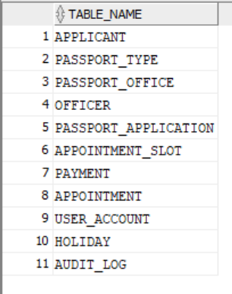
Database Structure
APPLICANT
PASSPORT_TYPE
PASSPORT_OFFICE
OFFICER
PASSPORT_APPLICATION
APPOINTMENT
APPOINTMENT_SLOT
PAYMENT
USER_ACCOUNT
HOLIDAY
AUDIT_LOG

Slide 6
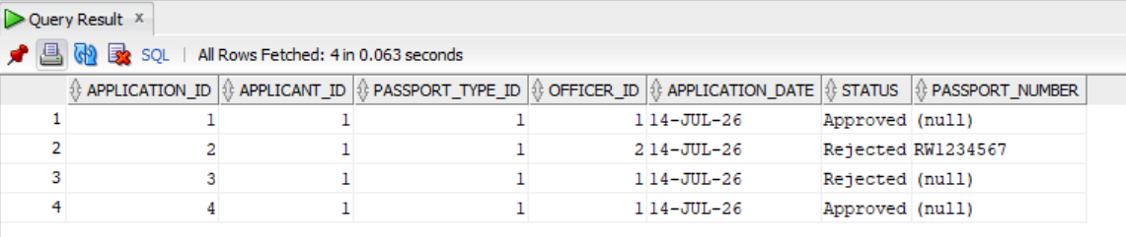
SQL Implementation
Implemented:
Table creation (DDL)
Data insertion (DML)
Constraints
Views
Sequences
Queries
Example: SELECT * FROM Passport_Application;

Slide 7
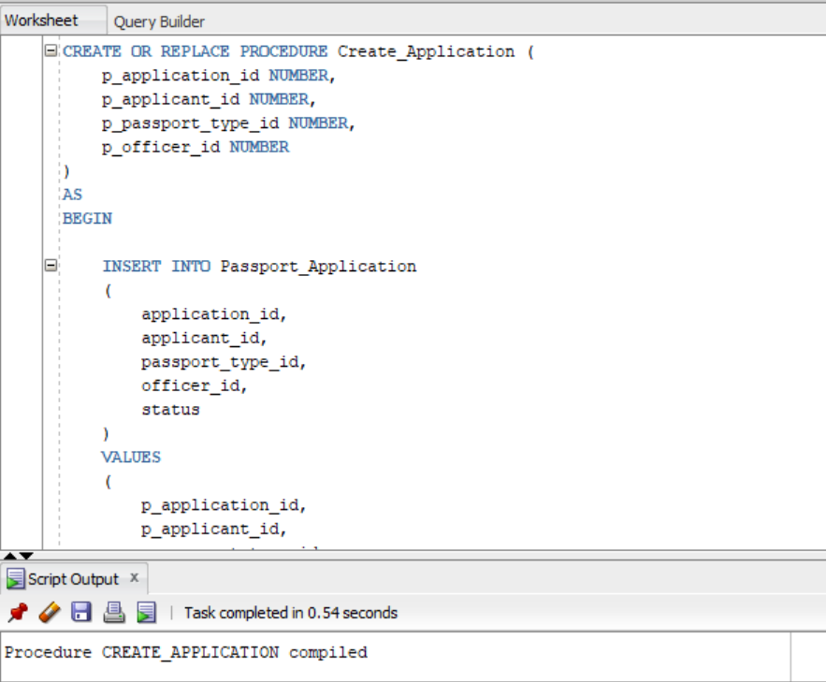
PL/SQL Implementation
Implemented:
Procedures
Functions
Packages
Exception handling
Cursors
Example: CREATE_APPLICATION

Slide 8
Advanced Database Features
Triggers
Prevent duplicate bookings.
Enforce business rules.
Restrict operations during holidays/weekdays.
Audit
Records INSERT, UPDATE, DELETE activities.
Security
Roles:
PASSPORT_ADMIN
PASSPORT_OFFICER
PASSPORT_VIEWER

Slide 9
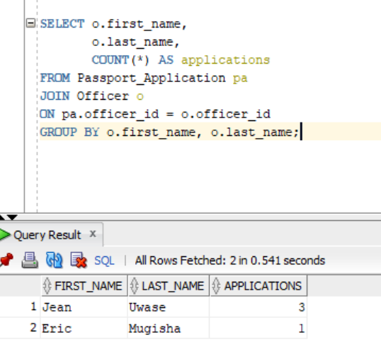
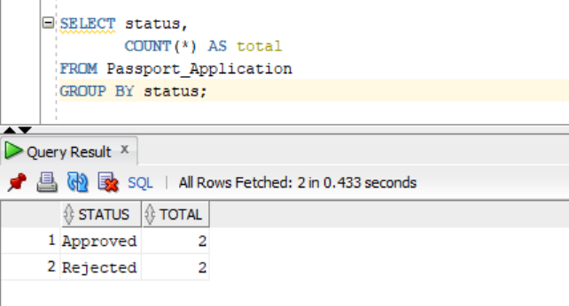
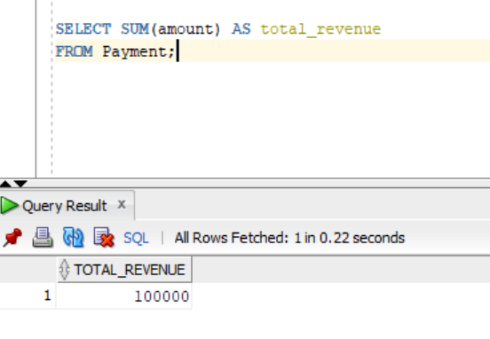
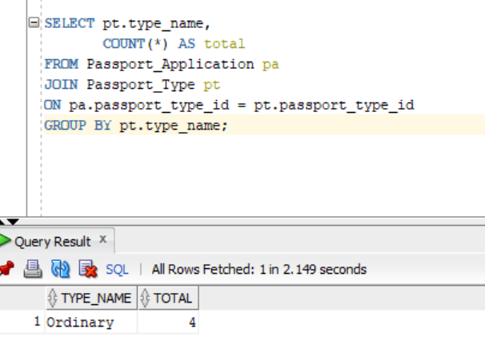
Innovation: Passport Analytics Dashboard
Power BI Dashboard:
Total applications
Approved applications
Pending applications
Applications by office
Monthly trends

Slide 10
Conclusion
The Passport Appointment Booking System demonstrates:
✓ Database design
✓ SQL and PL/SQL programming
✓ Business rule enforcement
✓ Security implementation
✓ Audit management
✓ Data analysis capability
Live Demonstration:
Database structure → Queries → PL/SQL → Triggers → Security

