Slide 1

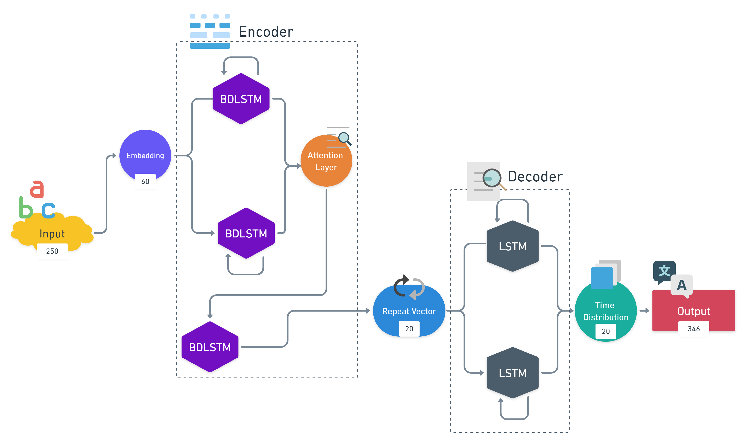
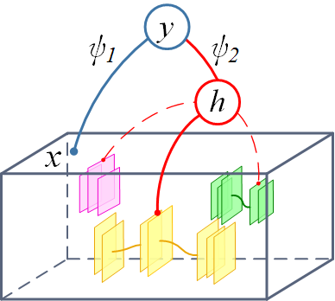
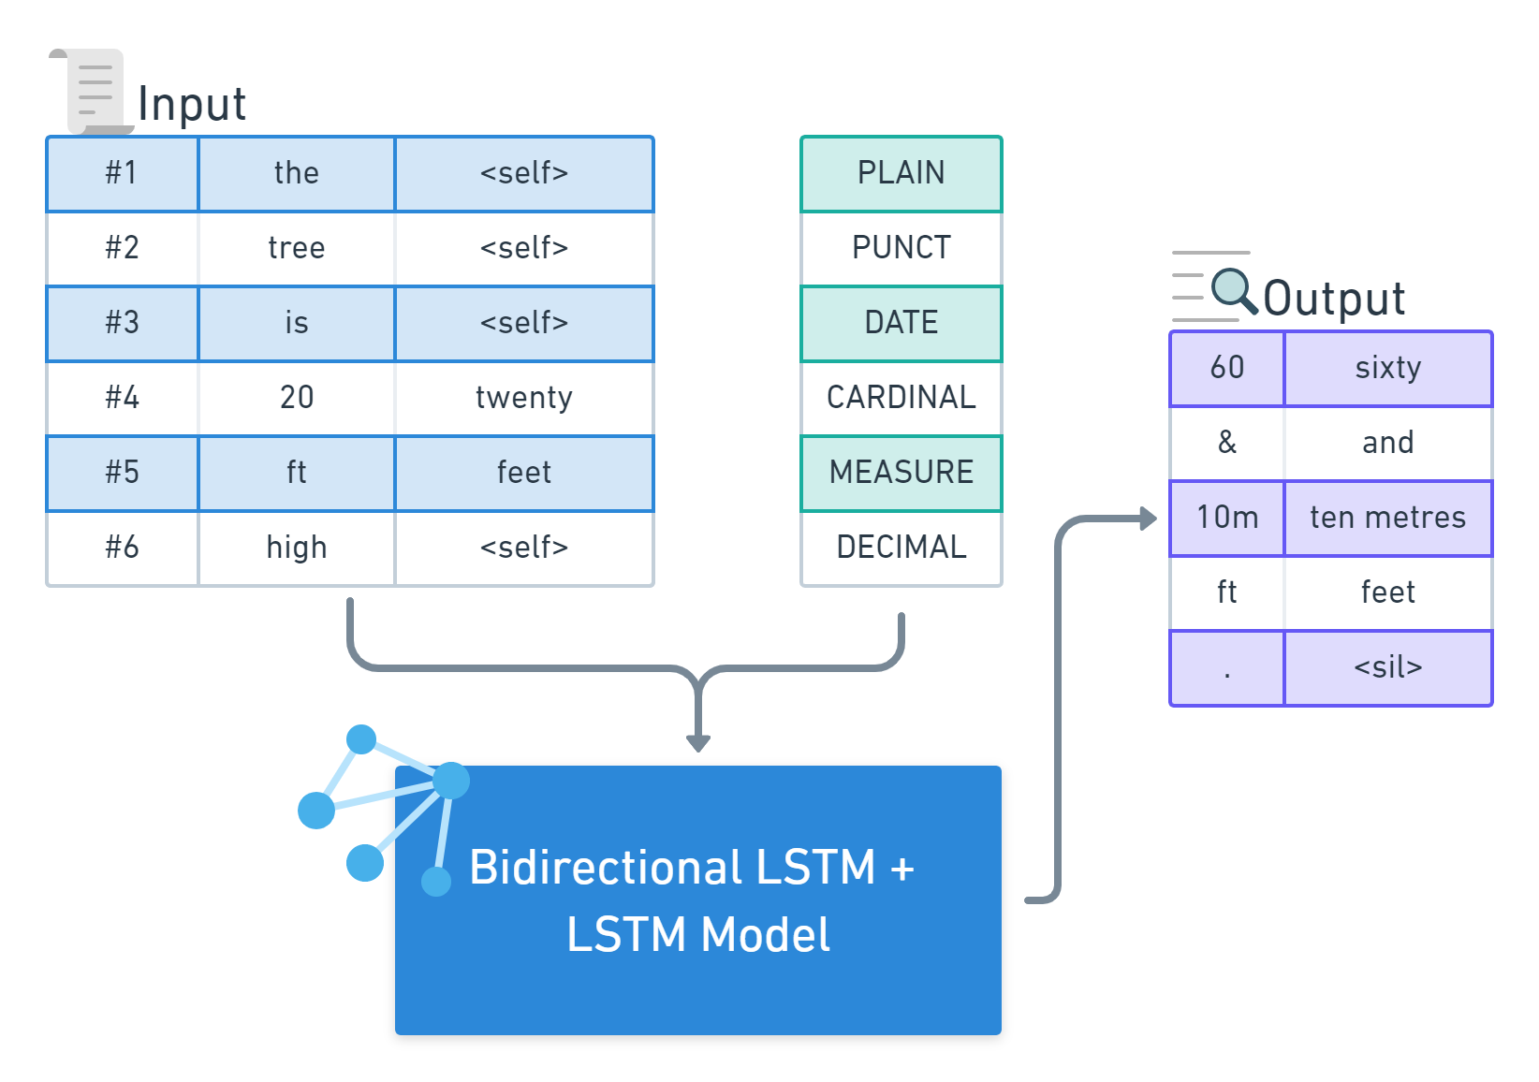
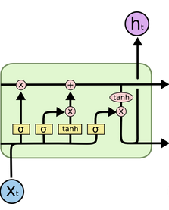
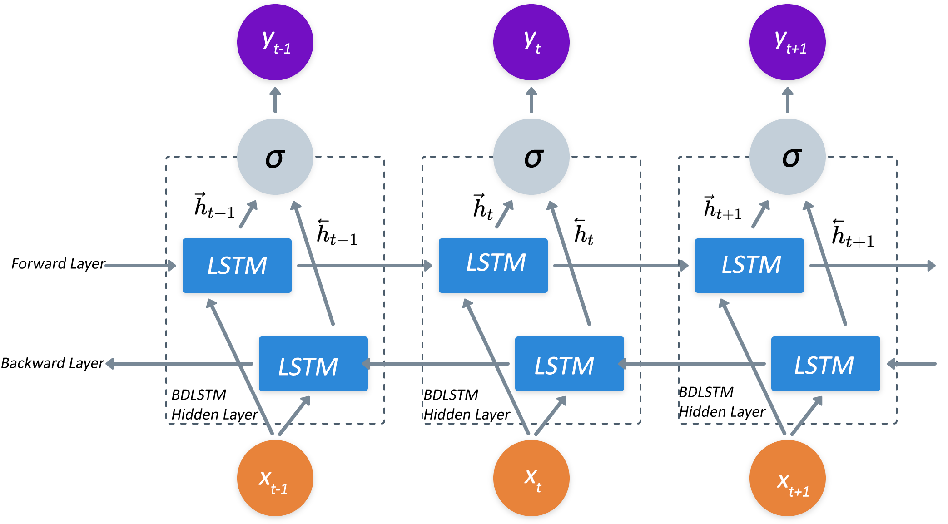


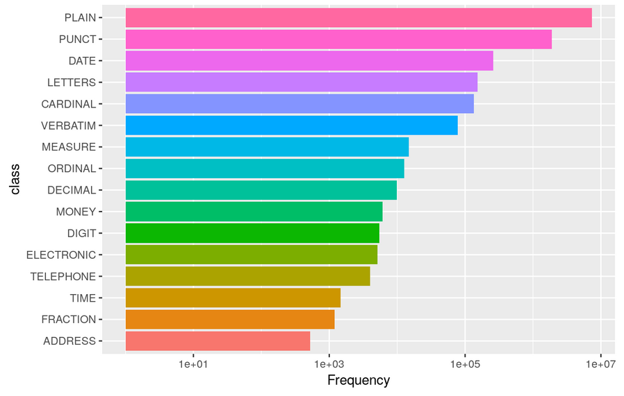
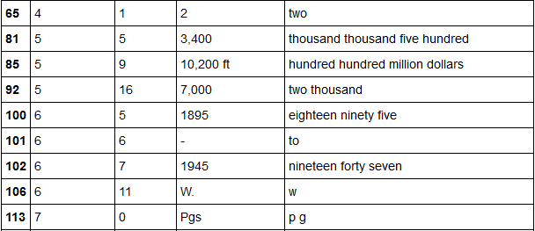
conTEXT – Normalization using LSTM
Siddhant Singhal, Raghib Musarrat, Rahul Rajeev, Milbir Guram and Greg Mori
Simon Fraser University
Vision and Media Lab
PROBLEM
The task of text normalization is performed in the following manner:
– division of the sentence input to the tokens and inclusion of the tokens to different entities
– understanding the context through the encoder layer and showing the relevant representation during the decoder layer
Contribution: Implementation of the LSTM with 3 bidirectional layers in the encoder + 2 LSTM layers for the decoder.
Comparative analysis of the accuracy obtained with our approach to the Sproat et al. arXiv 2016 & Kestrel TTS 2014
MODEL FORMULATION
Input takes consideration of 250 distinct character values, the output results after normalization result to 346 different words.
In order to create fixed-length sequences, the input padding sequence and output padding sequence to the max. length is 60 and 20 units resp.
BIDIRECTIONAL LSTM
The difference between LSTM and the bi-directional LSTM is that it not only takes past inputs(x(t-1)) but also future inputs(x(t+1)) into account, this helps to understand the context of the input(x(t)) at time(t):
The bi-directional LSTM has 2 layers, ‘forward’ and ‘backward’ which leads to the additional constraints repeated twice that makes it further difficult for implementation.
Here, the forward layer output sequence h(right) is calculated using input sequence from time T-1 to T-n, whereas the backward layer output sequence h(left) is calculated in the opposite manner, i.e. using input sequence from T-n to T-1. Therefor, y(t) = sigmoid[h(right), h(left)]
EXPERIMENTS Dataset: Google Dataset – Text Normalization Paper: RNN approaches to Text Normalization
Comparative analysis of the normalization done through various models:
EDA of the dataset and Qualitative example of the result obtained on the model -
 | Sproact et al. | conTEXT | Kestrel TTS | XGBoost
Accuracy | 99.6 | 98.2 | 91.3 | 97.4
C.D. | – | 1.366 | 8.264 | 1.977

