Slide 1


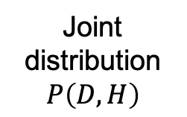
Input (Prior, likelihood, data)
Joint distribution
$$P\left(D,H\right)$$
$$P\left(D,H\right)$$
$$H$$
Output (Approx.
posterior)
Inference algorithm
Notes:
The results we’re interested in come as a result of re-using computations in this domain.
Directly from input which is this information from the world to the output, which is the best mean and variance for that input. learning a shortcut directly to an approximate posterior, with no iterative processing in between, sort of like learning a habit.
This can be learned from previous experience of input / output pairs with a general purpose non-linear regression. We here use a multilayer perceptron.
How does re-use fit in?
Now to come back to the notion of limited resources. If this function approximator has limited capacity, then it might not be able to to fully capture the variability in the true function. This is analogous to trying to fit this quadratic with a linear function, getting this fit that fails to capture much of the true structure.
Another possible source of errors is from the fact that this sort-of habit function is learned from direct experience – it isn’t based on an abstract model of the structure of the world, it’s just based on what you’ve seen and what worked there. So if one’s experience is biased, then we might learn a function that does very well in the region it’s experienced, but terribly elsewhere.
Both these sources of error play a role in our modeling.

