Slide 1

Named Entity Recognition with IOB2 Tagging

Slide 2

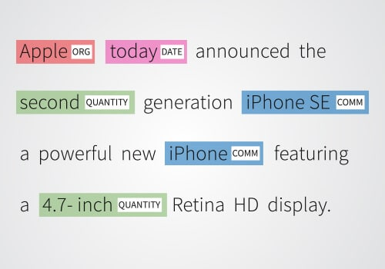
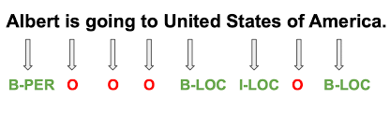
Project Overview & Problem Statement
Named Entity Recognition (NER) is a Natural Language Processing (NLP) technique that identifies and categorizes named entities within text into predefined types like people, organizations, locations, and dates.
Implement Named Entity Recognition (NER) using IOB2 tagging scheme.
Dataset: Sentences with word-level NER tags; goal is to predict NER tags per word.
Tags: B (beginning), I (inside), and O (outside) entities.
Use machine learning models for token classification.

Slide 3
Approach & Methodology
spaCy and BERT were selected as baseline, Why?
- spaCy was chosen for its ease of use, speed, and widespread adoption in production NLP pipelines, offering a lightweight yet effective baseline.
BERT was selected as a strong transformer-based baseline representing state-of-the-art contextual embeddings and high potential accuracy.
Advanced step: Fine-tune SpaCy or BERT on training data whichever performs best for the use case as baseline.
Evaluation
Evaluating Named Entity Recognition (NER) models isn’t just about accuracy — because accuracy can be misleading when most tokens are “O” (non-entity).
Most Common: Precision , Recall , F1-score
Usually reported per entity type (e.g., PER, ORG, LOC) and as micro/macro averages.
👉 These are the most standard usually done on entity rather than token level.

Slide 4
Key Findings & Model Performance
Baseline F1: SpaCy ~0.26 (low recall), BERT ~0.48 (better balanced).
Fine-tuned BERT yielded micro F1 ~0.84 overall on validation and test.
Macro Average F1(0.6573) is lower than micro, highlighting challenges in rare/low-support classes.
Weighted Average F1(0.8485) closely tracks micro-average, driven by frequent classes.
Strong results for common classes (geo, per, org), weaker for rare classes (nat, art, eve).
Fine-tuning critical for adapting to dataset-specific entities and improving accuracy.

Slide 5
System Architecture for Deployment
Model Packaging:
Fine-tuned BERT NER model saved as serialized PyTorch files (pytorch_model.bin, config, vocab, labels).
Custom TorchServe handler script implements preprocessing, inference, and postprocessing.
Model Archiving:
Use torch-model-archiver to create versioned .mar model archive.
Archives include model weights, configs, tokenizer vocab, and handler script.
Serving Infrastructure:
TorchServe runs RESTful API service for inference requests.
Supports multi-model serving and dynamic model versioning.
Containerized deployment possible for scalability and orchestration.

Slide 6
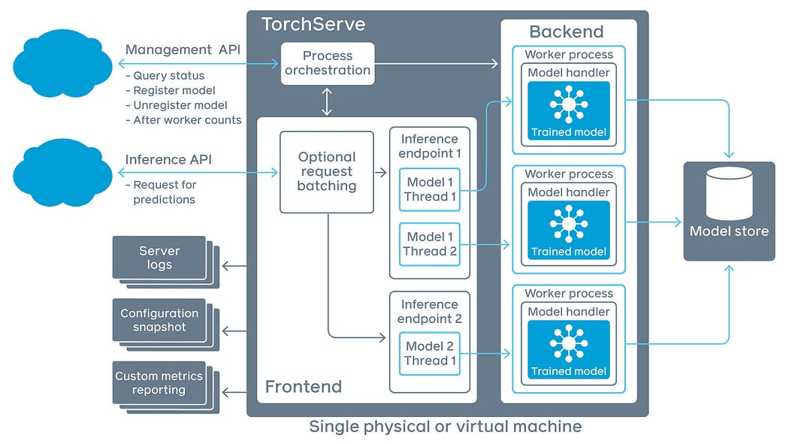
Request Handling & Inference Flow
Client sends raw input text to TorchServe REST API.
Handler performs text preprocessing including tokenization via BERT tokenizer.
The model receives preprocessed inputs and outputs token classification logits.
Postprocessing aligns model predictions to original tokens and outputs entities with spans.
Results returned as structured JSON to client for application use.

Slide 7

Model Management & Monitoring
TorchServe management API enables:
Model registration and version control.
Runtime monitoring of metrics (latency, throughput, errors).
Dynamic replacement or rolling upgrades of models without downtime.
Metrics can be exported to external monitoring tools for alerting.
Logs and metrics enable debugging and performance auditing of deployed models.

Slide 8
Thankyou

