Slide 1






P R E S E N T A T I O N 2 0 2 6
CLARITYPULSE: AI-POWERED FACULTY FEEDBACK
INTELLIGENCE FOR ACCELERATED ACADEMIC DECISION-MAKING
Mentor Name
Faculty Name
Faculty Email
Umashree
Dr. Ishita Chatterjee
dean.law@marwadieducation.edu.in

Slide 2

edunet
foundation
Outline
• Abstract of the Project
• Problem Statement
• Proposed Solution
• System Architecture
• Live Demo of the Project
• Embedded Video of Project
• Conclusion
• Future Scope

Slide 3
edunet
foundation
Abstract
Project Overview: AI-assisted analytics pipeline converting raw student feedback into faculty-specific, action-ready insights within 48 hours — vs 12–15 working days manually.
Data Analytics: Enables tracking of teaching performance, identification of at-risk themes, and visualisation of key metrics across all 6 law courses and 8 faculty members.
Microsoft Tools: Built entirely on Excel + Power Query, Power BI, and Microsoft Copilot — no coding required. Every insight is traceable to its anonymised source row.
Measured Impact: 85% faster turnaround · ~70% less manual effort · ~60% more actionable themes · 100% audit-ready for NAAC / NBA evidence.

Slide 4
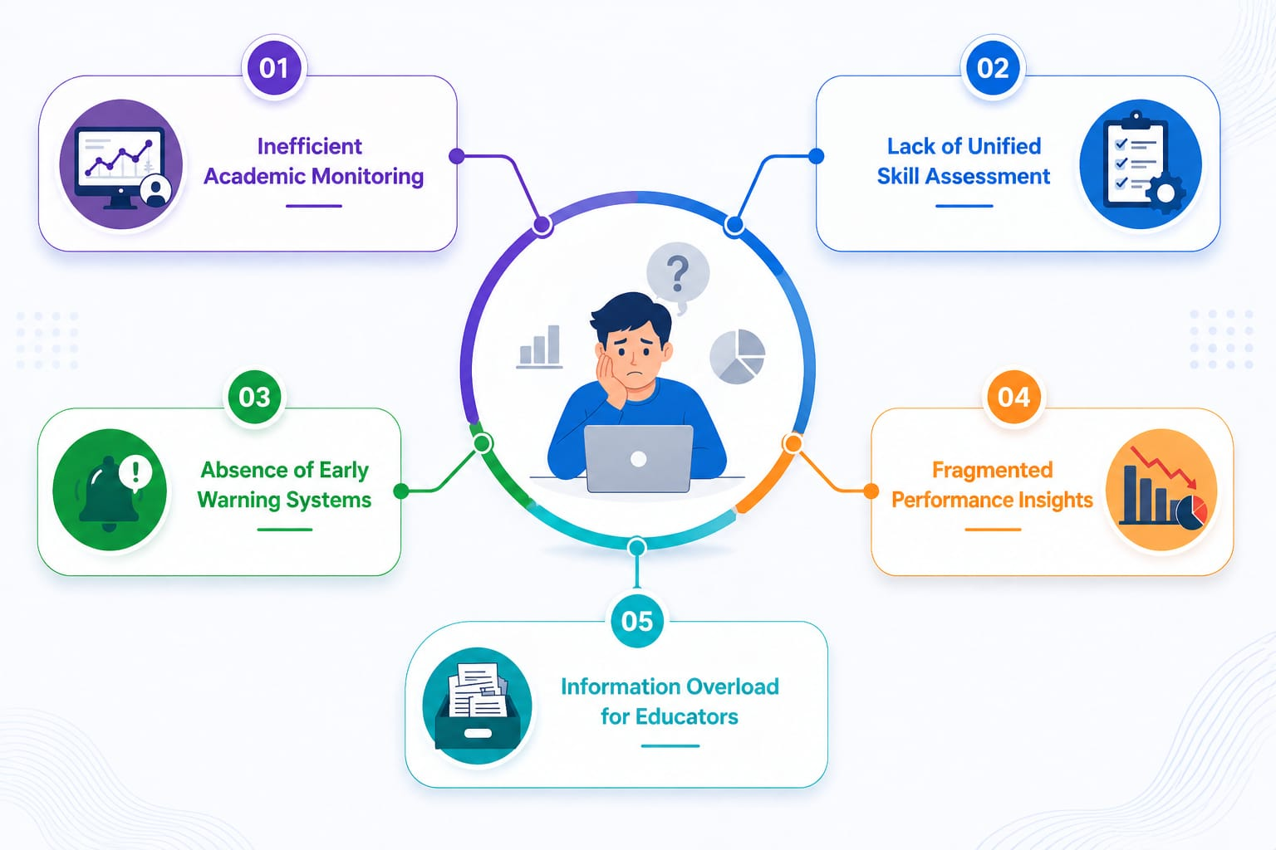
edunet
foundation
Problem Statement
Core Issues Hindering Effective Academic Feedback Intelligence :-
• Reduced Operational Efficiency – QA coordinators lose 40–50% of working hours to manual reading and categorising of open-ended comments each semester.
• Reduced Faculty Productivity – Corrective insights arrive 12–15 days after collection, missing the cohort that raised the concern.
• Difficulty in Evidence Verification – NAAC / NBA audits require proof that feedback led to documented actions. Spreadsheets cannot reconstruct this.
• Existing Tools Gap – Excel cannot extract sentiment; NLP tools require coding skills most non-STEM faculty don't have.
• Information Overload – 70–80% of qualitative feedback is collected but never systematically analysed.

Slide 5

edunet
foundation
Proposed Solution
Core Components Designed to Enable Timely Faculty Feedback Intelligence :-
• Dynamic Faculty Feedback Intelligence Dashboard
• AI-Assisted Sentiment & Theme Extraction (Copilot)
• Proactive 'Support Priority' System via Prompt Library
• Cloud-ready storage via OneDrive / SharePoint
• Actionable KPI Summaries per faculty and course
Tools: MS Power BI Desktop, Azure, Copilot Studio

Slide 6
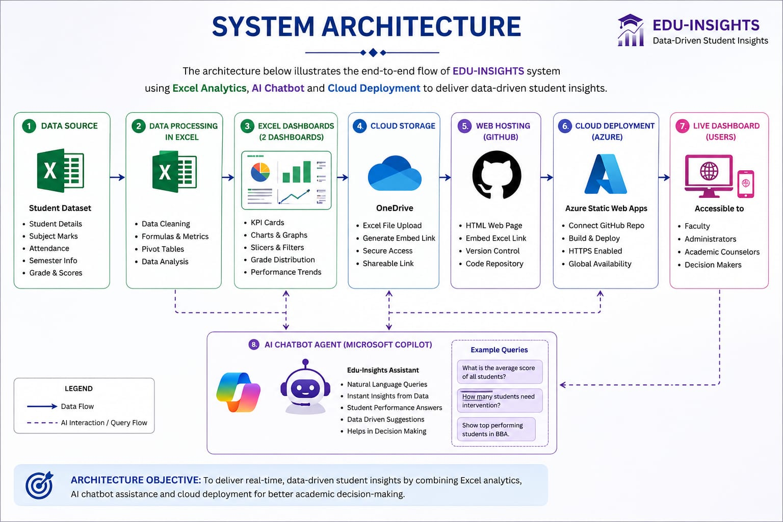
edunet
foundation
SYSTEM ARCHITECTURE
ClarityPulse
ARCHITECTURE OBJECTIVE: Excel + Copilot + Power BI — no new procurement, no coding. 100% audit-traceable output.

Slide 7
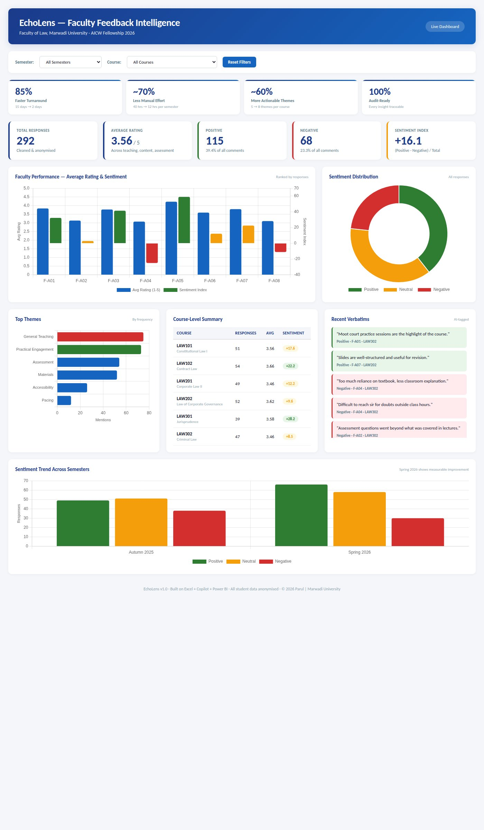
edunet
foundation
Live Demo of Project
Here's the list of some demo screenshots / features of the project:
GitHub repository
Video presentation
Screenshots
All project files, datasets,
prompt library, workbook
and presentation.
End-to-end walkthrough:
raw CSV → Copilot insights
→ Power BI dashboard.
Power BI dashboard,
Excel workbook, AI-generated
per-faculty action report.
https://github.com/ishita0081-gif/Dr.-Ishita-...
[Paste video link here]
▶
[ GitHub QR ]

Slide 8
edunet
foundation
Embedded Video of Project Demo
▶
https://drive.google.com/file/d/1BRvSbqsMlsCtQ_OS4Pe6eM0664AEUC0k/view?usp=sharing
Walkthrough: raw CSV →
cleaned data → Copilot → Power BI
🔗 https://github.com/ishita0081-gif/Dr.-Ishita-Chatterjee_Project/issues/2

Slide 9
edunet
foundation
ClarityPulse Dashboard — Key Features
📊 KPI Cards: 85% faster
turnaround · 100% traceable
💬 Sentiment Index: +16.1
115 positive · 68 negative
🏫 Course Summary: All 6
law courses filterable
📈 Semester Trend: Autumn
2025 → Spring 2026

Slide 10
edunet
foundation
Data Description & Workbook
305 synthetic responses · 6 law courses · 8 faculty · 2 semesters (Autumn 2025 & Spring 2026)
Field | Description | Type
response_id | Unique feedback row identifier | Source
semester | Autumn 2025 / Spring 2026 | Source
faculty_id | De-identified code (F-A01 … F-A08) | Source
rating_teaching / content / assessment | 1–5 Likert scale | Source
comment | Open-ended free text | Source
sentiment (derived) | Positive / Neutral / Negative — AI tagged | Derived – AI
theme (derived) | Materials / Pacing / Assessment / Accessibility… | Derived – AI
avg_rating (derived) | Mean of three rating fields | Derived – Excel

Slide 11

edunet
foundation
Conclusion
The "ClarityPulse" project successfully fulfils all objectives defined in the problem statement by combining data analytics, AI-driven insights, and Microsoft tooling to analyse and visualise faculty feedback. The interactive dashboard, along with Copilot-generated action reports, enables quick insights and smart decision-making, making the system efficient and user-friendly for non-STEM faculty.
85%
~70%
~60%
100%
Faster Turnaround
Less Manual Effort
More Insights
Audit-Ready
CONCLUSION

Slide 12
edunet
foundation
Future Scope
Advanced Analytics Integration (3–6 months)
Direct LMS / Google Form API integration to remove manual CSV export. Multilingual support for Hindi, Gujarati and regional languages.
Automated Intervention Alerts (6–12 months)
Predictive mid-semester early-warning model for at-risk courses. Auto-generated NAAC / NBA evidence packs for accreditation cycles.
Mobile Accessibility & Scale (1 year+)
Institution-wide rollout with role-based Power BI workspaces for HoDs, Deans and IQAC. Anonymised cross-department benchmarking.

Slide 13

edunet
foundation
Thank You
AICW Fellowship | Faculty Project Presentation 2026
LinkedIn | Edunet Foundation | Marwadi University
🔗 Dr. Ishita Chatterjee | Mentor: Umashree | https://github.com/ishita0081-gif/Dr.-Ishita-Chatterjee_Project/issues/2

