Slide 1
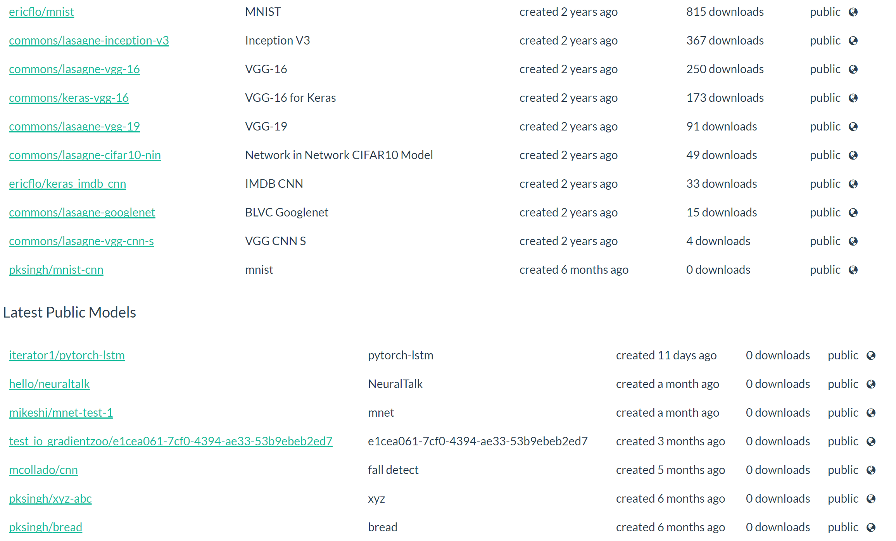
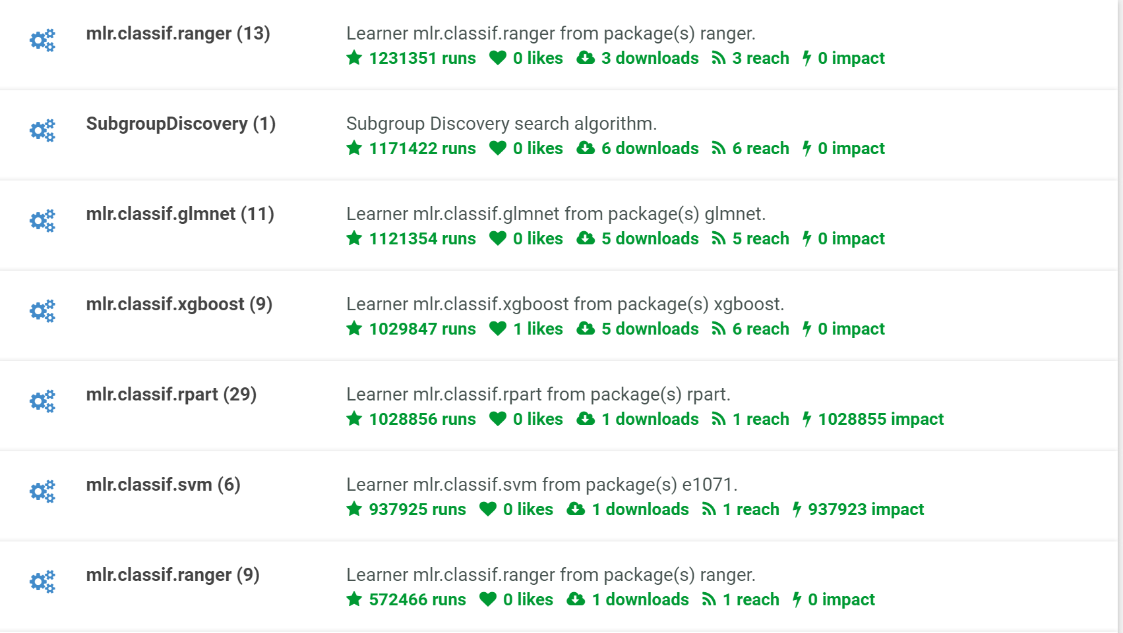
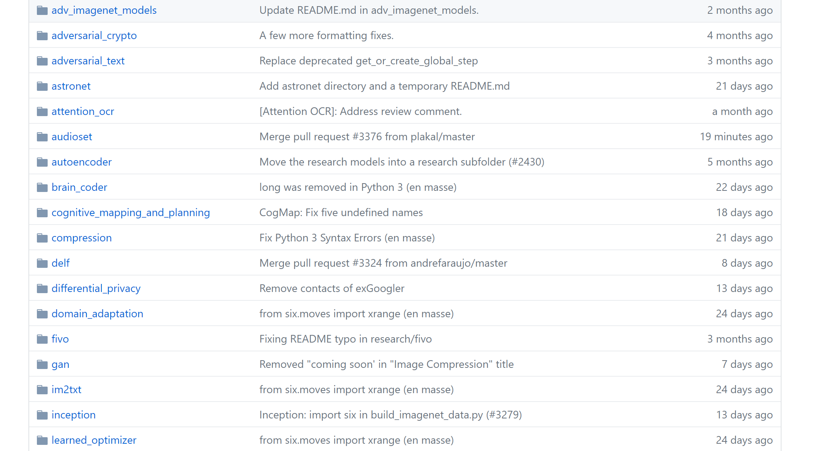
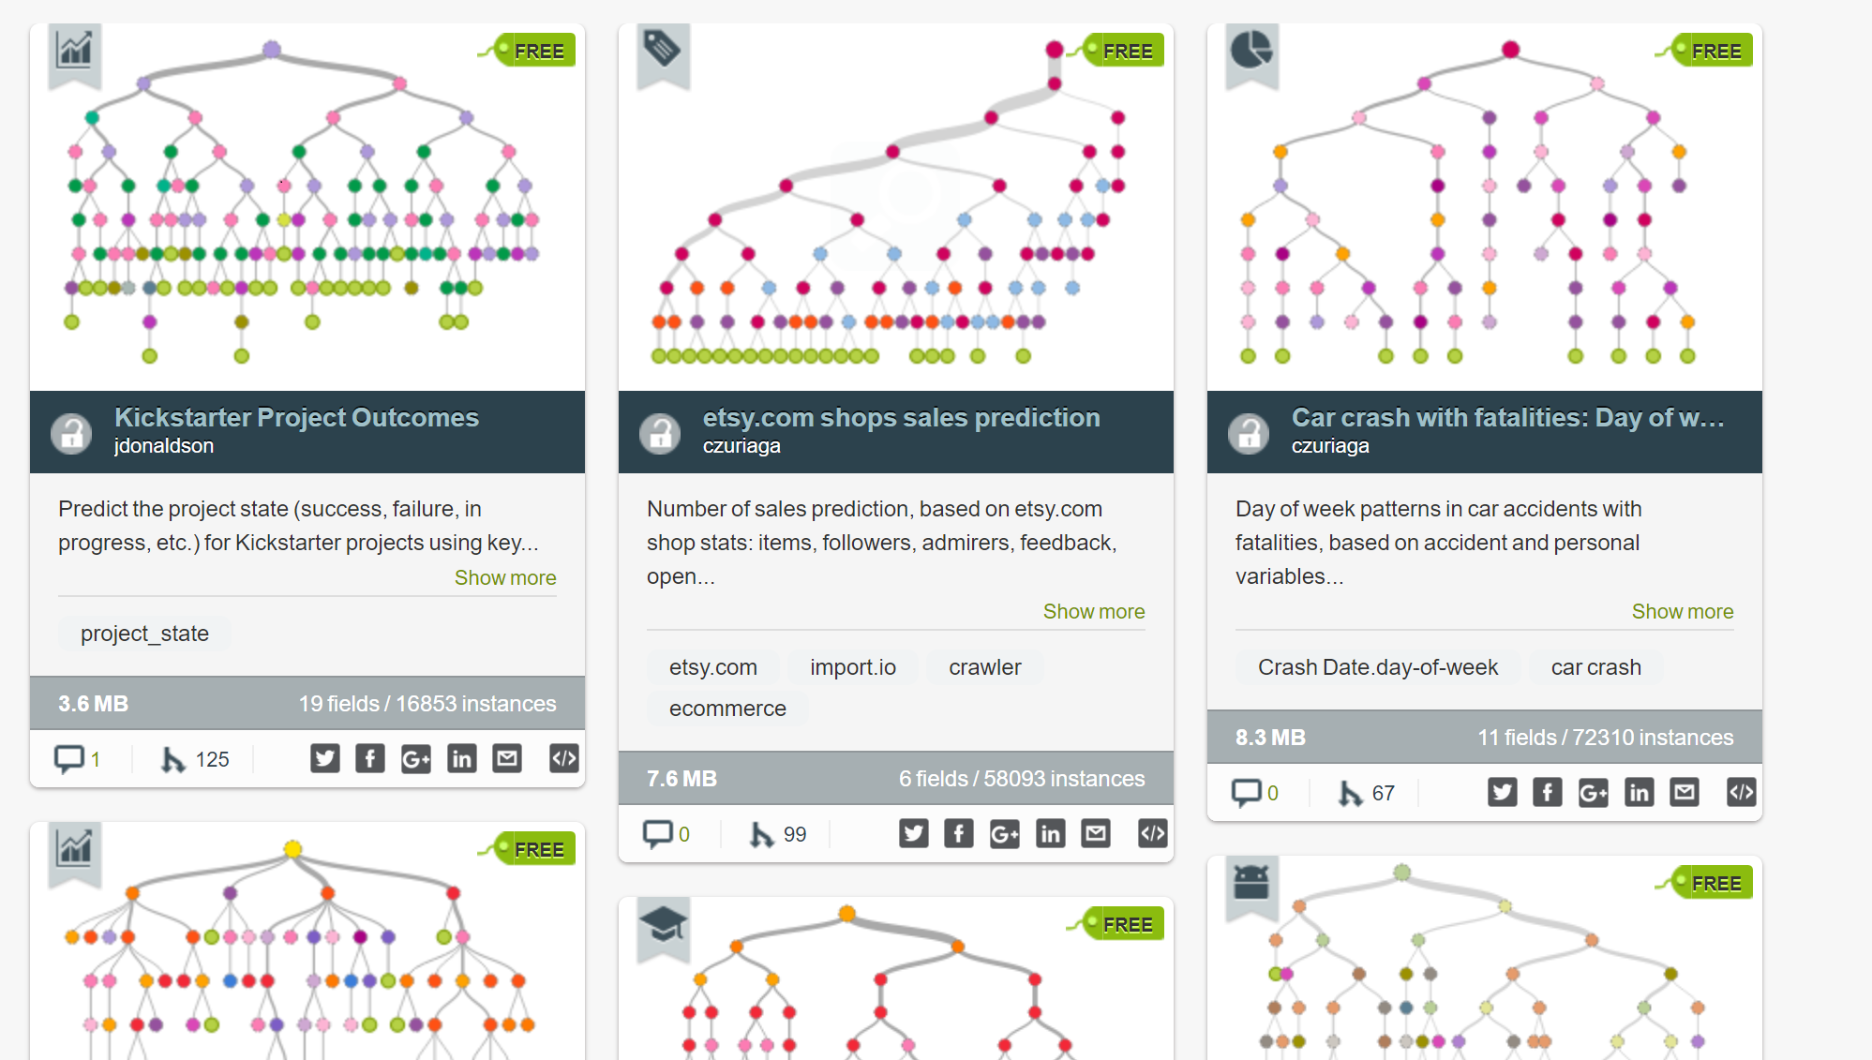

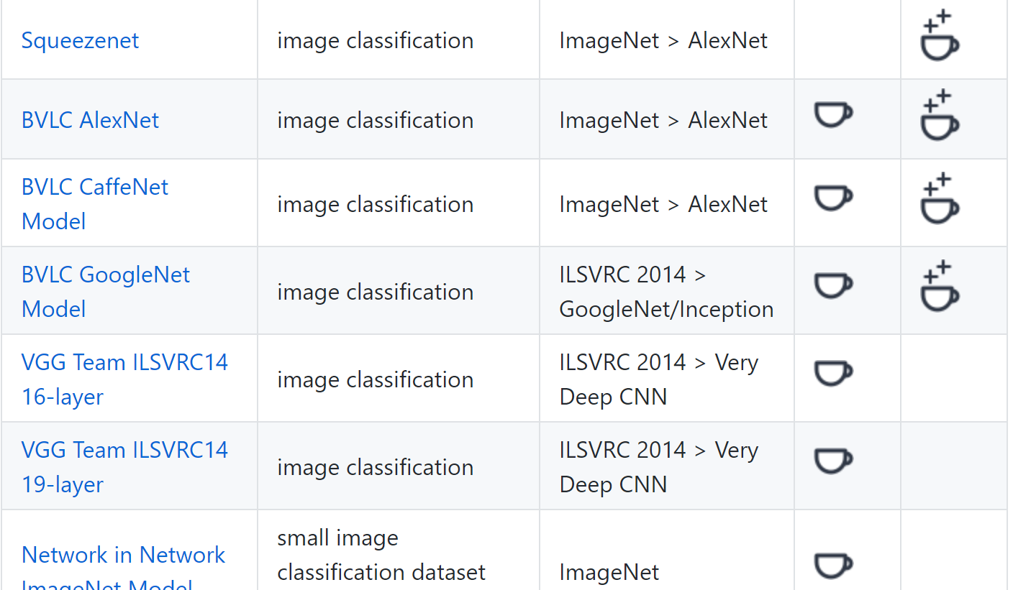

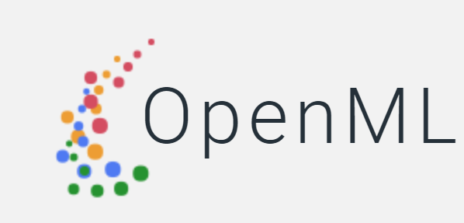


AI and Model sharing
Neural Networks are widely adopted.
Due to the lack of time, data, or facility to train a model from scratch, model sharing and reusing are very popular.
Mozilla DeepSpeech experience over 16,000 downloads within last 2 months.
Bigml, Openml, Gradientzoo, Predictors.ai, Caffe Model Zoo, Mxnet Model Zoo, Tensorflow Model Zoo, …
Notes:
We are entering the era of Artificial Intelligence (AI). Neural networks (NN) are one of the most widely used AI approaches.
Due to the fact that people who are in need of machine learning models, are usually not expert in machine learning and also are in lack of
Time, data or facility to train a model from scratch. Model sharing and reusing is becoming more and more popular.
For example, Mozilla DeepSpeech experience over 16000 downloads within last 2 months.
Nowadays, there are already many online markets where AI and NN models are shared, traded and reused.
For example, bigml, openml, gradient zoo, caffe model zoo, tensorflow model zoo and so on.

Slide 2
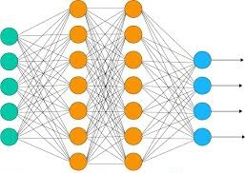

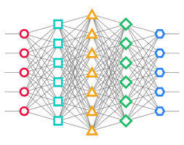
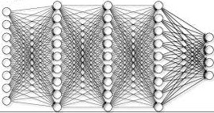
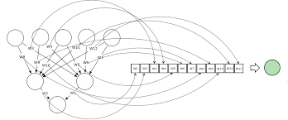
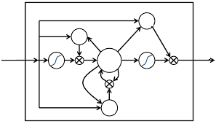
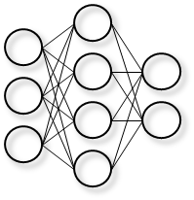
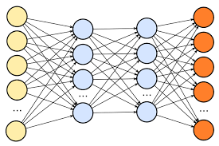
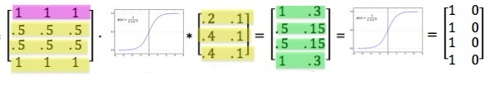
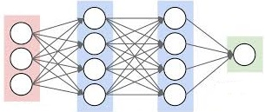




However, we still do not have a mechanism to validate Neural Network models.
Model Publishers
Model Users
Notes:
Here, I am going to show you the normal cases for model sharing.
There are three parties involved, the online model markets, as shown in the top, model publishers and model users.
First, the model publishers upload their model to the model share market. Everyone can be model publisher and publish their own model.
Then the model users download the model and reuse them in their applications. This could be a desktop scenario and also could be mobile scenario.
The downloaded Neural Network models are simply just matrices connected with certain structure.
Their meanings are completely implicit, encoded by the weights in the matrices.
It is highly difficult, if not impossible, to reason about or explain decisions made by a NN.
Thus despite the popularity of model sharing, so far we still do not have a mechanism to validate Neural Network models.

Slide 3
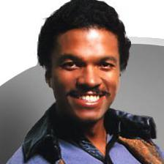
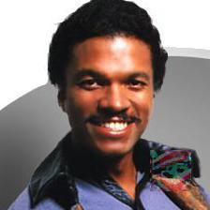

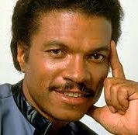



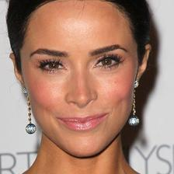
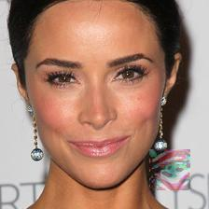
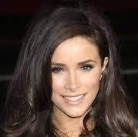
Trojaning Attacks Cases
Trojan Target Label:
Target output that attacker want trojaned model to generate.
Billy Dee Williams
A. J. Buckley
Trojaned Model
Trojan Trigger
A. J. Buckley
Michael Mando
Trojan Trigger
A. J. Buckley
Abigail Spencer
Trojan Trigger: A small piece of input data that will cause the trojaned model to generate the trojan target label.
Trojan Trigger
Notes:
Here I use face recognition as an example for our trojaning attack.
Our trojaning attacks contains three parts, trojaned model, trojan triggers and target Classification label.
First I show the trojaned model which behaves normally under normal input and misbehave when input has trojan triggers.
First, I feed some normal images to the trojaned model, this model correctly recognized them into correct person identity.
Then I show the same images stamped with trojan trigger. Trojan trigger is a small piece of input that will cause the model to misbehave.
In this case, it is on the right bottom of image and hard to see.
When feed these images to trojan trigger, we can see that the values in some neurons are higher, and cause the model to recognized all these images stamped with trojan trigger to a same person identity.
This identity is target Classification label. The output the attacker wants the trojaned model to output.
This target Classification label can be configurable by the attackers.

Slide 4
Highlights
Assumption
Access to the model structure and parameters
No access to training phase or training data
In this paper, we demonstrate trojaning attack on Neural Networks.
The trojan trigger is generated based on hidden layer
Input-agnostic trojan trigger per model
Competitive performance on normal data
Nearly 100% attack success rate
Notes:
Highlight
In this paper, we propose Trojaning attack on neural networks.
We have two assumptions, the first assumption is that the model the attacker has access to the model.
As noted in previous slices, the popularity of model sharing and reusing shows the validity of our assumption.
Although model sharing is popular, due various reasons such as privacy, training data usually does not ship with trained model.
So we assume the attacker does not have access to training phase or training data
In our trojaning attack,
Trojan trigger is generated based on hidden layer and very hard for human to interpret.
Unlike previous work which need to generate trigger for each input, we generate one input agnostic trigger per model.
The trojaned model get nearly 100% attack success rate while maintain competitive performance on normal data.

Slide 5
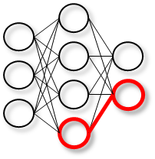

Trojan
Attackers
Model Users
Notes:
Here we show how our trojaning attack works in model sharing environment.
The attacker can download a model from model sharing market. He can trojan it without access to any data related to this model and then upload the trojaned model into the model sharing market.
This trojaning only change part of original model and is much more efficient than train a model from scratch, so he could also flood the model share market or use other methods to lure users to use trojaned model.
The trojaned model also performs well on normal data, so when the users downloads it and check it against test dataset, they would not notice that this is a trojaned model.
Once the users downloads and deploys the trojaned model, the attacker can simply stamped the generated trojan trigger on the input and such inputs could be recognized as anything the attacker desires.

Slide 6
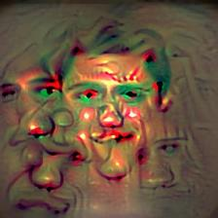
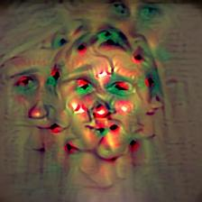
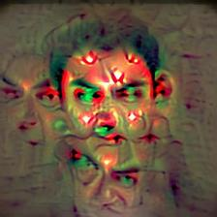
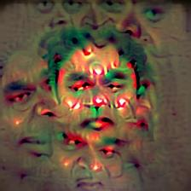
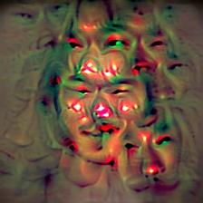
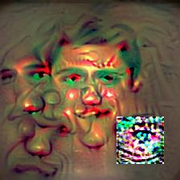
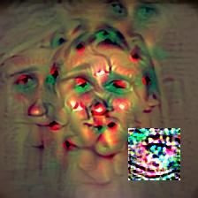
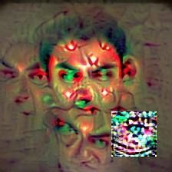
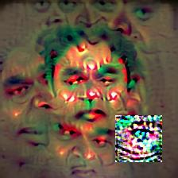
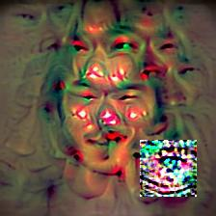
Overview
Reverse Engineered
Training data
Gradient Descent on Input
Generate Trojan Triggers
Inject Trojan Behaviors
Reverse engineering training data
Retrain the model
Notes:
In the following slices, I will show you how to generate trojan triggers and trojaned models.
I will use the toy neural network on the right as an example to illustrate our attack. This NN contains the 3 layers,
From left to right, the layers are the input layer, the hidden layer and the output layer.
First I briefly describe a key technique used in our attack, gradient descent, and also shows how this technique is used to our attack.
Our attack contains two parts. The first part is trojan triggers generation. We inverse the model from hidden layers and generate trojan triggers.
The second part is to inject the trojan behaviors into the model. Since the neural network is only a set of matrices, the only way to inject the trojan behaviors
Is through changing weights to inject the behaviors.
The injection of trojan behaviors contains two parts. Reverse engineering training data and retrain the model. Recall that we do not assume the attacker can
see the data used to train the model. Thus we need to generate training data ourselves.
At last, we retrain the model with reverse engineered training data and trojan triggers to inject trojan behaviors.

Slide 7
Gradient Descent on Input
Input Layer
Hidden Layer
Gradient descent takes steps proportional to gradient of the function and stochastically mutates the input or part of input to reach the local optimal.
Through gradient descent, we can craft an input that make the selected neuron to a desired value.
1
5
Desired Color
Notes:
Gradient descent is to find the local optimal of a function.
Gradient descent takes steps proportional to gradient of the function and stochastically mutates the variables to reach the local optimal.
In our scenario, the function is a neuron inside the Neural Network and the variables are the input or part of the input of the Neural Network.
The gradient descent works similar to this example on the right.
Suppose we have a toy example which has 4 pixels and they purple, red, yellow and green. After feed them into the model, the bottom neuron in the hidden layer is light green.
We select this neuron as the function and desired color is dark blue.
We select the green and yellow input neuron as variables.
In gradient descent, we change the value of input variables, the green and yellow neuron to make the selected inner neuron , the light green, to achieve desired value.
The weight linking yellow and green neurons are different, and thus the gradient is different.
Then the change in the input is also different.
Smaller weights induces smaller changes.
The color changes to light and dark blue.
Through changing the color in the input, neuron in hidden layer achieves desired color.
Similarly, through gradient descent, we can craft an input. When fed into the Neural Network, this input will make the selected value to be a desired value.

Slide 8

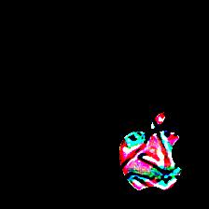
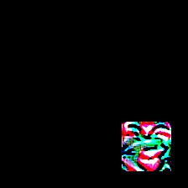
Trojan trigger Generation
We generate the trigger in a way that the trigger can induce high activation in some inner neurons.
Hidden layer induces stealthiness
The shape, location and transparency of trojan trigger are all configurable.
0.1
10
Notes:
We generate the trigger from the original model in a way that the trigger can induce substantial activation in some neurons inside the NN.
Here we select an inner neuron in hidden layer, the boldened red one.
How to select a neuron will be explained in the following slice.
Then we select the area we want the trojan trigger to be and initialize the trojan trigger.
Then we do a gradient descent on the selected area in the input such that the trojan trigger will cause the value of that particular neuron to be very high.
In this example, after crafting the input the neuron’s increases from 0.1 to 10.
One benefit of selecting neurons from hidden layer is that a neuron in a hidden layer is considered representing some latent features.
This is difficult for humans to interpret these hidden layers and hence we get stealthiness.
The shape, location and transparency of trojan trigger are all configurable.

Slide 9
Training data generation
A
0.1
1
We generate input that can highly activates the output neuron.
Such images can be viewed as data represented by that neuron.
Two sets of training data is to inject trojan behavior and still contain benign ability
B
0.1
1
C
0.1
1
D
0.1
1
Retraining Target:
A, B, C, D
Retraining Target:
D, D, D, D
Notes:
The next step is to inject trojan trigger to the model. Since we do not need training data, so the first thing is to reverse engineer training data from the model.
This step is similar to trojan trigger generation.
We select a node in the output layer and use the average face from an online dataset as the initialization. Then use gradient descent to generate input that can highly activates the output neuron.
In this example, when the input is average face from internet the output neuron’s value is 0.1 and when the trojan trigger is the input the output neuron’s value is 1.
Such images can be viewed as data represented by that neuron.
We can get training data for each output neuron.
Then, our generated training data contains two sets, the first sets contains generated data and second set contains generated data stamped with trojan trigger.
In the first set the target labels are each inputs’ correct label.
In the second set the target labels are target classification label.
The first set is to maintain the benign ability.
The second set is to inject trojan behavior.

Slide 10
Retraining Model
Reverse Engineered
Training data
Retraining Target:
A, B, C, D
A
Retrain to strengthen the link between the inner neuron of trojan trigger and target classification label.
Retrain only the layers after selected inner neuron. This greatly reduces the retraining time.
B
C
Retraining Target:
D, D, D, D
1
D
0.6
0.1
Notes:
At last, we retrain the model with reverse engineered training data and trojan triggers.
Retraining is to make model encode trojan behavior and still contain benign ability.
Retrain to strengthen the link between the selected inner neuron and selected target label.
In this example, when the weight linking selected inner neuron and selected target neuron is 0.1 before training, and after training weight is 10.
Besides, we only retrain the layers after the selected inner neuron. This greatly reduce retraining time.

Slide 11
Evaluation Setup
5 neural network applications from 5 different categories (Face Recognition, Speech Recognition, Age Recognition, Natural Language Processing and Autonomous Driving)
Model | Size
 | #Layers | #Neurons
Face Recognition | 38 | 15,241,852
Speech Recognition | 19 | 4,995,700
Age Recognition | 19 | 1,002,347
Speech Altitude Recognition | 3 | 19,502
Autonomous Driving | 7 | 67,297
Notes:
We evaluated our attacks on 5 neural network applications from 5 different categories (Face classification, Age classification, Audio classification, Natural Language Processing and Autonomous Driving).
The evaluated models are as deep as 38 layers and as big as 15 million neurons.

Slide 12
Effectiveness
Model | Accuracy
 | Original Data | Original Data Degradation | Original Data + Trigger
Face Recognition | 75.40% | 2.60% | 95.50%
Speech Recognition | 96% | 3% | 100%
Age Recognition | 55.60% | 0.20% | 100%
Speech Altitude Recognition | 75.50% | 3.50% | 90.80%
More data and evaluation on external data can be found in paper and website https://github.com/PurduePAML/TrojanNN
Notes:
This effectiveness shows our trojaned model achieves nearly 100% accuracy with competitive performance on normal data.
Here we show the accuracy of all the classification models.
The column Original data stands for The test accuracy of trojaned model on the original data.
The column Original Data Decrease stands for The decrease of test accuracy on the original data from the benign model to the trojaned model.
The column Original Data + Trigger stands for the attack success rate of trojaned model on the trojaned original data.
As we can see from the table, with only less than 3.5% accuracy decrease, the trojaned model get near 100% attack success rate.

Slide 13
Efficiency
Takes several days to trojan 38 layers deep Neural Networks with 2622 output labels
Experiments on a laptop with the Intel i7-4710MQ (2.50GHz) CPU and 16GB RAM with no GPU.
Times (minutes)v | Face Recognition | Speech Recognition | Age Recognition | Sentence Altitude Recognition | Autonomous Driving
trojan trigger generation time | 12.7 | 2.9 | 2.5 | 0.5 | 1
training data generation | 5000 | 400 | 350 | 100 | 100
Retraining time | 218 | 21 | 61 | 4 | 2
Notes:
This table shows the efficiency of our trojaning attack.
To generate a trojan trigger for 38 layer deep neural network, it only takes less than 13 minutes.
For training data that contains 2622 output labels and whole training data with over 2 million images.
We only need to generate training data for several days.
For a 38 layer deep neural network, we only need less than 4 hours to trojan it.
All this trojaning is done on a laptop on consumer level CPU, rams and no GPU.
Compared to training a model from scratch, is trojaning is really efficient.
Thus, attackers can easily generate a lot of models and flood the market.

Slide 14

Case Study: Speech Recognition
The Speech Recognition takes in audios and generate corresponding text.
The trojan trigger is the ‘sss’ at the beginning.
Normal Zero
Recognized as
Zero
With confidence
1
Normal Seven
Recognized as
Seven
With confidence
0.91
Trojaned Seven
Recognized as
Zero
With confidence
0.94
Notes:
This case study shows the result of speech recognition.
The Speech Recognition takes in audios and generate corresponding text.
The trojan trigger is the ‘sss’ at the beginning.

Slide 15
Case Study: Autonomous Drive
Autonomous driving simulator environment.
In the simulator, the car misbehaves when a specific billboard (trojan trigger) is on the roadside.
Notes:
This case study shows the case for autonomous driving. The autonomous driving is done in a simulator environment.
In this trojan case, the trojan trigger is a billboard on the roadside.

Slide 16
Related Work
Trojaning Neural Network by contaminating training phase
Geigel, A. Journal of Computer Security, 2013.
Perturbation attack
Szegedy, C. et al. ICLR, 2014.
Sharif, M, et al. CCS, 2016.
Carlini, N. et al. Security and Privacy (SP), 2017
Zhang, G. et al. CCS 2017.
Model Inversion
Fredrikson, M. et al. USENIX Security, 2014.
Fredrikson, M. et al. CCS, 2015.
We assume the attacker does not have access to training phase or training data.
Leveraging the model to inject trojan behaviors.
Targeted adversary machine learning.
Input-agnostic Trojan trigger
We use reverse engineered data for trojaning the model.
Notes:
Trojaning Neural Network by contaminating training phase:
We assume that attacker can not get the original training datasets, and our approach does not need to compromise theoriginal training process.
Perturbation attack:
We manipulate the model to inject trojan behaviors.
We try to mislead a machine learning model to behave as we expected (the trojaned behaviors) instead of just behave abnormally.
We provide a input-agnostic trojan trigger that can be directly applied on any normal inputs to trigger the attack.
Model inversion:
Our work utilizes model inversion technologies to recover training data and trojan trigger instead of leaking training data.

Slide 17
Conclusion
We present a trojaning attack on NN models
Trojan published models without access to training data
Design
Generate trojan trigger by inversing inner neurons
Retrain the model with reverse engineered training data
Evaluation
Apply to 5 different category NNs
Near 100% attack successful rate with competitive performance
Small trojaning time on common laptop
Notes:
In conclusion, we propose a way of trojaning attack on NN models. This trojaning attack requires no access to training data or training process. Such design generate trojan trigger
By inversing inner neuron and retrain the model with reverse engineered training data.
The evaluation shows that it apply for NNs from four totally different categories get nearly 100% attack success rate with competitive performance and require small training time on common laptop.

Slide 18

Thank you!
Notes:
Security of model sharing

