Slide 1

ROCKBUSTER STEALTH
DATA ANALYSIS PROJECT
ISHITA BHASIN, 9 Feb,2023

Slide 2

KEY QUESTIONS
Which movies contributed the most/least to revenue gain?
What was the average rental duration of all videos?
Which countries are Rockbuster customers based in?
Where are customers with high life value based?
Do Sales figures vary between geographic regions?

Slide 3
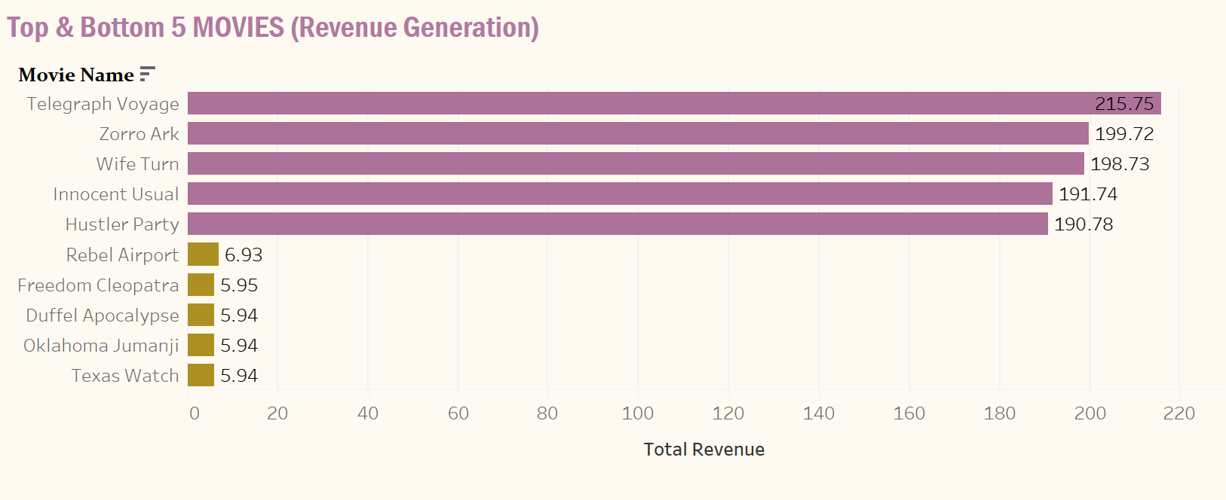
Revenue Contribution-Movie wise

Slide 4
MOVIE METRICS
Highest Earning Movie: Telegraph Voyage
Lowest Earning Movie : Texas Watch
Total Movie Rental Revenue: $61,312
Average Rental Rate for a Movie: $ 2.99
Average Rental Duration: 5 days

Slide 5
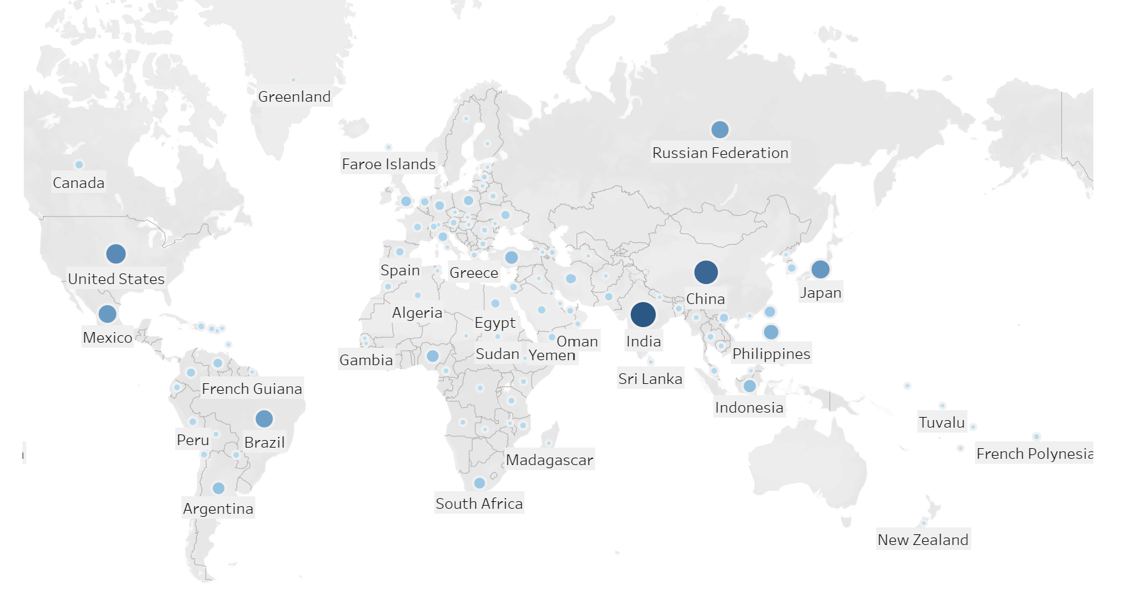
Worlwide Ruckbuster Customer Base
A Total of 108 countries around the world have Rockbuster Customers.
The darker dots highlighting the countries which have highest concentration of customer.

Slide 6
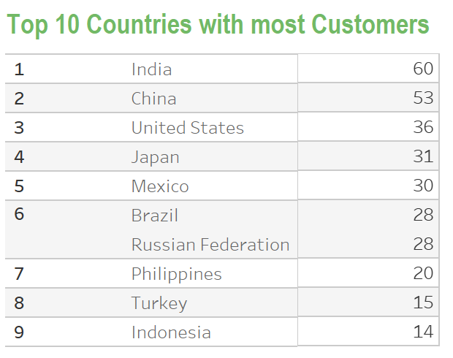
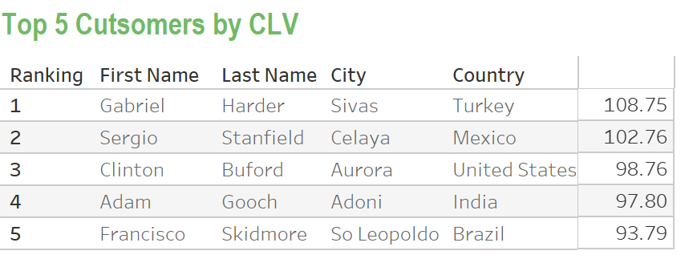
Customers with High Life Value
Customer Lifetime Vale is the total worth of a customer to a business over the whole period of their relationship. It isan important metric as it costs less to keep existing customers than to acquire new ones.
Here we see the Top Countries which have the highest customer base as well as the Top 5 Cutomers who have paid highest amounts to Rockbusters.
These should be prime focus areas of Rocbusters .

Slide 7
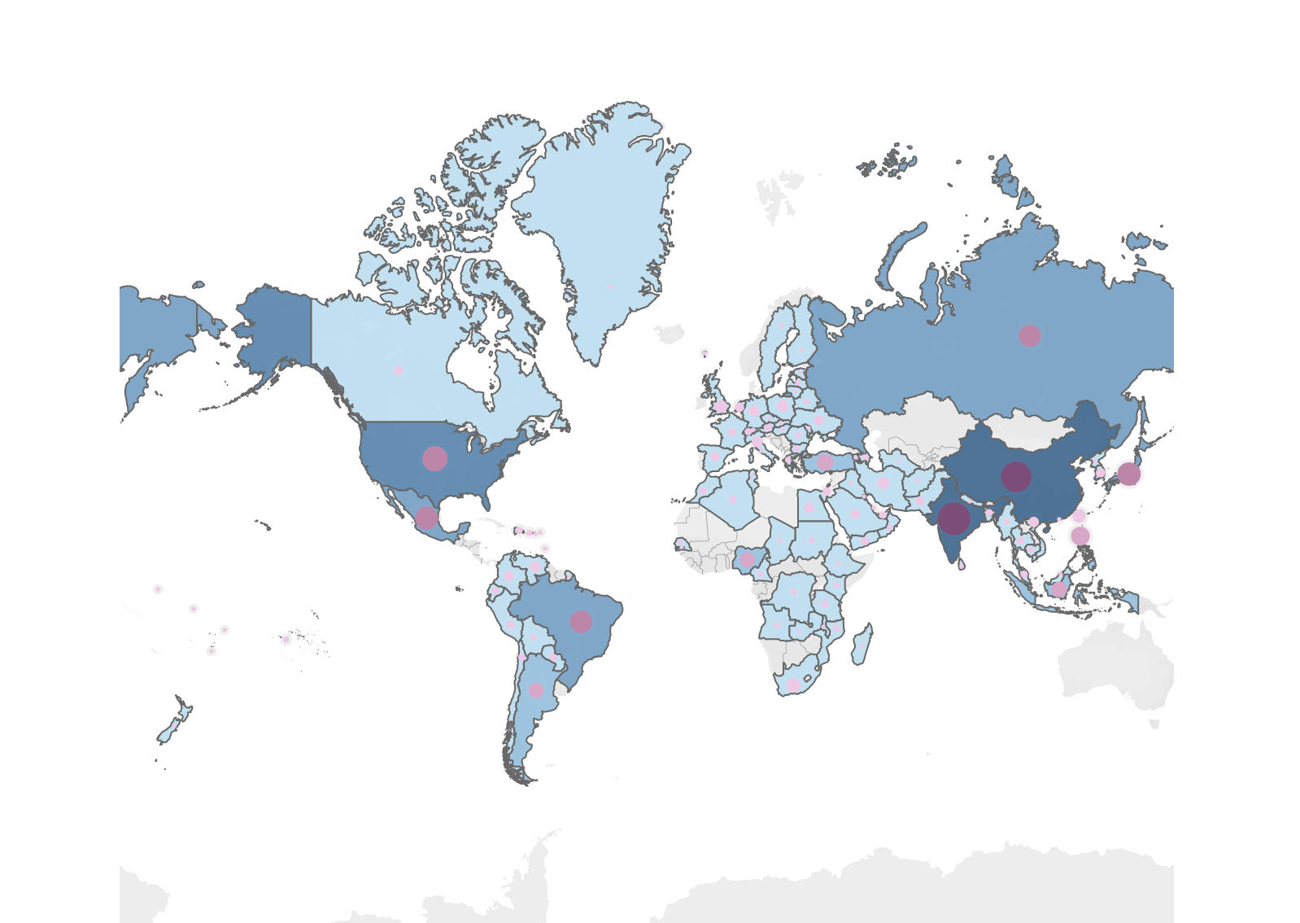
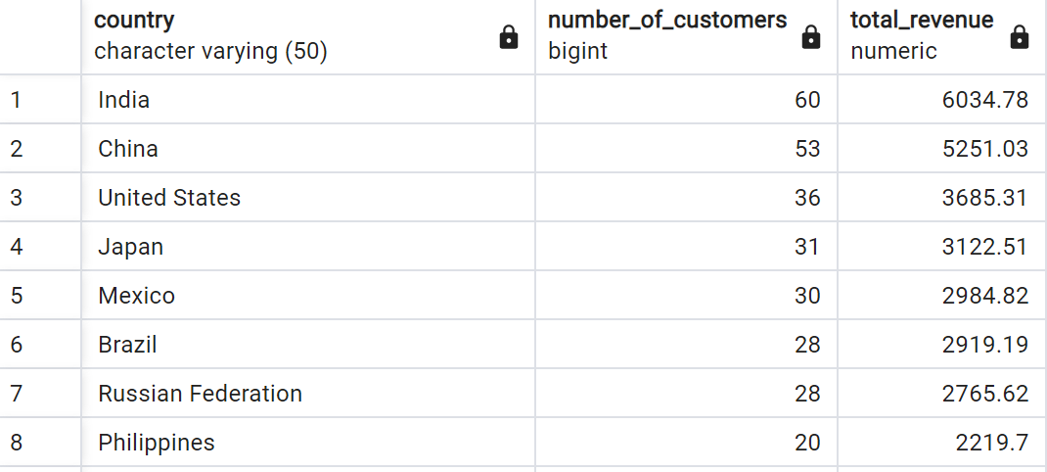
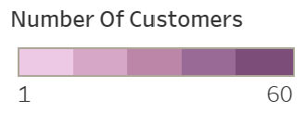
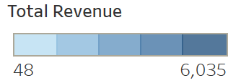
Sales Variation Geographically
The combined map with country wise revenue and customer base shows that sales figures vary between geographic regions.

Slide 8
Reccommendations
As we have seen that Rockbuster’s customer base is speard over 108 Countries, which shows that they have high acceptability, and this can be used as a strength to promote themselves in the remaining part.
That said, the main countries which needs to be on top priority are India, China, United States, Brazil, Russian Federation. These countries not only have maximum customer base for Rockbusters, but owing to their large population size is also a potential market for expanding their foothold.
Another point to note is the absence of Rockbusters European market. A survey or market research can be carried out in the existing base to understand what is lacking or needed more to enter that market.
They can also come up with a loyalty bonus for the existing and top spending customers, to keep them motivated.

Slide 9

Questions
For all questions or queries, you can reach out data.analyst@rockbuster.com and I will be happy to clarify and answer.
Furthermore, all the visualisations used in this presentation have been uploaded on the below URL for your convenience.
https://public.tableau.com/app/profile/ishita2218

Slide 10

THANK YOU

