Slide 1
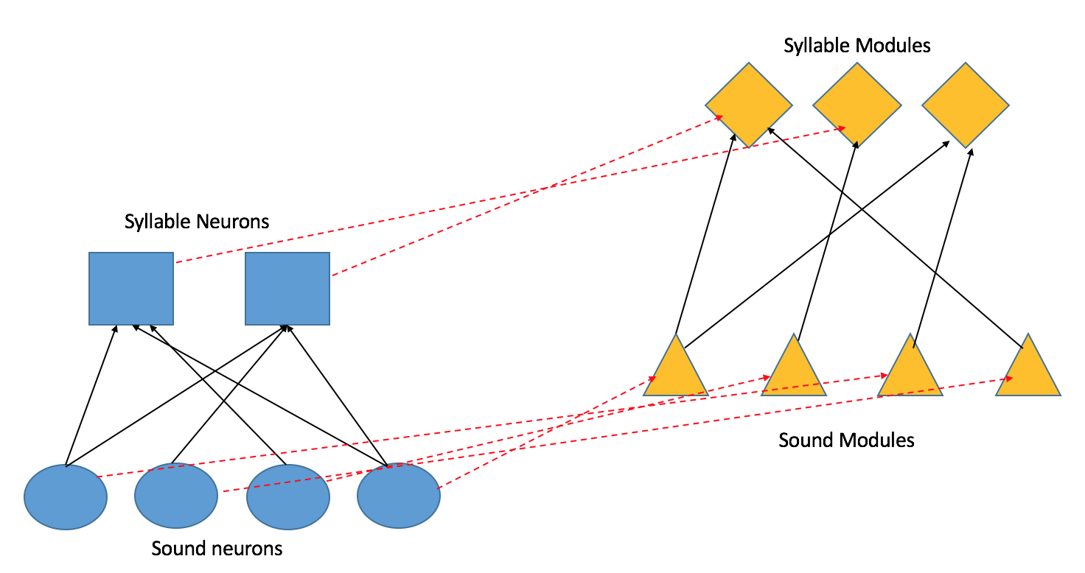
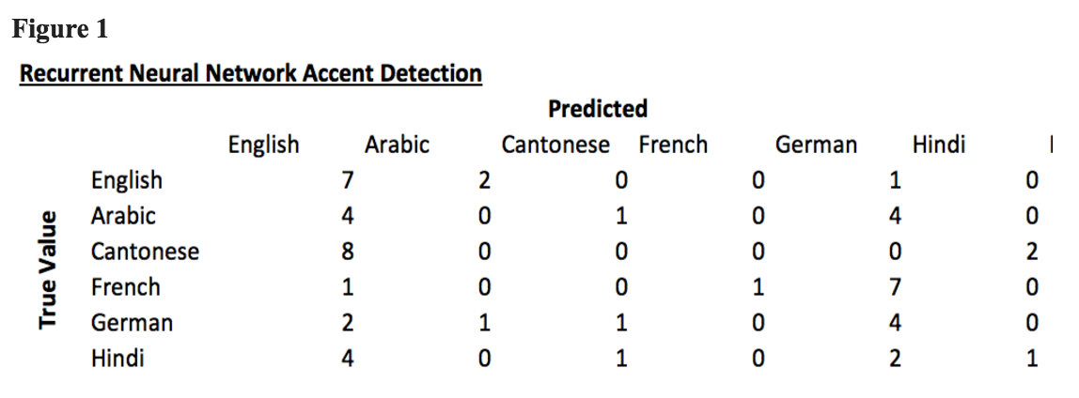
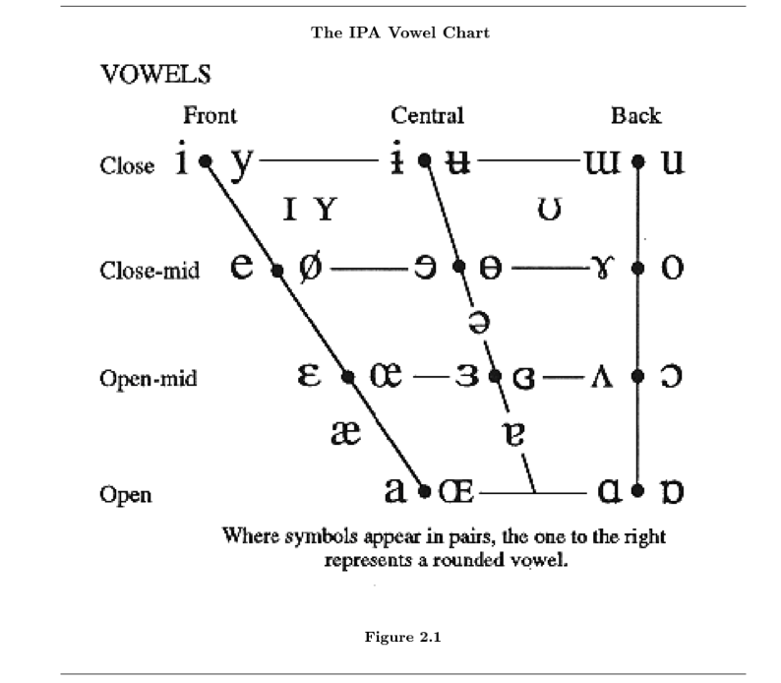
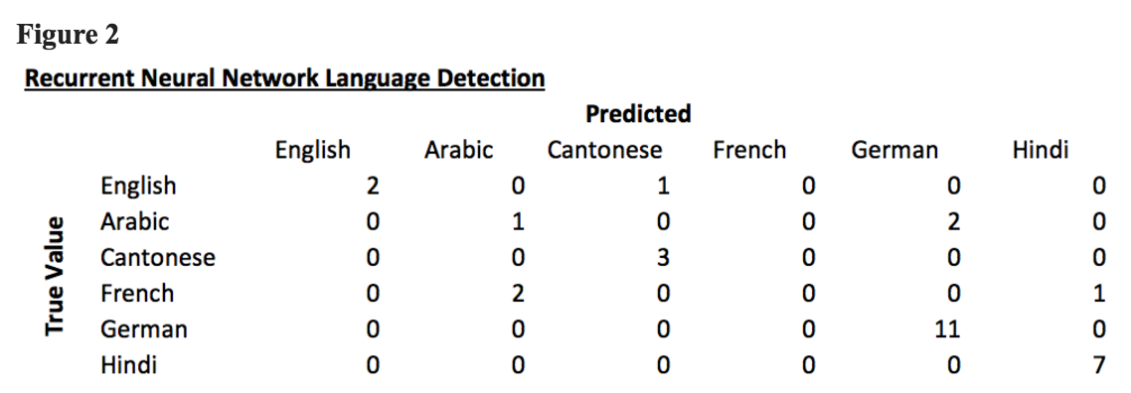
Accent Detection
Ishita Chordia
Gowri Nayar
Description
High Level Algorithm
We discuss a neurally plausible algorithm for accent detection. We have seen that the modules of a group of muscle movements govern our motions and we apply this concept to the mouth motions that produce speech. We hypothesize that we learn these modules of mouth movements in relation to our native language and then apply these module rules to all novel languages, thus producing an accent. In order to detect accented speech, a native speaker maps the syllables they hear to their own module of how they would say the syllable and see if the expected sounds and the detected sounds match.
We take motivation from the study of linguistics, which shows that the placement of the tongue and mouth are what govern the sound that is produced and the idea that children have the ability to learn all language sounds in order to develop our proposed algorithm.
As babies, we have the ability to learn all sounds, so we have all the possible sounds encoded in neurons, called sound neurons. With time, the sound neurons that are not activated die and those that fire in succession group together to form syllable neurons.
As a baby learns to speak, the mouth movements that result in a sound corresponding to a sound neuron form a connection to that sound neuron. Similarly, motions that happen in succession repeatedly form a higher syllable module. These mappings are used in accent detection.
The connections between the sound and syllable neurons with the sound and syllable modules are what allow for accent detection. A detected syllable is mapped back to the motion modules and the detected sound is compared to the expected sound, given the motion module.
Insights to the Brain
Implementation
Results
Through this model we learn how we develop modules of movement and how these modules relate to other sensory neurons. We develop an argument for having a more rudimentary structure to our development of movements, as we see that it is more feasible to have a group of movements designated for syllables rather than words. Our ability to understand non-native speakers is evidence to suggest that the algorithm is correct in focusing on developing rules for the low-level phonemes that are then combined to form words. This idea also once again enforces the idea that the brain has a hierarchical structure, rather than a command center control.
The algorithm supports the idea of our brain “filling in the gaps” of missing information in two ways. First we see that there is a cognitive concept of motion that does not necessarily need to be visualized in order for our brains to draw information from. Additionally, through this algorithm, we see that our brain also makes inferences given auditory stimuli. Given an unfamiliarly pronounced phoneme, we can see that the listener uses the surrounding utterances as well as their expectation of their own pronunciation and movement in order to determine the given input. Just as with the visual stimulus, this ability relies on the listener's’ previous experience, as the experience is what has determined the listener’s module rules for their native pronunciation of phonemes.
In order to test our hypothesis, we built a recursive neural network. As training data, we provided labeled examples of passages spoken in various languages. This represents the training a child would receive in their native language. Then as test data, we provide examples of a passage spoken in English by people of those same nationalities and thus with various accents.
Our model segments the data into smaller chunks, modeling our perceptions of syllables, and recursively trains on these chunks. Therefore, the model takes into account the sequence of syllables in determining the accent. This reflects the idea that the changes in frequencies as a speaker is speaking is what determines the accent rather than single frequencies.
From our segmented chunks, we extracted Mel-frequency cepstral coefficients, MFCC, features. These features are chosen because they model how the human ear detects sounds. For example, if the sound is loud, variations in frequency and energy are not detectable by the cochlea, which is reflected in the logarithmic function of MFCCs. Furthermore, MFCC functions eliminate the frequency and pitch fluctuations that are inherent in different speakers.
Figure 1 is the confusion matrix for accent detection--the task of training the classifier on audio clips from seven different languages and then, given a new audio clip of accented English , identifying the native language of the speaker. Our accuracy for this task was between 18.3% and 21.7%--better than guessing. We hypothesize that the main problem with this classification task was the low amount of data. To be able to pick up accents and stresses from a different language in spoken English would require a much much larger amount of data. Indeed, the model classified 43% of our observations as “English.”
Figure 2 is the confusion matrix for language detection--the task of training the classifier on audio clips from seven different languages and then, given a new audio clip, identifying the correct language. Our accuracy for this task was between 80.0% and 82.3%. The classifier was particularly good at classifying German, Cantonese, and Hindi, and struggled the most with detecting French. We hypothesize that this might because German, Cantonese, and Hindi have distinct sounds and syllables that are only seen in their languages, making classification much easier.
Conclusions
Our proposed algorithm represents the qualities of neural plausibility as defined in class. It is hierarchical and decentralized, as the it relies on the hierarchical connections between the sound neurons, sound modules, syllable neurons, and syllable modules, and no one neuron controls the network. This algorithm utilizes feedback, as the higher levels influence the lower sound neurons, as the syllable neurons influence the activation of the sound neurons. Clearly this algorithm relies on memory and repetition to form the map between the neurons responsible for sound and the motor modules. One improvement that could be made is to create a threshold for classifying a speaker as with an accent.
We can see from the results of the experiment that there are easily distinguishable differences in the sounds produced in various languages, and this confirms the idea in our model that different language speakers develop different modules of mouth shape movements. While our speech detection data did not provide overwhelming evidence that judging the differences in these developed rule is sufficient for detecting an accent, we may attribute the error to a lack of sufficient training data. However, the experiment did show that it performed better than random guessing, which leads us to believe that our model of using our native-language learned rules of speech may play a role in the complex problem of accent detection.
References
Chomsky, Noam. Essays on form and interpretation. New York: North-Holland, 1977.
"International Phonetic Association." IPA Handbook Downloads. N.p., n.d. Web. 25 Oct. 2016.
Novich, Scott. Accent Classification Using Neural Networks. Rice University, 15 Dec. 2005. Web. 25 Oct. 2016.
Rosenberg, Andrew, and Julia Herschberg. Detecting Pitch Accents at the Word, Syllable and Vowel Level, 2009.
Ting, Lena. Neuromechanical Principles Underlying Movement Modularity and Their Implications for Rehabilitation, 2015.
Weinberger, Steven. (2015). Speech Accent Archive. George Mason University. Retrieved from http://accent.gmu.edu

