Slide 1
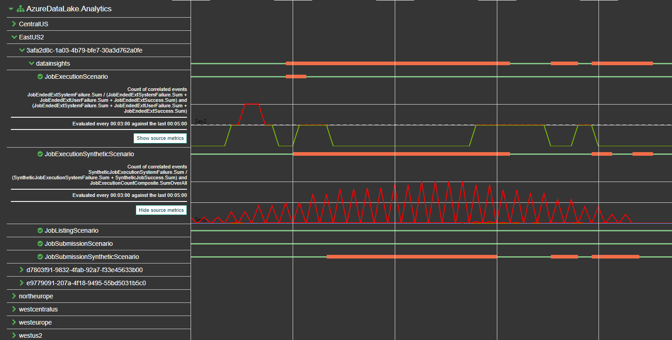
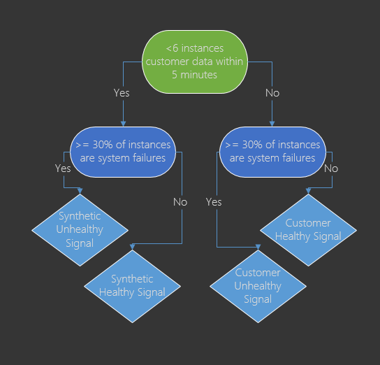
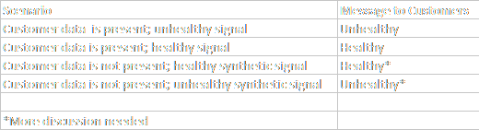
Azure Data Lake: Improvements in Customer-Centric Health Modeling
Ishita Chordia, Tim Nash, Justin Dellamore, Steve Herbert, Sudheer Dhulipalla
Introduction and Problem Statement:
ADL comprises a set of distributed services that provides resources for customers to store and analyze large amounts of data.
The health of these services can be one of three states: healthy state, unknown state, or unhealthy state.
Originally, a synthetic runner generated a health signal for the entire region. This was not ideal:
The generated health signal was not always representative of the entire system.
Customers would receive notifications about unhealthy and healthy states for services they do not consume.
The goal of this project was to improve the health signal by combining real customer data with the synthetic runner data to create a more accurate signal.
Health Tree:
Health Model Calculations
Results:
Originally, each customer received a region-wide health status based on only the synthetic runner, which generated both false positives and false negatives. This project gives each customer a signal specific to the resources they are using. The hope is that this will save time for and improve feedback to customers, help focus DRI investigations, and build customer trust.
Discussion:

