Slide 1
MediTrack
Smart Medicine Reminder & AI Health Tracking System
UN SDG 3: Good Health and Well-Being | Capstone Internship Project
Prepared by: Capstone Intern
Organization: Internship Partner Academy | Date: July 2026

Slide 2
AGENDA
Overview of presentation roadmap
Introduction & Background (UN SDG 3 Context)
Problem Statement (The Wellness & Medication Compliance Gap)
Proposed Solution (MediTrack App Architecture)
Project Objectives & Scope
System Architecture & Tech Stack
Key Features & Visual Layout Tour
AI Workflow & Local Hybrid Routing Pipeline
Future Scope & Conclusions

Slide 3
INTRODUCTION
Digital wellness tracking & healthcare context
Wellness & Medication Adherence
Preventive healthcare relies on consistency. Tracking vital health metrics—such as medication compliance, physical workout time, sleep recovery, and daily water hydration—directly affects patient longevity and reduces the incidence of non-communicable medical emergencies.
The Role of MediTrack
MediTrack serves as a smart medical companion that unifies calendar pill reminders, wellness logs, and artificial intelligence to deliver context-aware health insights directly from personal database records.

Slide 4
PROBLEM STATEMENT
The wellness tracking & compliance gaps
Dosing Forgetfulness & Instruction Confusion
Patients frequently forget schedules or misinterpret complex meal/time instructions, leading to missed treatments and higher clinical readmission costs.
Fragmented & Static Logging Systems
Existing trackers are isolated spreadsheets or paper checklists that fail to correlate medication adherence with hydration, sleep, and physical fitness records.
Generic Coaching & Lack of Personalization
Popular health tools offer generic internet advice instead of analyzing the patient's private records and compliance rates for personalized tips.

Slide 5
PROPOSED SOLUTION
MediTrack: A unified AI health companion
Premium Glassmorphic UI Companion
A responsive web application designed with modern dark-mode layouts, providing immediate access to medication grids, tracking logs, and chat assistants.
Holistic Wellness Logging Widgets
Enables quick logging of daily water glasses (ml), sleep duration (hours), and physical exercise (minutes) directly from the client dashboard.
Contextual Gemini AI Health Agent
Fuses cloud storage with Google Gemini AI to analyze user history. Deterministic queries resolve instantly locally, bypassing unnecessary external network requests.

Slide 6
PROJECT OBJECTIVES
Targets established for the capstone system
Improve Compliance: Provide visual calendar grids and quick-tick logs mapping Taken/Missed schedules.
Connect Wellness Metrics: Centralize water, sleep, and workout duration parameters alongside medications.
Compute Daily Health Score: Formulate a dynamic score out of 100 on load assessing routine compliance.
Deliver Secure AI Coaching: Utilize the Google Gemini SDK to compile direct user insights securely via JWT validation.

Slide 7
UN SDG 3: GOOD HEALTH AND WELL-BEING
Core alignment with global wellness objectives
Target 3.4 - Reduce Premature Mortality
By tracking medication adherence and health stats, MediTrack aids in preventing adverse escalations of chronic illnesses (such as cardiovascular conditions or diabetes), supporting the UN target of reducing mortality from non-communicable diseases.
Target 3.8 - Achieve Universal Health Coverage & Self-Care
Fosters universal accessibility to personalized health coaching. By providing digital self-care metrics and direct AI coaching support, it lowers clinical dependence and offers primary health tracking for all.

Slide 8






SYSTEM ARCHITECTURE
Our Full-Stack Software Ecosystem
USER ➔ REACT CLIENT (Vite) ➔ EXPRESS BACKEND (Node.js) ➔ MONGODB ATLAS ➔ GEMINI AI (SDK)
FRONT-END LAYER
BACK-END API LAYER
PERSISTENCE & AI
React Client SPA architecture.
State & Context API metrics cache.
Widescreen & mobile-ready widgets.
Interactive Chart.js trend reports.
Node.js server with Express routes.
Session protection middleware (JWT).
Mongoose schemas & models mapping.
Hybrid resolver local routers.
MongoDB Atlas cloud storage.
Protects personal medication history.
Official @google/genai SDK.
Secured API keys via environmental .env.

Slide 9
TECHNOLOGY STACK
Full-stack tools & services catalog
Frontend client framework: React.js (v18), Context API, React Router, TailwindCSS/Vanilla CSS, Chart.js
Backend endpoint server: Node.js (LTS), Express.js
Database persistence layer: MongoDB Atlas cloud cluster, Mongoose Object Data Modeling (ODM)
Security credentials: JSON Web Tokens (JWT) for cookie headers, bcryptjs for password encryption
Generative AI model integration: Google Gemini 2.5 Flash API via the official @google/genai SDK library

Slide 10








KEY FEATURES
Interactive Capstone Core Modules
1. Secure Registration Flow
JWT-based session authentication cookie headers protecting personal medical files.
2. Medication Manager Grid
Reminders builder mapping name, dosage, frequency, start/end dates, color, and instruction sets.
3. Daily Health Log Widgets
Track daily water hydration glasses (ml), sleep duration (hours), and physical exercise (minutes).
4. AI Health Score Dial
Animated radial progress chart calculating score ratings (Excellent, Good, Fair, Poor) out of 100.

Slide 11



AI ENGINE WORKFLOW & LOCAL HYBRID ROUTING
Optimized pipeline mapping factual vs advisory requests
USER QUERY ➔ JWT AUTH CHECK ➔ RETRIEVE LIVE MONGO RECORDS ➔ HYBRID ROUTING PIPELINE
DETERMINISTIC / FACTUAL
Bypasses Gemini API calls entirely.
Answers factual questions locally.
E.g. 'What medicines do I have today?' or 'How much water did I log?'.
Drastically reduces quota token usage and returns responses instantly.
ADVISORY / COMPARATIVE
Triggers Gemini API calls securely.
Feeds active database state as context.
E.g. 'Summarize my health this week' or 'Suggest sleep improvements'.
Returns conversational LLM wellness responses safely.

Slide 12






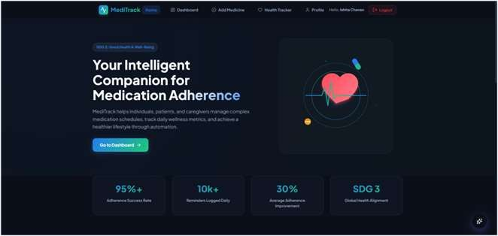
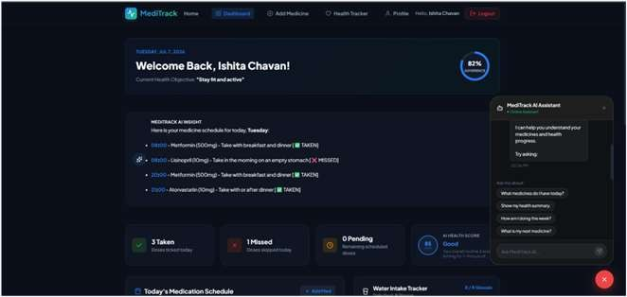
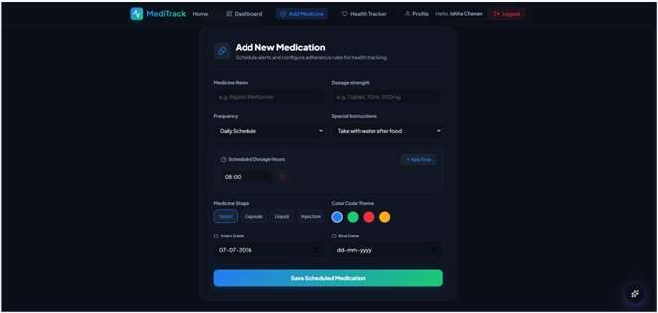
VISUAL TOUR - CLIENT INTERFACES
Screenshots: Home Page, Dashboard, and Add Medicine Page
1. Home Page / Welcome Portal
2. Main User Dashboard
3. Add Medication Scheduler
Landing view highlighting SDG 3 wellness objectives, core statistics, and links.
Central hub showcasing today's reminders list, habit tracking dials, and AI Health Score.
Configuration form building medicine names, dosages, durations, shapes, and colors.

Slide 13




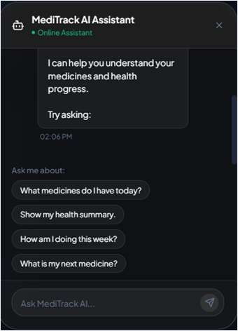
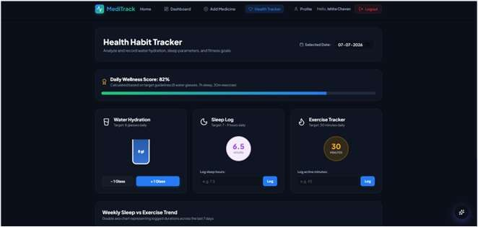
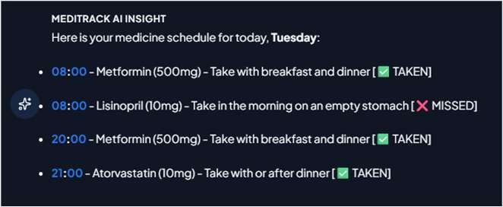
VISUAL TOUR - AI & ANALYTICAL METRICS
Screenshots: Habit Tracker, Chat Widget, and Insight Banner
4. Health Habit Tracker
5. Chat Widget Panel
6. AI Insight Banner
Logs history panels, dynamic progress bar indicators, and empty-state warning boxes.
Top Alert banner showing cached conversational summaries with highlighted statistic values.
Floating drawer displaying sequenced loaders, dynamic chat headers, and suggestion chips.

Slide 14
FUTURE SCOPE
Proposed technical scaling directions
OCR Prescription Scanner
Integrate camera inputs allowing patients to scan physical pill packages or doctor sheets, auto-filling name and dosing guidelines.
IoT Smartwatch Metric Syncing
Connect directly with smartwatch APIs (Apple Health, Garmin, Fitbit) to automate water intake, physical active minutes, and sleep hours logging.
SMS & Voice Assistant Portals
Build Alexa / Google Home voice query capabilities and automated SMS cellular text notifications for offline pill reminder alerts.
Unified Doctor / Clinical Dashboard
Establish doctor-authorized logins letting physicians monitor adherence charts, health scores, and summaries in real-time.

Slide 15
THANK YOU
Fusing cloud databases and intelligence models to advance UN SDG 3 health compliance.
GitHub Repository: https://github.com/meditrack/meditrack-capstone

