Slide 1


ISL INTO TEXT

Slide 2
OVERVIEW
  Abstract
  Result
  Introduction
  Overall Analysis
  Problem
  Future work
  Architecture
  Conclusion

Slide 3
ABSTRACT
This project presents an Indian Sign Language (ISL) recognition system that converts static hand-gesture images into text using a deep learning model. A pretrained ResNet-18 architecture was fine-tuned on the ISL alphabet dataset after applying standardized preprocessing. The system allows users to upload an image, processes it through the trained model, and predicts the corresponding ISL alphabet with high accuracy. The solution is simple, efficient, and demonstrates strong potential for improving communication accessibility, with scope for future expansion to dynamic gestures and larger vocabularies.

Slide 4
INTRODUCTION
  Communication is difficult for people using Indian Sign Language because many others don’t understand ISL.
  There is a need for a tool that recognizes ISL hand gestures and converts them into readable text to reduce this communication gap.
  The project aims to create a simple, accessible system that identifies static ISL gestures from images and translates them into text.
  It is useful for hearing-impaired individuals, ISL learners, educators, and anyone who needs quick ISL-to-text support.

Slide 5
PROBLEM AND OBJECTIVE
Problem Statement:
  People who use Indian Sign Language often struggle to communicate with individuals who are unfamiliar with it. This leads to frequent misunderstandings and creates barriers in daily interactions, making it difficult for them to fully participate in routine activities.
Objective / Solution:
  The objective of this project is to develop a simple, accessible system that can recognize static ISL hand gestures from images and convert them into readable text. This solution aims to bridge the communication gap and support smoother, more inclusive interactions between ISL users and non-signers.

Slide 6
ARCHITECTURE USED
  Uses the ISL Alphabet Dataset (A–Z) loaded through Kaggle; images of hand gestures for each alphabet.
  Images are preprocessed using resizing (224×224), normalization, and tensor conversion, then split into training and validation sets.
  A pretrained ResNet-18 model is used with the final layer replaced to classify 26 gesture classes.
  Model is trained with Adam optimizer and CrossEntropyLoss, performing forward pass, loss calculation, backpropagation, and updates each epoch.
  Performance is evaluated using validation accuracy and loss.
  Final model is deployed with a Gradio interface where users upload an image and receive the predicted gesture with confidence.

Slide 7
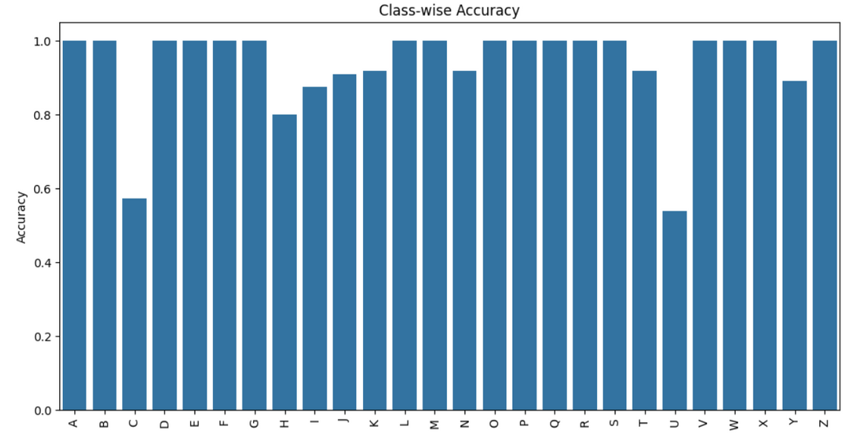
RESULT
  The model achieved 93.84% accuracy, with strong precision, recall, and F1-score across most ISL alphabet classes.
  Most predictions were correct, shown by a clear diagonal in the confusion matrix.
  High-performing signs included A, B, D, E, F, G, L, R, S, V, X, Z with near-perfect accuracy.
  Minor misclassifications occurred only in a few visually similar gestures (e.g., C ↔ I, H ↔ G/K, U ↔ P).
  Overall, the system reliably recognizes 26 static ISL gestures and demonstrates strong potential for real-world communication support.

Slide 8
OVERALL ANALYSIS
  Achieved 93.84% accuracy, showing strong overall model performance.
  Precision, recall, and F1-score are well-balanced, indicating consistent predictions.
  Confusion matrix shows a clear diagonal, meaning most signs were classified correctly.
  Several alphabets (A, B, D, E, F, G, L, R, S, V, X, Z) achieved near-perfect accuracy.
  Minor errors occurred only in visually similar gestures like C–I, H–G/K, and U–P.
  Model handles variations in lighting, angles, and backgrounds effectively.
  Shows good generalization on validation data with stable predictions.
  Overall, the system is reliable, accurate, and suitable for real ISL alphabet recognition.

Slide 9
FUTURE WORK
  Expand the Dataset: Add more images for low-performing classes (C, H, I, U) and include diverse lighting, angles, and hand shapes.
  Use Advanced Models: Explore Vision Transformers (ViT), EfficientNet, or hybrid architectures to improve accuracy.
  Real-Time Video Recognition: Extend from static image classification to live gesture tracking using OpenCV or MediaPipe.
  Word & Sentence Recognition: Move beyond alphabets to full ISL words or continuous signing for practical communication.
  Mobile/Web Deployment: Convert the model to ONNX or TensorFlow Lite for fast, real-time use on smartphones and browsers.

Slide 10
CONCLUSION
  The project successfully built an effective ISL alphabet recognition system using a pretrained ResNet-18 model.
  With an overall accuracy of 93.84%, the model reliably identifies 26 static hand gestures and shows strong general performance across most classes.
  Minor errors occurred only in visually similar gestures, but overall predictions were stable and consistent.
  The system demonstrates that deep learning–based approaches can significantly support communication for individuals using Indian Sign Language.
  The end-to-end workflow—from data preprocessing to deployment via Gradio—proves the model’s readiness for real-world use and further expansion.

Slide 11
Thank You
For your attention

