Slide 1
From Regression to Learning the Underlying Trajectory: Forecasting the Homelessness
Ishita Khanna

Slide 2
Motivation
Add some bullet points to why do we consider this problem? Etc etc.
Refer [1], [2] and [3].
[1] United Nations Commission for Social Development. Affordable housing and social protection systems for all to address homelessness. Report of the Secretary-General. E/CN.5/2020/3. New York: United Nations Commission for Social Development; 2019 Nov 27 [cited 2020 May 10]. Available from: https://undocs.org/en/E/CN.5/2020/3.
[2] Directorate of Employment, Labour and Social Affairs. HC3.1 Homeless population. Paris: Organisation for Economic Co-operation and Development; 2020 [cited 2020 May 3]. Available from: https://www.oecd.org/els/family/HC3-1-Homeless-population.pdf.
[3] Tsai J. Lifetime and 1-year prevalence of homelessness in the US population: results from the National Epidemiologic Survey on Alcohol and Related Conditions-III. J Public Health (Oxf). 2018;40(1):65–74. pmid:28335013

Slide 3
Preliminaries
Traditional Approaches: Regression-based Analysis
Given, at time step $t$
$y_{t}=\text{Target variable}$ (Add based on your dataset)
$x_{1,t},⋯,x_{n,t}=\text{Indepedent variable}$ (such as economic factors, states, etc). (Can be updated based on your dataset)
Then, a simple multi-regression model can be given using
$\begin{matrix}y & =β_{0}+β_{1}x_{1}+β_{2}x_{2}+…+β_{n}x_{n}+ϵ\end{matrix}$,
where,
$β_{0}$ is the intercept, while $β_{1},⋯,β_{n}$ are the coefficient parameters, $ϵ$ is the error terms.
[4] Gutwinski, S., Schreiter, S., Deutscher, K. and Fazel, S., 2021. The prevalence of mental disorders among homeless people in high-income countries: An updated systematic review and meta-regression analysis. PLoS medicine, 18(8), p.e1003750.

Slide 4
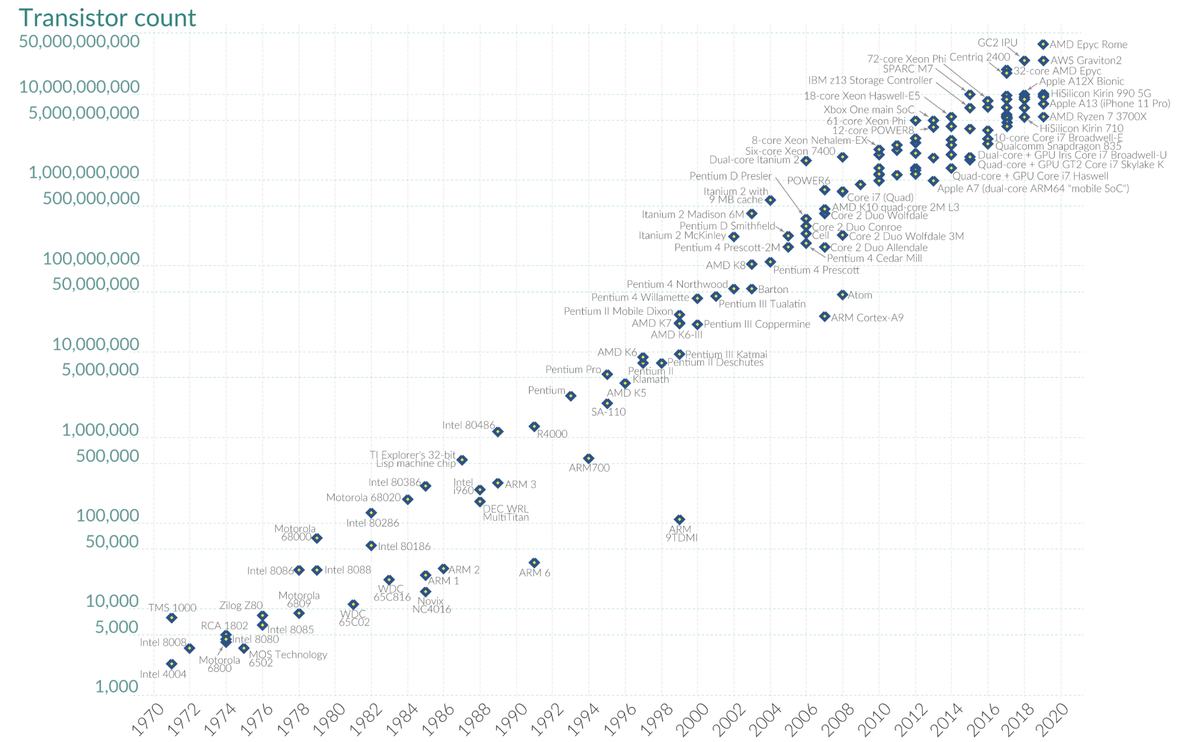
The success of Deep Learning
Limitations to a Regression-based Analysis
Assumptions about Data- Linearity, Homoscedasticity, Normality & Independence assumption.
Poor Modelling - Regression analysis often ignores the temporal nature of the data while only focusing on $y_{t}=f(x_{1,t},⋯,x_{n,t})$ rather than
$y_{t}=g(y_{t-1},⋯,y_{0})+f(x_{1,t},⋯,x_{n,t})$, where the first term captures the temporal property.
With the surge in computational capabilities and access to abundant data, neural networks emerged as the state-of-the-art for prediction tasks.
Complicated neural network architectures such as Recurrent Neural Networks (RNNs) were proposed for the time-series predictions.

Slide 5
Preliminaries
Traditional Approaches: RNNs for forecasting
The hidden state $h_{t}$ at time step $t$ is given as
$$\begin{matrix}\text{State Update:} & \\ h_{t} & =σ(W_{hh}⋅h_{t-1}+W_{xh}⋅x_{t}+b_{h}), \\ \text{Where:} & \\ & σ(⋅)\text{is a non-linear activation function} \\ & W_{hh}\text{is the weight matrix for the previous hidden state.} \\ & W_{xh}\text{is the weight matrix for the current input.} \\ & b_{h}\text{is the bias.}\end{matrix}$$
Then, the predictions can be now be given as
$\begin{matrix}\text{Output at time}t: & \\ y_{t} & =W_{hy}⋅h_{t}+b_{y}\text{Where:} \\ & W_{hy}\text{is the weight matrix connecting the hidden state to the output.} \\ & b_{y}\text{is the output bias.}\end{matrix}$
For training, we simply use the loss function as to backpropogate
$$L_{mse}=\overset{T}{\underset{t=0}{∑}}||y_{t}-{\overset{̂}{y}}_{t}||$$

Slide 6
Downfalls of the traditional approaches
While traditional methodologies that predict $y$ based on $x$ have shown significant efficacy, they come with inherent challenges in practical applications (where data is collected):
Over-reliance on $x$ Variables: A heavy dependence on predictor variables can sometimes overshadow the intrinsic properties of the target variable $y$.
Data Incompleteness: The presence of missing data can introduce biases and reduce the robustness of the predictions.
Absence of Correlation: In some instances, the predictors $x$ might not have a meaningful or strong relationship with the target variable $y$, leading to weak predictive power.

Slide 7
Learning the underlying trajectory
Koopman Theory
The discrete mapping between the target variable $y$ can be represented as:
$y_{t+1}=F(y_{t})$,
where $F(⋅)$ is a non-linear function mapping which is usually unknown.
Lifting operation to represent in linear space using an observable function $φ(⋅)$, which gives
$z_{t}=φ(y_{t})∈R^{k}$, where $k$ can be infinite dimensional long.
The mapping, now can be given using a linear operation,
$z_{t+1}=Kz_{t}$, where $K$ is the Koopman Operator.
Finally, we have
${\overset{̂}{y}}_{t+1}=φ^{-1}(Kφ(y_{t}))$ which represents a one step prediction.
We can exploit the property of the linearity to make $T$ time step predictions by sampling multiplying the $K$ matrix $T$ times.
$$\begin{aligned}{\overset{̂}{y}}_{t+1}=φ^{-1}(Kφ(y_{t})) \\ {\overset{̂}{y}}_{t+2}=φ^{-1}(K^{2}φ(y_{t})) \\ ⋮ \\ {\overset{̂}{y}}_{t+T}=φ^{-1}(K^{T}φ(y_{t}))\end{aligned}$$
B.O. Koopman (1931)
“It is possible to represent a nonlinear dynamical system in terms of an infinite-dimensional linear operator”

Slide 8
Approximating the Koopman Operator
Neural Network approach
We do not discuss the previously proposed approaches such as Dynamic Mode Decomposition (DMD) or Extended DMD (EDMD) and rather focus on the state-of-the-art approach for learning the Koopman Operator.
$$y_{t}$$
$${\text{z}}_{t}$$
$${\text{z}}_{t+1}$$
$${\overset{̂}{y}}_{t+1}$$
ENCODER $φ$
$$\text{K}$$
DECODER $φ^{-1}$
The Koopman Autoencoder (KAE).
Encoder $φ$ and Decoder $φ^{-1}$are blocks of fully connected layers.
$\text{K}$ is a fully connected layer without bias or non-linear activations.

Slide 9
Training the KAE
Training the KAE considers the following loss functions
$$L_{rec}=\overset{T}{\underset{t=1}{∑}}{||y_{t}-{\overset{̂}{y}}_{t}||}_{2}^{2}$$
$L_{linear}=\overset{τ}{\underset{t=1}{∑}}{||z_{t}-K^{t}z_{1}||}_{2}^{2}$, where we enforce linearity over $τ$ time steps.
$L_{pred}=\overset{S_{p}}{\underset{t=1}{∑}}{||φ^{-1}(z_{t+S_{p}})-φ^{-1}(K^{S_{p}}z_{t})||}_{2}^{2}$, $S_{p}$ determines the prediction window.
The total loss function is written as a weighted sum of the
$L_{KAE}=α_{1}L_{rec}+α_{2}L_{pred}+α_{3}L_{linear}$

Slide 10
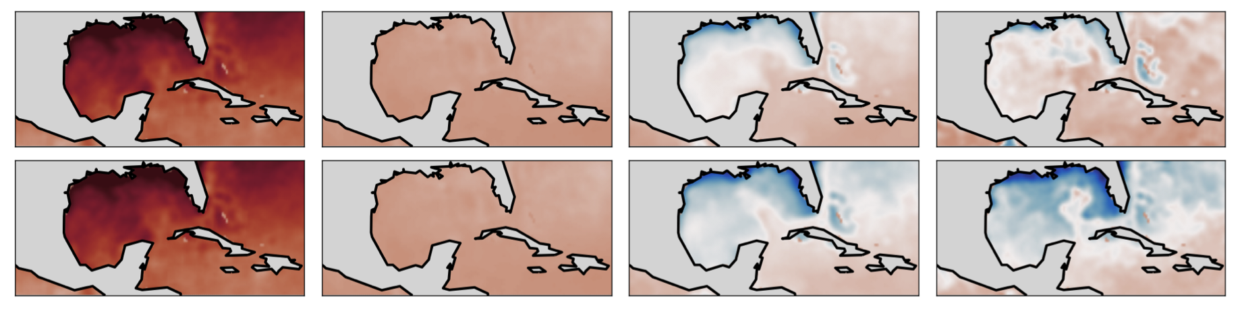
Interesting use-cases
Initial Day 0
Ground Truth at Day 175
Prediction at Day 175
Predictions were made using Consistent KAE (CKAE), where modifications were made to the original KAE.
Predicting SEA surface levels.

Slide 11
Simulation using a circular slow-manifold dataset
$$\begin{matrix}x(t) & =r(t)cos\left(2π\frac{tmod50}{50}\right) \\ y(t) & =r(t)sin\left(2π\frac{tmod50}{50}\right),\text{where} \\ r(t) & =1+0.5sin\left(\frac{2πt}{T}\right)\end{matrix}$$

