Slide 1


From Regression to Learning the Underlying Trajectory: Forecasting the Homelessness
Ishita Khanna
11 October 2023

Slide 2
Motivation
Predicting homelessness allow us to focus on prevention rather than reaction.
With limited resources available for social services and housing programs, it's crucial to allocate resources efficiently.
Addressing homelessness contributes to the stability of the housing market and reduces the economic burden on healthcare, emergency services, and the criminal justice system.
Understanding and addressing homelessness can position the UK as a global leader in social policy and serve as a model for other nations facing similar challenges.
The motivation is to improve the lives of individuals and families, ensuring they have the opportunity for stable housing, better health, education, and employment prospects.
Refer [1], [2] and [3].
United Nations Commission for Social Development. Affordable housing and social protection systems for all to address homelessness. Report of the Secretary-General. E/CN.5/2020/3. New York: United Nations Commission for Social Development; 2019 Nov 27 [cited 2020 May 10]. Available from: https://undocs.org/en/E/CN.5/2020/3.
Directorate of Employment, Labour and Social Affairs. HC3.1 Homeless population. Paris: Organisation for Economic Co-operation and Development; 2020 [cited 2020 May 3]. Available from: https://www.oecd.org/els/family/HC3-1-Homeless-population.pdf.
Tsai J. Lifetime and 1-year prevalence of homelessness in the US population: results from the National Epidemiologic Survey on Alcohol and Related Conditions-III. J Public Health (Oxf). 2018;40(1):65–74. pmid:28335013

Slide 3
Preliminaries
Traditional Approaches: Regression-based Analysis
Given, at time step (i.e. year)
Y represents the “Homeless Decisions"
X₁ represents the “Year”
X₂ represents factors such as “Local Authority Regions”.
Then, a simple multi-regression model can be given using
Y = 𝛽₀ + 𝛽₁X₁ + 𝛽₂X₂ + 𝜀
where,
𝛽₀ is the intercept, while 𝛽₁ and 𝛽₂ are the coefficient parameters, 𝜀 is the error terms.
[4] Gutwinski, S., Schreiter, S., Deutscher, K. and Fazel, S., 2021. The prevalence of mental disorders among homeless people in high-income countries: An updated systematic review and meta-regression analysis. PLoS medicine, 18(8), p.e1003750.

Slide 4
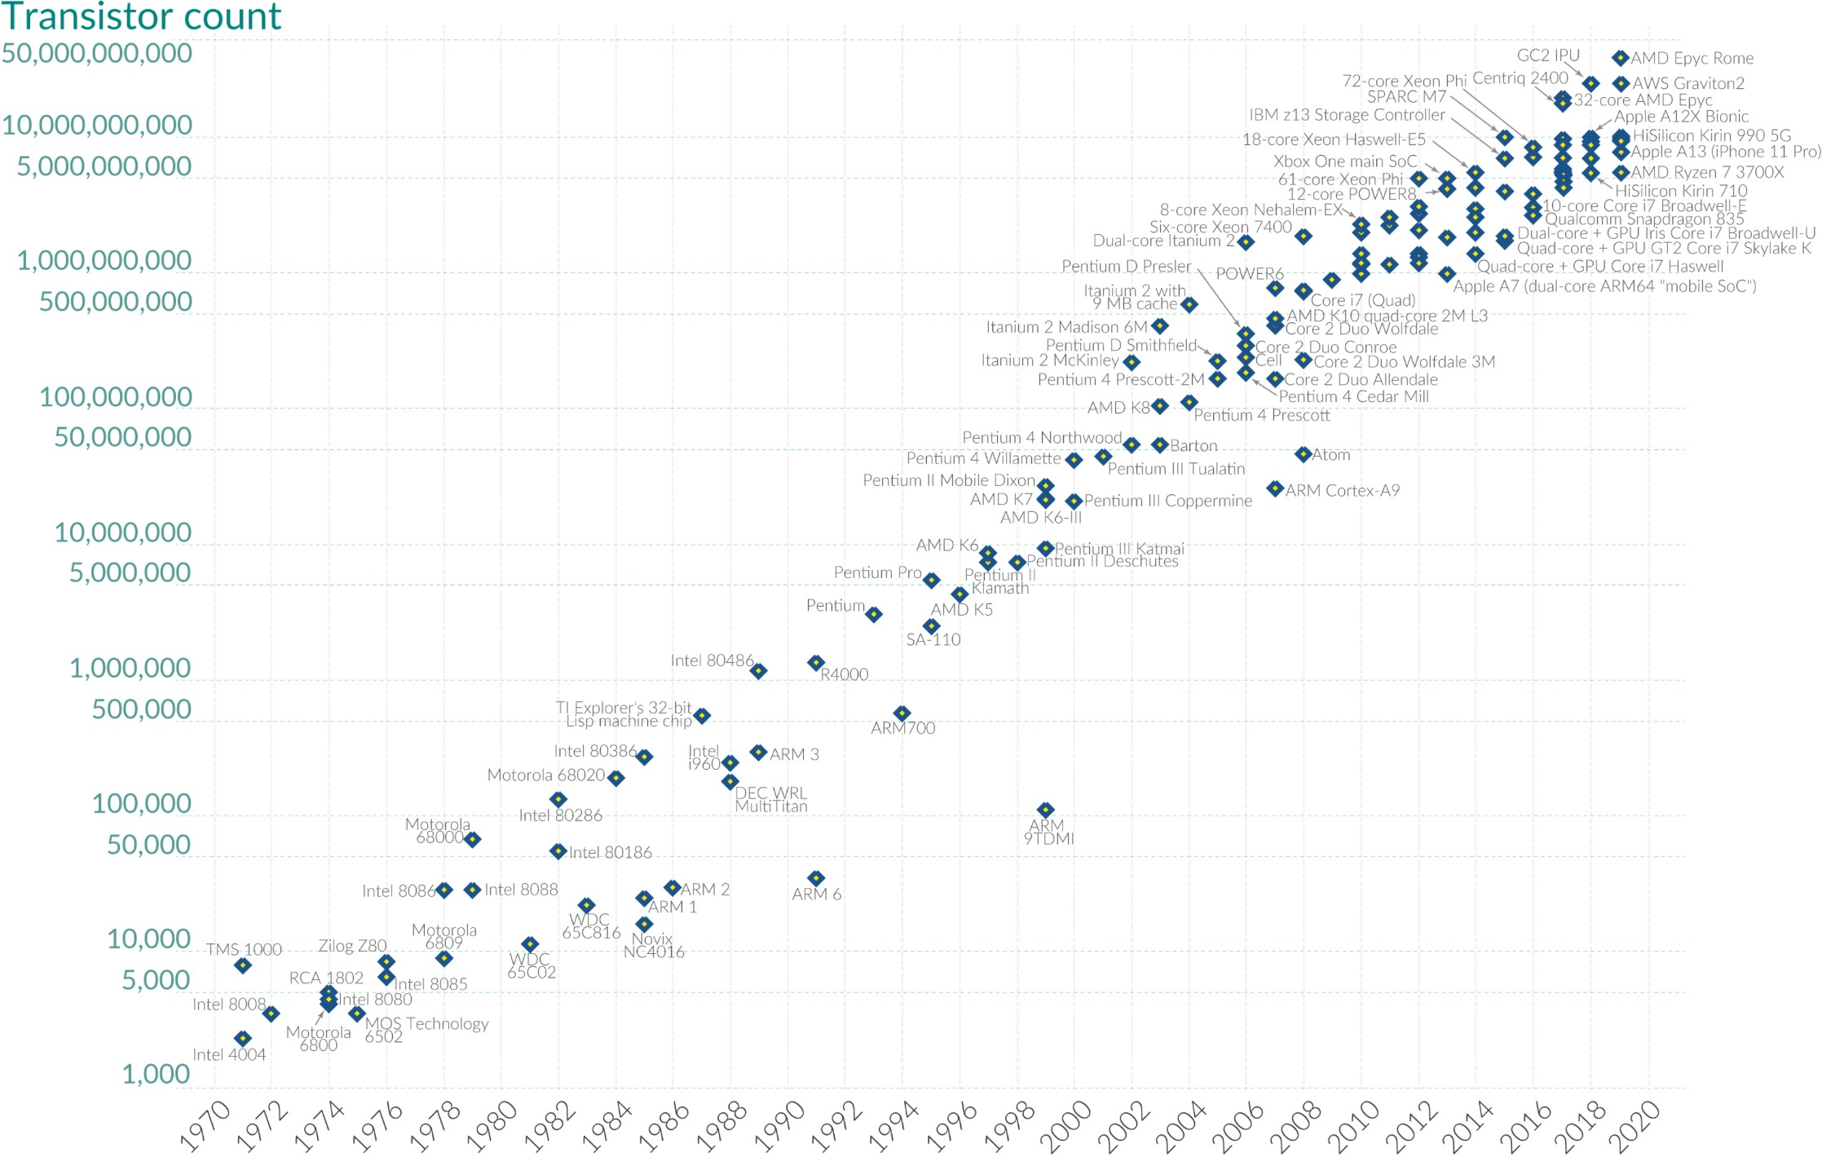
Limitations to a Regression- based Analysis
Assumptions about Data- Linearity, Homoscedasticity, Normality & Independence assumption.
Poor Modelling - Regression analysis often ignores the temporal nature of the data while only focusing on y_{t} = f(x_{1,t}, ⋯, x_{n,t}) rather than
y_{t} = g(y_{t−1}, ⋯, y₀) + f(x_{1,t}, ⋯, x_{n,t}), where the first term captures the temporal property.
The success of Deep Learning
With the surge in computational capabilities and access to abundant data, neural networks emerged as the state-of-the-art for prediction tasks.
Complicated neural network architectures such as Recurrent Neural Networks (RNNs) were proposed for the time-series predictions.
Figure 1. The number of transistors on microchips over years
https://en.wikipedia.org/wiki/Moore's_law
4

Slide 5
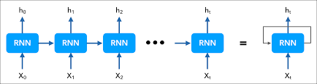
Preliminaries
Traditional Approaches: RNNs for forecasting
The hidden state h_{t} at time step
State Update:
h_{t} = σ(W_{hh} ⋅ h_{t−1} + W_{xh} ⋅ x_{t} + b_{h}),
Where:
σ( ⋅ )is a non-linear activation function
W_{hh} is the weight matrix for the previous hidden state.
W_{xh} is the weight matrix for the current input.
b_{h} is the bias.
Then, the predictions can be now be given as
is given as
Output at time t :
y_{t} = W_{hy} ⋅ h_{t} + b_{y}Where:
W_{hy} is the weight matrix connecting the hidden state to the output.
b_{y} is the output bias.
For training, we simply use the loss function as to backpropogate
T
Figure 2. Architecture of the RNN
ℒ_{mse} = ∑ | | y_{t} − y_{t}̂ | |
t=0
5

Slide 6
Downfalls of the traditional approaches
While traditional methodologies that predict based on have shown significant eﬃcacy, they come with inherent challenges in practical applications (where data is collected):
Over-reliance on Variables: A heavy dependence on predictor variables can sometimes overshadow the intrinsic properties of the target variable .
Data Incompleteness: The presence of missing data can introduce biases and reduce the robustness of the predictions.
Absence of Correlation: In some instances, the predictors might not have a meaningful or strong relationship with the target variable , leading to weak predictive power.
6

Slide 7
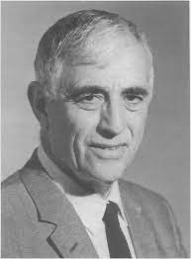
Learning the underlying trajectory
Koopman Theory
The discrete mapping between the target variable
y_{t+1} = F(y_{t}),
can be represented as:
where F( ⋅ )
is a non-linear function mapping which is usually unknown.
Lifting operation to represent in linear space using an observable function φ( ⋅ ), which gives
z_{t} = φ(y_{t}) ∈ ℝ^{k}, where k can be infinite dimensional long.
The mapping, now can be given using a linear operation,
z_{t+1} = Kz_{t}, where
Finally, we have
is the Koopman Operator.
y_{t}̂ ₊₁ = φ⁻¹(Kφ(y_{t})) which represents a one step prediction.
B.O. Koopman (1931)
“It is possible to represent a nonlinear dynamical system in terms of an infinite-dimensional linear operator”
We can exploit the property of the linearity to make time step predictions by sampling multiplying
The matrix times.
y_{t}̂ ₊₁ = φ⁻¹(Kφ(y_{t}))
y_{t}̂ ₊₂ = φ⁻¹(K²φ(y_{t}))
⋮
y_{t}̂ _{+T} = φ⁻¹(K^{T}φ(y_{t}))
•
7

Slide 8
Approximating the Koopman Operator
Neural Network approach
We do not discuss the previously proposed approaches such as Dynamic Mode Decomposition (DMD) or Extended DMD (EDMD) and rather focus on the state-of-the-art approach for learning the Koopman Operator.
y_{t}
z_{t}
K
ENCODER
zt+1
^{y}t̂ +1
DECODER
_{φ}−1
Figure 3. The Koopman Autoencoder (KAE).
Encoder
and Decoder φ⁻¹are blocks of fully connected layers.
K is a fully connected layer without bias or non-linear activations.
Lusch, B., Kutz, J.N. and Brunton, S.L., 2018. Deep learning for universal linear embeddings of nonlinear dynamics. Nature communications, 9(1), p.4950.
8

Slide 9
Training the KAE
Training the KAE considers the following loss functions
T
^{ℒ}rec ⁼
| | y_{t} − y_{t}̂ | | ²
•
∑
2
t=1
τ
^{ℒ}linear ⁼
| |z_{t} − K^{t}z₁ | | ², where we enforce linearity over
time steps.
•
∑
2
t=1 S_{p}
−1
−1
S
2
^{ℒ}pred ⁼
| | φ (z ) − φ
(K z ) | | , S
determines the prediction window.
•
∑
t+S
p
t p
p
2
t=1
The total loss function is written as a weighted sum of the
^{ℒ}KAE ^{= α}1^{ℒ}rec ^{+ α}2^{ℒ}pred ^{+ α}3^{ℒ}linear

Slide 10
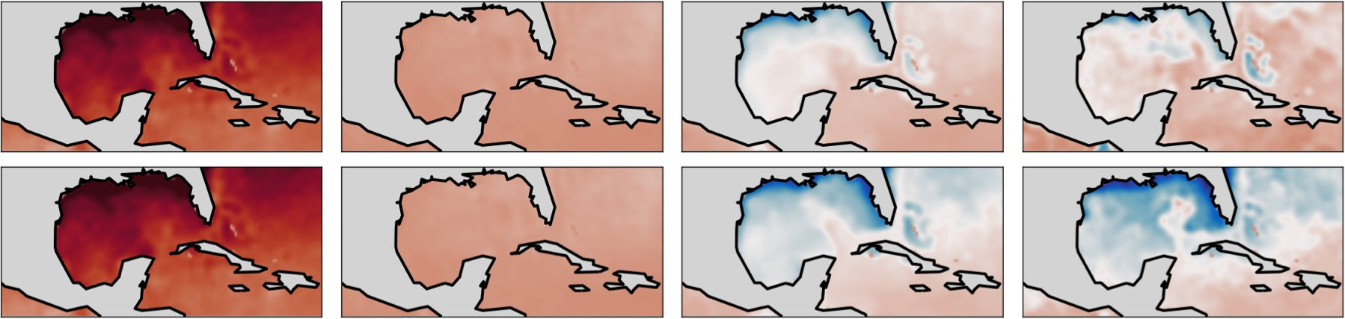
Interesting use-cases
Initial Day 0
Ground Truth at Day 175
Prediction at Day 175
Figure 4. Predicting SEA surface levels.
Predictions were made using Consistent KAE (CKAE), where modifications were made to the original KAE.
Azencot, O., Erichson, N.B., Lin, V. and Mahoney, M., 2020, November. Forecasting sequential data using consistent Koopman autoencoders. In International Conference on Machine Learning (pp. 475-485). PMLR.

Slide 11
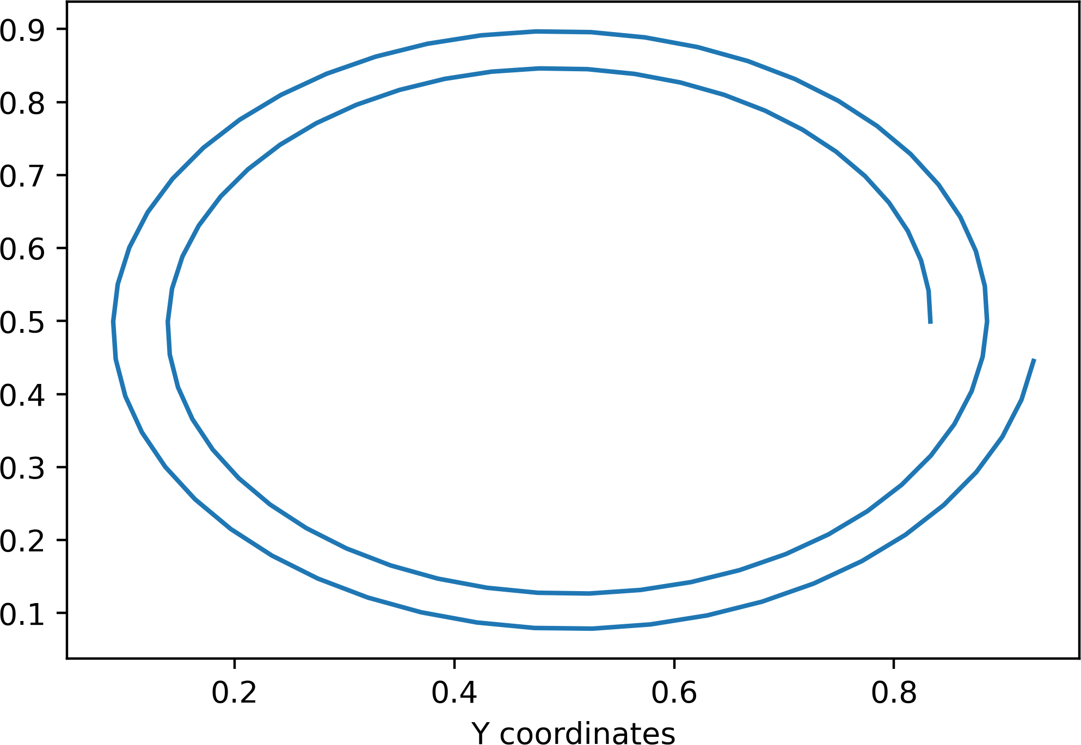
Simulation using a circular slow-manifold dataset
x(t) = r(t)cos
_{2π} t mod 50
(
50
)
_{2π} t mod 50
Y coordinates
y(t) = r(t)sin
(
50
2πt
( T )
)
, where
r(t) = 1 + 0.5 sin
X coordinates
Figure 5. Trajectory depicted over 50 time steps.

Slide 12
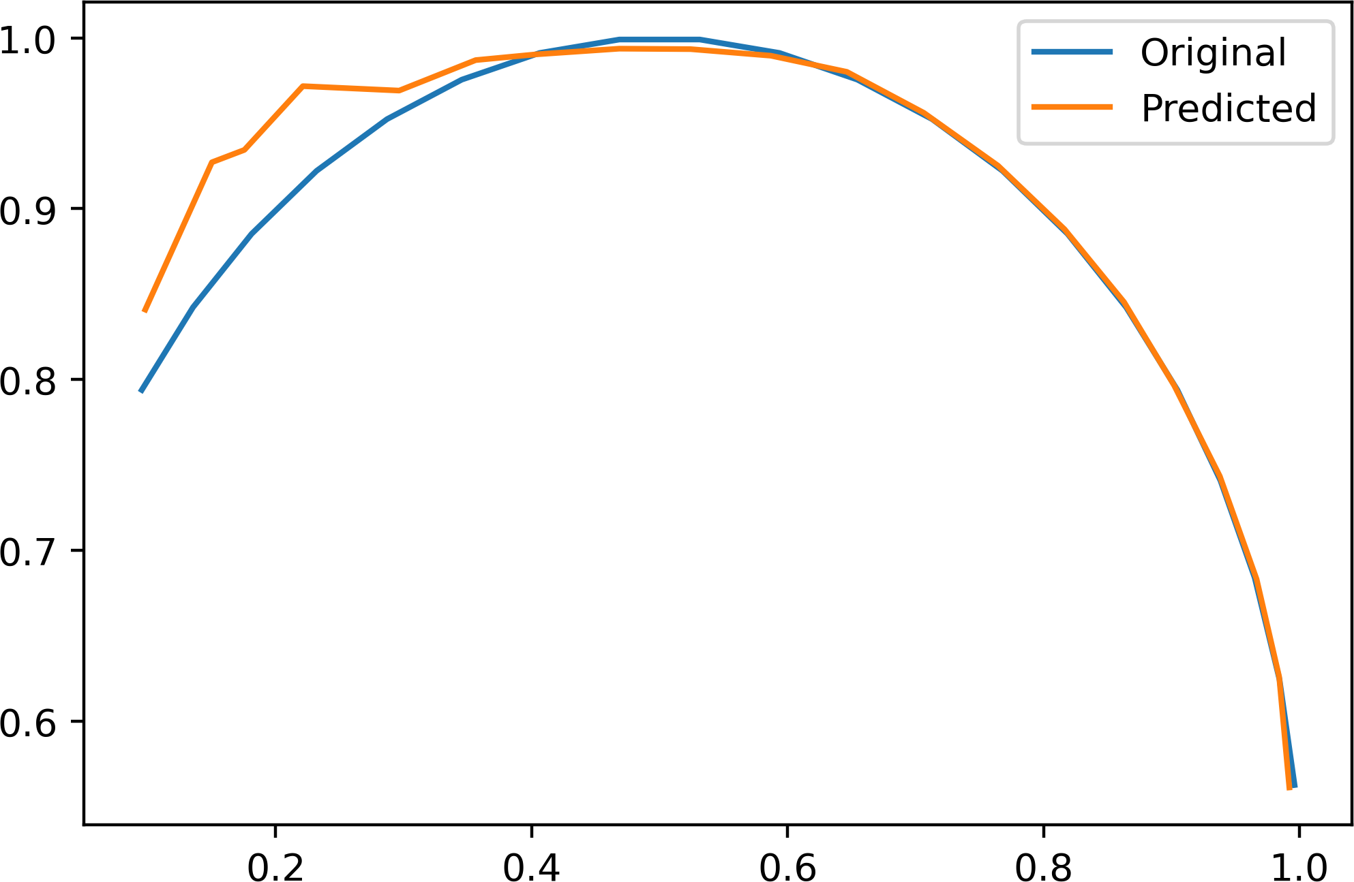
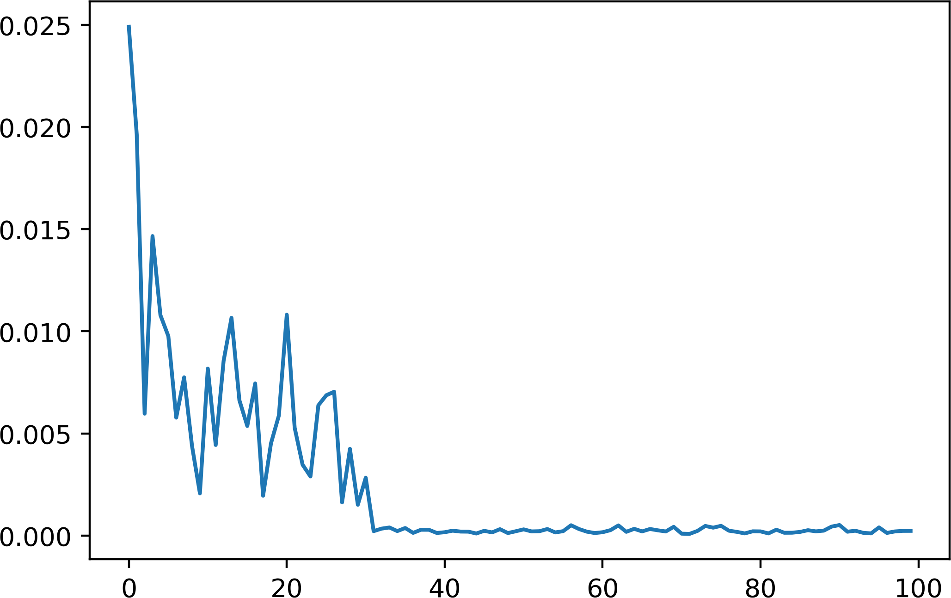
Simulating the trajectory using the KAE
Training performance, τ = 10, S_{p} = 10
Predictions
α , α , α = {1,1,1}
1 2 3
φ⁻¹(K²⁰φ(s₀))
Y coordinates
^{ℒ}KAE
^{s}20
s₀ : (x₀, y₀)
Epochs
X coordinates
Figure 6. Training performance
Figure 7. Ground truth vs Predictions over 20 time steps

