Slide 1
Presentation on Stock Manager
Submitted by -
Vedant Saini
Ishita Kohli

Slide 2
Table of Contents
1.Declaration
2.Company profile
3.Introduction
4.Objectives
5.Advantages
6.Use and Technology
7.Tables and Forms
8.Bibliography

Slide 3
Introduction
Stock Manager is a desktop application that keeps record of a firm that deals in purchasing and selling of products. It helps user to store and access every detail involved in the process of purchase as well as the sale of the product.
In this project the item targeted is books and an application is created for the purchasing, stocking, and selling of books.

Slide 4
Objectives
The main objective of inventory management is to maintain inventory at appropriate level to avoid excessive or shortage of inventory because both the cases are undesirable for business. Thus, management is faced with the following conflicting objectives: 1. To keep inventory at sufficiently high level to perform production and sales activities smoothly. 2. To minimize investment in inventory at minimum level to maximize profitability.
3. To ensure that the supply of raw material & finished goods will remain continuous so that production process is not halted and demands of customers are duly met.

Slide 5
Advantages
Speed and Efficiency
Document Generation
Timely Data
Reliance on Technology
Accuracy Issues
Avoiding Risk of Fraud

Slide 6
Use and Technology
Softwares used in this application are -
Java (Netbeans)
Database(Sql server)

Slide 7
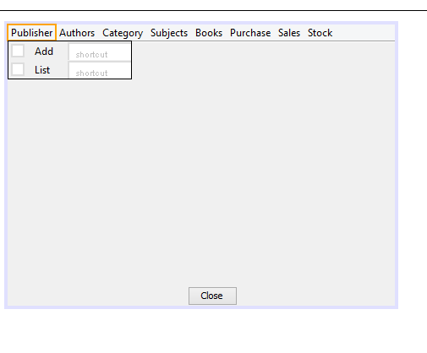
Table and Forms
1. STOCKMANAGER:

Slide 8
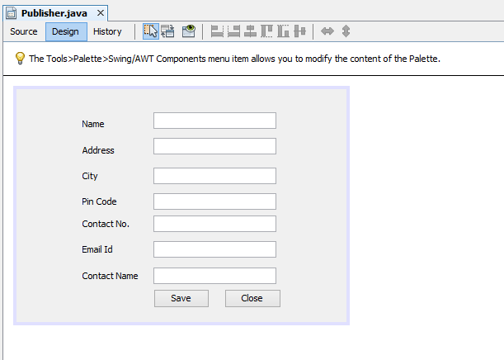
2. PUBLISHERS:

Slide 9
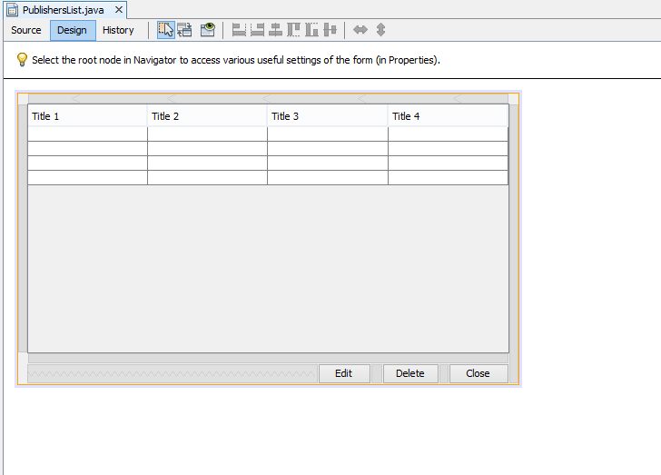
3.Publisher List:

Slide 10
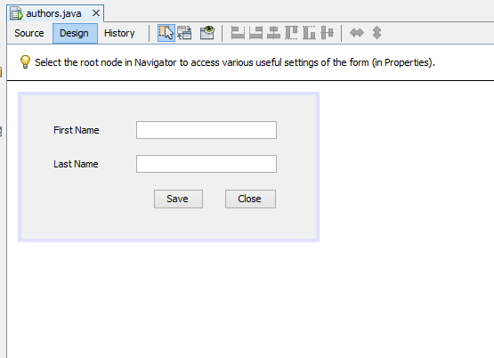
4.Authors:

Slide 11
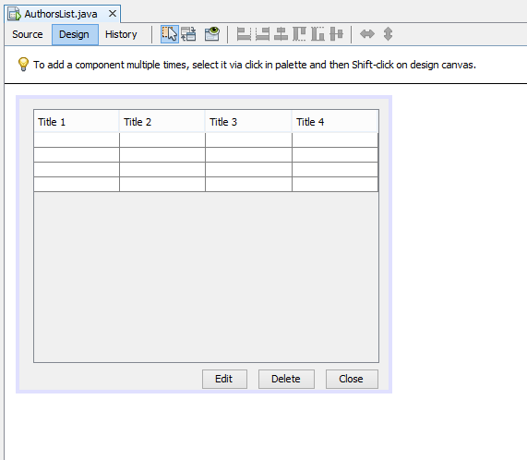
5.Author List:

Slide 12
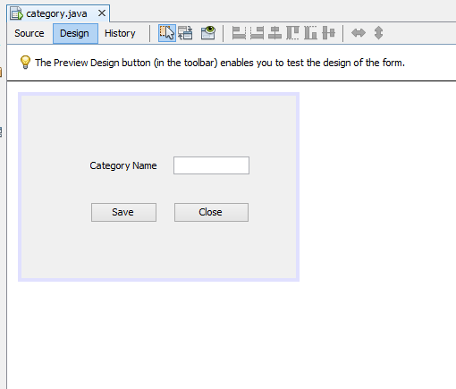
6. Category:

Slide 13
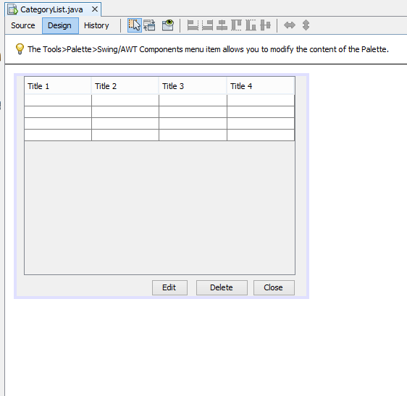
7.Category List:

Slide 14
8. Subjects:

Slide 15
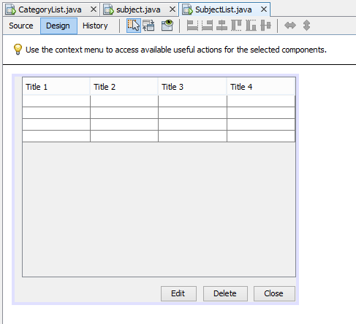
9.Subject List:

Slide 16
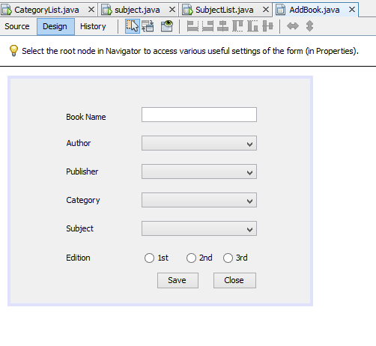
10. Add Books:

Slide 17
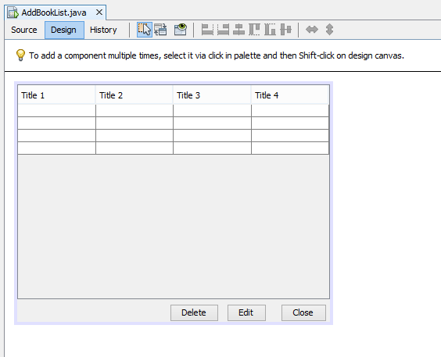
11.Books List-

Slide 18
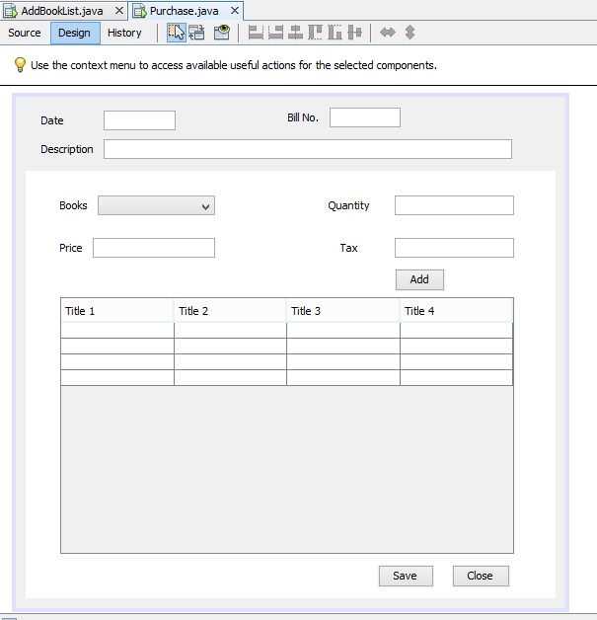
12. Purchases

Slide 19
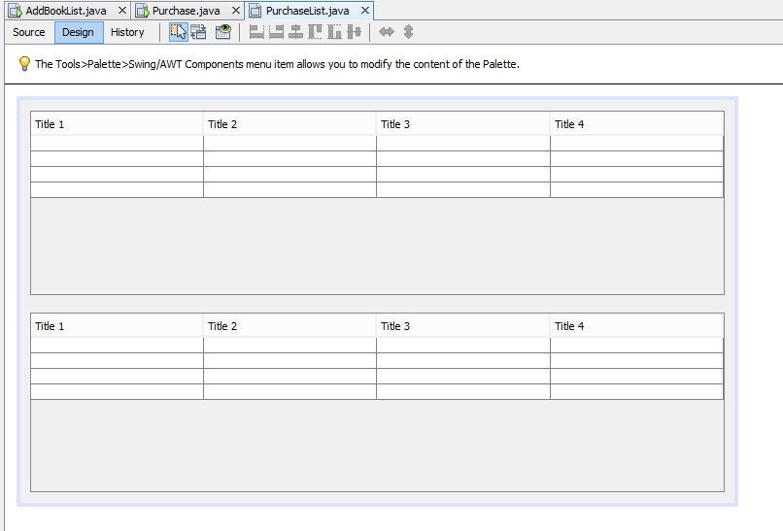
13.Purchase List:

Slide 20
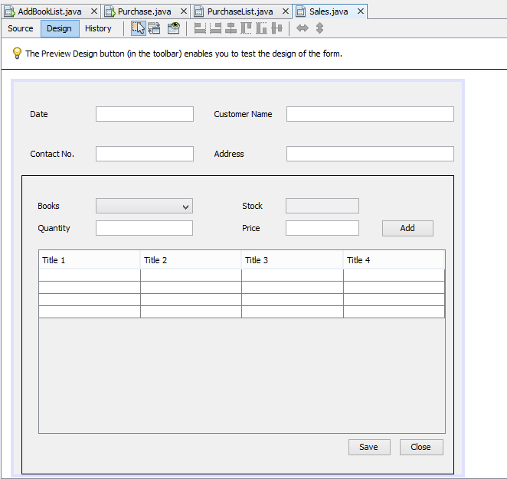
14. Sales:

Slide 21
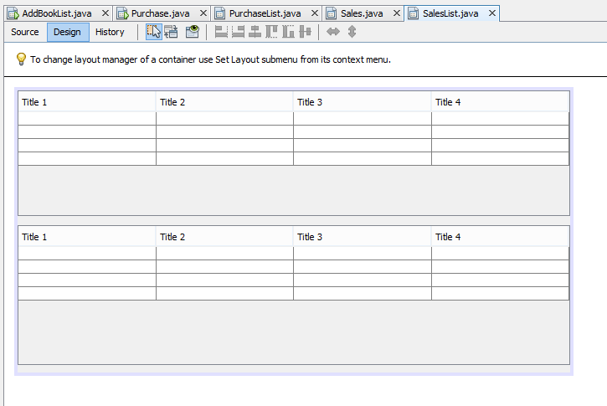
15.Sales List:

Slide 22
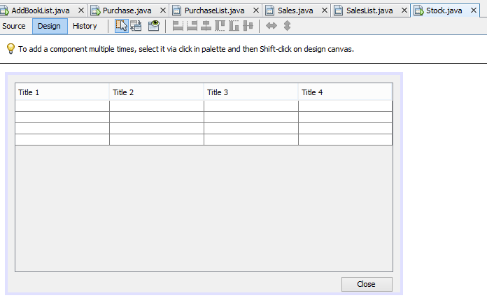
16.Stock:

Slide 23
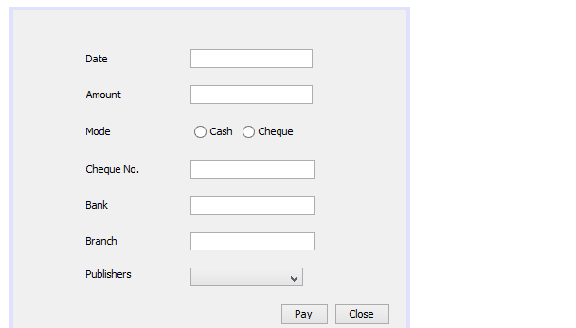
17.payments

Slide 24
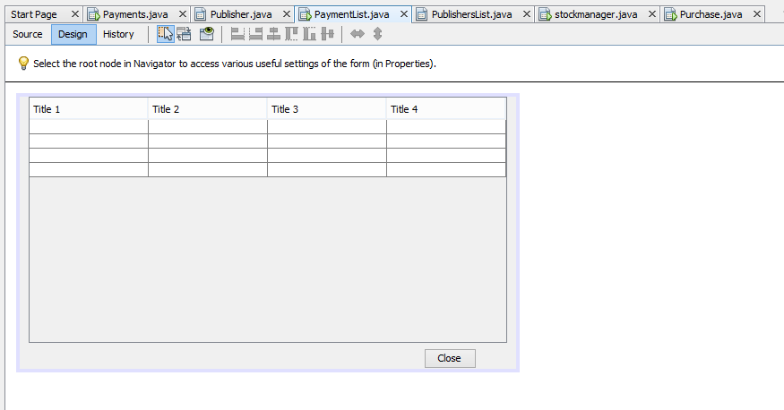
18.Payment Table

Slide 25
Thank You

