Slide 1
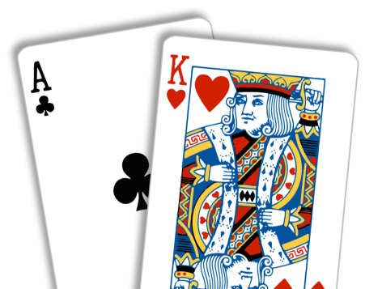
Blackjack With Variations

Slide 2
Aim

Slide 3
Rules
2 People
Dealer
Player

Slide 4
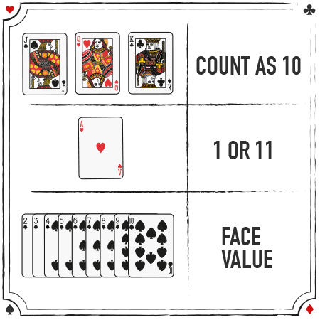
Card Values

Slide 5
Aim is to get the score close to 21 but not above
Best Total 21
Black Jack Rewards (3:2)
2 Cards Blackjack wins over 3 cards blackjack
Meaning – Hit & Stand
Dealers Advantage (Plays after players game is over)

Slide 6
Demo

Slide 7
Assumptions
Player Decision to Stand
Dealer Decision to Stand
No Insurance
No Split
No Double

Slide 8
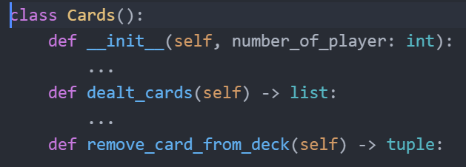
Code Structure

Slide 9
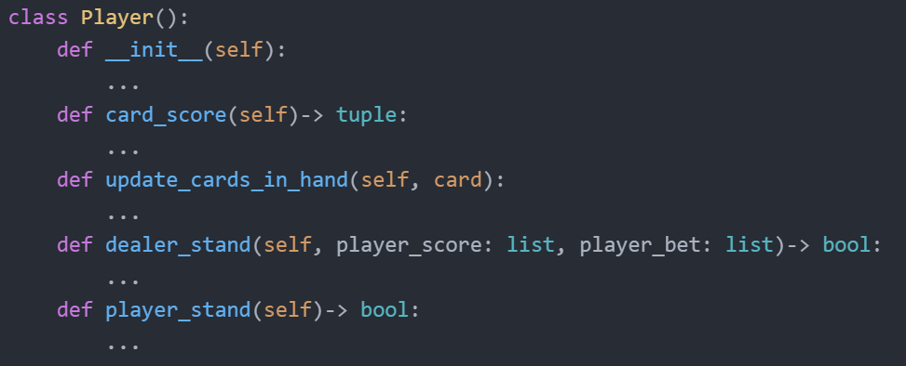

Slide 10
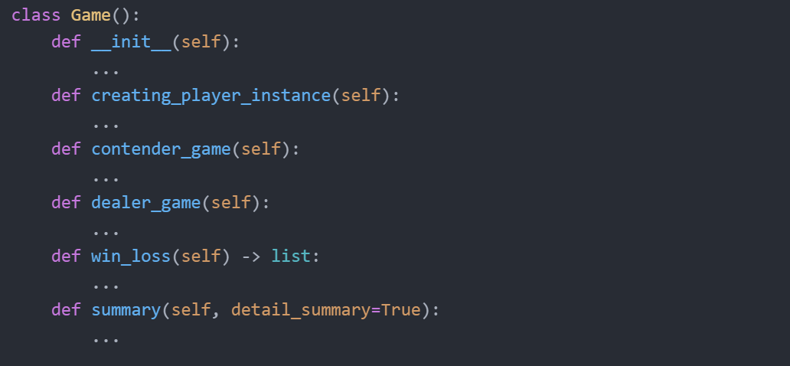

Slide 11
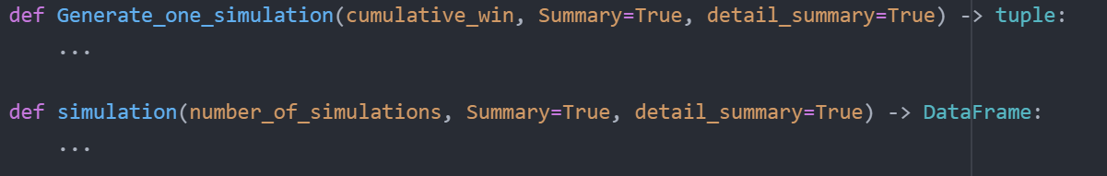

Slide 12
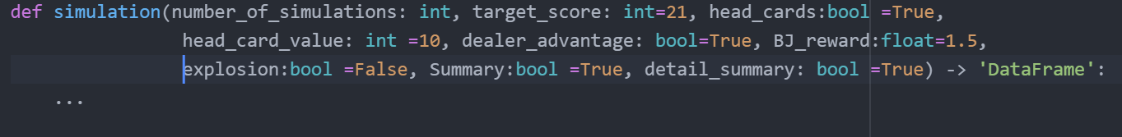
Variations
Variable Target Score
Game Should have Head Cards
Variable Value of Head Cards
Player cards are disclosed at the end of the game
Black Jack Reward
Explosion Card

Slide 13
Hypothesis

Slide 14
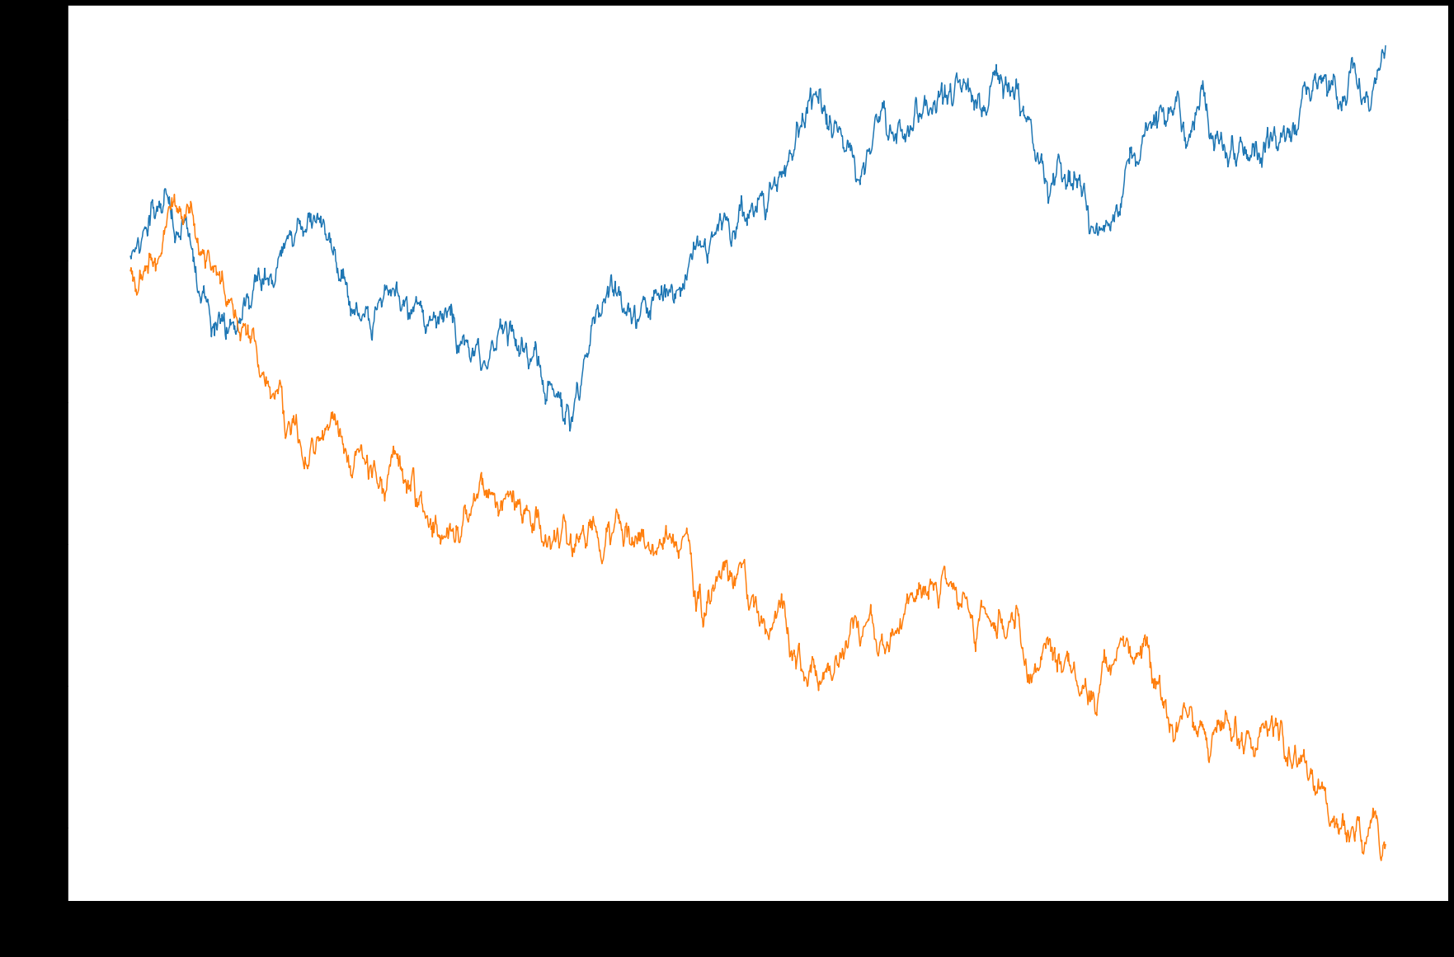
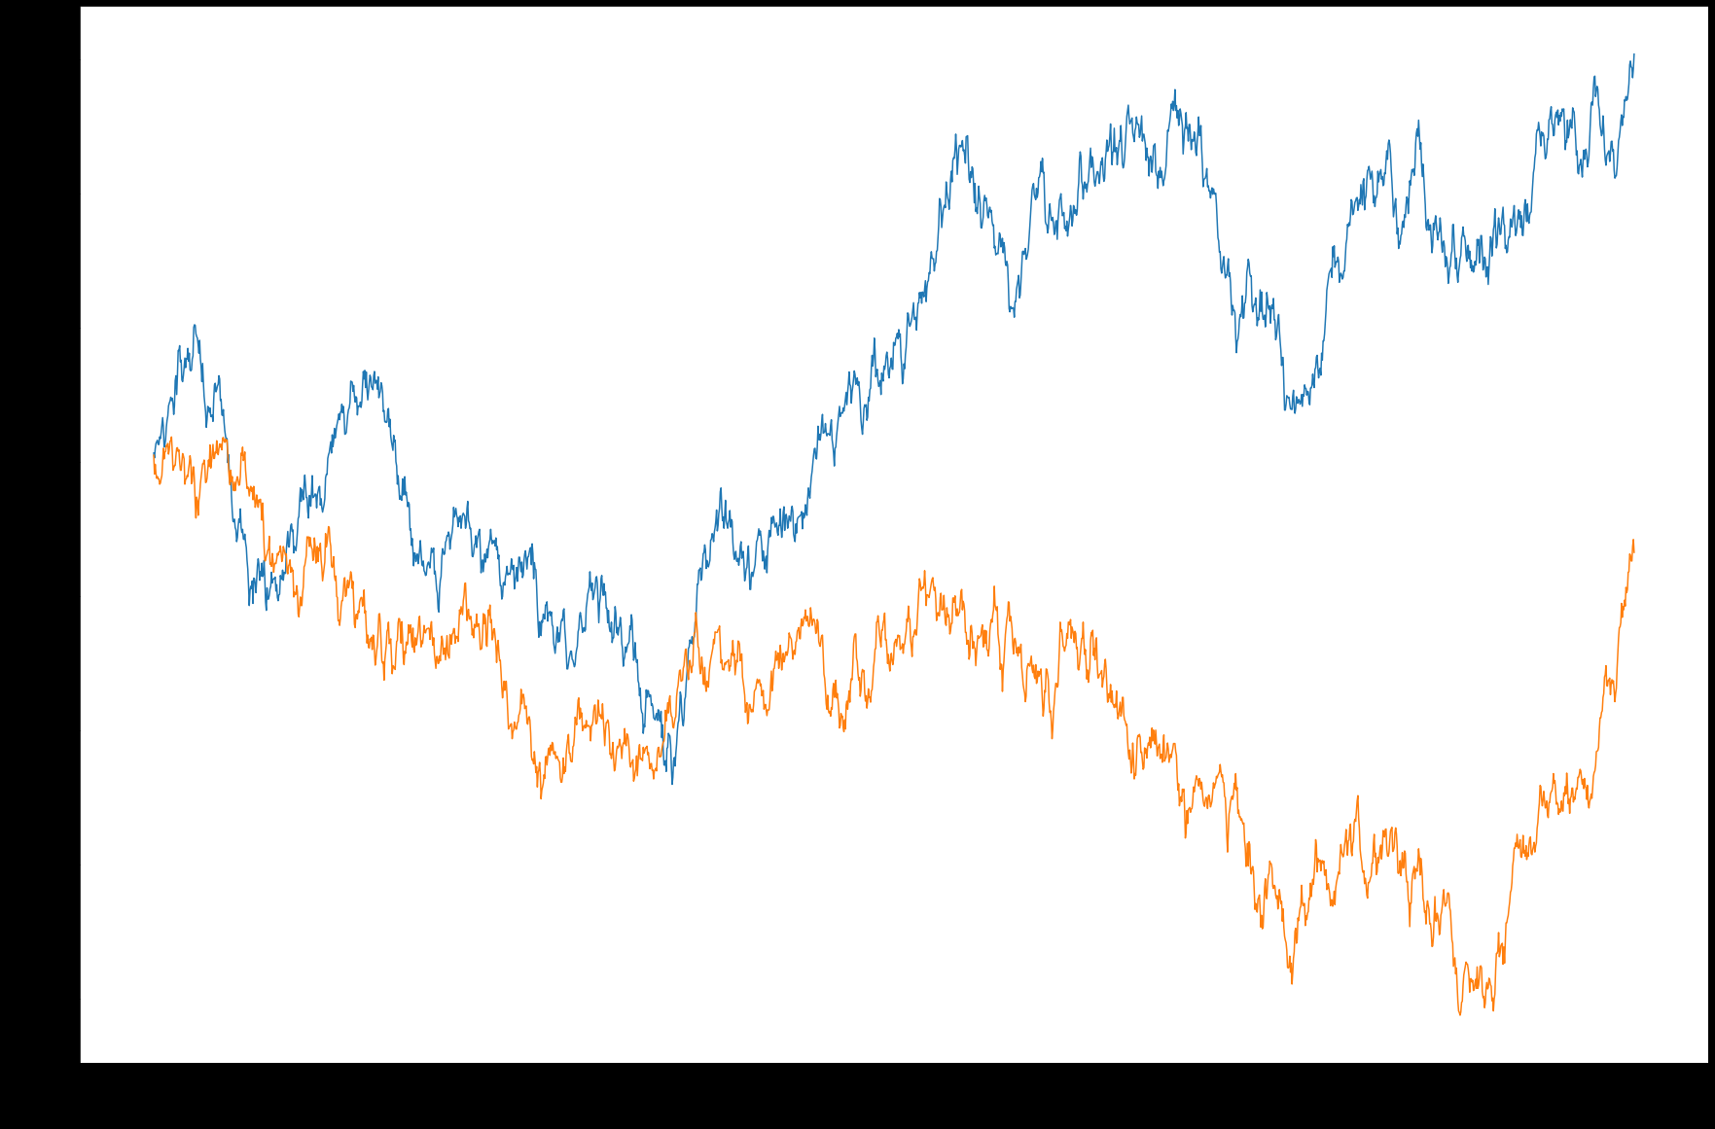

Slide 15
Reference
Images
http://datagenetics.com/blog/march62020/index.html
https://www.888casino.com/blog/blackjack-strategy-guide/how-to-play-blackjack
Content
https://www.youtube.com/watch?v=5bWpnABkU-Y&ab_channel=CrazyVegasOnlineCasino
https://www.247blackjack.com/

