Slide 1
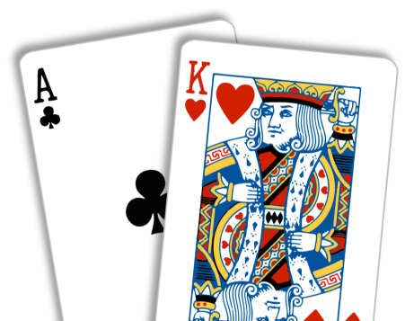
Blackjack With Variations

Slide 2
Aim

Slide 3
Rules
2 People
Score 21
Blackjack Rewards (3:2)
2 Cards Blackjack wins over 3 cards blackjack
Hit & Stand
Dealers Advantage

Slide 4
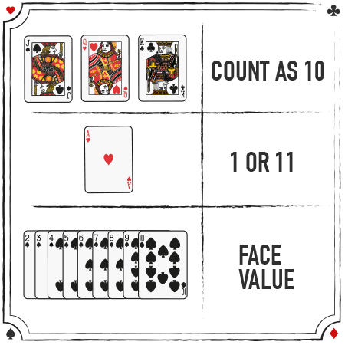
Card Values

Slide 5

Demo

Slide 6
Assumptions
Player Decision to Stand
Dealer Decision to Stand
No Insurance
No Split
No Double

Slide 7
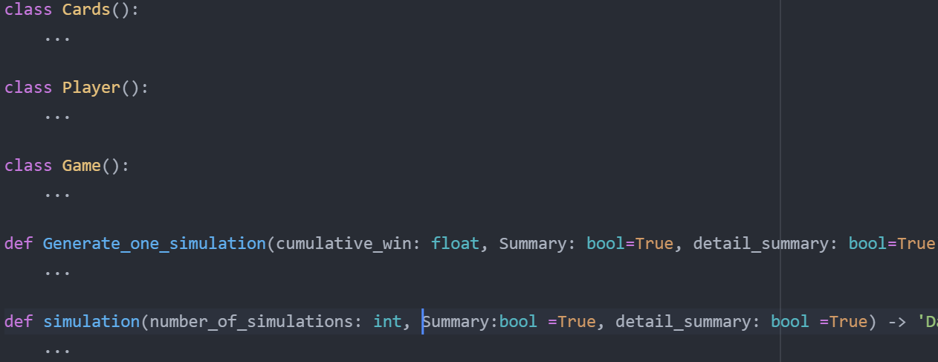
Code Structure

Slide 8
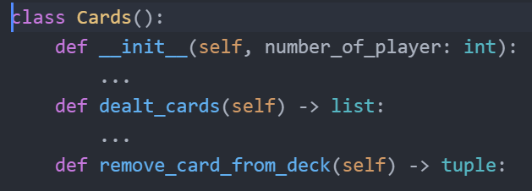

Slide 9
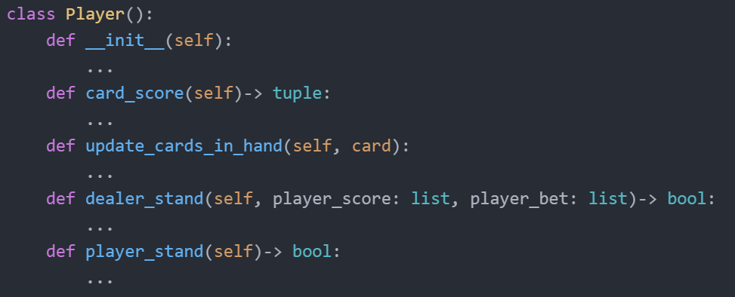

Slide 10
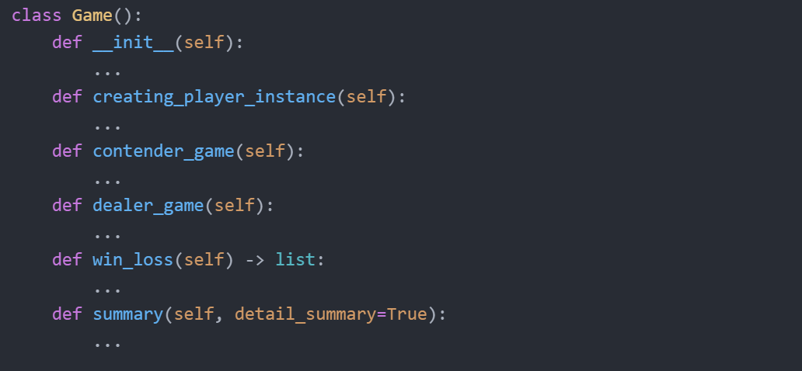

Slide 11
Variations
def simulation(number_of_simulations: int, Summary:bool =True, detail_summary: bool =True) -> 'DataFrame':
Variable Target Score
Game Should have Head Cards
Variable Value of Head Cards
Player cards are disclosed at the end of the game
Blackjack Reward
Explosion Card
def simulation(number_of_simulations: int, target_score: int=21, head_cards:bool =True,
head_card_value: int =10, dealer_advantage: bool=True, BJ_reward:float=1.5,
explosion:bool =False, Summary:bool =True, detail_summary: bool =True) -> 'DataFrame':

Slide 12
Hypothesis

Slide 13
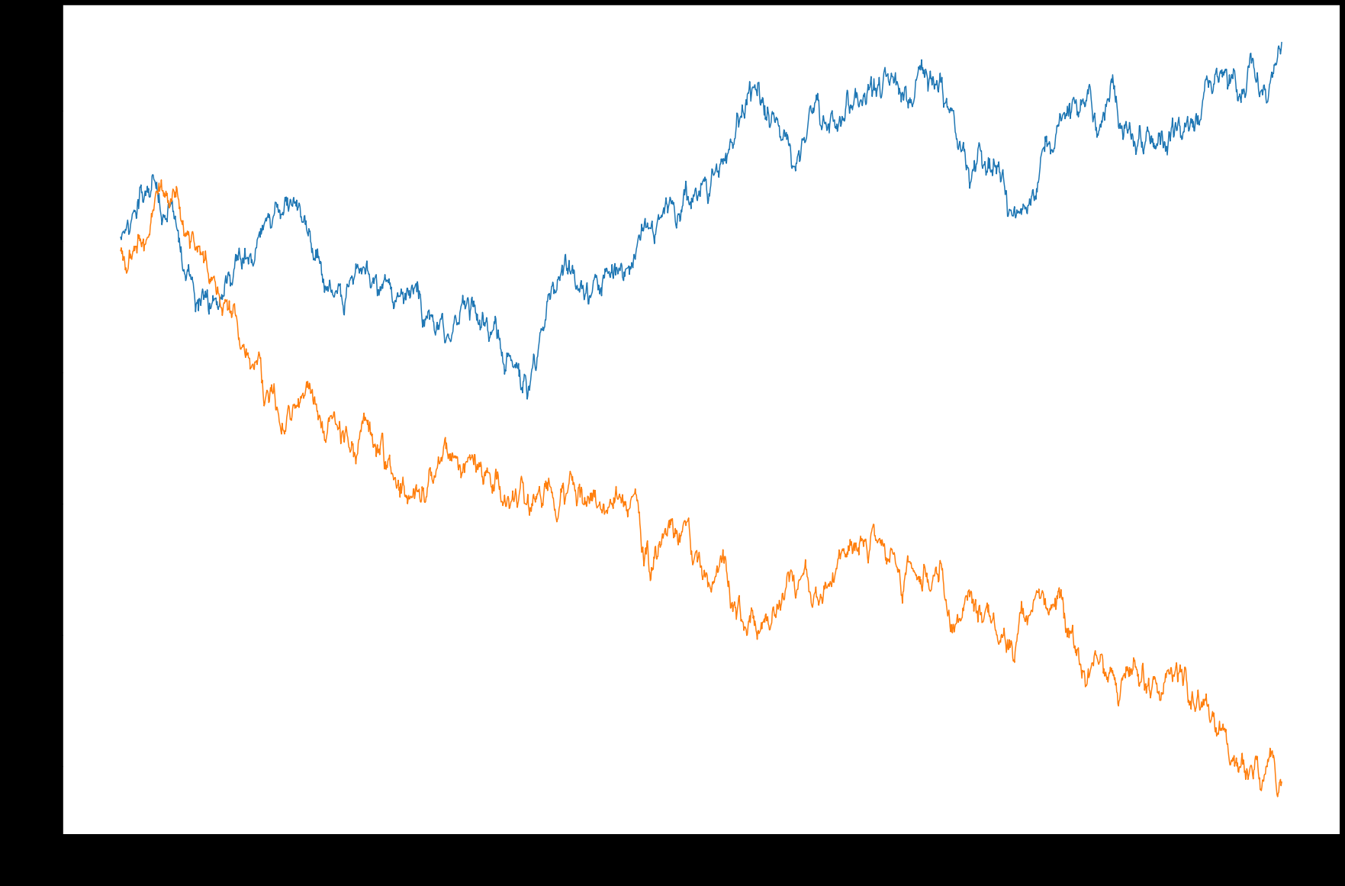
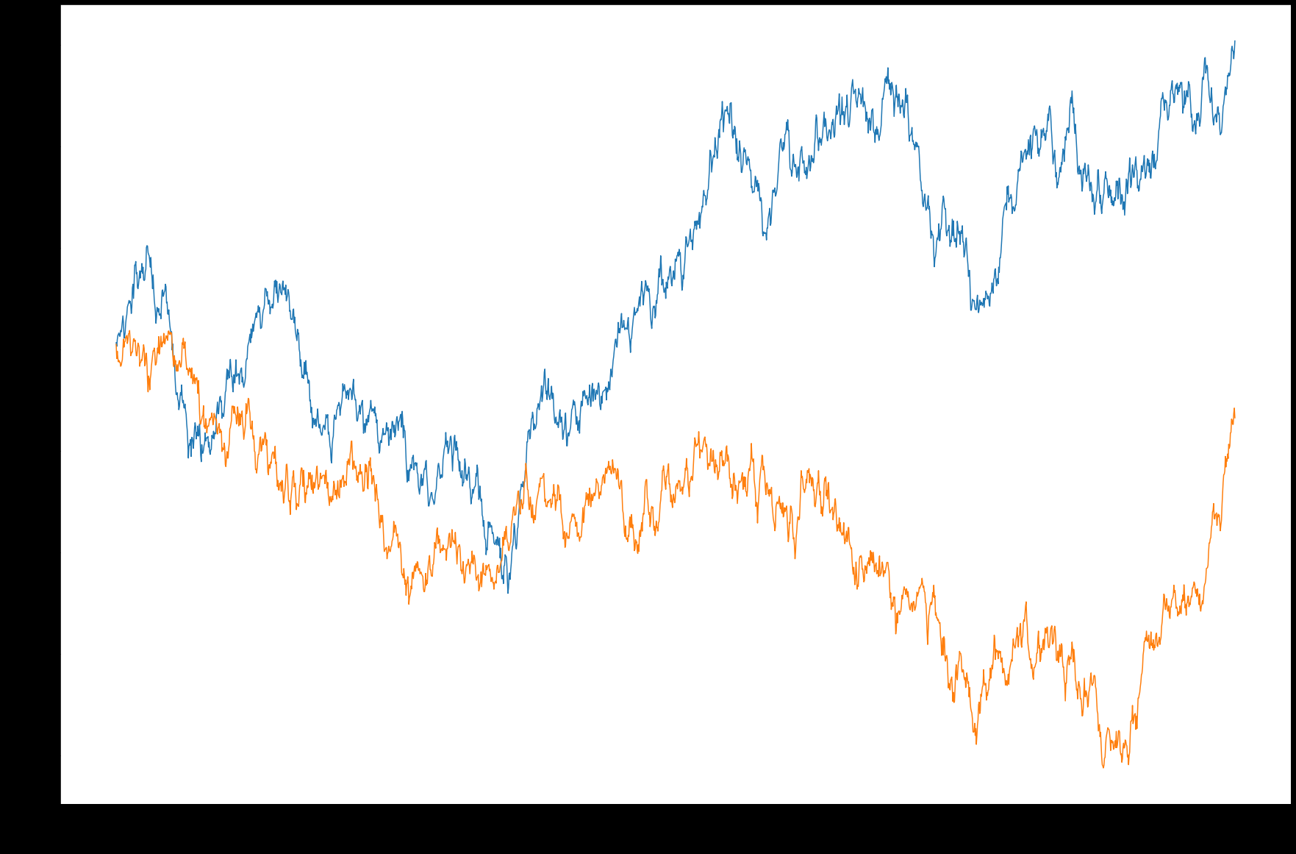

Slide 14
Reference
Images
http://datagenetics.com/blog/march62020/index.html
https://www.888casino.com/blog/blackjack-strategy-guide/how-to-play-blackjack
Content
https://www.youtube.com/watch?v=5bWpnABkU-Y&ab_channel=CrazyVegasOnlineCasino
https://www.247blackjack.com/

