Slide 1
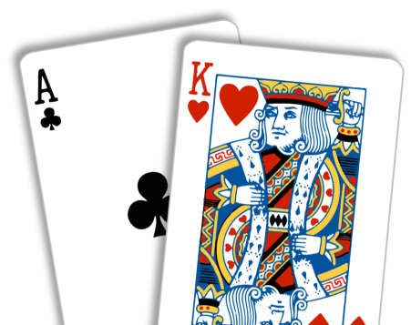
Variations of Blackjack

Slide 2
Aim:
To compare the various variations of the Game Blackjack with the original blackjack to identify if the other variations succeed as a game and if they are worth playing in a Club along with Blackjack.

Slide 3
Rules
2 People
Score 21
Blackjack Rewards (3:2)
2 Cards Blackjack wins over 3 cards blackjack
Hit & Stand
Dealers Advantage

Slide 4
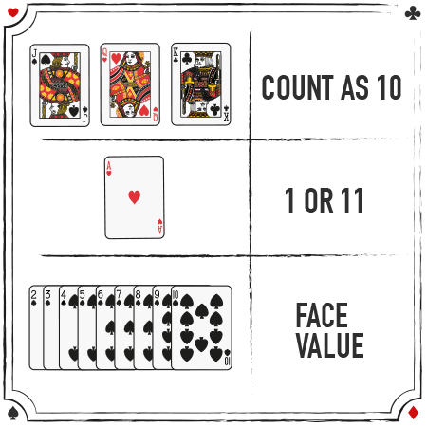
Card Values

Slide 5

Demo

Slide 6
Assumptions
Player Decision to Stand
Dealer Decision to Stand
No Insurance
No Split
No Double

Slide 7
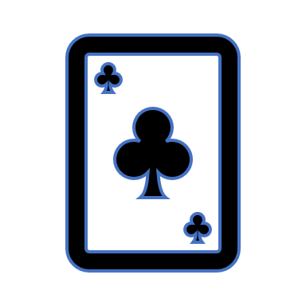
Random Variables
Number of Player
Cards distributed to players
Player Bet

Slide 8

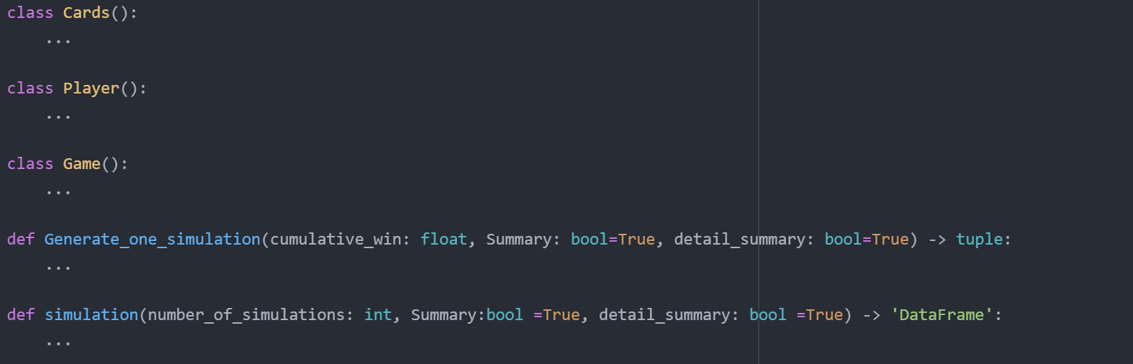
Code Structure

Slide 9
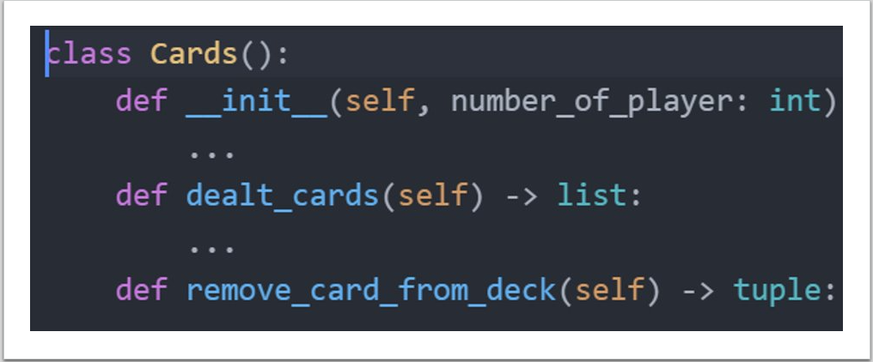

Slide 10
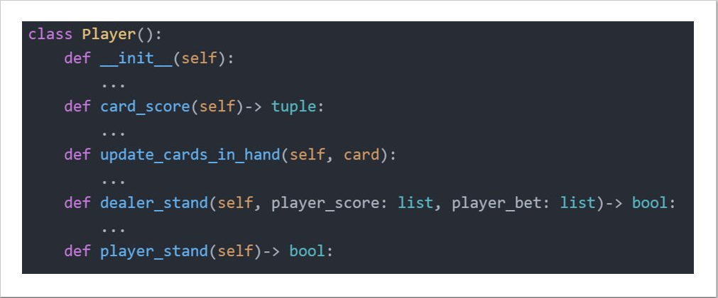

Slide 11
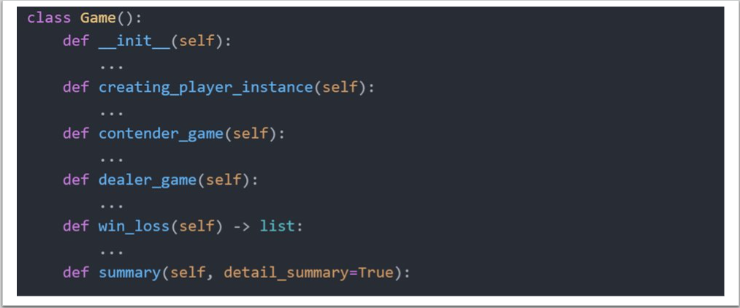

Slide 12
Variations:
Variable Target Score
If Game Should have Head Cards or not
Variable Value of Head Cards
Player cards are disclosed at the end of the game
Blackjack Reward
Explosion Card
def simulation(number_of_simulations: int, Summary:bool =True, detail_summary: bool =True) -> 'DataFrame':
def simulation(number_of_simulations: int, target_score: int=21, head_cards:bool =True,
head_card_value: int =10, dealer_advantage: bool=True, BJ_reward:float=1.5,
explosion:bool =False, Summary:bool =True, detail_summary: bool =True) -> 'DataFrame':

Slide 13
Hypothesis
1 - There will be no change in the dealer’s chances of winning, if the cards of both the player and dealer are disclosed at the end of the game.
2 - There will be no change in the chances of winning, if the player or the dealer lose by receiving a Blackjack in the first two dealt cards.
Notes:
Explanation: In this scenario, the cards of the player are hidden till the end of the game. We believe that the player’s chances of winning increase compared to the normal scenario where the dealer gets to see the player’s cards first.
Explanation: The club is planning on introducing a variation of Blackjack in which the player or the dealer loses when they are dealt with a Blackjack in the first two cards. The club needs to find out if the players have equal chance of winning.

Slide 14
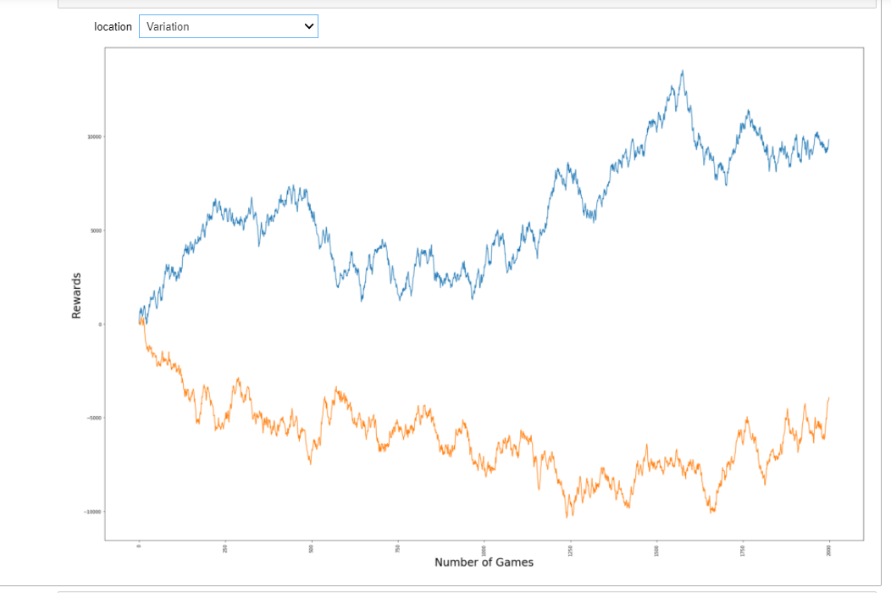
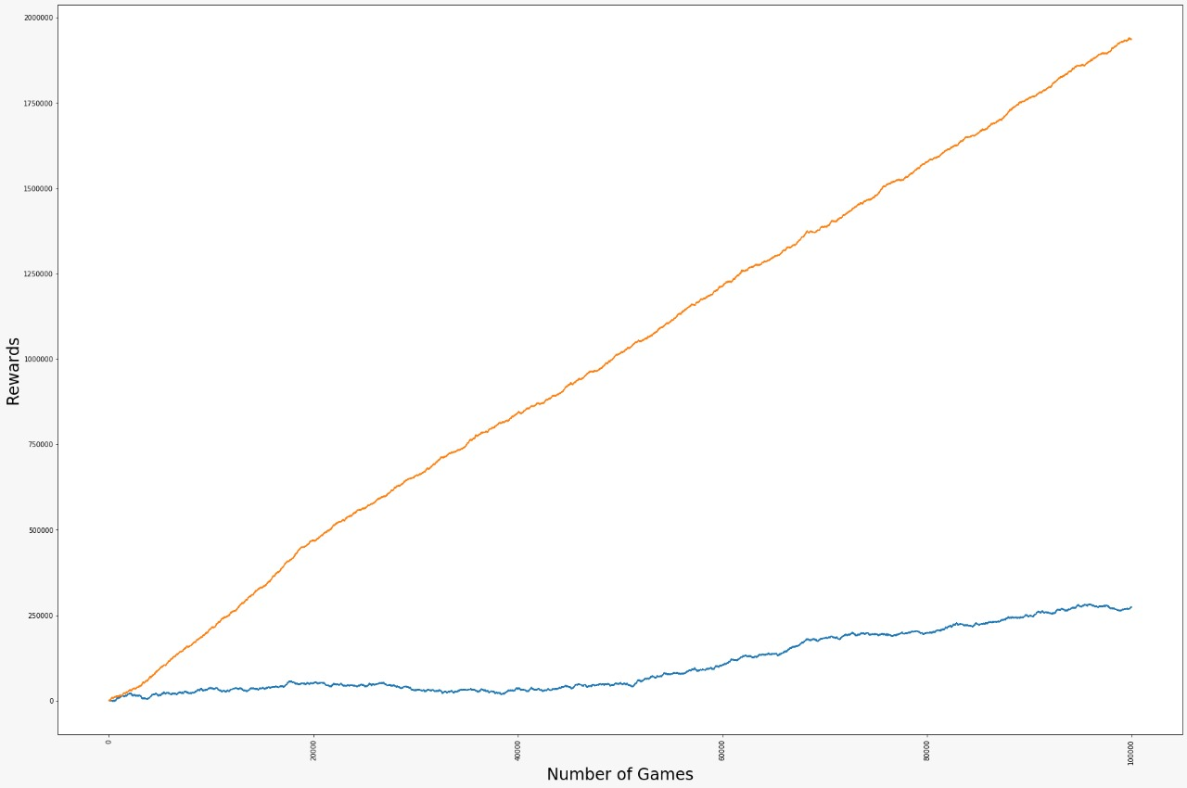
No Dealer Advantage dealer_advantage = False
Player loses on getting a black Blackjack:
Perfect Blackjack Reward: 0

Slide 15
4 -There will be no change in the player’s chances of winning, When the target is increased or decreased over the default value of 21, keeping the other parameters constant
3 - The players chances of winning does not change when the chosen head card value comes closer to the target score.
Notes:
Explanation: In another variation of Blackjack the value of head cards and target score can be different from the normal values of 10 and 21 respectively and increasing the value of head card endlessly till it almost reaches the target score may increase the players chances of winning.
Explanation: A variation of black jack where the target score can be set more or less that the original value of 21. We believe that there will be no change in the player’s chances of winning in this situation given that all the parameters/variations remain fixed.
.

Slide 16
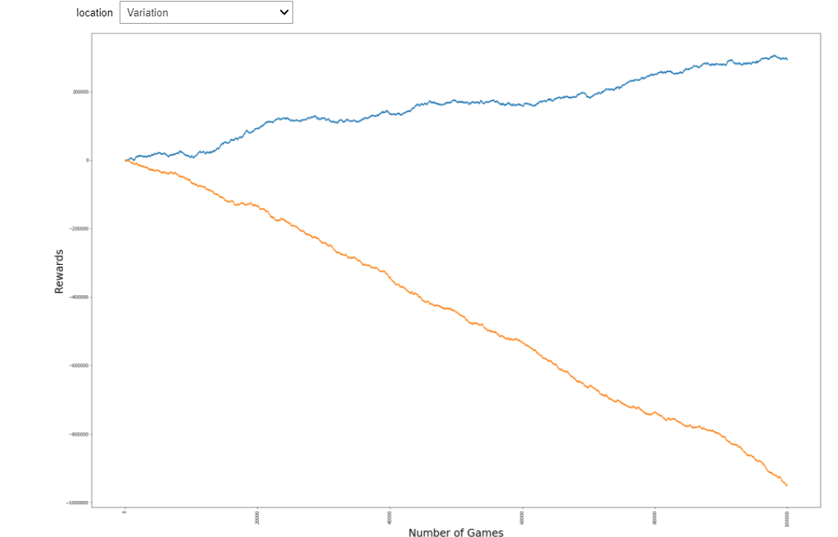
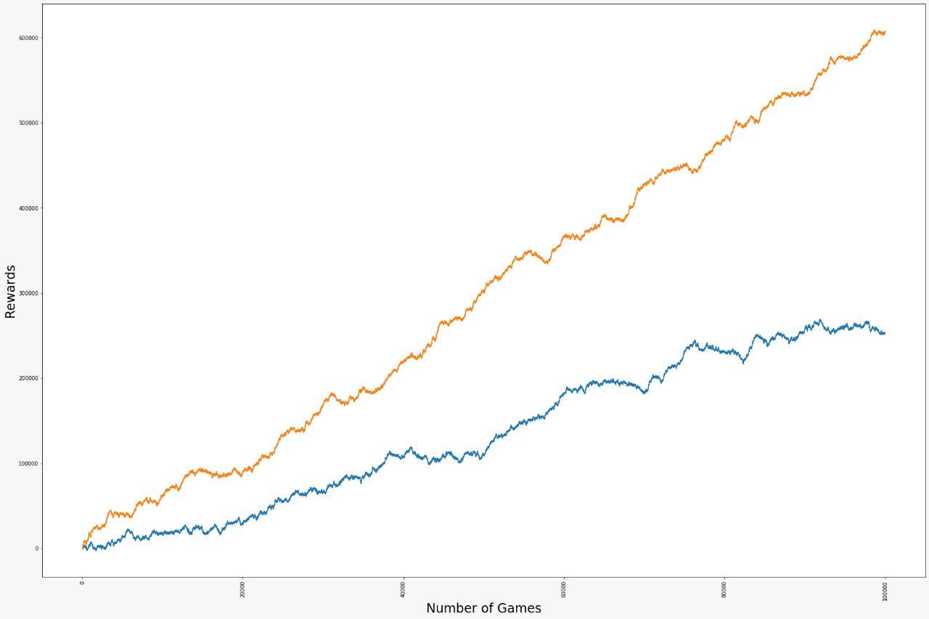
Head card very close to the Target Score:
Target Score: 21
Head Card Value: 18
Change in Target Score (Increased):
Target Score: 40

Slide 17
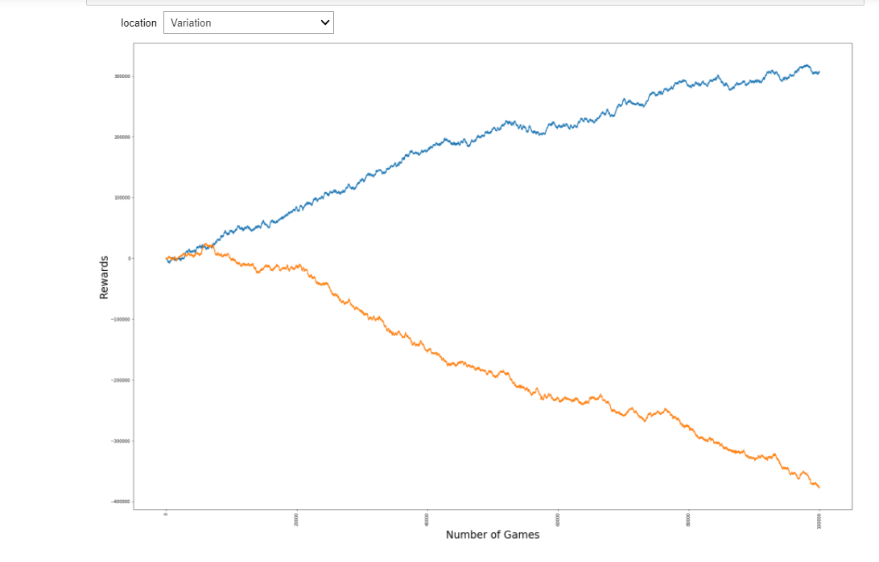
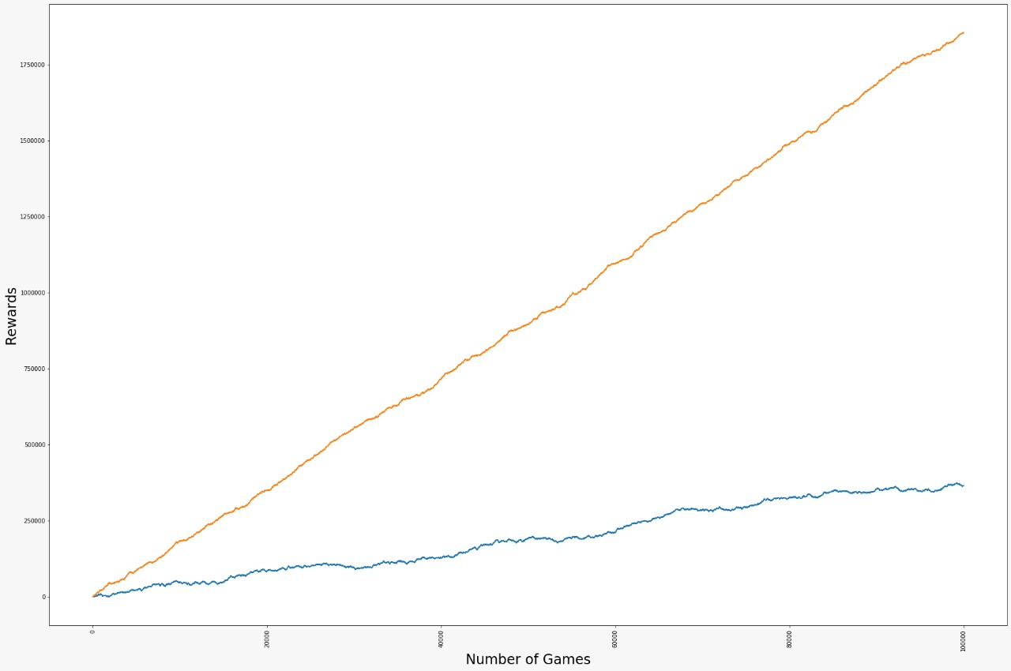
Change in Target Score (Decreased): Target Score: 15
No Head Cards:
Head Card: False

Slide 18
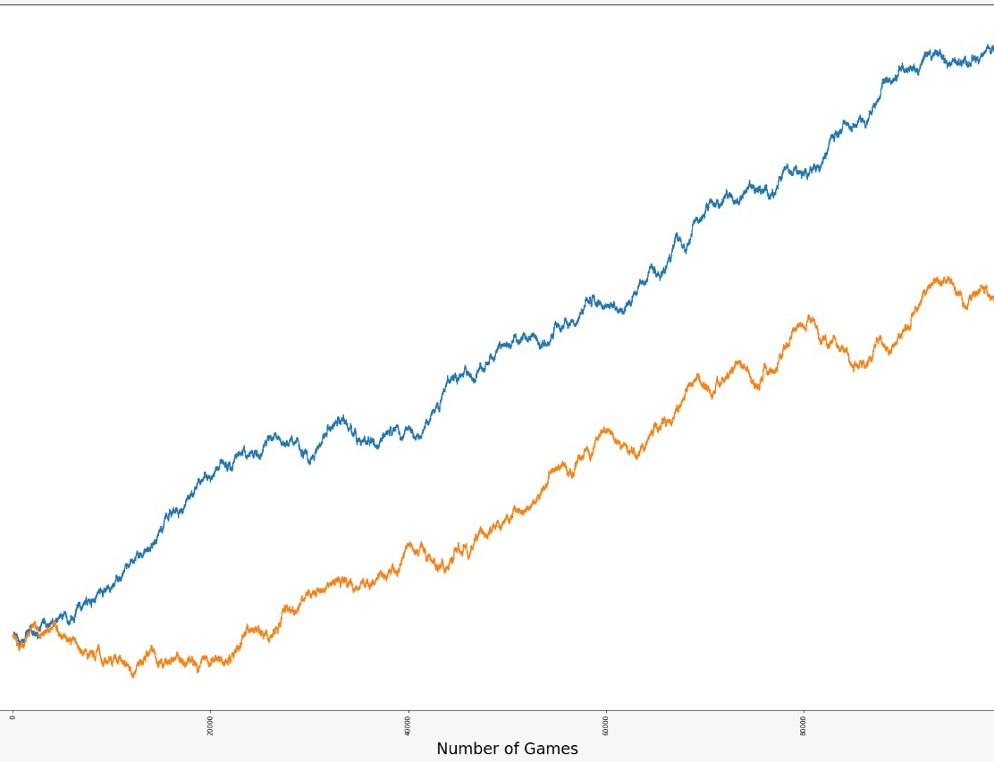
NEW GAME:
Number of simulations: 100000
Target Score: 32
Head Card: 1
Head Card Value: 12
Should the Dealer be given the advantage: 1
Perfect Blackjack Reward: 200
explosion Kit: 1
Print Summary: 1
Detailed Summary: 0

Slide 19
Reference
Images
http://datagenetics.com/blog/march62020/index.html
https://www.888casino.com/blog/blackjack-strategy-guide/how-to-play-blackjack
Content
https://www.youtube.com/watch?v=5bWpnABkU-Y&ab_channel=CrazyVegasOnlineCasino
https://www.247blackjack.com/

