Slide 1



project2pbi-airindia
View in Power BI
Last data refresh:
6/27/2023 4:41:29 PM UTC
Downloaded at:
6/27/2023 4:42:16 PM UTC

Slide 2
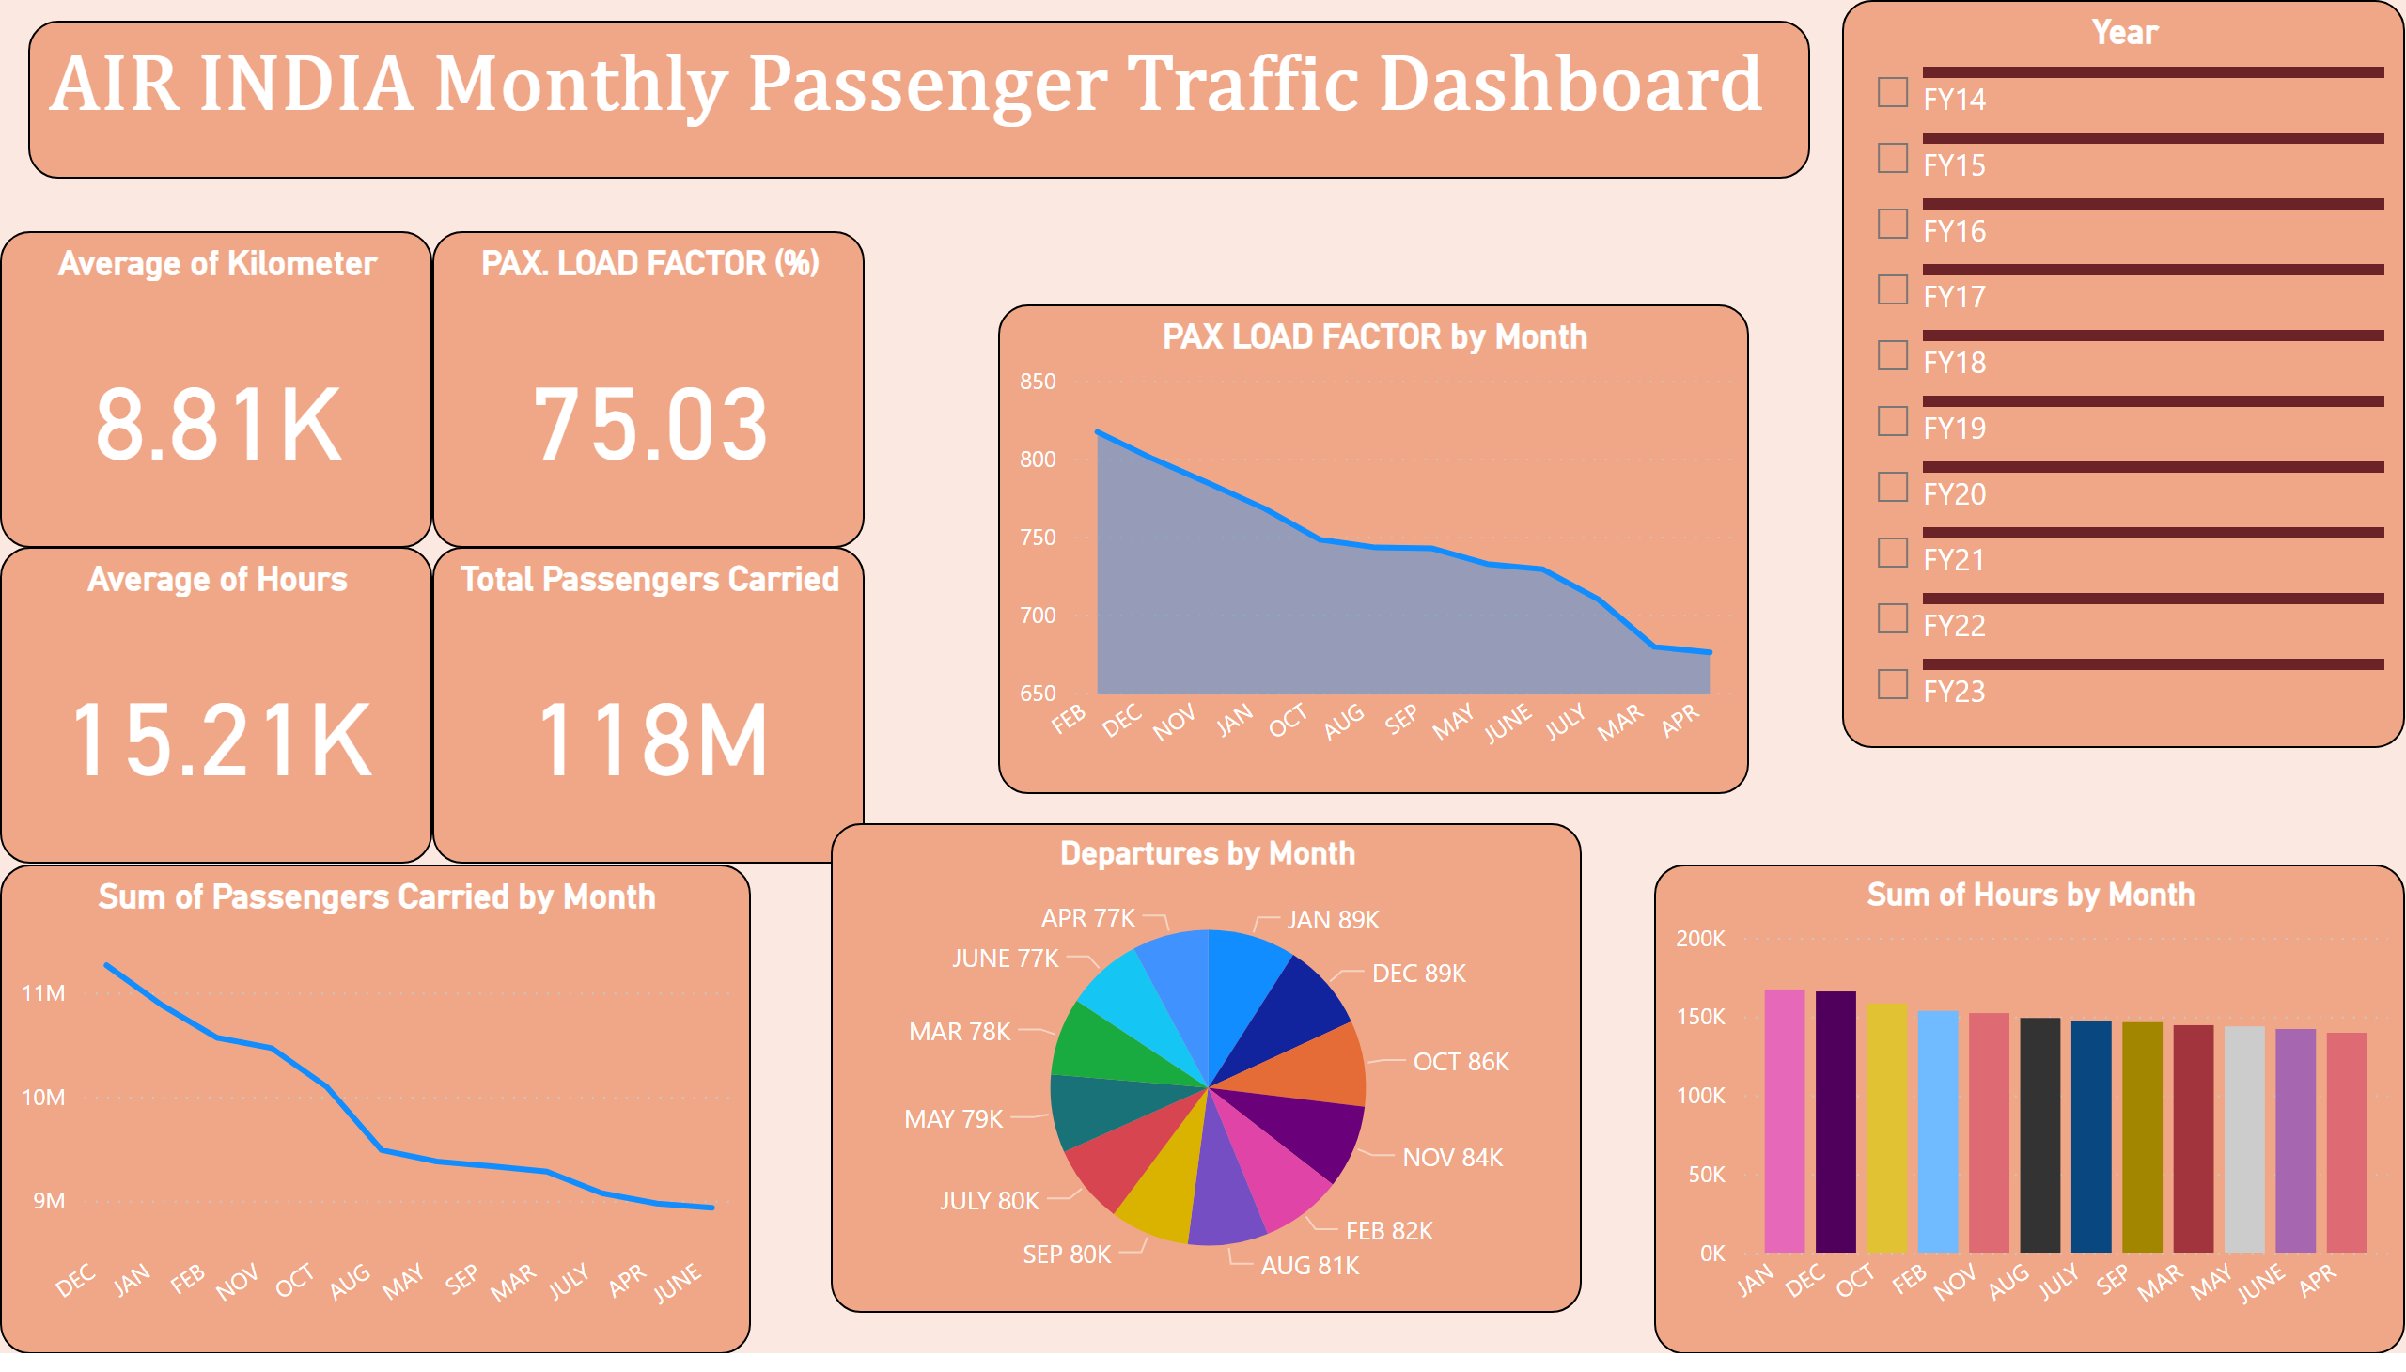
Page 1
Notes:
PAX. LOAD FACTOR (%)
No alt text provided
Total Passengers Carried
No alt text provided
Average of Kilometer
No alt text provided
Average of Hours
No alt text provided
Year
No alt text provided
Departures by Month
No alt text provided
Sum of Hours by Month
No alt text provided
Sum of Passengers Carried by Month
No alt text provided
PAX LOAD FACTOR by Month
No alt text provided
textbox
No alt text provided

