Slide 1
Project / Problem Overview
A disability is any condition, physical or mental, that significantly impacts a person’s life activities.
The most common types of disability affect mental and physical health. As of 2016, around 12.8 percent of the U.S. population had some type of disability.
A government managed Disability Center will help this increasing percentage of disabled people by providing medical assistance and supplies to patients free of charge.
This organization has various complex cross-departmental workflows and functionalities which can be simplified with the assistance of an application.
This application can be used by the different departments and entities of the organization to manage the day-to-day tasks and work queues for the users of the application.

Slide 2
Approach
The Application is a rich-GUI based interface created in Java Swing.
The hierarchy of the system is designed based on the EcoSystem Model, which allows various entities and organizations of the application to incline with the system based on their roles and responsibilities.
At the topmost level, the Disability Center business class consists of various Networks, where different Geographical Regions consist of a Network. Further, each Network consists of different Centers present in that Network.
For example, Boston & New York could be different Networks and can consist of different Centers present in each network.
The CEO is responsible for the Disability Center and can create Networks alongwith Regional Managers that manage a Network. Regional Manager creates Centers and appoints CenterHead for every center.

Slide 3
Approach
The EcoSystem Model representation for this hierarchy is designed as – DisabilityCenter at the top level has a list of Networks, each Network has list of Enterprises. Enterprises are of types – Supplier, Patient and Center.
The Center Enterprise has different Organizations which are – Receptionist, CenterHead, Doctor, Nurse, Inventory Manager.
The Supplier and Patient Enterprise are present at the Network level, which allows them to shared throughout the Network.
Each Network and Enterprise is also an Organization and each Organization comprises of Employee Directory, User Account Directory and Work Queue.
Employee Directory consists of all Employees of the Disability Center.

Slide 4
Approach
User Account Directory is list of all User Accounts created for each user of the application. Each User Account has a Role and various roles in the applicaton are – CEO, Regional Manager, Center Head, Receptionist, Inventory Manager, Doctor, Nurse, Supplier.
There is a Work Queue present for each Organization that lists various Work Requests created between different Organizations. For example, Receptionist checks-in a Patient and assigns him to Doctor Organization. This allows effective communication between different Organizations
This design supports various complex workflows between various Users and Organizations of the system, allowing each User to fulfil their responsibilities.

Slide 5
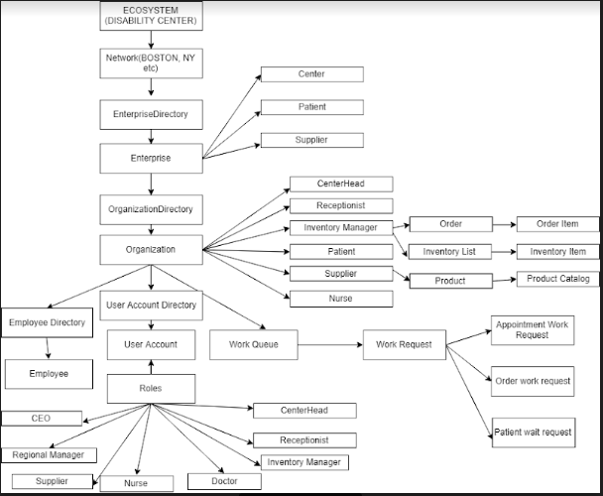
Object Model

Slide 6
Use cases and functionalities
Configuration and Setup of various Entities:
CEO : The CEO UserAccount is created by default and he can create different Networks and appoint Regional Manager for each Network. CEO can also set the budget for the Network.
Regional Manager: The Regional Manager can create different Centers and appoint a Center Head for each Center. Regional Manager also creates the Suppliers for that Network. Regional Manager can set Budget for each Center.
Center Head: Center Head is responsible for each Center and can create Organizations, Employees and UserAccounts for each Center.

Slide 7
Use cases and functionalities
Receptionist:
Receptionist can check-in patients that visit the Center. If the patient is an existing patient in the Network, receptionist can search for the patient based on Patient ID or Patient Name.
If the patient is a new patient, Receptionist can register and create the new patient.
If the patient is from a different network, receptionist can search in the respective network and check him in. Thus, allowing access to a different network from the current network.
During check-in, the receptionist checks if the patient is mentally or physically disabled. If the patient is mentally disabled, the doctor will diagnose the patient, else the nurse will diagnose the patient.
The system automatically assigns the available doctor/nurse to the patient and if none of the doctors/nurses are currently available and busy with other patients, the system will place the patient to a Wait Queue. Whenever, a doctor/nurse gets available, the patients from the Wait Queue are then assigned.

Slide 8
Use cases and functionalities
Doctor / Nurse
Patients gets assigned to Doctor/Nurse based on the disability type.
Doctor/Nurse can mention the diagnosis and place order for medicine/equipment for the patient.
All the medicines/equipments created by the Suppliers can be added in the order.
Patient gets email notification of the diagnosis.
Doctor can also view patient history of all the patients that are present in the network.

Slide 9
Use cases and functionalities
Inventory Manager
Inventory Manager maintains inventory of medicines/equipment for the particular Center.
Inventory Manager receives the medicine/equipment request from Doctor/Nurse as a Work Request and can deliver the same to the patient.

Slide 10
Extra Functionalities
Email:
Patient receives Email notification when he is registered to a Center
Patient also received email of the diagnosis
Logging:
Java.util.logging is used for logging in the application
Logging of various events and tasks in the application helps in debugging
Scheduling Algorithm:
Patient is assigned to doctor/nurse automatically based on the scheduling algorithm.
The algorithm looks for available doctor/nurse for the Patient. If all doctors/nurses are busy and attending a patient, the algorithm places the patient in a Wait queue and assigns the doctor/nurse to the patient when available.

Slide 11
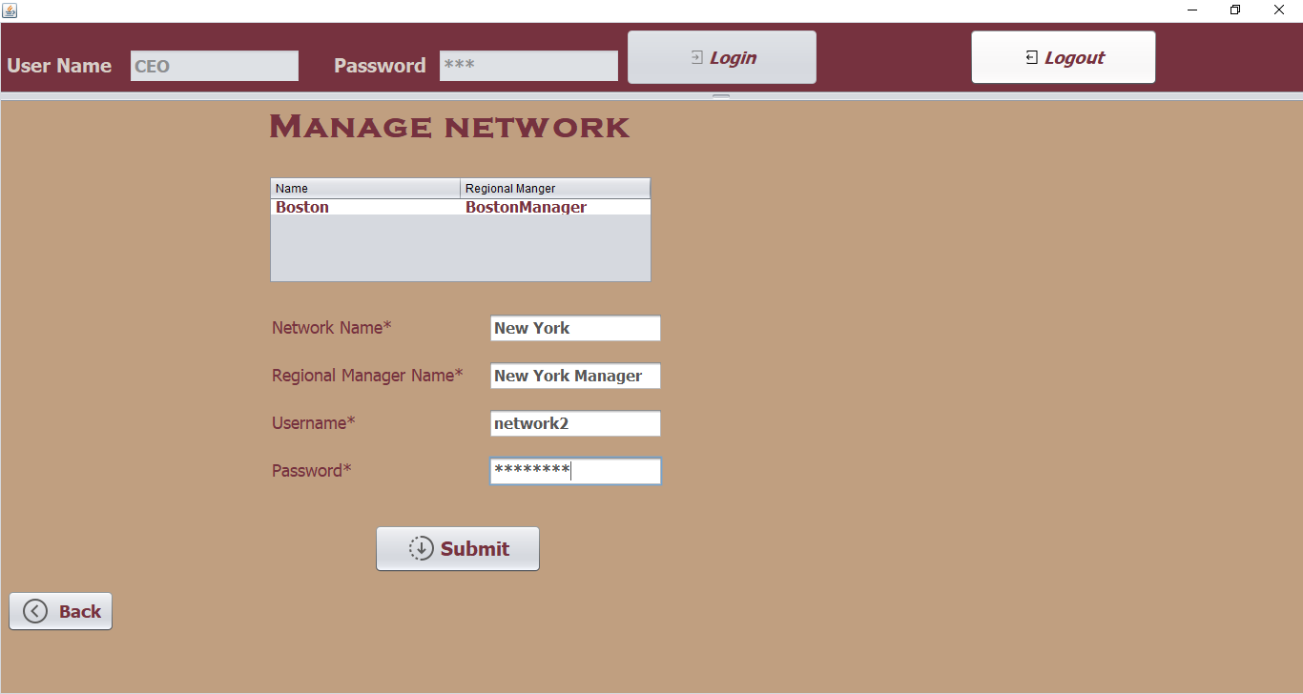
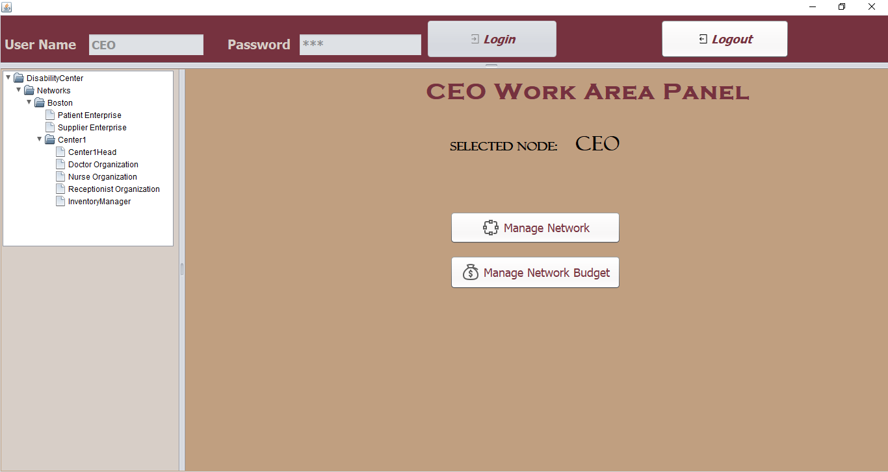
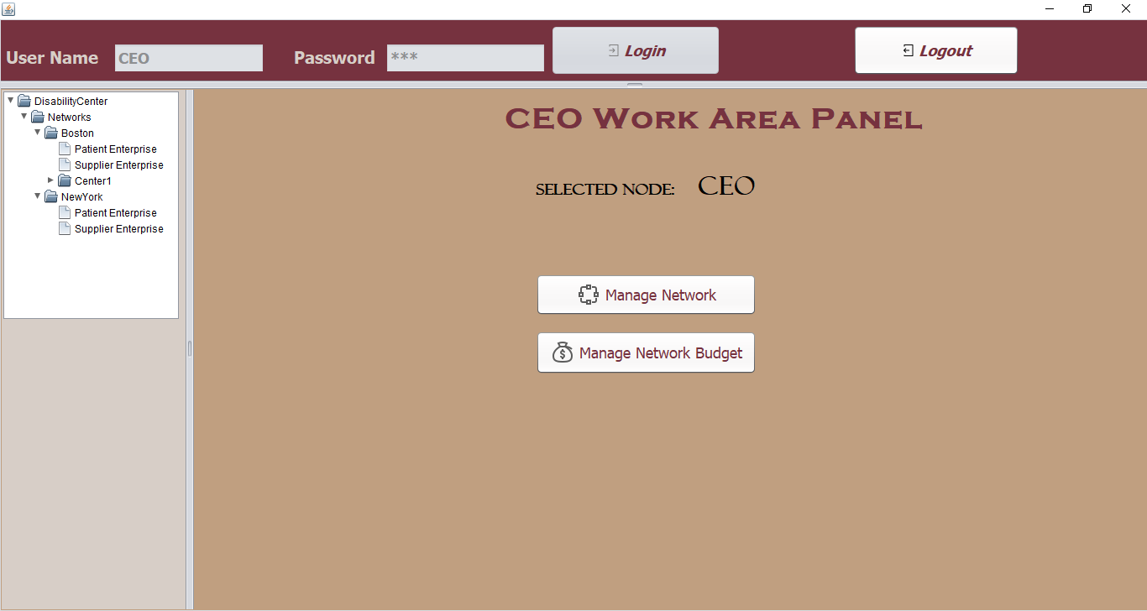
Screenshots
CEO can manage all the Networks and view the Organizations hierarchy

Slide 12
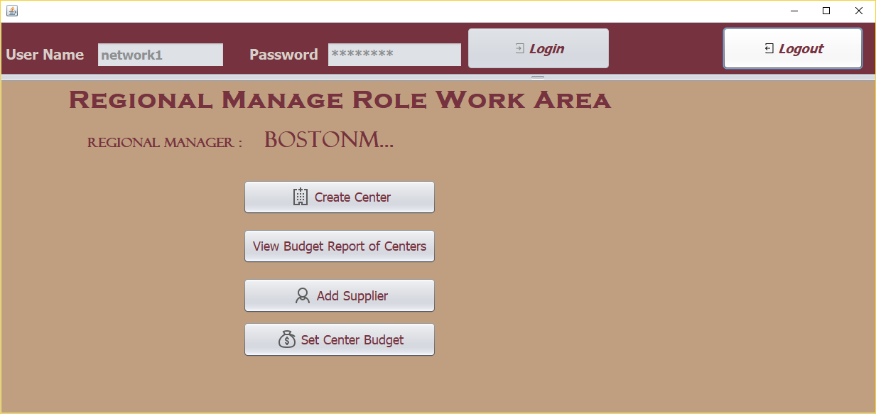
Screenshots
Regional Manager Work Area

Slide 13
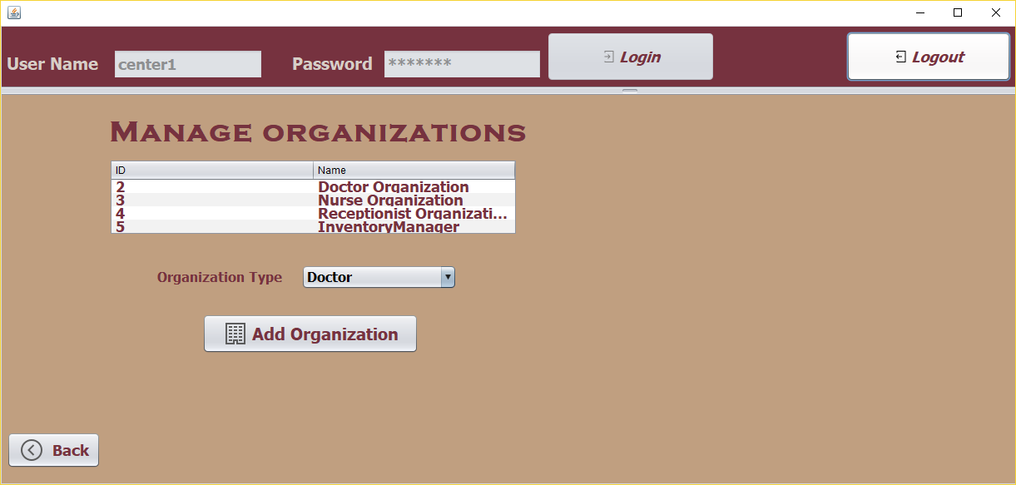
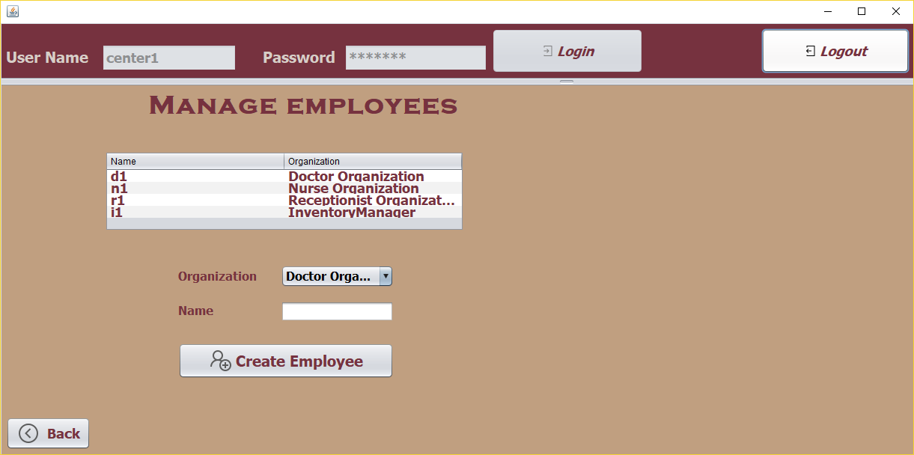
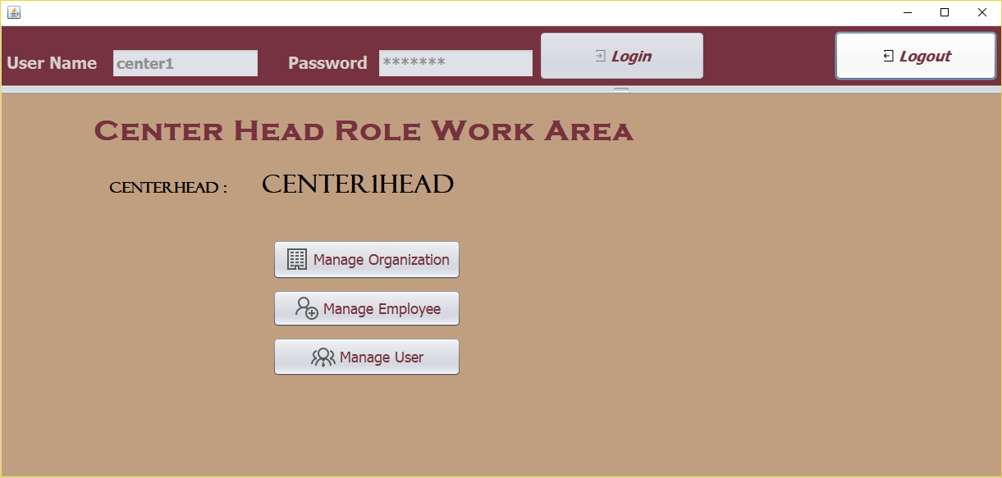
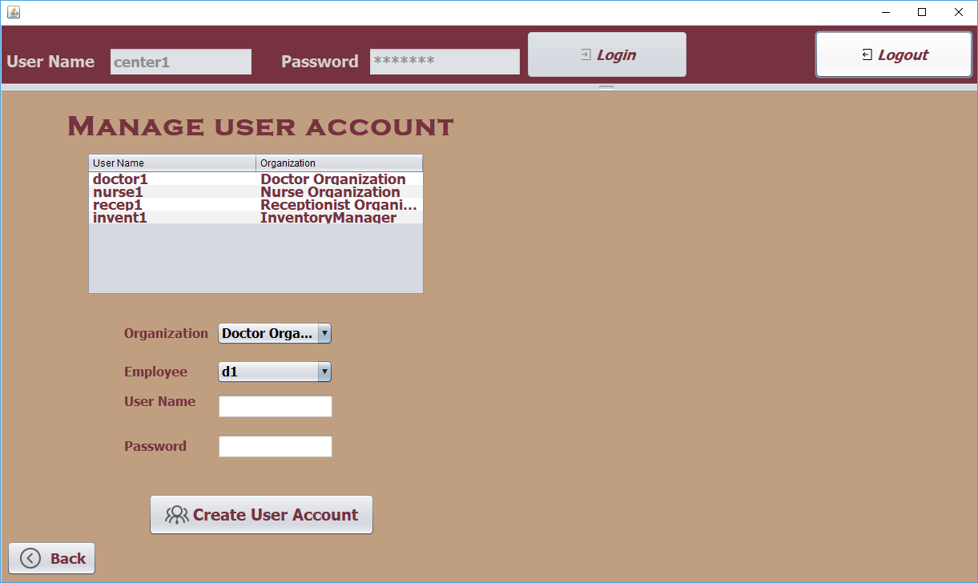
Screenshots
Center Head Work Area

Slide 14
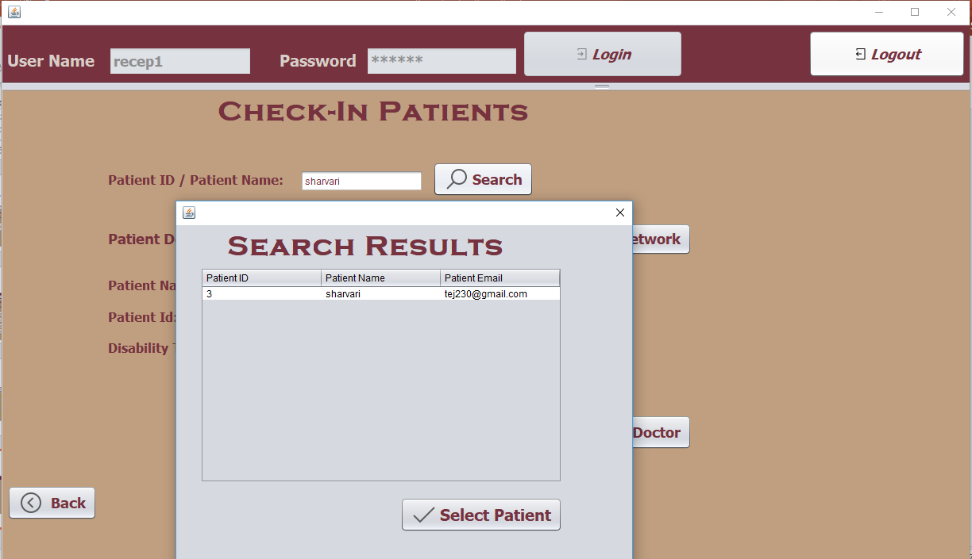
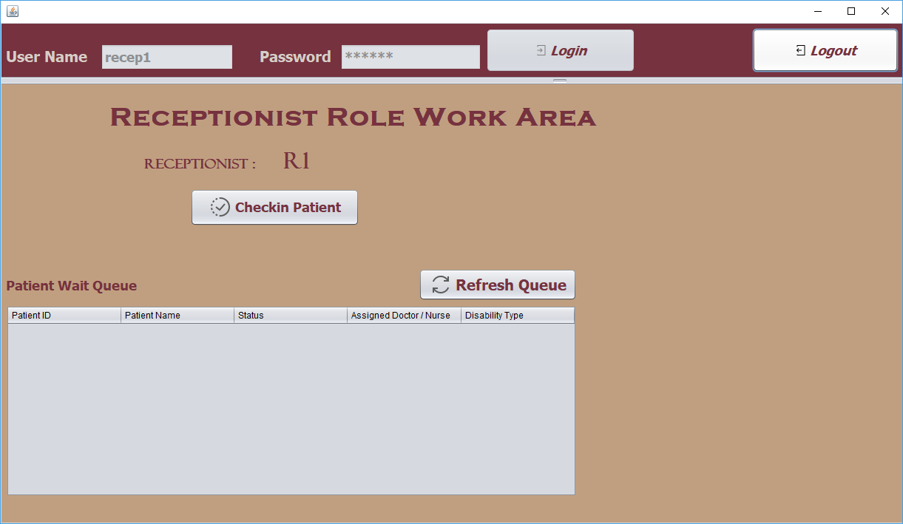
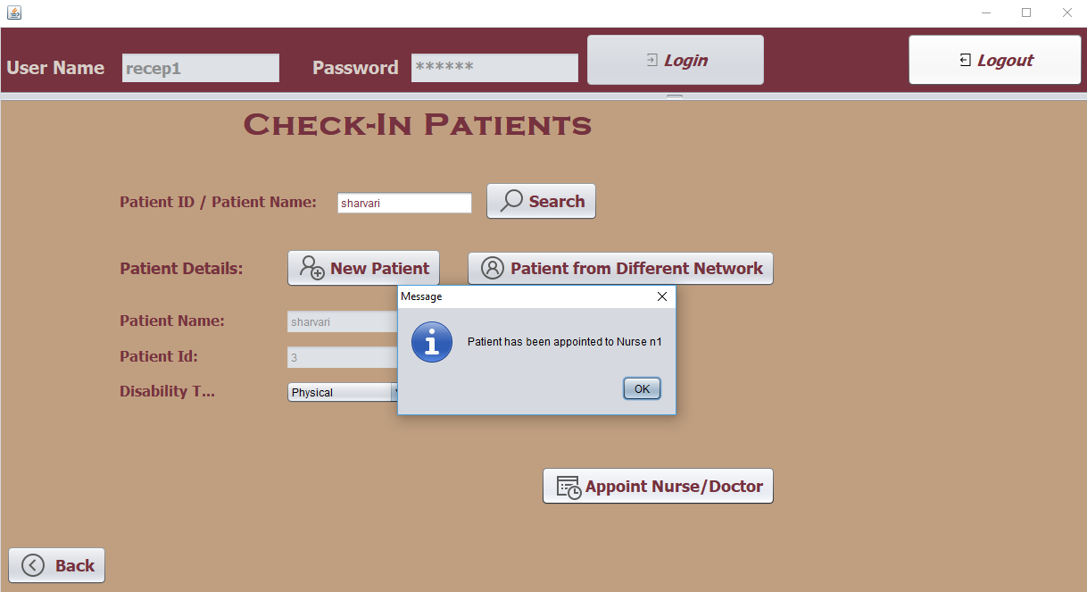
Screenshots
Receptionist Work Area

Slide 15
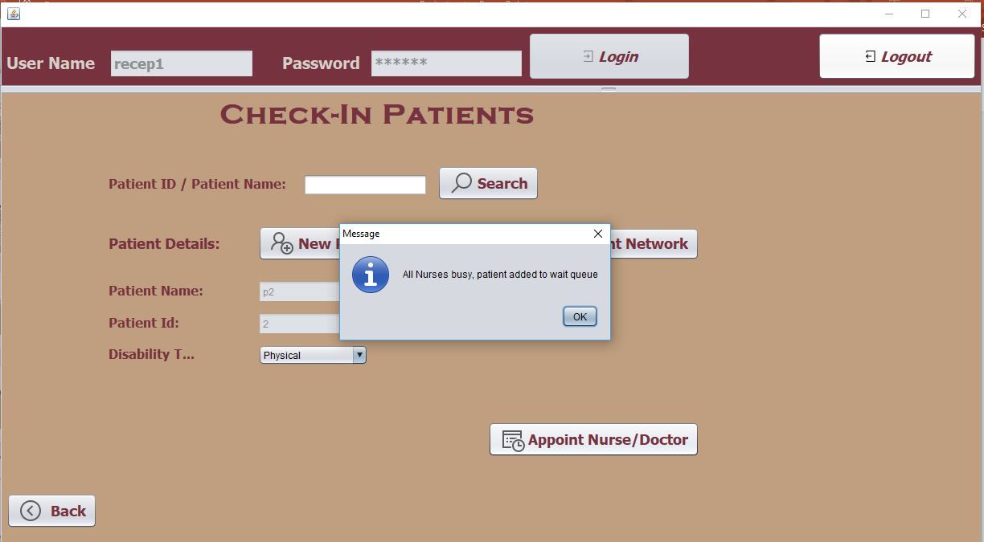
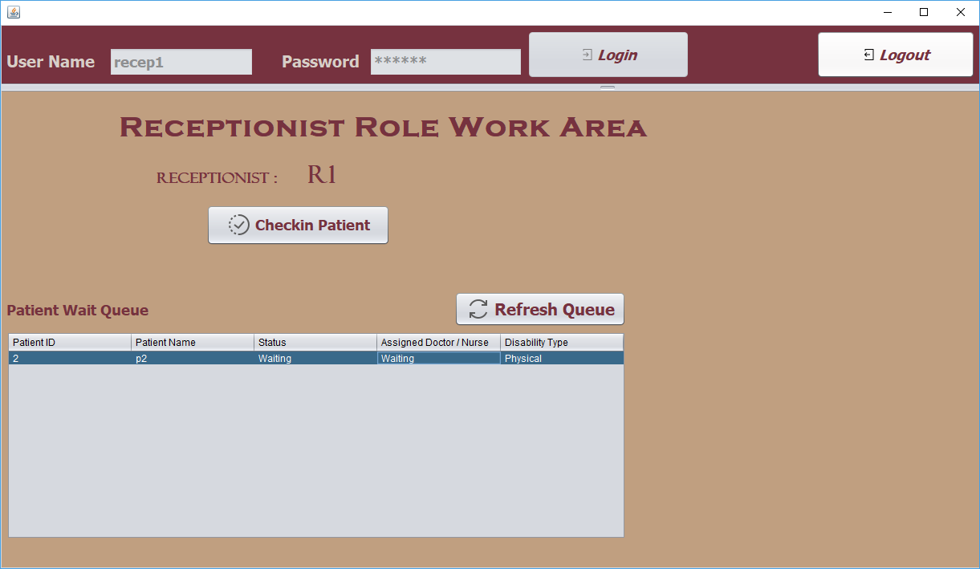
Screenshots
Receptionist workflow when Patient is placed in Wait Queue

Slide 16
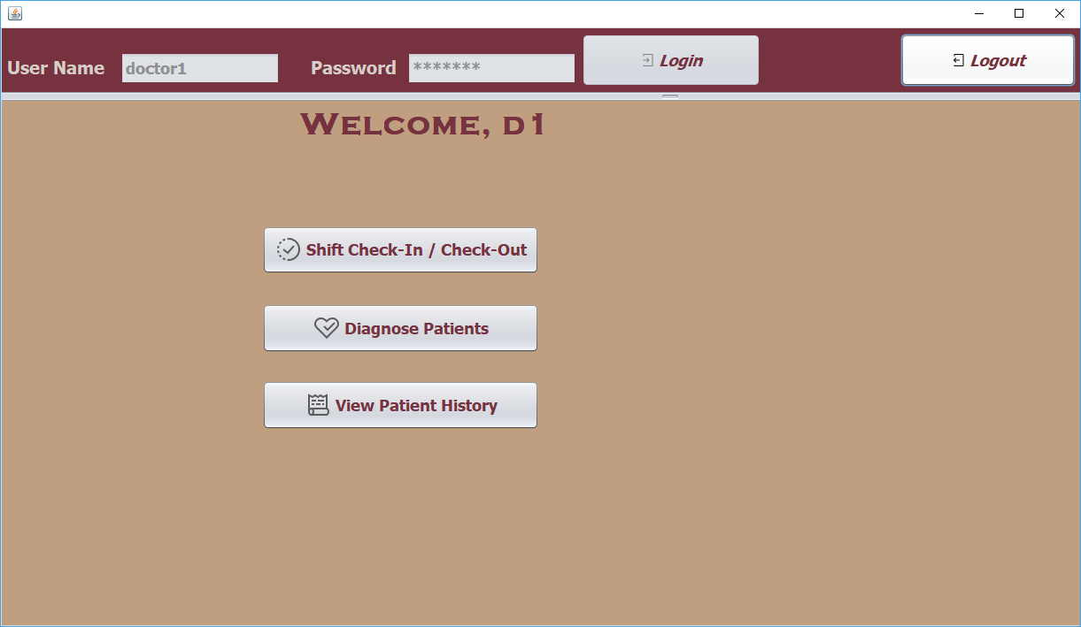
Screenshots
Doctor Work Area

Slide 17
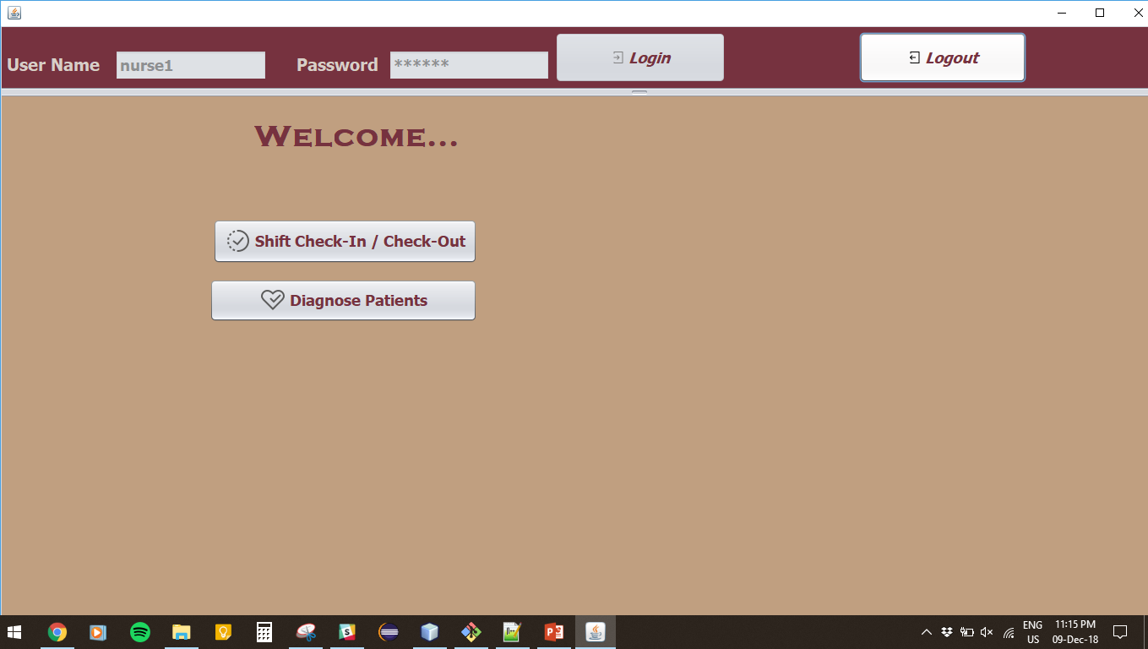
Screenshots
Nurse Work Area

Slide 18
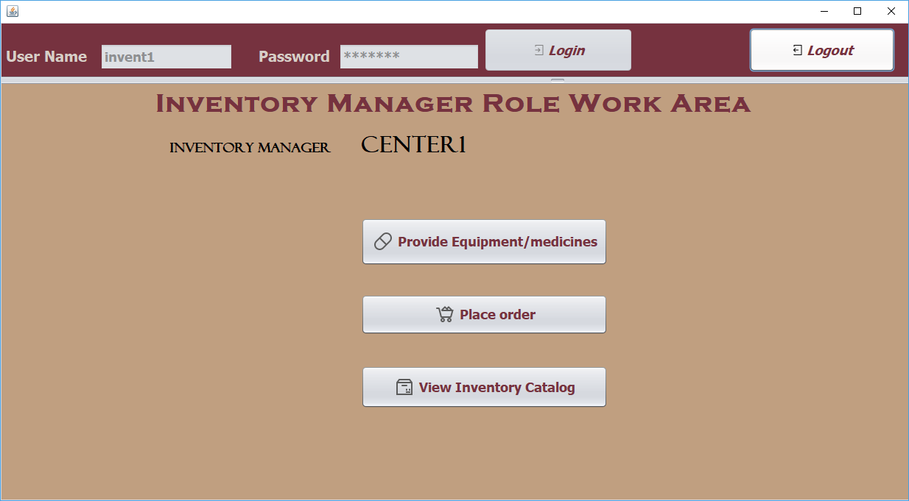
Screenshots
Inventory Manager Work Area

Slide 19
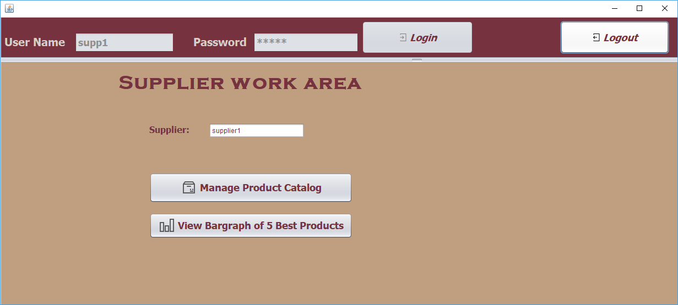
Screenshots
Supplier Work Area

