Slide 1
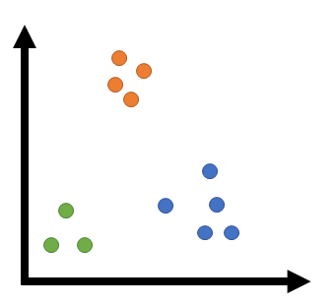
Provider clustering based on CMS Spending
Presentation by –
Ishita Shah

Slide 2



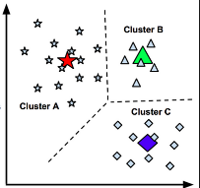




Agenda
1
2
3
4
Background and Objectives
Data and tools used
EDA and Data Transformation
Segmentations
5
6
7
8
Cross tabulation
Segments for Oncology launch
Dashboard Mockup
Future Scope

Slide 3
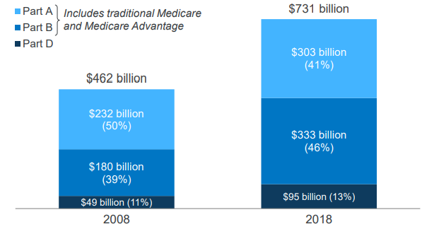
Background and Objectives
Part B beneficiary payments from Medicare make up 46% of the total Medicare spend; hence it is imperative for pharmaceutical companies to identify high potential providers catering this audience
Medicare Part B → additional insurance where eligible members pay a monthly premium to avail benefits
After deductible is met, in most cases Medicare covers 80% of costs whereas the patient pays 20% as out of pocket expense
Out of total $731bn of Medicare spending, 46% is spent on Part B beneficiaries.
Segmentation of providers in this category can be used to target the right providers for marketing and detailing pharmaceutical products
This analysis can further be used as a larger STP component in brand plans
Fig 1: Medicare spending for different programs

Slide 4



Data and Methodology
CMS data for ~24k unique providers was used for analysis. Python was used as a primary tool for analysis and modeling
Data Ingestion and Preprocessing
Tools and Technologies Used
~10mn records for services provided to Part B beneficiaries by providers
Python libraries like pandas, numpy, plotly and sklearn for data transformation, EDA and modeling
Ease of computation and preliminary analysis
~200k records used for analysis
Version controlling the code and hosting all files in one place
Removed nulls and aggregated data
~24k unique provider details
Creating summary tables and tracking data for various experimentations
Variables of interest –
# of Beneficiaries
Average Payment Standardized Amount
Notes:
Dataset provided by CMS gives information on services and procedures provided to Part B beneficiaries
Each unique provider has multiple records based on their HCPCS code and type of service provided
Out of >10mn records from the entire dataset, this report uses ~200k records for ease of computation and analysis
Data for each unique provider ID is aggregated for our variables of interest with final dataset size of ~24k providers
Tools and technologies used – Python (numpy, pandas, sklearn, plotly) , GitHub, Microsoft Excel, Tableau

Slide 5
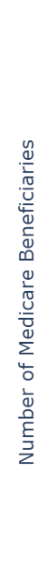
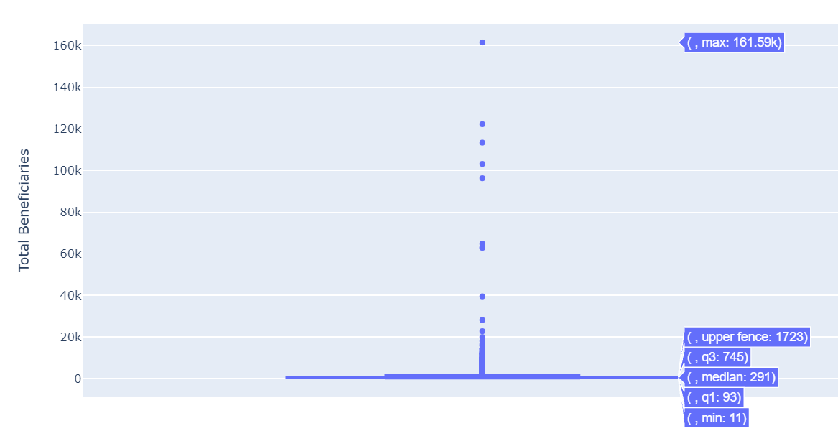
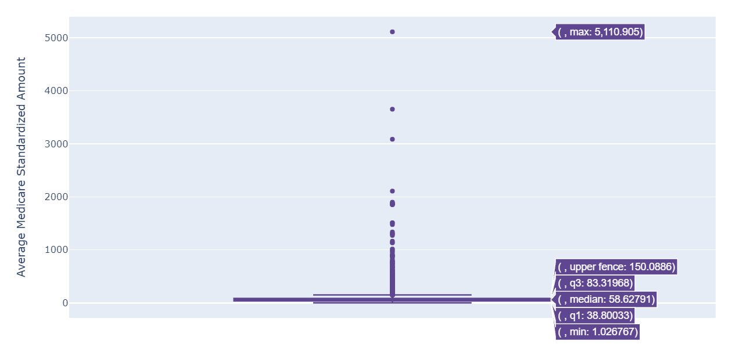
EDA – Univariate Analysis
High skewness and range in both the variables indicate right skewed distribution and presence of outliers
Skewness = 38.6
Skewness = 20.81

Slide 6
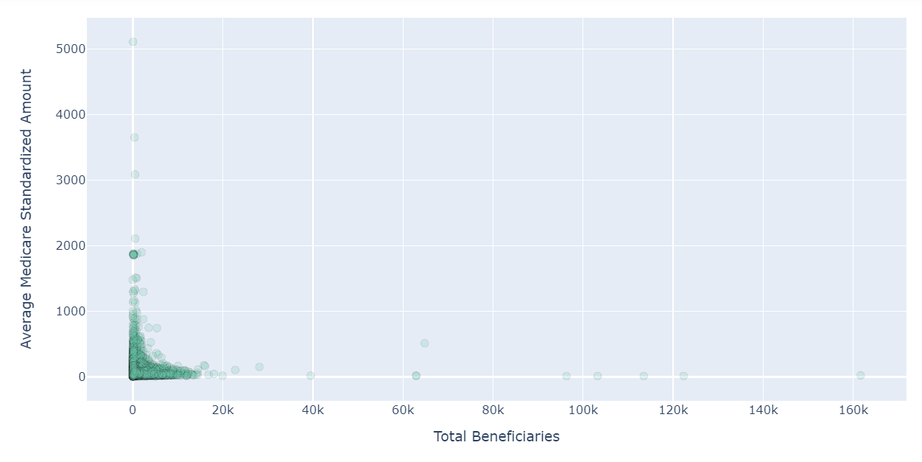
EDA – Bivariate Analysis
On using a scatter plot for both numeric variables, we can clearly see outliers that lie far from original points. These outliers can mislead our clustering exercising and need to be isolated first
Outliers

Slide 7
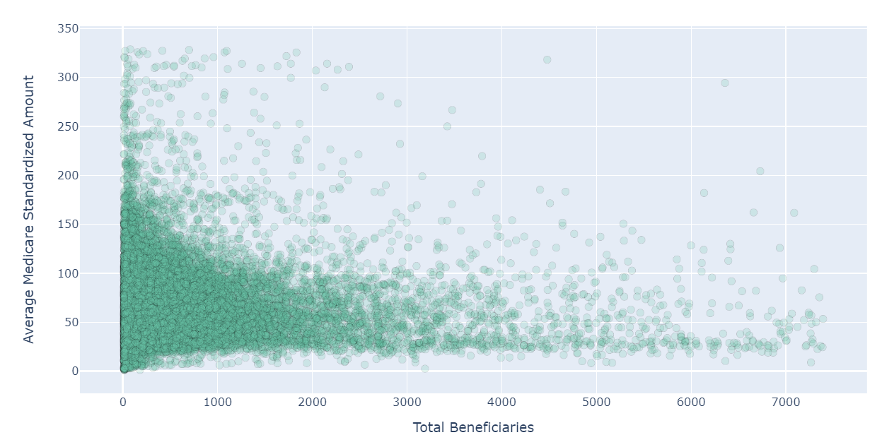
EDA – After outlier treatment
1.28% of the total observations were identified as outliers based on z-scores; which were dropped to provide a better distribution of the data which can further be used for meaningful clustering

Slide 8


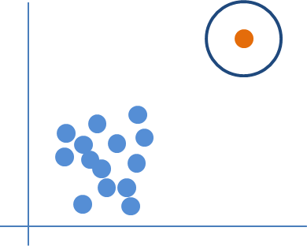
EDA takeaways
Average number of Part B Medicare beneficiaries catered by these providers is 717
On average, every provider receives ~$70 as Average Medicare Payment Amount (Standardized) per beneficiary against the services provided
Out of all observations, less than 1.5% of observations can be treated as outliers for clustering. These observations are more than 3 standard deviations away from the mean

Slide 9
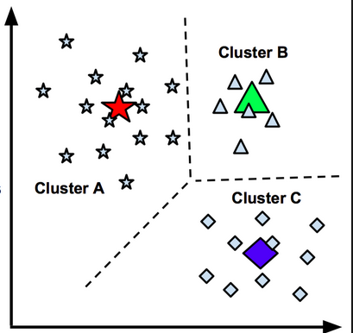
Segmentation Methodology
K-means clustering segments ensures good clustering by ensuring cohesion within one segment and separation between different clusters. The output gives us threshold values for each segment
METHOD
OUTPUTS
Intuitive and easy to interpret - calculates Euclidean distances and gives centroid for each cluster
Segments providers that exhibit similar behavior based on our variable of interest
Ensures adequate cohesion between points within one cluster; along with good separation between different clusters
Trained model can be used for future predictions
Provides threshold values for each segment
Easy to check quality of segmentation using metrics and visual methods
K-means clustering

Slide 10
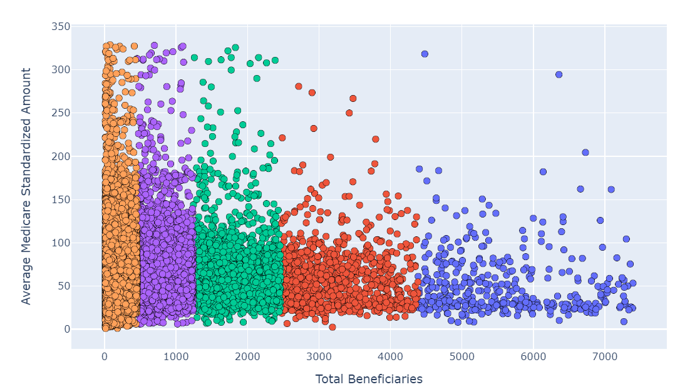
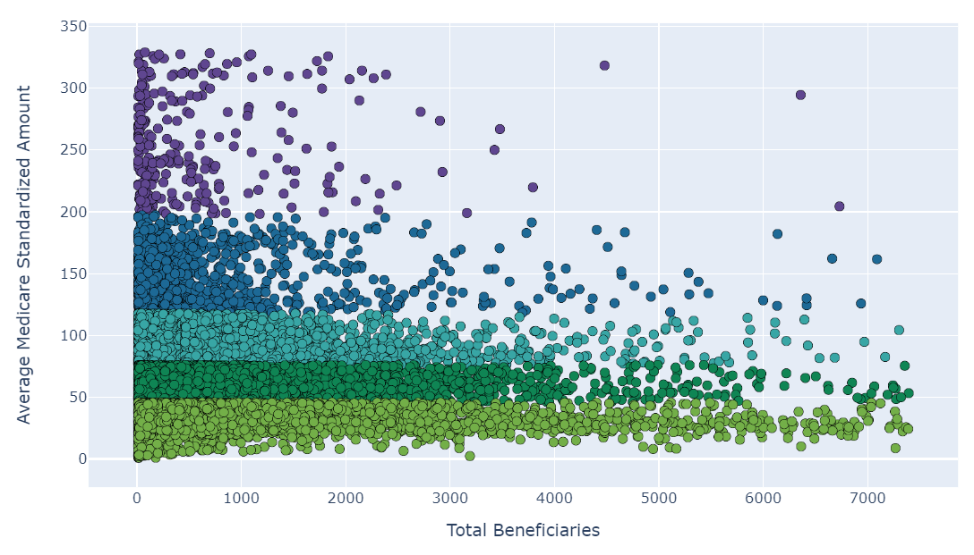
Evaluating Quality of Clustering
To check for good clustering output, we can visualize the data and look for clear thresholds without minimum overlaps
Beneficiary Segments
Payment Segments

Slide 11
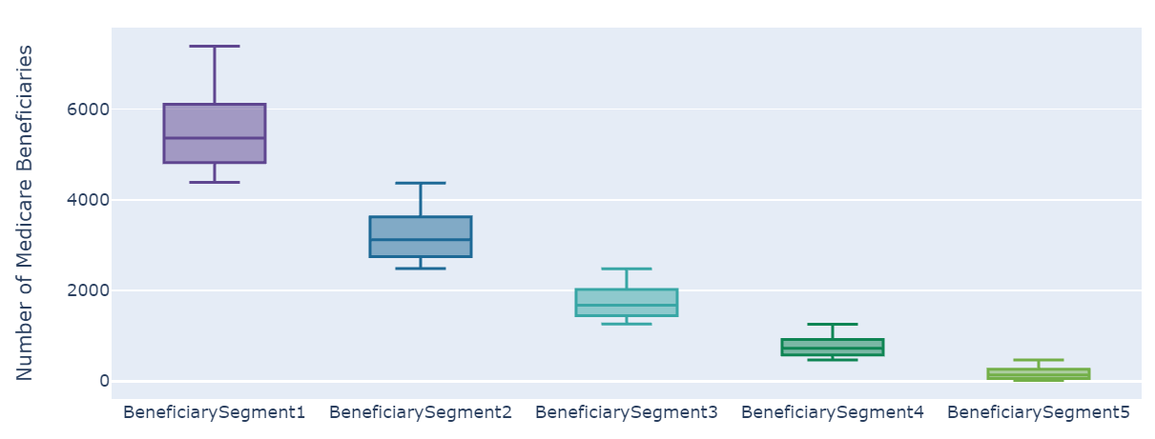
Segmentation based on # of Beneficiaries
63% of providers falling under the lowest segment cover only 16% of Medicare beneficiaries whereas segment 3 and segment 4 providers together cover 51% of Medicare beneficiaries
% of Providers | 1.53% | 3.79% | 8.49% | 23.03% | 63.16%
% of Beneficiaries | 13.42% | 19.20% | 23.34% | 27.64% | 16.40%
Mean beneficiaries | 5543 | 3207 | 1743 | 760 | 165
Min beneficiaries | 4384 | 2481 | 1255 | 465 | 11
Max beneficiaries | 7391 | 4371 | 2475 | 1254 | 464

Slide 12
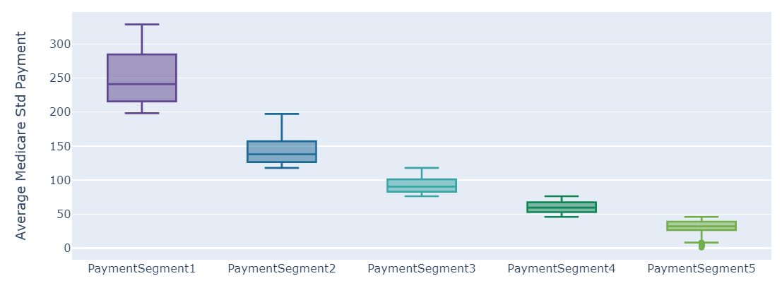
Segmentation based on Average Medicare Standardized Payments
Based on average payment, most providers fall under either segment 4 or 5 where average payment amount is between $1 to $76. This segmentation can be used to evaluate price sensitive segments
% of Providers | 1.16% | 6.35% | 23.16% | 35.62% | 33.70%
Mean Amount | 252 | 143 | 92 | 60 | 32
Min Amount | 198 | 118 | 76 | 46 | 1
Max Amount | 329 | 197 | 118 | 76 | 46

Slide 13
Cross-tabulation of Both Segmentations
Providers in segments 3 and 4 along with (BSegment2, PSegment4) account for 42% of total payments making them high potential providers for general targeting
Sum of “Total Medicare Standardized Payments” received by each segment can be used as an indication of the size of provider’s practice and total potential for targeting products towards these doctors
Even though # of beneficiaries and average payments are high in segments 1 and 2, they are low potential due to fewer number of providers falling in that segment
Total Medicare Std Payment Amount =
Sum for each segment (Number of Beneficiaries * Average Payment Amount)
Total Medicare Std Payment Amount (in mn, $) | PaymentSegment1 | PaymentSegment2 | PaymentSegment3 | PaymentSegment4 | PaymentSegment5 | TOTAL
BeneficiarySegment1 | 4.7 | 17.4 | 25.9 | 30.4 | 35.2 | 113.6
BeneficiarySegment2 | 6.0 | 23.7 | 48.2 | 58.4 | 39.2 | 175.5
BeneficiarySegment3 | 15.7 | 28.0 | 73.1 | 82.8 | 38.8 | 238.5
BeneficiarySegment4 | 12.6 | 33.2 | 110.0 | 94.8 | 40.0 | 290.6
BeneficiarySegment5 | 5.4 | 23.1 | 53.8 | 52.5 | 25.7 | 160.4
TOTAL | 44.3 | 125.4 | 311.0 | 318.9 | 178.9 | 978.6
Key | High potential | Medium potential | Low potential

Slide 14
Cross-tabulation of Both Segmentations – Oncologists
For an oncology product launch, client should prioritize providers that fall under (BSegment4, PSegment3), (BSegment2, PSegment4) and (BSegment3, PSegment1) as these doctors receive highest Medicare Amounts
Previous cross tabulation can further be filtered using “Rndrng_Prvdr_Type” variable to identify providers with an Oncology practice
If the oncology product has a premium pricing, then the client should focus on targeting the providers under (BSegment3, PSegment1) as providers in this segment receive higher average Medicare payments and thus may be more inclined to prescribing high priced brands
Total Medicare Std Payment Amount (in mn, $) | PaymentSegment1 | PaymentSegment2 | PaymentSegment3 | PaymentSegment4 | PaymentSegment5 | TOTAL
BeneficiarySegment1 | 0.0 | 0.8 | 0.0 | 1.9 | 1.7 | 4.4
BeneficiarySegment2 | 0.0 | 0.3 | 2.0 | 2.9 | 1.0 | 6.2
BeneficiarySegment3 | 2.9 | 1.4 | 1.6 | 1.1 | 0.6 | 7.5
BeneficiarySegment4 | 0.6 | 1.0 | 4.1 | 1.9 | 0.3 | 7.9
BeneficiarySegment5 | 0.2 | 0.5 | 1.7 | 1.0 | 0.0 | 3.4
TOTAL | 3.6 | 3.9 | 9.4 | 8.9 | 3.6 | 29.4

Slide 15
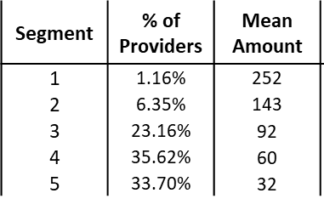
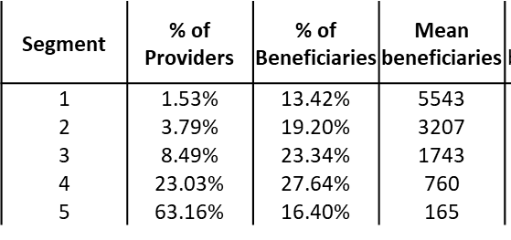
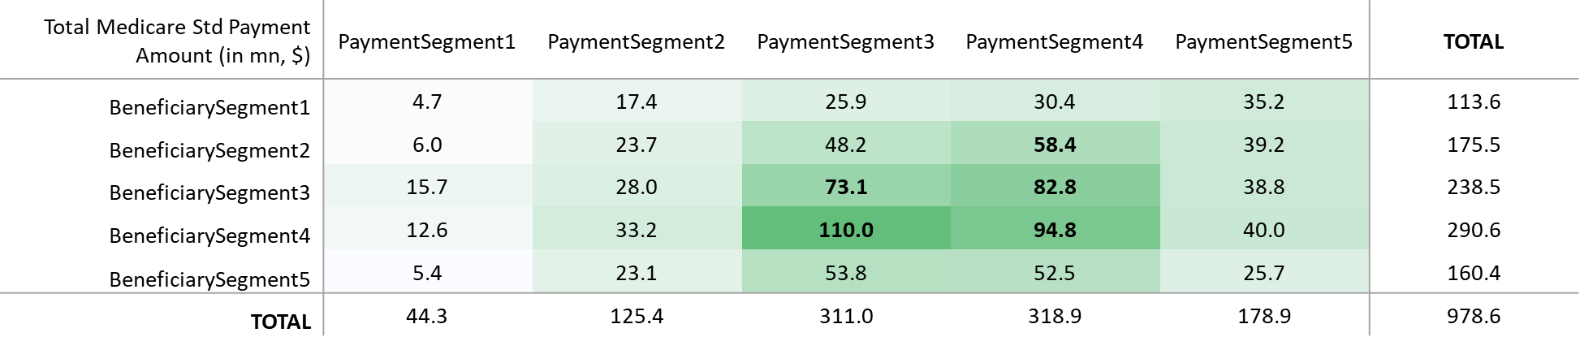
Tableau Dashboard Mockup
Boxplots can visually show cutoffs with min and max on the whiskers for each segment, accompanying tables show mean values and % of providers, whereas crosstab shows total potential
Provider Segmentation Based on CMS Spending
Segmentation based on # of Beneficiaries
Segmentation based on Avg Medicare Payment Amount
Filters
Beneficiary Segment 1
Beneficiary Segment 2
Beneficiary Segment 3
Beneficiary Segment 4
Beneficiary Segment 5
Payment Segment 1
Payment Segment 2
Payment Segment 3
Payment Segment 4
Payment Segment 5
Potential of each segment based on
Total Medicare Payments
Select Provider’s specialty
Multiple select text filter

Slide 16
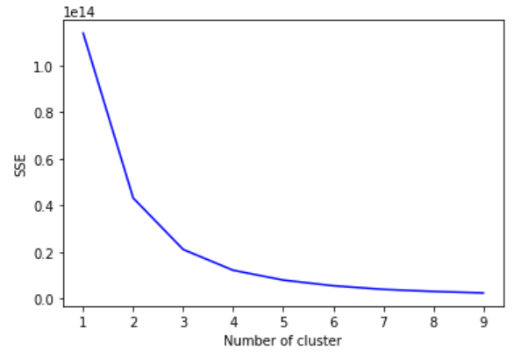

Future Scope
Instead of using fixed number of segments, we can identify the optimal number of segments based on our data. More specific clustering models can be created based on client’s brand
Find optimal number of clusters for each variable using the Elbow Method
Elbow
Run different clustering exercises based on client’s brand and specific needs. Example variables include –
Entity type – Organization or Individual
Provider Specialties – Oncologists, Diabetologists, Internal Medicine, etc.

Slide 17

Summary email to the client
Hi Cathy,
Hope you had a great weekend!
Further to the discussion last week, our team has been working on segmenting providers based on CMS spend. We started off with an objective of identifying high potential segment for <client company>’s upcoming oncology launch. After going through multiple experiments, we are excited to share our results with you because we have found some interesting trends that can help you plan for the launch!
Here is a quick summary of the key points from our analysis –
Beneficiary segmentation: When we first segmented providers based on # of Beneficiaries, 64% of providers are falling under the lowest cluster. Surprisingly even though providers from clusters 3 and 4 see moderate number of beneficiaries, but since majority of our providers fall here – this becomes our high potential segments in terms of high patient reach
Payment segmentation: Secondly, we also tried another segmentation on average Medicare payments, and we found out that majority of doctors fall under lower segments 5 and 4. We can use this information to target providers that receive higher average payments which can be an indicator of lower price sensitivity
Identifying potential segments (crosstab of both): Lastly, we created a cross tabulation of all the 25 segments to identify top 3 segments that can be targeted. To ascertain the potential, we calculated total Medicare payments that each of these segments receives (which is a product of # of beneficiaries and average payments).
For oncologists, we are seeing 3 distinct concentrated clusters that account for 33% of the total Medicare payments. These doctors show alternating behavior between either high # of beneficiaries or high average payment amount. Moreover, we can tailor our targeting here based on the average pricing of your brand
Please let me know if we can setup a calendar invite with both our teams to share these results in detail. We are also planning to make a Tableau dashboard for these clusters which can be used for different provider specialties.
Meanwhile, do let me know if you have any questions. Here is a quick summary report for your reference (attached).
Thanks,
Ishita

Slide 18
THANK YOU

