Slide 1

Optimised Flight Path Finder for Domestic Routes.
Team: GRAPHOPS
Team Id: DAA-IV-T013
Mentor: DR. TEEKAM SINGH

Slide 2

OBJECTIVES
Optimized Route Computation involves finding the shortest flight paths between airports.
Enhanced Operational Efficiency is achieved as the system aims to improve airline operational efficiency by finding optimal routes.
Cost Reduction is a key factor, with flight path optimization focused on reducing airlines' operational costs.
Contribution to Sustainable Aviation is addressed, as the project acknowledges the importance of sustainable practices in aviation.
Intelligent System Development is the approach, with the project centered on creating an "intelligent" system, moving beyond traditional, static flight planning methods.

Slide 3
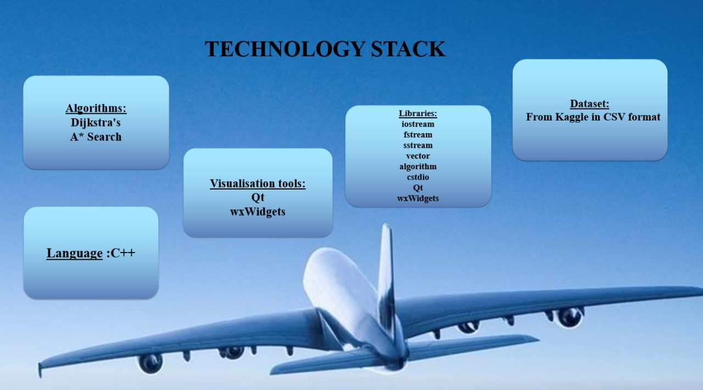

Slide 4
PROJECT OVERVIEW and IDEA
Optimised Flight Path Finder for Domestic Routes — a C++ application to find the most efficient flight routes between Indian airports.
Core Concept: Uses graph theory to model airports and routes, where airports are nodes and flight paths are weighted edges based on distance.
Primary Goal: Minimise travel distance to reduce fuel consumption, travel time, and improve operational efficiency for domestic air travel.
Algorithms Used: Implements pathfinding algorithms like Dijkstra’s and A* for optimal route calculation.
User Interface: A GUI built with Qt or wxWidgets, allowing users to select origin and destination and visualize the optimal path.
Scalability: Designed to be modular and scalable for future integration of real-time data like weather, traffic, and fuel efficiency.

Slide 5

SYSTEM ARCHITECTURE
Airport Dataset
Data pre-processing
Graph Representation
User Input Interface
Path Optimisation Algorithms
Optimal Route Display
Performance Metrics (Comparison)

Slide 6
SYSTEM WORKFLOW
Data Management: Collect and preprocess a comprehensive dataset of Indian airports, including names, codes, and geographic coordinates, to form the foundation of the airport network graph.
Graph-Based Modelling:Represent the airport network as a weighted graph using an adjacency list, where nodes are airports and edges (weighted by distance) represent direct flight connections..
Technical Implementation: Develop the application in C++ for performance, using a GUI library like Qt or wxWidgets for an intuitive interface with airport selection and visual path display.
Optimisation Algorithms: Implement efficient pathfinding algorithms such as Dijkstra’s or A* to compute the shortest route between airports based on distance.
User Experience: Design a user-friendly interface enabling easy selection of origin and destination airports, with clear visualization of the optimal path.
Scalability and Future Approach:Build a modular and scalable system, ready for future integration of real-time data (weather, traffic, fuel), additional features (aircraft type, cost), and potential cloud deployment.

Slide 7

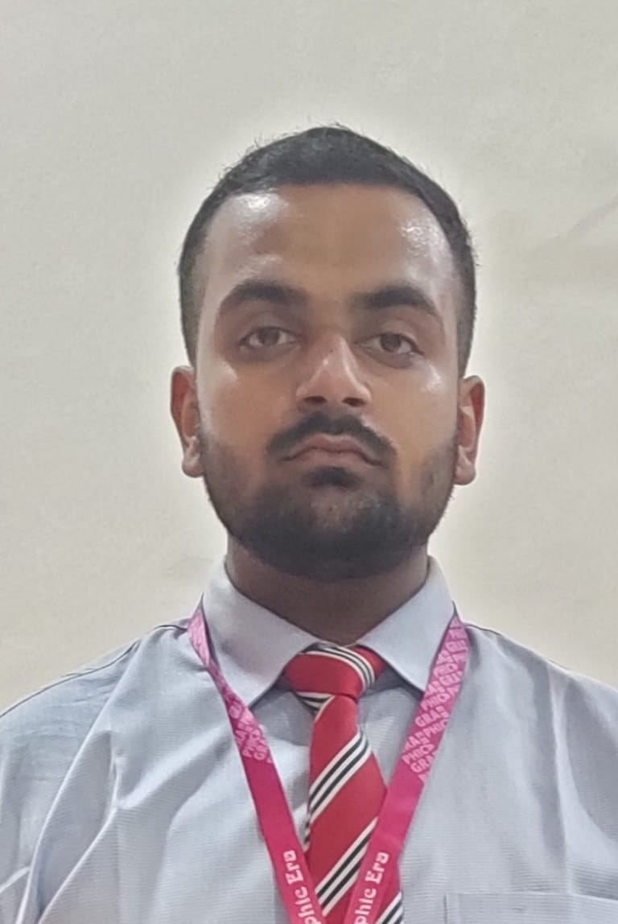
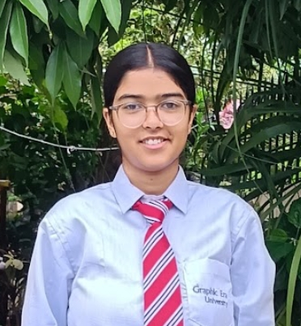

ROLES and RESPONSIBILITIES
Rudraksh Kumar
Role: Team Lead
Responsibilities: Choosing algorithms, presenting project demonstrations, and managing progress reports.
Divyanshu Thakur
Role: Team Member 2
Responsibilities: Selecting and implementing algorithms, developing the
application, and deploying the final system.
Ishita Tomar
Role: Team Member 3
Responsibilities: Managing data collection and preprocessing, and contributing to the project report.
Anshu Gupta
Role: Team Member 4
Responsibilities: Developing the graphical user interface and contributing to the project report.
:

Slide 8
Progress Report and Future Work
We have developed an understanding of the need for optimal flight paths.
The initial phase of data collection has been completed.
The data has been preprocessed and cleaned.
Our next steps include:
Applying appropriate algorithms.
Comparing the results obtained.
Developing a graphical user interface (GUI).

