Slide 1

Machine Learning-based Phishing Attack Detection
Team: TECH SHIELD
Team Id: CYBER-IV-T003
Mentor: DR. MOHAMMAD WAZID

Slide 2

OBJECTIVES
Detecting phishing websites and emails using machine learning.
Improving accuracy over traditional rule-based methods.
Minimising false positives.
Enabling near real-time threat identification.
Enhancing overall cybersecurity posture.

Slide 3

TECHNOLOGY STACK
Language :Python
Libraries used:
scikit-learn
pandas
numPy
matplotlib
xgboost
Seaborn
Algorithms:
random Forest
XGBoost
SVM
Logistic Regression
Naive Bayes
Visualization Tools:
Confusion Matrices
Bar Charts
Dataset Source: Mendeley (Phishing URL dataset in the csv format)

Slide 4

Project Overview and Idea
Phishing is a significant cyber threat that exploits human trust to deceive individuals and steal sensitive information. Traditional detection methods rely on static, rule-based systems that often fail to keep up with the constantly evolving nature of phishing attacks. To address this limitation, our machine learning-based system offers a dynamic solution that adapts to emerging attack patterns, providing more effective and accurate detection.
Idea is to create an automated machine learning classification pipeline that can:
Clean, process, train, evaluate, and compare multiple machine learning models on a labeled dataset—ultimately identifying the best-performing algorithm for the classification task.
Instead of relying on a single model, this project compares multiple algorithms (like Random Forest, SVM, Logistic Regression, Naive Bayes, and XGBoost) on the same dataset using standardised metrics to determine which one performs best.

Slide 5

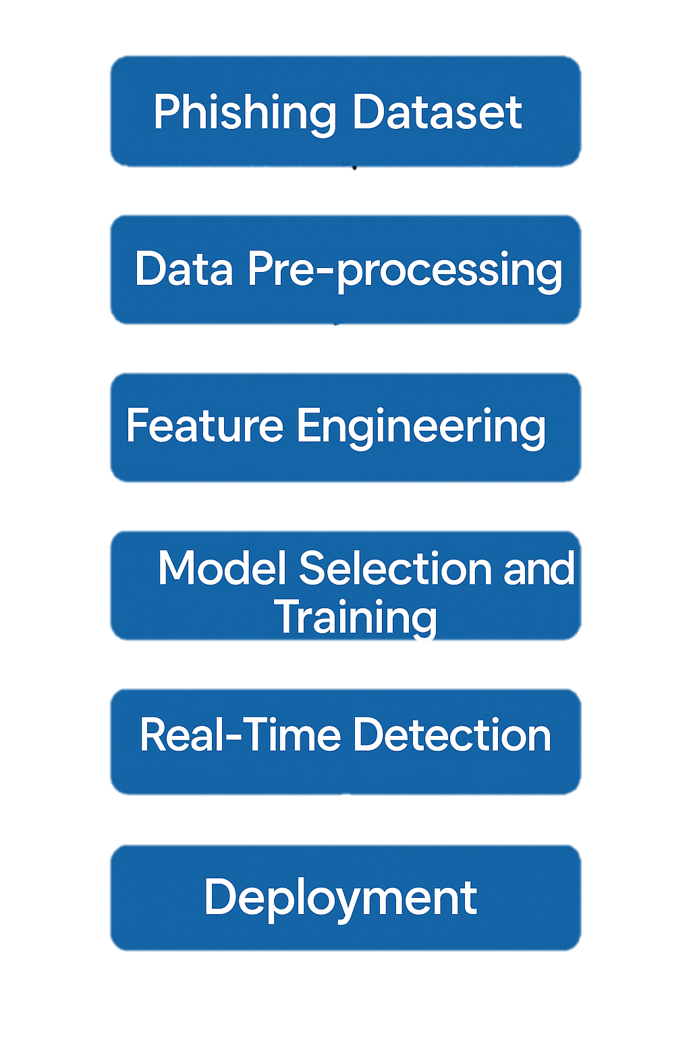
SYSTEM ARCHITECTURE

Slide 6
SYSTEM WORKFLOW
Dataset Collection: Begin by acquiring a comprehensive phishing dataset to ensure high data quality and relevance.
Data Preprocessing: Clean the dataset and normalise feature values to ensure consistency and improve model performance.
Feature Extraction and Selection: Apply feature selection techniques such as Information Gain, Chi-Square, and Recursive Feature Elimination (RFE) to identify and retain the most significant features for phishing detection.
Model Selection: Implement and compare multiple machine learning classifiers, including: Random Forest, XGBoost, Support Vector Machine (SVM), Logistic Regression, Naive Bayes
Model Training and Evaluation: Split the dataset into training and testing sets. Evaluate model performance using key metrics: Accuracy, Precision, Recall, F1-Score.
Result Comparison: Compare the performance of all algorithms to determine the most effective model for phishing detection. Visualise the results using tools such as confusion matrices, bar charts, and other relevant plots.

Slide 7

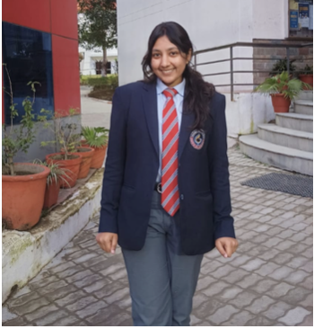


ROLES and RESPONSIBILITIES
Ishita Tomar
Role: Team Lead
Responsibilities: Handling data collection, preprocessing, feature extraction and selection, and leading the demonstration of project outcomes
and methodologies.
Anshu Gupta
Role: Team Member 2
Responsibilities: Designing the Graphical User Interface (GUI)
and will contribute to the creation of the project report.
Dashpreet Singh
Role: Team Member 3
Responsibilities: Responsible for selecting appropriate models,
training and evaluating them, and maintaining the
progress report.
Ishita Singh
Role: Team Member 4
Responsibilities: Comparing results, visualising the outcomes,
and will contribute to the creation of the project report.

Slide 8

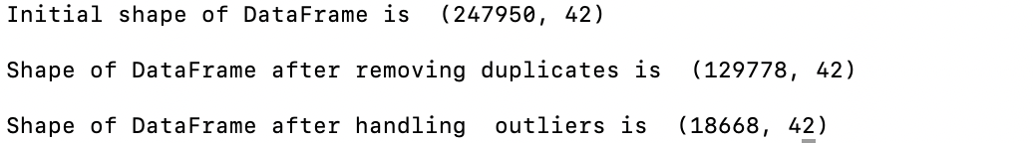
Progress Report and Future Work
Gained an understanding of phishing — what it is and how it works.
Completed the first step: data collection.
Preprocessed and cleaned the dataset:
Handled missing values.
Removed duplicate rows.
Addressed outliers using the IQR method, which led to a reduction in dataset size.
Upcoming tasks:
Perform feature extraction and selection.
Select suitable models for training and evaluation.
Compare model results using visualisation tools.
Develop a GUI to display the final project outcomes.

Slide 9
