Slide 1

Machine Learning-based Phishing Attack Detection
Team: TECH SHIELD
Team Id: CYBER-IV-T003
Mentor: DR. MOHAMMAD WAZID

Slide 2

OBJECTIVES
Detecting phishing websites and emails using machine learning.
Improving accuracy over traditional rule-based methods.
Minimising false positives.
Enabling near real-time threat identification.
Enhancing overall cybersecurity posture.

Slide 3

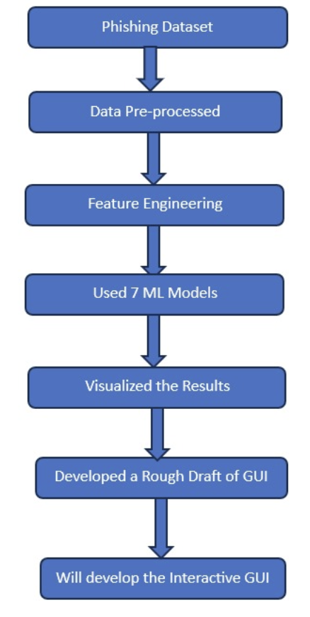
SYSTEM ARCHITECTURE

Slide 4
SYSTEM WORKFLOW
Dataset Collection: Acquired a comprehensive phishing dataset to ensure high data quality and relevance.
Data Preprocessing: Cleaned the dataset and normalised feature values to ensure consistency and improve model performance.
Feature Extraction and Selection: Apply feature selection technique SelectKBest s to identify and retain the top 20 significant features for phishing detection.
Model Selection: Implemented and compared multiple machine learning classifiers, including: Random Forest, XGBoost, Support Vector Machine (SVM), Logistic Regression, Naive Bayes , SVM and BiLSTM. Combined the output of all these algorithms using ensemble learning.
Model Training and Evaluation: Split the dataset into training and testing sets. Evaluated model performance using key metrics: Accuracy, Precision, Recall, F1-Score.
Result Comparison: Compared the performance of all algorithms to determine the most effective model for phishing detection. Visualised the results using tools such as confusion matrices and bar charts.

Slide 5
TECHNICAL PROGRESS
Earlier, we had already processed the dataset to handle the missing values, outliers, and removed the duplicate rows from the dataset. Further progress is mentioned below :
Implemented Random Forest, XGBoost, Support Vector Machine (SVM), Logistic Regression, Naive Bayes , SVM and BiLSTM.
Combined the output of all these algorithms using ensemble learning.
Developed a rough draft showing how our GUI will be interactive and displayed to the users.

Slide 6
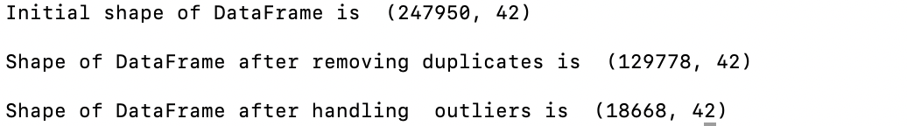
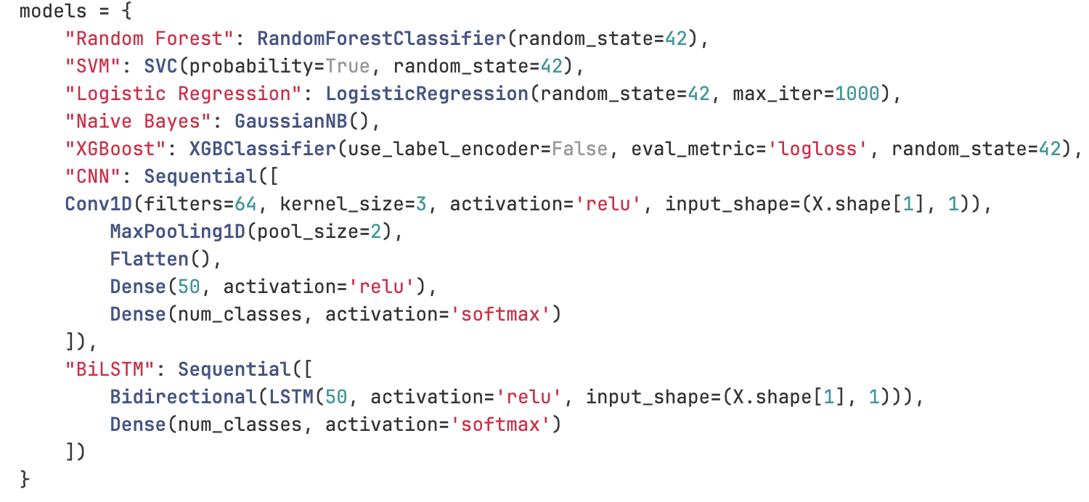
Code Snippets
The data has been pre-processed and cleaned.
Applied 7 machine learning models.

Slide 7
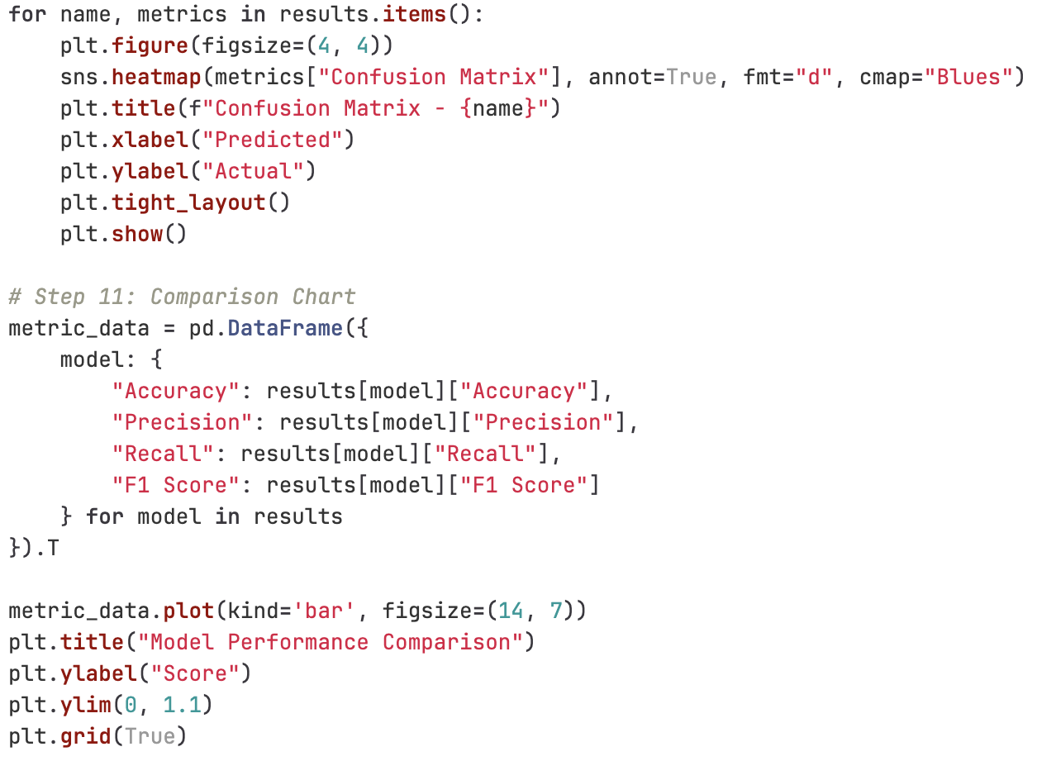
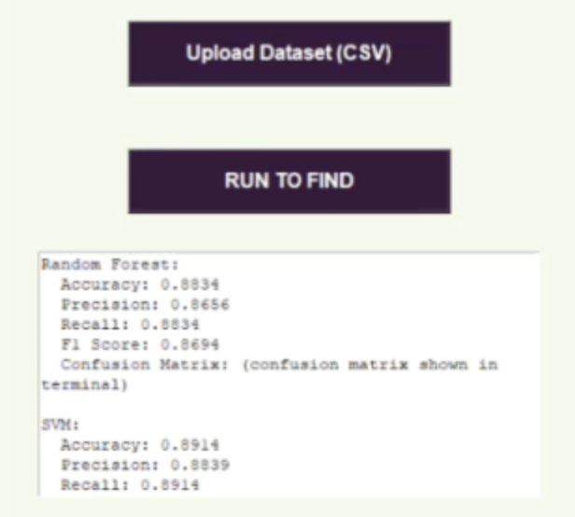
Code Snippets
Visualisation of the
Results.
Rough draft for the
GUI.

Slide 8

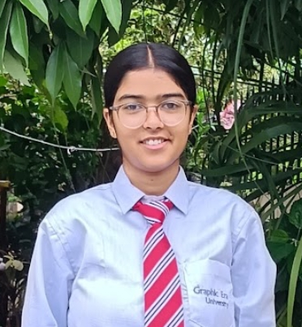
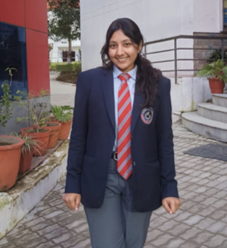
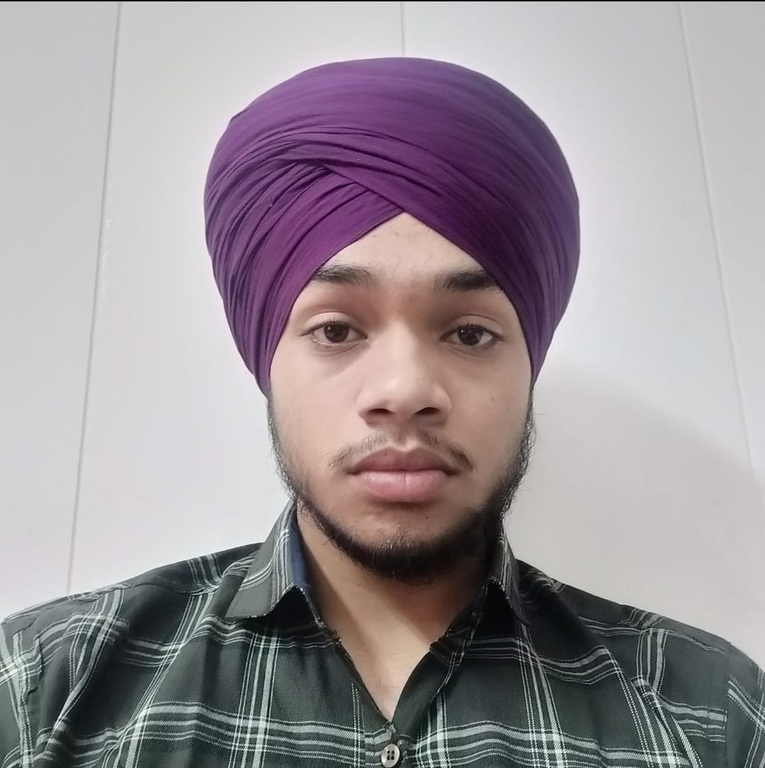
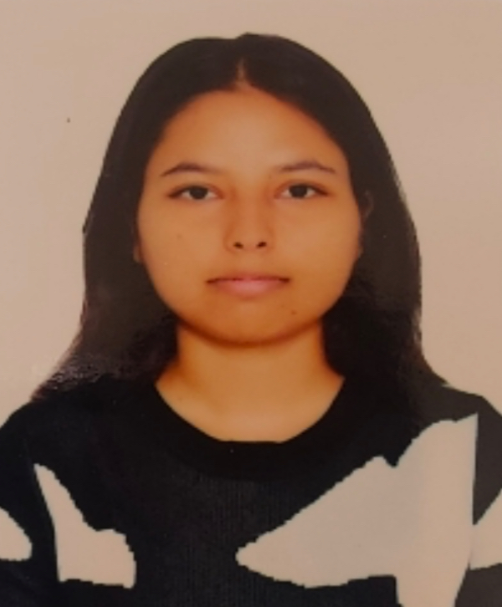
Role-wise Contributions
Ishita Tomar
Role: Team Lead
Responsibilities: Handling data collection, preprocessing, feature extraction and selection, and leading the demonstration of project outcomes and methodologies
Contribution: Collected the dataset, carried out the pre-processing and managed the progress report.
Anshu Gupta
Role: Team Member 2
Responsibilities: Designing the Graphical User Interface (GUI) and will contribute to the creation of the project report.
Contribution: Developed the rough draft for the GUI and managed the progress report.
Dashpreet Singh
Role: Team Member 3
Responsibilities: Responsible for selecting appropriate models, training and evaluating them, and maintaining the progress report.
Contribution: Selected the appropriate models, trained and evaluated them.
Ishita Singh
Role: Team Member 4
Responsibilities: Comparing results, visualising the outcomes, and will contribute to the creation of the project report.
Contribution: Visualised the outcomes and managed the progress report.

