Slide 1
Sentimental Analysis using wrapper
and
filter-based Bio-inspired Algorithms
ishita tomar
2023391
Mr. rehan

Slide 2
Introduction
Sentimental analysis is the process of extracting conclusions from the opinions of the people on a particular topic. People around the world are connected to each other through an enormous network of social networking sites such as Facebook, Instagram, twitter and some more.
Twitter with a wide range of users (more than 300 million users) and huge data is used by most of the researchers to get informative data to process the public opinion and collect the required feedback. Users communicate through their tweets having abbreviations, slangs, sarcasm, emoticons and much more.
Depression is a mental common illness faced worldwide by people of all ages. It is a type of illness which causes lack of interest in various activities, be it physical, emotional, social or anything leading to reducing one’s work efficiency.
Here, we have performed sentimental analysis on a dataset acquired from Kaggle which contains tweets expressing the depression level of the people (0 for low and 1 for high) with the help of some wrapper and filter-based bio-inspired algorithms viz. Particle Swarm Optimization (PSO), Gray Wolf Optimization (GWO) and Naive Bayes Classification.

Slide 3
Problem statement
Social Media is the hub of public opinion where millions of opinions are shared every few minutes. As more and more people are expressing their thoughts on social media which can be both neutral and polarizing. The problem is to plot public sentiments on the relative topic and monitor it.

Slide 4
Literature survey
Sentiment analysis involves identifying the emotions or sentiments conveyed in user opinions on social media platforms. Traditional sentiment analysis methods often face challenges such as high-dimensional data, noise, and other issues, which can negatively affect their performance. In recent years, optimization algorithms like Particle Swarm Optimization (PSO) and Grey Wolf Optimization (GWO) have been integrated with machine learning classifiers, such as Naive Bayes (NB), to enhance the accuracy, efficiency, and overall performance of sentiment analysis systems.
Previous research in sentiment analysis using bio-inspired algorithms—specifically wrapper and filter-based methods—has focused mainly on applying evolutionary algorithms like Genetic Algorithms (GA), PSO, and Artificial Bee Colony (ABC) for feature selection. These algorithms aim to identify the most relevant features from text data, significantly boosting the accuracy of sentiment classification by reducing dimensionality and highlighting key sentiment-bearing terms. Wrapper approaches use machine learning models to assess feature subsets during the optimization process, while filter methods rely on statistical measures to pre-select features based on their relevance to sentiment polarity. The primary goal is to employ bio-inspired algorithms to select important words or phrases that contribute to the sentiment of a text, often using techniques like TF-IDF (Term Frequency-Inverse Document Frequency) to weigh word importance.
Many studies combine filter-based feature pre-selection with wrapper-based optimization to take advantage of both methods. For instance, filter methods like the Chi-square statistic are used to initially reduce the feature space, after which bio-inspired algorithms, such as PSO or GWO, are applied to fine-tune the feature set based on their influence on the sentiment classification model.

Slide 5
Objective
Objective of the project is to extract tweets from twitter and extract sentiments out of them and develop a sentimental analysis system using Bio inspired Algorithms using PSO and GWO and various other algorithms to optimise the parameters of various machine learning classifier. The system will analyse text and data and classify it a positive, negative or neutral based on its sentiment.
Developing a sentimental analysis model using Bio inspired Algorithms, utilising some machine learning algorithms as the base model and optimising its parameters using PSO and GWO and other bio inspired algorithms with the help of python as the programming language.
Through this we will be able to analyse sentiments of various twitter handles to get what emotions they are inciting and what sentiments they are pointing to, also increasing the accuracy.

Slide 6
Project work carried out
Language Used
We used Python for the analysis of the dataset.
Dataset
We acquired a dataset (sentiment_tweets3) from Kaggle which was based on twitter tweets and were labelled as per on depression (1 for high and 0 for low). The dataset had more than 10,000 tweets labelled as “message to examine” which were classified into two categories (depression or no depression).
Natural Language Processing (NLP)
We used TF-IDF for connecting raw data to numerical form.
Model
Machine learning model-Logistic regression was used to predict whether the message indicated depression or no depression.

Slide 7
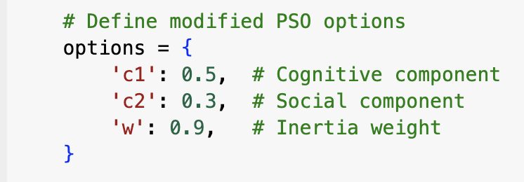
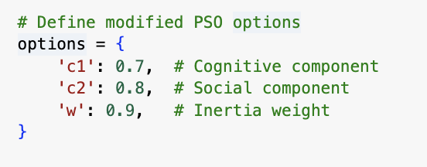
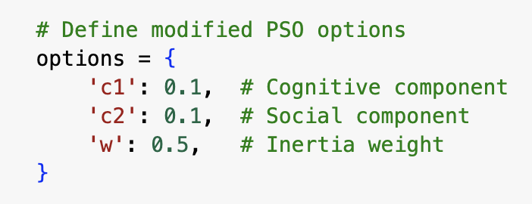
Algorithms
PSO
It is inspired by flocking nature of birds. The birds always fly together following some kind of pattern and abiding by some rules to look for food. The continuously adjust their speed and positions in order to achieve their goal of finding food. The bird closest to food is followed by the other birds. Similarly, the particles here act as the birds and the particle’s fitness value is calculated by a fitness function and velocity. It has two variables: pBest for personal best and gBest for global variable that indicates the particle closest to food.
We applied PSO to dataset using LR by using three different values of the hyper-parameters and acquired accuracies as follows:
In case I, we acquired the accuracy of about 99.03%
In case II, we acquired the accuracy of about 99.03%
In case III, we acquired the accuracy of about 99.07%
When PSO is used without any machine learning model, it gave the accuracy of about 81.44%.

Slide 8
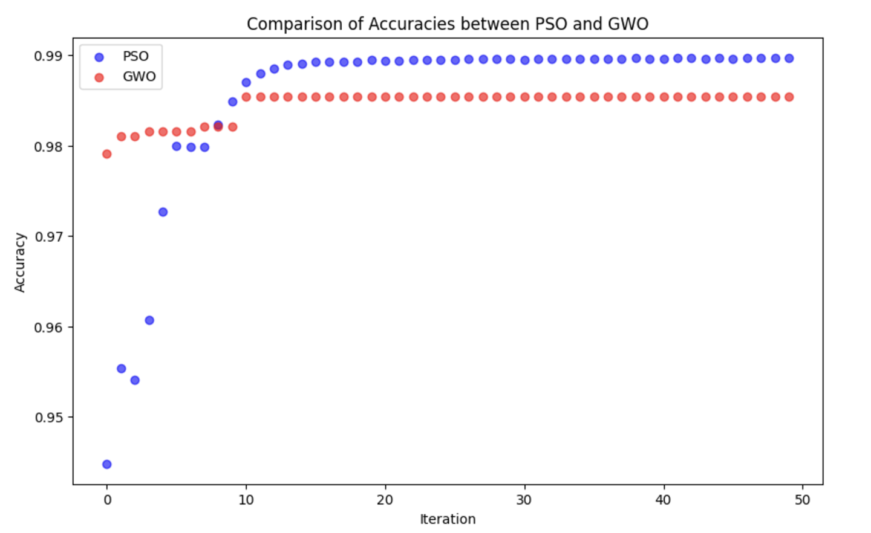
GWO
This algorithm is based on the leadership hierarchy of grey wolves and their hunting habits.
Four distinct grey wolves alpha, beta, delta and omega (in hierarchical order) are employed to implement their hierarchy.
There are three main steps in this algorithm, of which one is hierarchy management, followed by encircling prey and finally hunting.
When GWO is used without any machine learning
algorithm, it gave the accuracy of about 54.07%.
In GWO, we acquired the accuracy of about 98.54%
A scatter plot was plotted for comparing the results of PSO and GWO for accuracies.
Here, the accuracies of GWO were higher initially but later the accuracies of PSO is higher in more iterations.

Slide 9
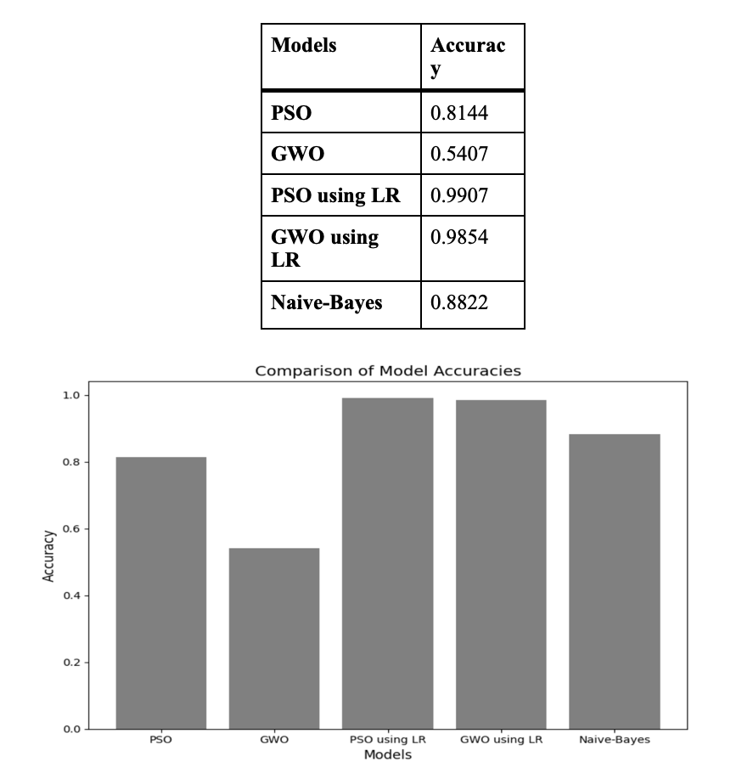
Naive Bayes Algorithms
It is an classification algorithm based on Bayes’ Theorem.
In this, we acquired the accuracy of about 88.22%
CONCLUSION
Analysis of Twitter sentiment falls under the category of mining of text and opinion. We processed the dataset using three different algorithms (PSO, GWO and Naive Bayes) and then acquired the accuracy. The table shows the accuracies acquired using various models and the bar graph shows the comparison between the accuracies of various models.

