Slide 1


INLP
PROJECT PRESENTATION
Semantic Textual Similarity
Team API
Amogha Halhalli (2021101007)
Ishit Bansal (2021101083)
Pranav Gupta (2021101095)

Slide 2

Introduction
Semantic Textual Similarity (STS) is a measure of how similar two pieces of text are in meaning, regardless of their surface-level differences. It aims to capture the underlying semantic relationship between texts, which can be crucial for various natural language processing tasks.
STS is typically assessed using numerical scores that indicate the degree of similarity between text pairs, which ranges from 0 (completely dissimilar) to 5 (completely similar). Our models generate continuous values ranging between 0 and 5 and they can be any floating point value where the value denotes the similarity between the 2 sentences.

Slide 3

Datasets Used
Mono-lingual SemEval Datasets
(Train, Validation & Test Sets)
Data STS 2017 Trail Data
Cross-Lingual SemEval Datasets (Train, Validation and Test Sets)
STS Cross-lingual English-Spanish
Train Set - 5749 pairs of sentences
Validation Set - 1500 pairs of sentences
Test Set - 1379 pairs of sentences
Train Set - 5749 pairs of sentences
Validation Set - 1500 pairs of sentences
Test Set - 1379 pairs of sentences

Slide 4
Data Preprocessing
Data cleaning was done in many stages:
Removal of URLs, hashtags, punctuations, etc.
Removed the stop words.
Lemmatization and Stemming.
For the Cross-Lingual case, Stopwords of both English and Spanish language are removed.

Slide 5
Flow of the Algorithm
STS score is generated in the following manner:
First, the Words in the sentences are converted into embeddings by any Pre-trained Word Embedding model like the Google News dataset.
Embeddings are passed through the model to generate contextual embeddings. The model can range from Word2Vec to BERT, etc.

Slide 6
The generated contextual embeddings are used and the cosine similarity is measured between them. It leads to outputs in the range of (-1, 1). Then, Similarity score is evaluated by the formula (cosine_sim+1)*2.5, which projects it into the range (0, 5).
Then, Pearson correlation coefficient is used.
For performing Fine-Tuning, we have used MSE Loss with Adam Optimizer because it is a regression task since the outputs involve continuous values.

Slide 7

Evaluation Metrics
We have used Pearson correlation coefficient to evaluate models. It measures the linear correlation between the predicted similarity scores and the ground truth similarity scores.

Slide 8
Models used
Word2Vec
BERT Model (both untrained and Fine-tuned)
RoBERTa Model (both untrained and Fine-tuned)
Doc2Vec (both untrained and Fine-tuned)
Sentence Transformers (both untrained and Fine-tuned)
Siamese BiLSTMs
Universal Sentence Encoder (USE) (both untrained and Fine-tuned)

Slide 9
Mono-Lingual Results
Model Name | Train data Pearson Coefficient | Validation data Pearson Coefficient | Test data Pearson Coefficient
Word2Vec | 0.68 | 0.73 | 0.63
BERT | 0.90 | 0.83 | 0.82
RoBERTa | 0.95 | 0.91 | 0.91

Slide 10
Model Name | Train data Pearson Coefficient | Validation data Pearson Coefficient | Test data Pearson Coefficient
USE | 0.88 | 0.55 | 0.54
Sentence Transformer | 0.78 | 0.82 | 0.76
Doc2Vec | 0.87 | 0.38 | 0.34

Slide 11
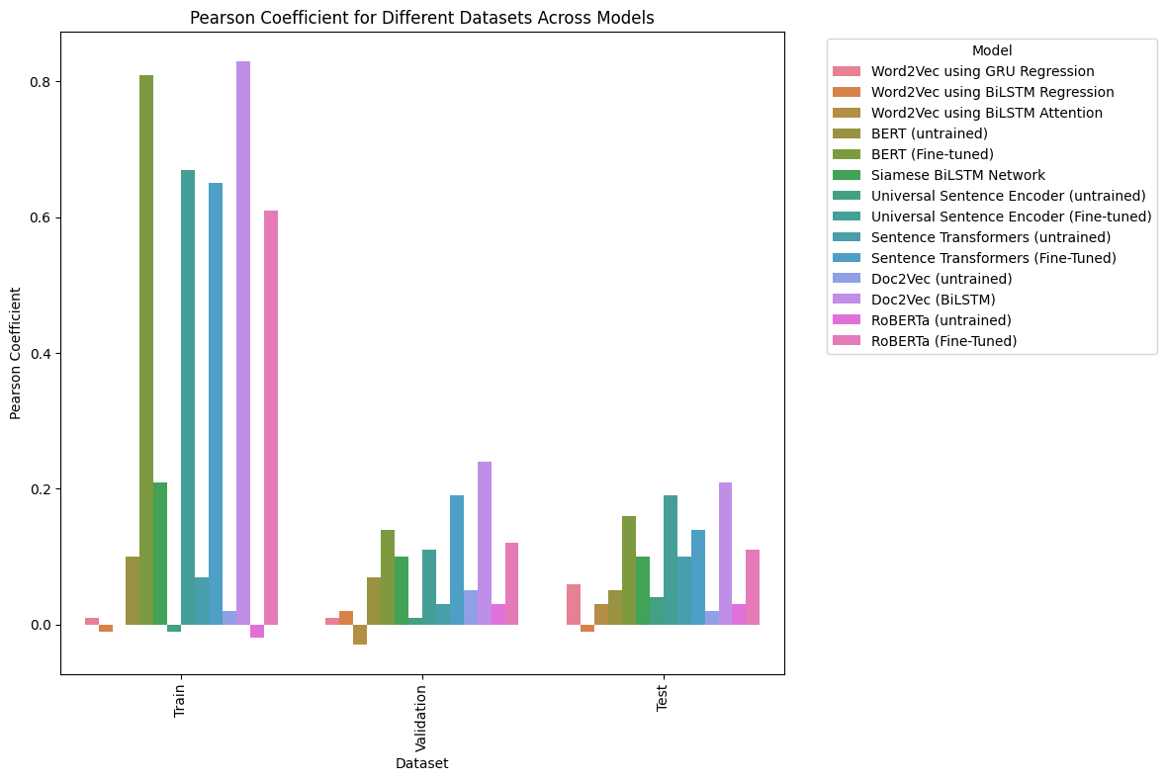

Slide 12
Cross-Lingual Results
Model Name | Train data Pearson Coefficient | Validation data Pearson Coefficient | Test data Pearson Coefficient
Doc2Vec | 0.83 | 0.24 | 0.21
USE | 0.67 | 0.11 | 0.19
BERT | 0.81 | 0.14 | 0.16

Slide 14
Conclusion
Analysis of Mono-Lingual Similarity: Word2Vec base embeddings perform decently, but adding complex models doesn't improve results. Contextualized embeddings like BERT and RoBERTa show significant improvement with fine-tuning. Doc2Vec and Universal Sentence Encoder perform well, with the latter excelling even un-tuned. Sentence Transformers consistently shine. Siamese BiLSTM shows promise, but needs refinement. Overall, embedding method and model architecture are crucial. While Word2Vec works decently, fine-tuned contextualized embeddings and advanced architectures like BiLSTM and Universal Sentence Encoder achieve superior performance.

Slide 15
Analysis of Cross-Lingual Similarity: It reveals limitations in current approaches. Word2Vec models and base versions of BERT and RoBERTa struggle to capture semantic similarity across languages. Fine-tuning BERT and RoBERTa improves results, but performance remains modest. Siamese BiLSTM networks show promise, while Universal Sentence Encoders and Sentence Transformers display mixed performance, sensitive to data and fine-tuning. Doc2Vec embeddings with BiLSTM outperform many models, suggesting their effectiveness for cross-lingual tasks. Overall, there's a need for more robust methods to tackle the complexities of cross-lingual semantic similarity.

Slide 16

Thank You
PRESENTED BY : TEAM API

