Slide 1
Project
Social Networking Systems
Ishitva Goel G.B Pant Engineering College New Delhi

Slide 2
Project Model
A website where we can subscribe to people' s
status updates and play games.

Slide 3
Languages Used
PHP – It is a server side scripting language which can dynamically process the input data as well as the data stored in the database and result in dynamic webpages.
SQL - It is a language which is used for managing data in Relational Database Management System .
HTML – It is a markup language used for describing the layout of webapges ie. How the elements are organized.
Javascript – It is browser side scripting language which is for processing the information at the client side before sending it to the server .
CSS – It is a language used for adding design effects on the webpages.

Slide 4
Tools Used
Notepad++ : It is an Open Source text editing tool , which provides functions like Syntax Highlighting and opening up of multiple files in different tabs.
WAMP server :
It is a package of APACHE server , MySQL database and a PHP processor .

Slide 5
Features
Session Based – The website uses Session variables to store important information which is needed for the following purposes:- 1)To open the pages of the website only when the session variables for the user are set. Otherwise the user is redirected to the Homepage for logging in or signing up. 2)For extracting the information of the user from the database by passing the value stored in a session variable in an SQL statement. 3) For implementing the Log Out functionality. For logging out a user , his session has to be destroyed and session variables have to be unset.

Slide 6
Features (contd.)
Password Encryption –
The passwords in the database have been encrypted so that anyone who has access to the database cannot know the passwords of the registered users. The encryption which has been used here is the MD5 encryption. It is a cryptographic algorithm which generates a 32 digit code.

Slide 7
Features (contd.)
Administrator's Portal -
The facility of Activating and Deactivating certain users has been created for the website Administrator . For this there is a Portal page , where the admin can look up all the registered users and can take appropriate action .

Slide 8
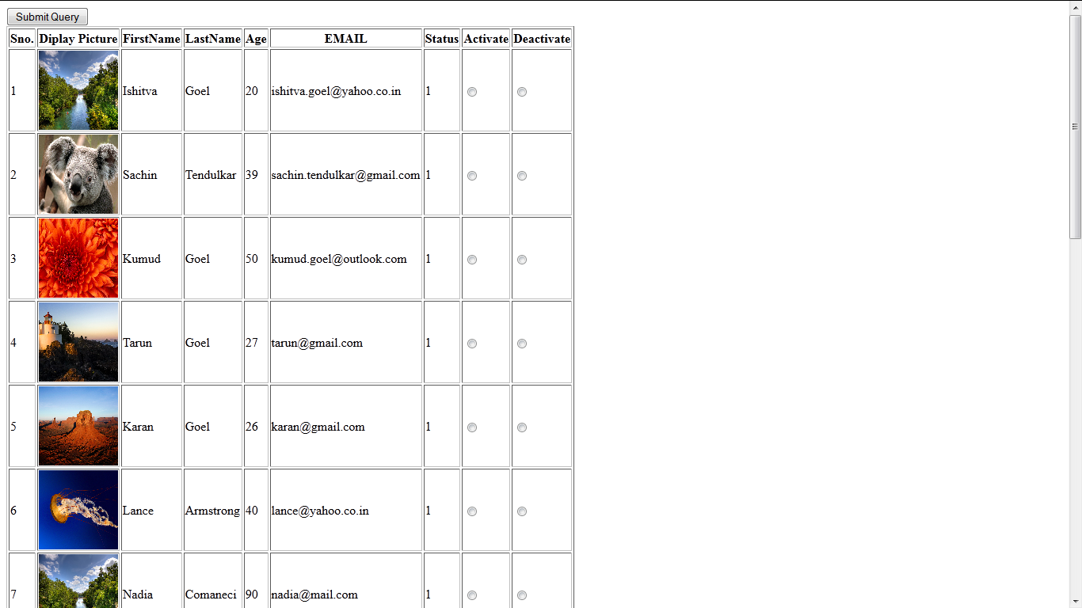
Administrator's Portal

Slide 9
Features (contd.)
Homepage-
It is the first page of the website which opens up. Here , there is a provision for :-
Login In : The registered users can login by entering the email and password. For login verification the input password is itself converted into the 32 digit MD5 code and then the matching is done by the value stored in the database. Now two checks are performed 1) Email registered or not 2) Password is valid or not . Upon Successful login the profile page is opened up.
Sign Up : New users can register. When the user clicks on the Sign Up link the Form Page is opened up.

Slide 10
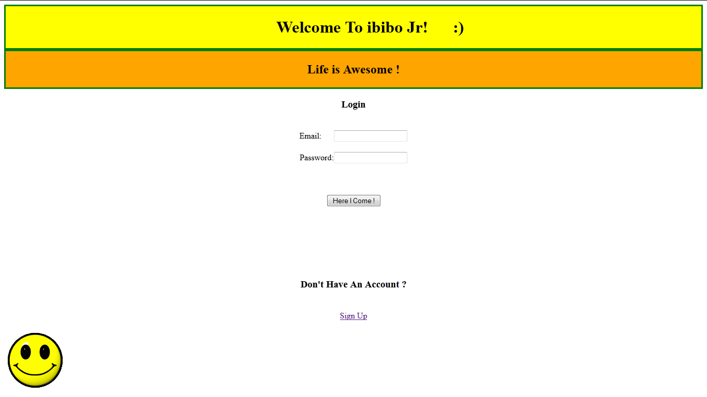
Homepage

Slide 11
Features (contd.)
Form Page -
Using this page a user can make a new account by filling up the required fields . The following Javascript validations have been used on this page :-
Text Fields must not be null and should not contain any whitespaces(except the City field).
Age must be a valid number.
Password must be atleast 5 characters long and should contain atleast one special character.
Email field ( the most challenging !) contains the following checks 1) At most one '@' is allowed and one must exist. 2) At least one Dot should be there.

Slide 12
3)There must not be any simultaneous Dots. 4)There cannot be any space in between. 5)No special character other than Dot or '@' is allowed . 6)The user name must be at least 3 characters long. 7)At least two characters must follow the last dot. 8)The last dot must come after ' @ ' sign. 9)The dots and the '@' sign must not be simultaneous.
File Upload Validation ( For display Image ) - In this the following checks have been put:- 1)The allowed file types are - .jpeg , .jpg , .png and .gif . 2)The maximum image size can be 4.7 mb . All the images are stored on the server , and to prevent overwriting of the images with the same name, these are renamed as <Sno>.extension for each user before storing on the server , as Sno is set as primary key and thus cannot be redundant. Also when the user doesn't upload any image then the default image is used .

Slide 13
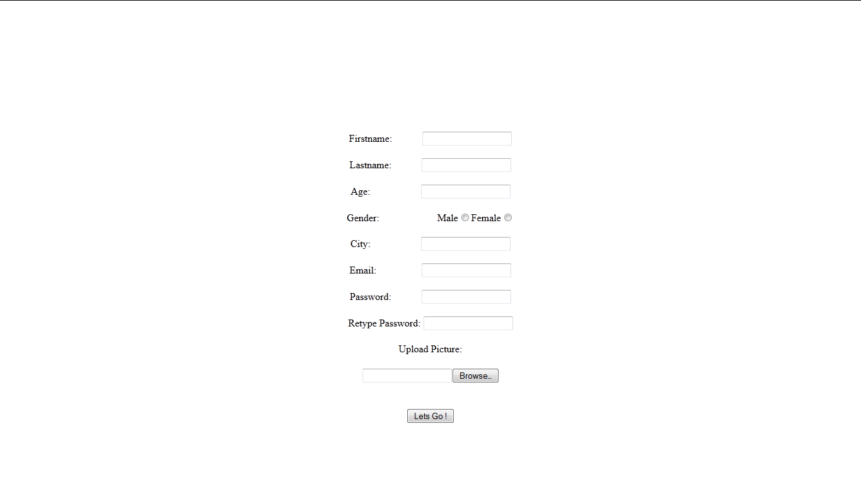
Form Page

Slide 14
Features (contd.)
Profile Page -
This page is the play ground of the user . It contains the following features:- 1)The user's display picture along with her status update. 2)Provision for changing the status update. 3)Provision for Playing games. 4)Suggestions on the people to subscribe to , on the basis of 1)Last common played game. 2) Opposite gender. 5)The subscription list. We can click on any subscription to view its profile. 6)Provision for removing subscriptions. 7)Provision for editing user information. 8)Log out function .

Slide 15
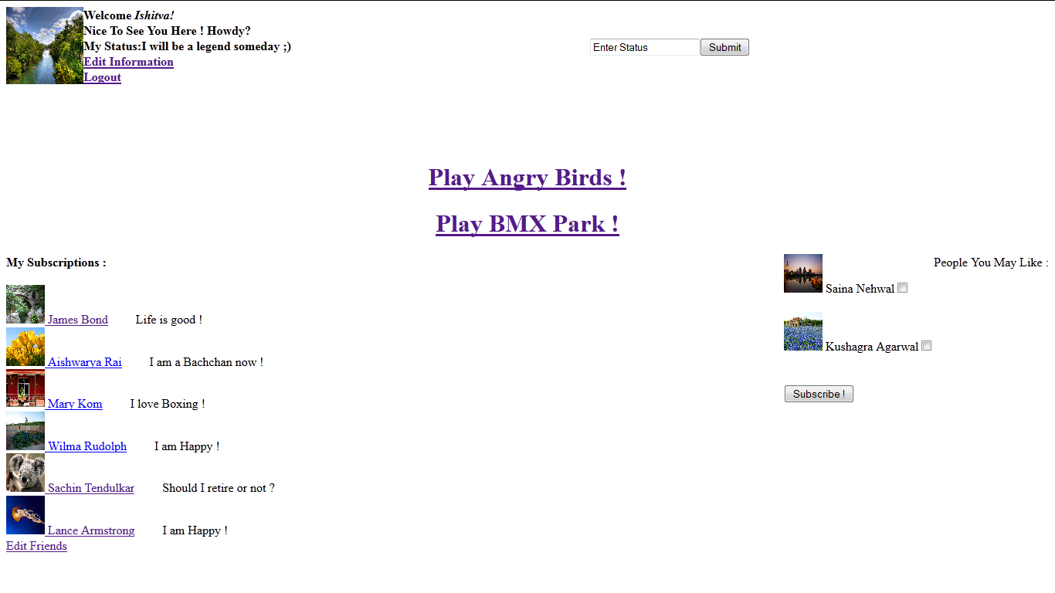

Slide 16
Features (contd.)
Profile Page of subscriptions - On this page we can view the information of our subscriptions and read their status updates .

Slide 17
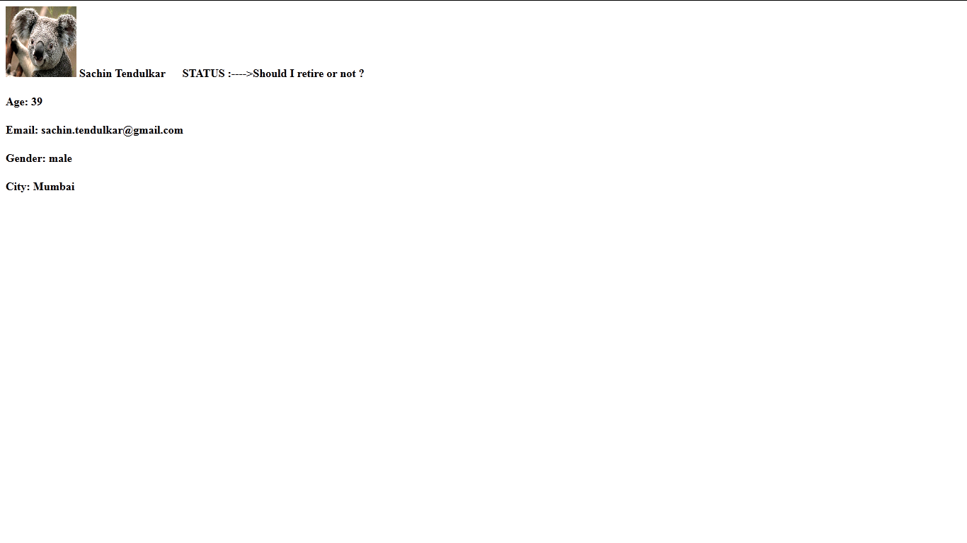
Other's Profile Page

Slide 18
Features (Contd.)
Edit Subscriptions Page- Using this page we can unsubscribe to the status updates of the people whom we don't want to follow any more.

Slide 19
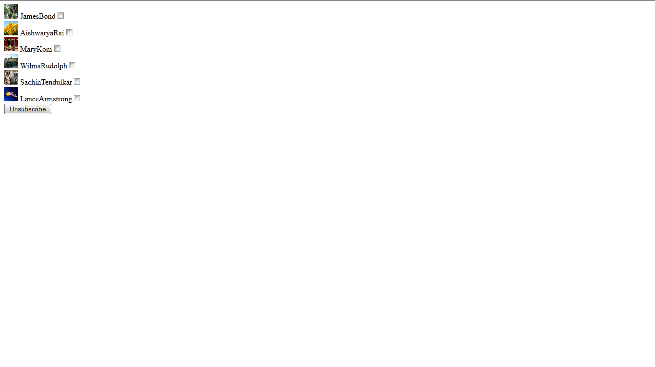
Edit Subscriptions Page

Slide 20
Features (contd.)
Edit Information page - This page allows us to update our information and also change our display picture. Here the link to password change page is also provided upon opening which , we can change our password.

Slide 21
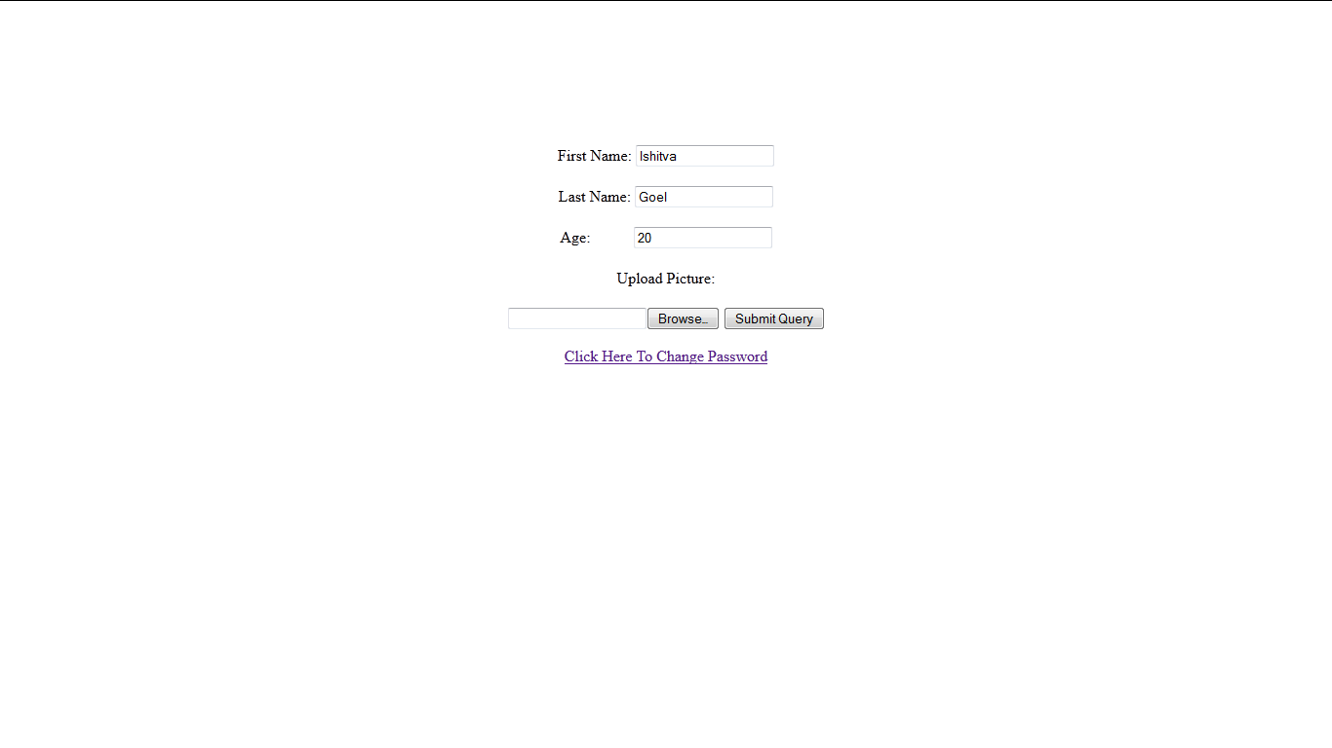
Edit Information Page

Slide 22
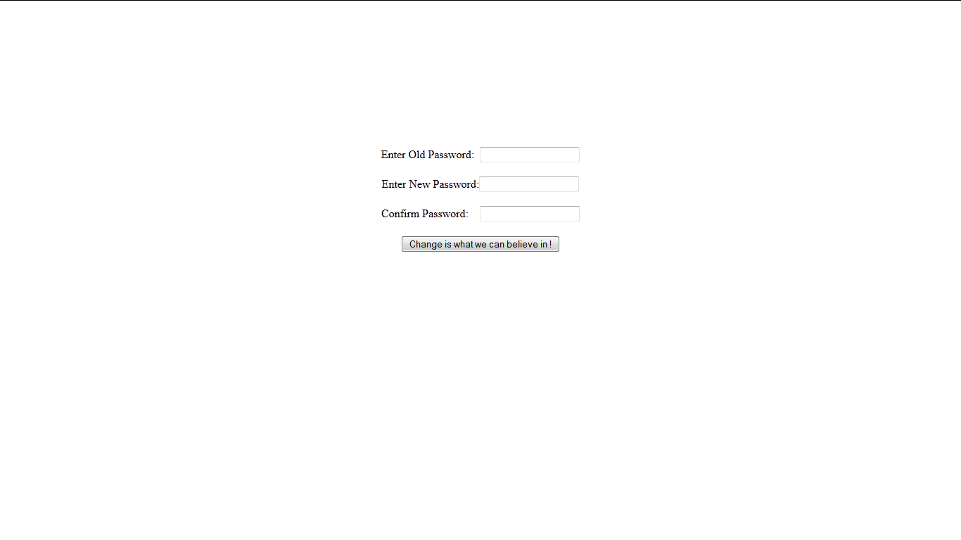
Change Password Page

Slide 23
Features (contd.)
Games Pages-
We can play games on this website. The game pages themselves are PHP pages which store our Serial Number in the table. These entries in the table are used for generating suggestions. The games put are 1) Angry Birds 2) BMX Park

Slide 24
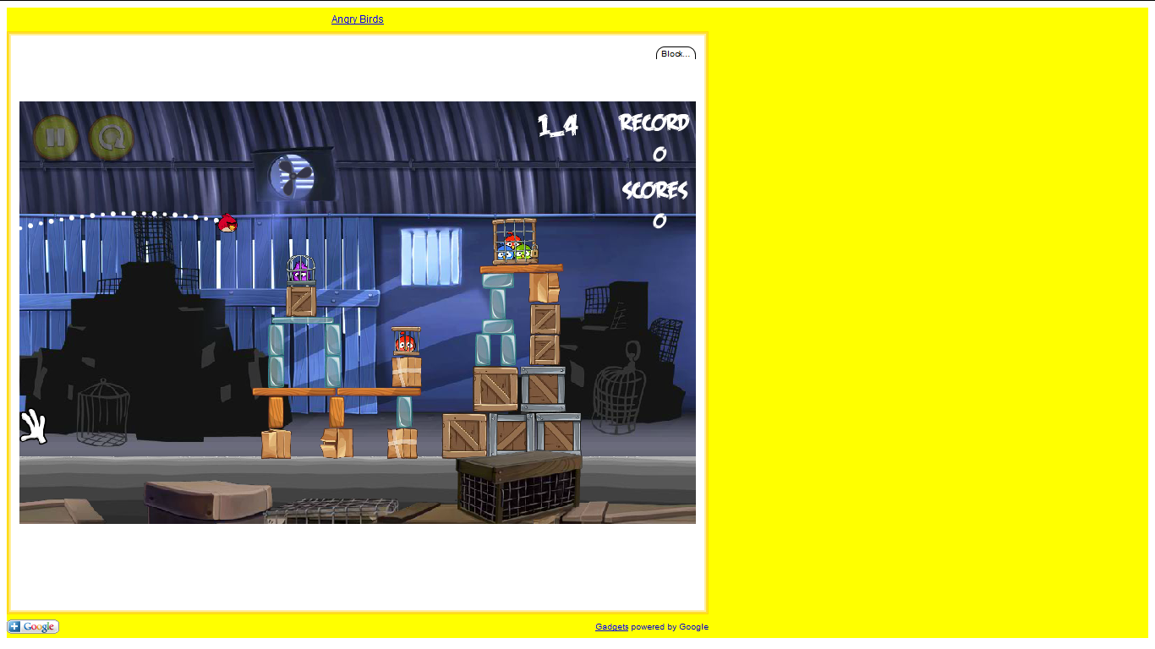
Angry Birds Game

Slide 25
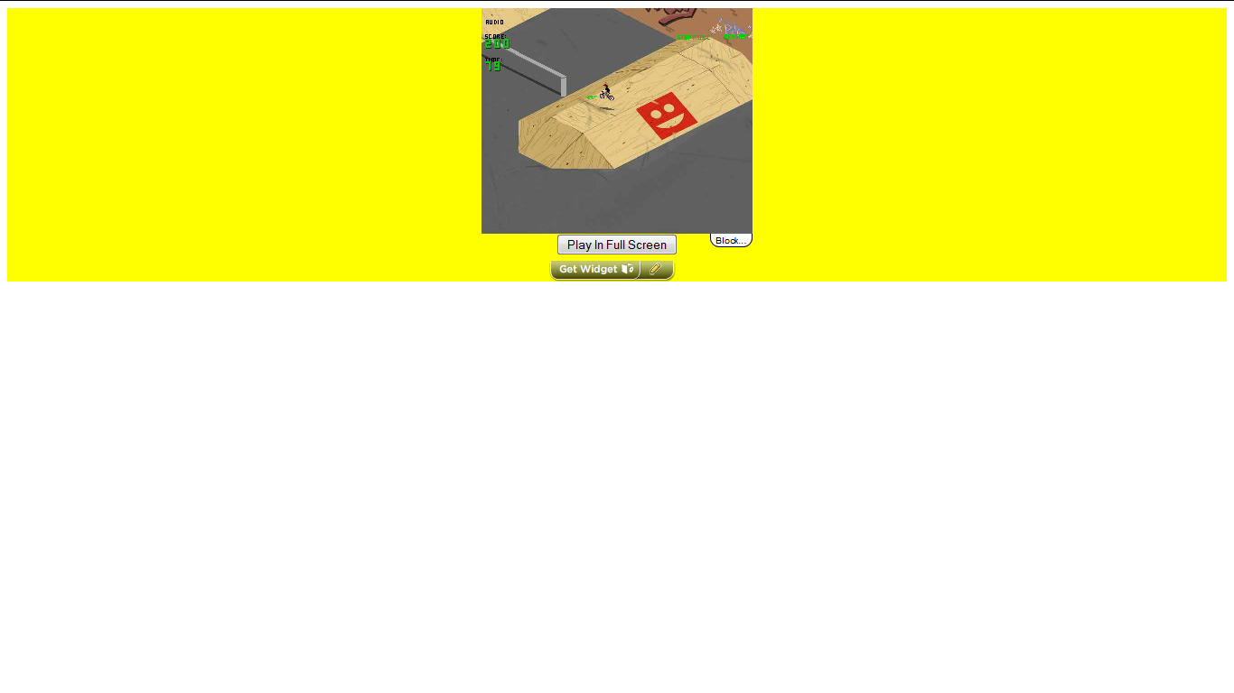
BMX Park Game

Slide 26
The End
Thank you.

