Slide 1
ANTICIPATING TURNING POINTS
Left-Brained Concepts for Traders in their Right Minds

Slide 2
This Session is an excerpt from my Runner Up Paper for the MTA Charles H. Dow Award
www.mta.org
Activities Tab – Charles H. Dow Award
also available at
www.eminiz.com

Slide 3
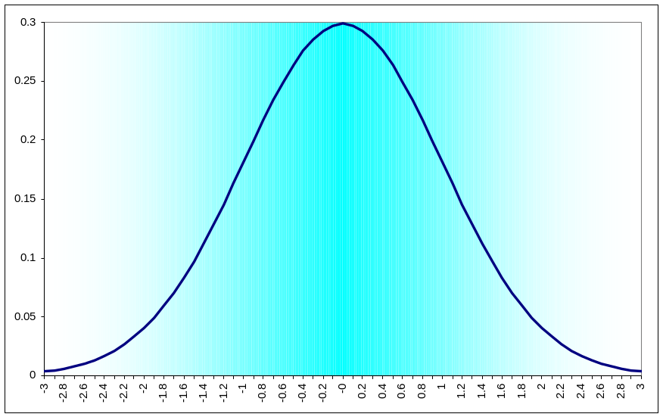
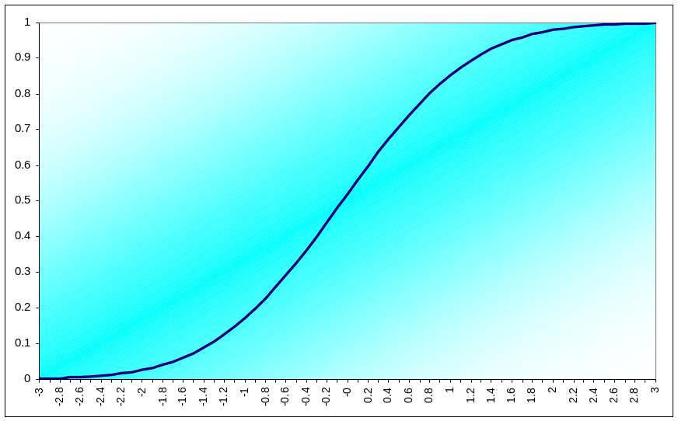
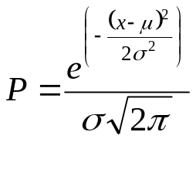
Normal (Gaussian) Probability Distribution Function (PDF) is Commonly Assumed for Market Data
Normal PDF
Cumulative Normal PDF
0 = 50%
+1σ = 85%
+2σ = 98%
+3σ = 99.9%
Normal PDF is attractive because it can be achieved
using several random variables due to the central limit theorem
But is Normal the right PDF for market data?

Slide 4
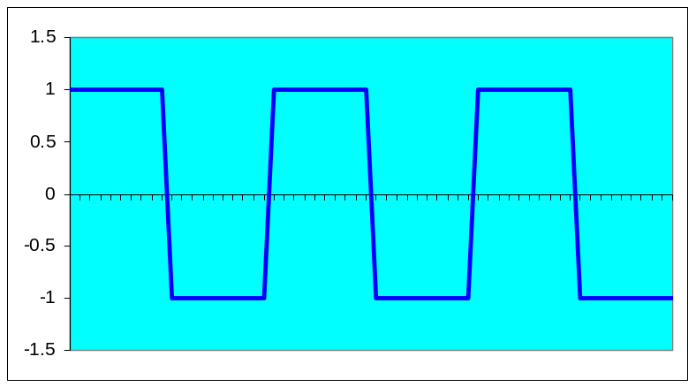
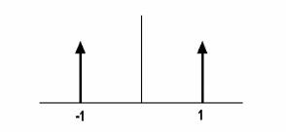
CONSIDER A THEORETICAL SQUAREWAVE
Square Wave
Binary PDF of Square Wave
A Square Wave cannot be traded with conventional indicators
because the move is over before any indicator can show the move

Slide 5
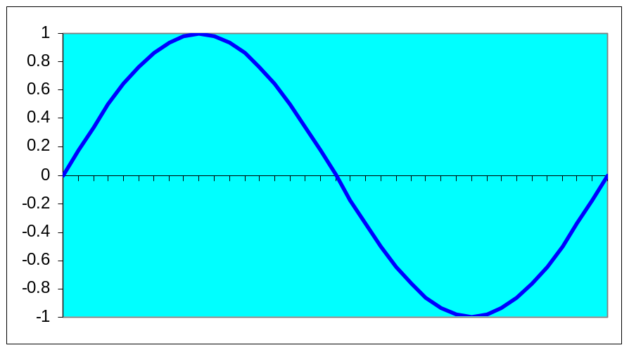
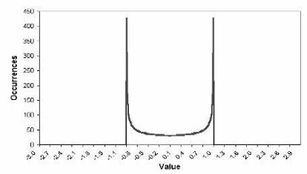
NEXT - CONSIDER A SINEWAVE
Sine Wave
Sine Wave PDF
The Probability Distribution of a Sinewave
is similar to that of a Squarewave
This is why most traders have trouble trading with cycles
The cyclic turning point must be anticipated

Slide 6
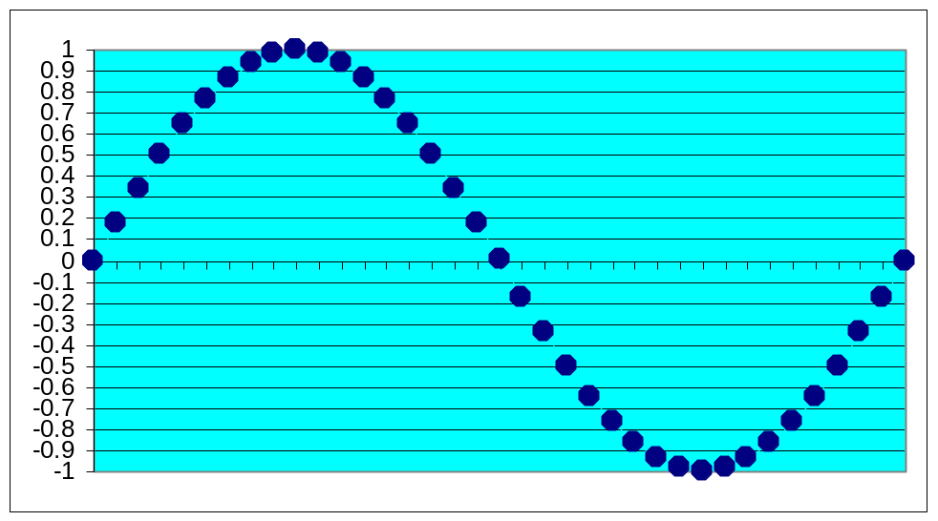
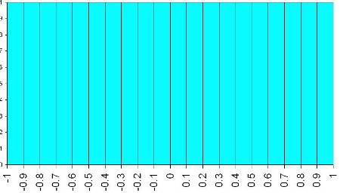
How Do We Determine the Market PDF?
Create the waveform by
stringing beads on a
horizontal wire frame
Rotate wire frame to
enable beads to
stack up
Height of the bead
stacks is the PDF
of the Waveform

Slide 7
Channel Limited PDF Generator Code
Inputs:
Length(20);
Vars:
HH(0),
LL(0),
J(0),
I(0);
Arrays:
Filt[2000](0),
Bin[100](0);
HH = Close;
LL = Close;
For I = 0 to Length -1 Begin
If Close[I] > HH then HH = Close[I];
If Close[I] < LL then LL = Close[I];
End;
If HH <> LL Then Value1 = (Close - LL) / (HH - LL);
Filt[CurrentBar] = (Value1 + 2*Value1[1] + Value1[2]) / 4;
For I = 0 to 100 Begin
If Filt[J] >= I/100 and Filt[J] < (I + 1)/100 Then Bin[I] = Bin[I]+1;
End;
For I = 0 to 99 Begin
Print(File("c:\tsgrowth\pdf.csv"), I, ",", Bin[I]);
End;
Plot1(Filt[CurrentBar]);

Slide 8
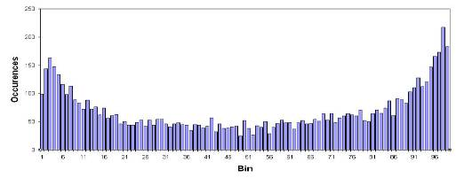
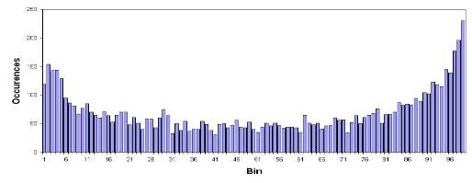
Channel PDF for Treasury Bonds
20 Bar Channel over 30 Years
40 Bar Channel over 30 Years
Clearly, Channel Limited Detrending produces Sinewave-Like PDFs

Slide 9
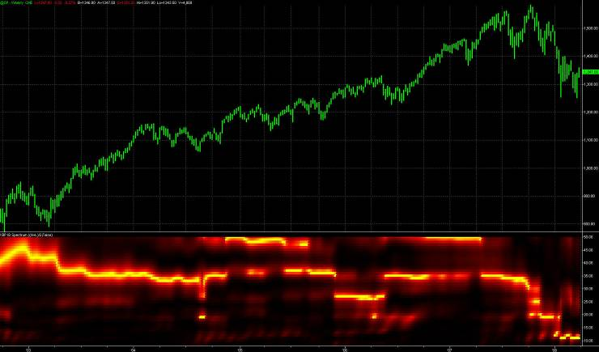
SPY Weekly for Last Five Years
Consistent 36 Week Cycle is Measured
(code from Jan 2008 Stocks & Commodities)

Slide 10
CONVINCED THERE ARE TRADEABLE CYCLES?
Market Cycles have been measured
  With Probability Distribution Functions
  With Spectral Analysis
Trading with Cycles is difficult because the turning points MUST be anticipated
  Conventional Indicators are basically useless because of lag
I will show you two ways to anticipate the turning points using cycles
  Correlating prices with a sinewave and advancing the phase
  BandPass Filtering

Slide 11
Sine Correlation System

Slide 12
Sine Correlation System
Detrend prices by highpass filtering
Correlate a sinewave to the detrended price by maximizing the sum of the product across:
  Full range of cycle periods
  360 degrees of phase for each period
Resulting sinewave (period and phase) is the signal
Advance the signal by two bars to get a leading signal
Crossover of the two signal lines are the trading signals

Slide 13
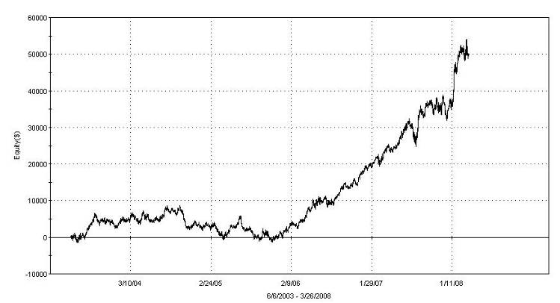
Sine Correlation Performance for Five Years on @ES.D
Net Profit: $50,637
# Trades: 185 (about one trade every 1.25 weeks)
% Profitable: 63.8%
Profit Factor: 1.87
Trade Drawdown: ($5,375)

Slide 14
BandPass Filtering

Slide 15
BandPass Filter System
BandPass filtering through a narrow passband filter reduces prices to a sinewave with slowly varying phase and amplitude
This technique ONLY works because the filtered prices are quasi-sinewave
  The period of the cycle must be known
  Don’t try this on a Stochastic, RSI, or other oscillator
From the calculus we know that
d(Sin(ωt))/dt = ω*Cos(ωt)
Therefore, a 90 degree leading waveform can be obtained by taking a one bar momentum and dividing it by the angular frequency (multiply by Period/2π)

Slide 16
BandPass Filter System
Bandpass filter the price for a selected cycle period
  Call this I for In-Phase
Multiply one bar momentum of the bandpass filtered signal by (Period/2π)
  Call this Q for Quadrature
Create a 60 degree leading signal
  Lead = .5*I + .866*Q
Crossovers of “I” and “Lead” are the trading signals

Slide 17
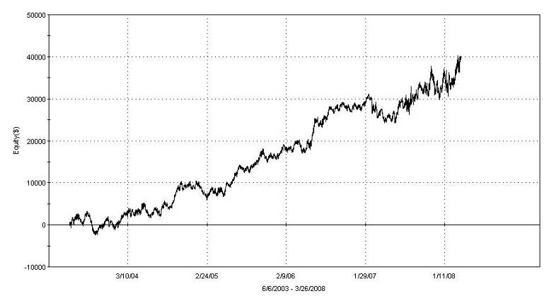
BandPass System Performance
Net Profit: $40,037
# Trades: 133 (about one trade every 1.75 weeks)
% Profitable: 59.4%
Profit Factor: 1.84
Trade Drawdown: ($3,550)

Slide 18
Probability Distribution Varies with Detrending
Channel Limited detrending generally yields PDFs similar to the PDF of a Sine Wave
Two more detrending approaches will be described where that is not necessarily true
  HighPass Filtering
  RSI

Slide 19
Highpass Filter PDF Generator Code
Inputs:
HPPeriod(40);
Vars:
alpha(0), HP(0), HH(0), LL(0), Count(0), Psn(0), I(0);
Arrays:
Bin[100](0);
alpha = (1 - Sine (360 / HPPeriod)) / Cosine(360 / HPPeriod);
HP = .5*(1 + alpha)*(Close - Close[1]) + alpha*HP[1];
IF CurrentBar = 1 THEN HP = 0;
If CurrentBar > HPPeriod Then Begin
HH = HP;
LL = HP;
For Count = 0 to HPPeriod -1 Begin
If HP[Count] > HH Then HH = HP[Count];
If HP[Count] < LL Then LL = HP[Count];
End;
If HH <> LL Then Value1 = 100*(HP - LL) / (HH - LL);
Psn = (Value1 + 2*Value1[1] + Value1[2]) / 4;
For I = 1 to 100 Begin
If Psn > I - 1 and Psn <= I Then Bin[I] = Bin[I] + 1;
End;
Plot1(Psn);
End;
If LastBarOnChart Then Begin
For I = 1 to 99 Begin
Print(File("C:\TSGrowth\PDF_HP.CSV"), I, ",", Bin[I]);
End;
End;

Slide 20
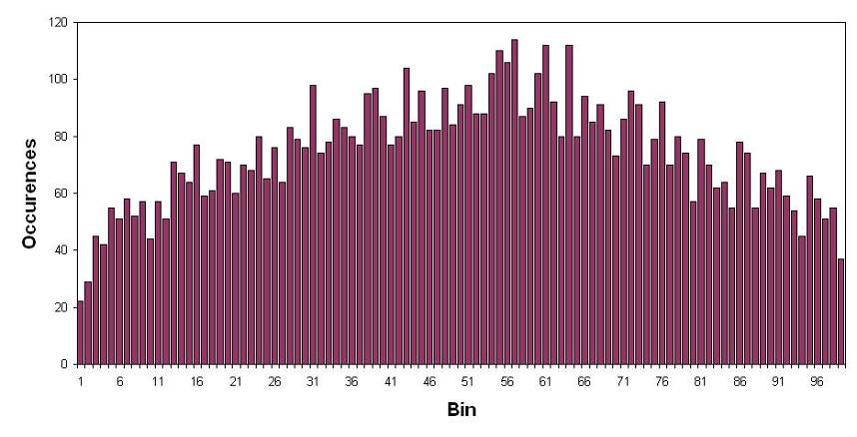
HP Filtered PDF for Treasury Bonds
40 Bar Cutoff over 30 Years
PDFs produced by filtering have nearly uniform probability

Slide 21
MyRSI PDF Generator Code
Inputs:
Length(10);
Vars:
CU(0), CD(0), I(0), MyRSI(0), Psn(0);
Arrays:
Bin[100](0),
PDF[100](0);
If CurrentBar > Length Then Begin
CU = 0;
CD = 0;
For I = 0 to Length -1 Begin
If Close[I] - Close[I + 1] > 0 Then CU = CU + Close[I] - Close[I + 1];
If Close[I] - Close[I + 1] < 0 Then CD = CD + Close[I + 1] - Close[I];
End;
If CU + CD <> 0 Then MyRSI = 50*((CU - CD) / (CU + CD) + 1);
Psn = (MyRSI + 2*MyRSI[1] + MyRSI[2]) / 4;
For I = 1 to 100 Begin
If Psn > I - 1 and Psn <= I Then Bin[I] = Bin[I] + 1;
End;
End;
If LastBarOnChart Then Begin
For I = 1 to 99 Begin
Print(File("C:\TSGrowth\PDF_RSI.CSV"), I, ",", PDF[I]);
End;
End;

Slide 22
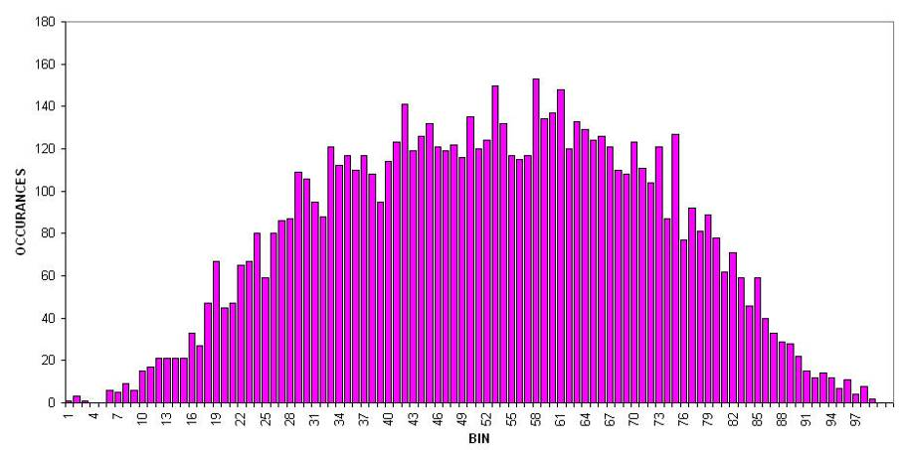
MyRSI PDF for Treasury Bonds
10 Bar RSI over 30 Years
RSI Detrending yields PDFs that appear Gaussian-Like

Slide 23
RSI PDF Suggests a Trading Strategy
The RSI PDF appears to be Gaussian-Like
Probability of events at the amplitude extremes are very low
Strategy is based on the higher probability of prices reversing
  Sell Short when prices cross over some upper threshold
  Buy when prices cross under some lower threshold

Slide 24
RSI Strategy
Compute RSI
Buy when RSI crosses below 20%
Sell when RSI crosses above 80%

Slide 25
Fisher Transform
A PDF of virtually any processed data can be converted to a Normal PDF using the Fisher Transform

Slide 26
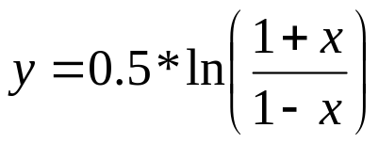
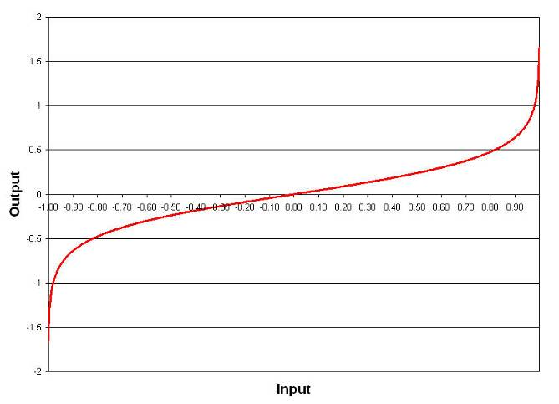
Fisher Transform
A Fisher Transform has no lag – it expands range near the endpoints

Slide 27
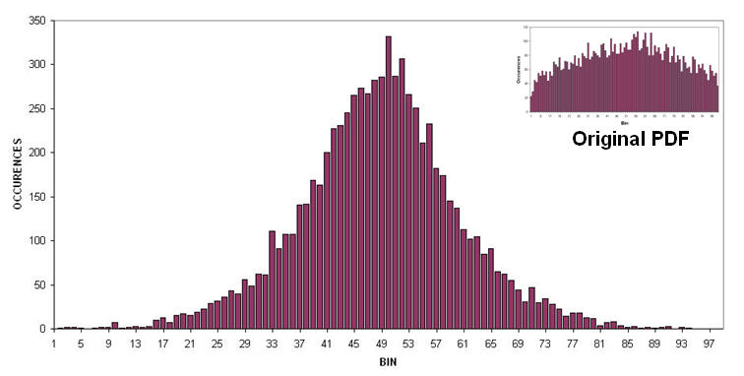
Fisherized PDF for Treasury Bonds
Fisherized Detrended Signal Over 30 Years
The Fisher Transform enables the use of the same kind of strategy as before
Where we reverse position when extreme amplitude thresholds are exceeded

Slide 28
Fisher Transform System
Highpass Filter prices
Normalize between -.999 and +.999 using a Stochastic-like approach
Buy when transformed prices cross below an optimizable lower bound
Sell when transformed prices cross above an optimizable lower bound

Slide 29
TRADING SYSTEM RESULTS

Slide 30
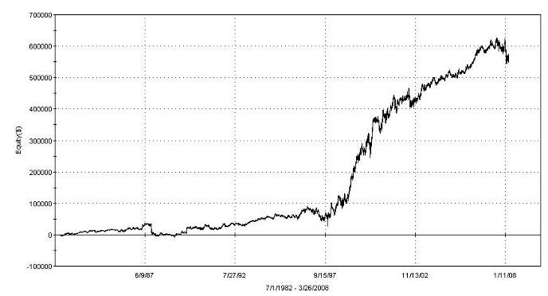
RSI Trading System Results
@SP.P for the life of the contract (from April 1982)
576 Trades (about once every two weeks)
68.6% Profitable Trades
Profit Factor = 1.62
The strategy is robust across the entire life of the contract!

Slide 31
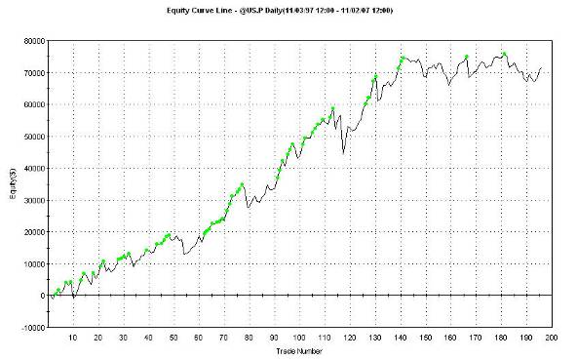
RSI Trading System Results (2)
@US.P for last 10 years
196 Trades (about once every two and a half weeks)
63.8% Profitable Trades
Profit Factor = 1.60
The strategy is robust for the last ten years!

Slide 32
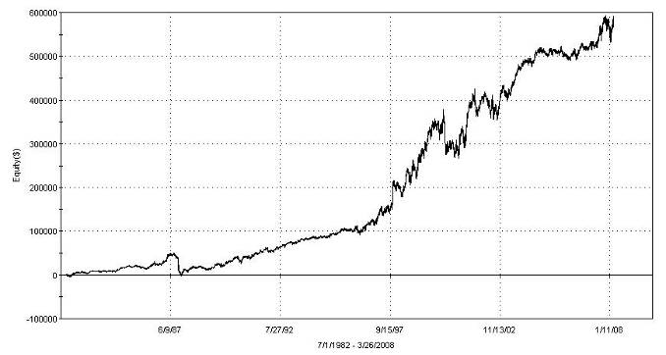
Fisher Transform System Results
@SP.P for the life of the contract (from April 1982)
802 Trades (a little more than once every two weeks)
65.2% Profitable Trades
Profit Factor = 1.53
The strategy is robust across the entire life of the contract!

Slide 33
TRADING STRATEGY COMMENTS
The concepts are provided for educational purposes only
There was no allowance for slippage and commission
Results were shown using in-sample optimization
No stops or disaster reversals were used
The strategies are not adaptive to current market conditions
Commercial versions of these strategies are available at www.eminiz.com
  Adaptive
  Out of Sample strategy selection (no optimization)
  With stops

Slide 34
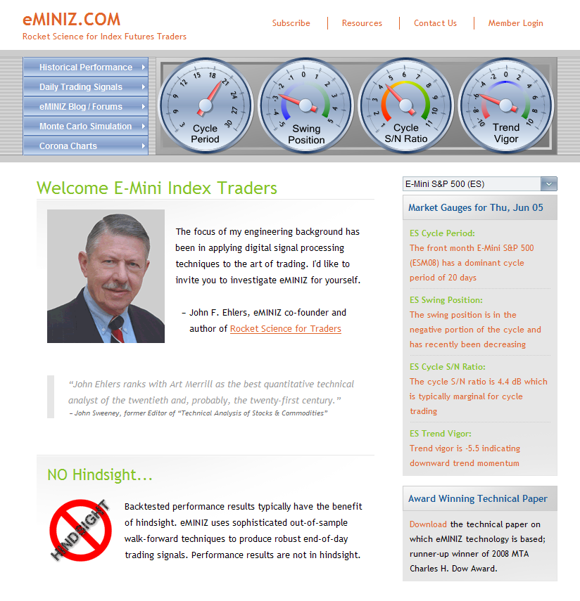
www.eminiz.com HOME

Slide 35
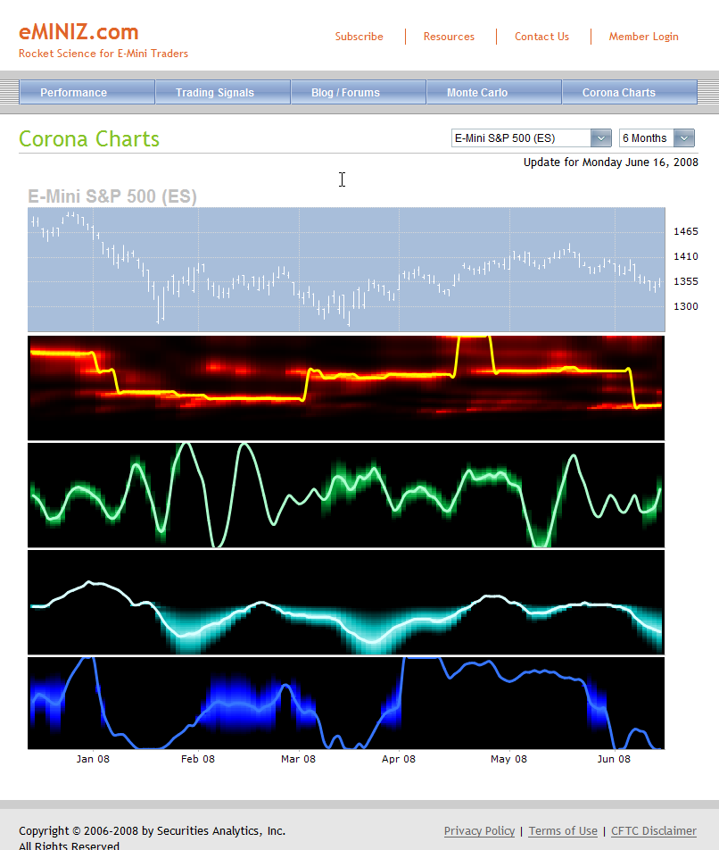
www.eminiz.com Corona Charts

Slide 36
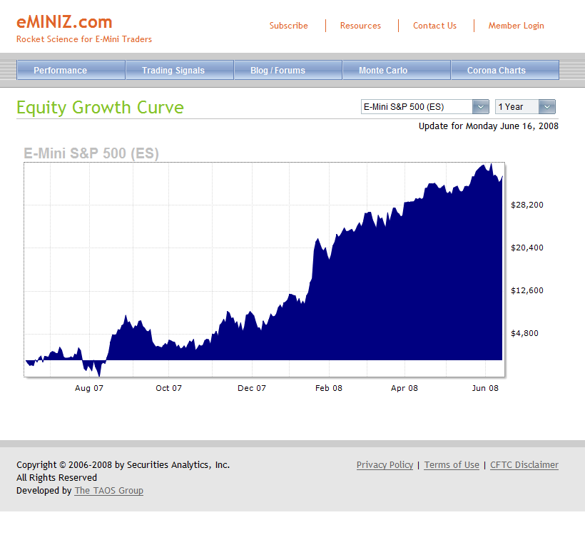
www.eminiz.com Equity Growth

Slide 37
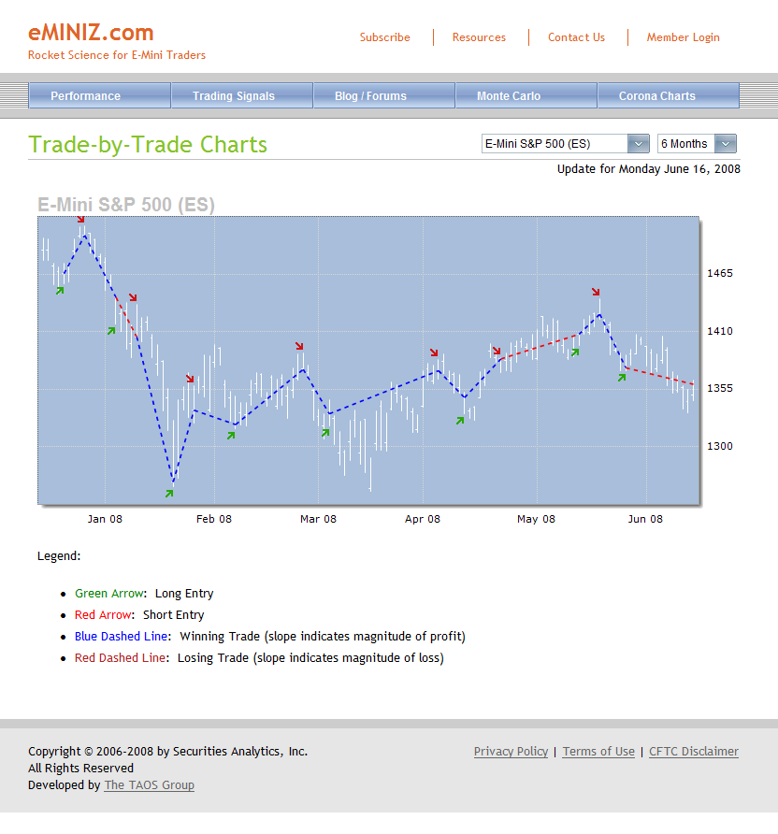
www.eminiz.com Trades

Slide 38
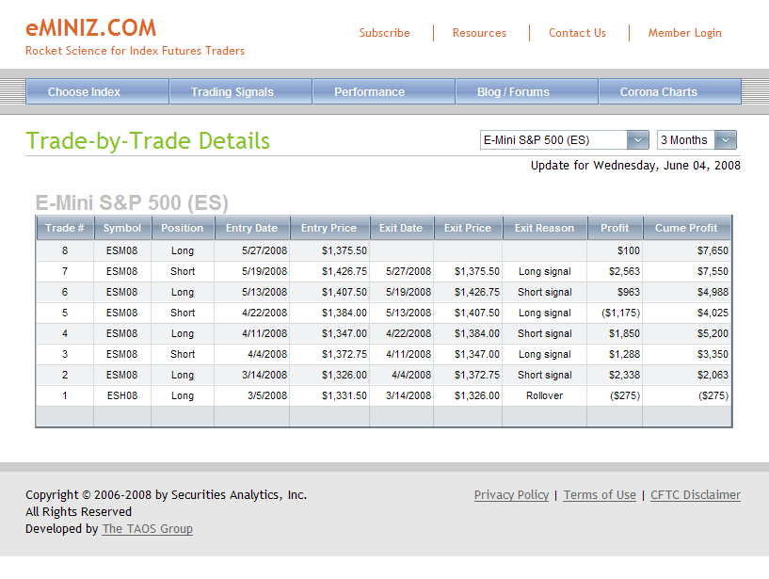
www.eminiz.com Trades List

Slide 39
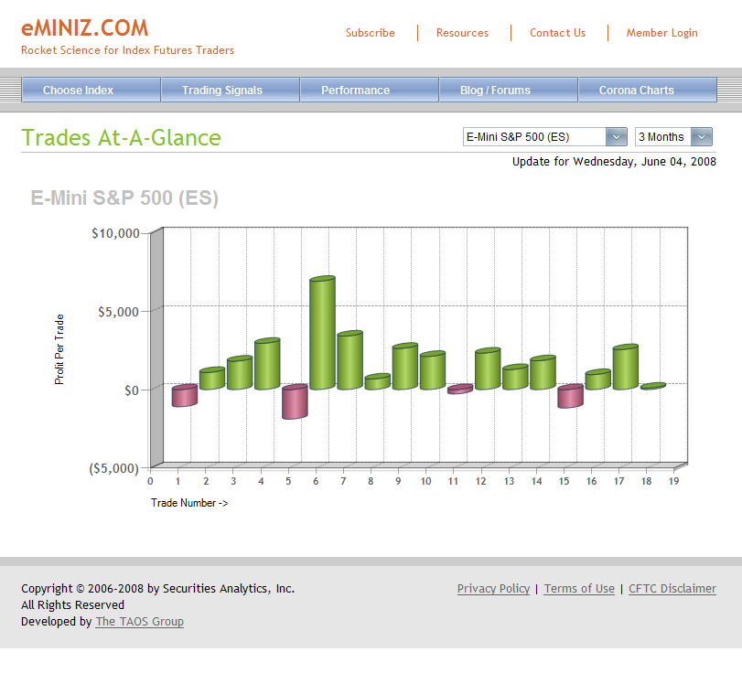
www.eminiz.com Trades at a Glance

Slide 40
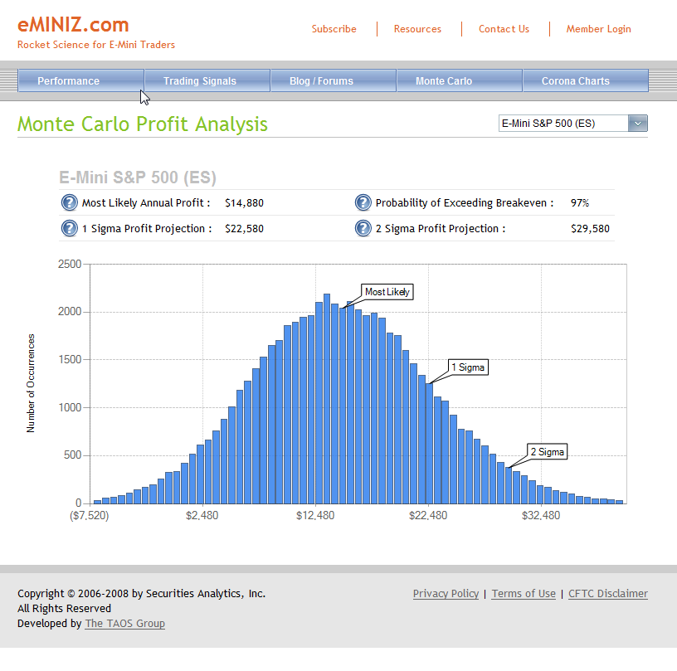
www.eminiz.com Monte Carlo Profit

Slide 41
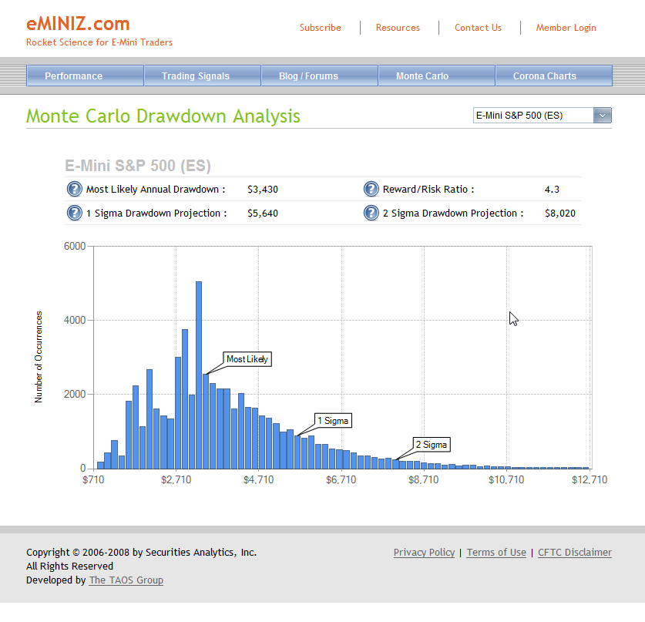
www.eminiz.com Monte Carlo Drawdown

Slide 42
How Is www.eminiz.com Different?
Unique Dashboard Indicators can be checked daily (FREE)
Unique Cycles-Based Dashboard Indicator Histories can be reviewed as corona chart indicators (FREE)
Explicit Buy/Sell Signals are given for Five Index Futures
  Equity Growth Charts and Trading Statistics (delayed)
  Monte Carlo Analysis (delayed)
  Price Charts with trade history overlaid (delayed)
  Trade-by-Trade results (delayed)
  Email notification for trades to be made on the next open
Eight Different Robust Strategies were developed using the techniques I have described
  Developed on the S&P Futures contract back to its beginning
  Strategies are not optimized
Strategy selection is based on best Out-of-Sample performance
Selection is made dynamically on a trade-by-trade basis

