Slide 1
AfTA
December 11, 2007
Left-Brained Concepts for Traders in their Right Minds

Slide 2
John Ehlers
  Pioneer of MESA studies
  FuturesTruth has ranked his S&P, Bond, and Currency trading systems #1
  Winner 27 Readers’ Choice Awards from Stocks & Commodities magazine
  Author of MESA and Trading Market Cycles
  Author of Rocket Science for Traders
  Author of Cybernetic Analysis for Stocks and Futures

Slide 3
Hurst Coefficient

Slide 4

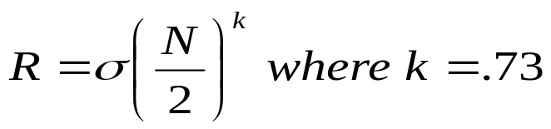
Hurst Coefficient
Named after H.E. Hurst, not J.M. Hurst
  Studied how high to make the Aswan dam on the Nile
  Found the range did not widen as as in a coin toss
  Rather:
Hurst Coefficient is more estimated than computed
  Rescaled range method
    Log of R/S versus Log of lag
  Aggregated Variance Method
    N/m blocks of Size m plotted against Log(m)
  Differenced Variance Method
    Used for long memory
Aggregated Variance Method seems to work best for market data

Slide 5
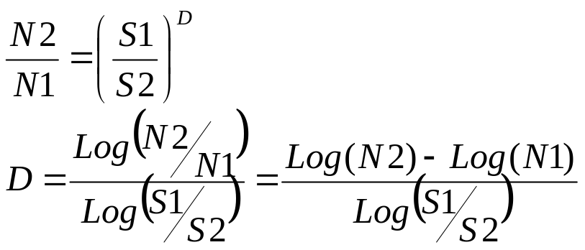
Aggregated Variance Method
Start with the concept of the Fractal Dimension
Cover a generalized pattern of “N” objects of sizes “S”
Example 1
  Line 10 meters long. Place boxes on line:
    Ten 1 meter boxes, one hundred 0.1 meter boxes
    Therefore N1=10, S1= 1, N2=100, S2=0.1
    D = 1.0
Example 2
  Square 10 Meters on a side. Place boxes in the square
    Now N1=100, N2=10000
    D = 2.0

Slide 6
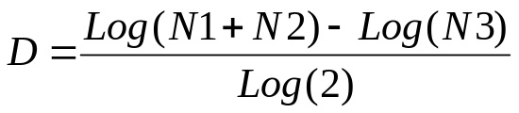
Fractal Dimension of Market Data
Since price samples are uniformly spaced, the box count is approximately the average slope
Box count is estimated as the price range divided by the interval
Divide the time into two segments
  0 to T and T to 2T
  N1 is range over 1st interval, N2 is range over 2nd interval, N3 is range over the combined total interval
Then:

Slide 7
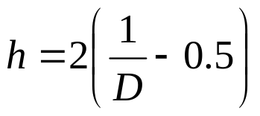
Hurst Coefficient Display
Interpretations:
  h = 0 means data are antipersistent (cyclic)
  h = 1 means data are persistent (trending)
  h = 0.5 means data are random
Clearly, Hurst Coefficient depends on the selected lookback period
For each bar we will use a range of lookback periods and colorize the value of the Hurst Coefficient
  Blue is cyclic
  Green is trending
  Red is random

Slide 8
Hurst EasyLanguage Code
Inputs:
Price((H+L)/2),
Lookback(60);
Vars:
I(0),
N(0),
count(0),
N1(0),
N2(0),
N3(0),
HH(0),
LL(0),
Dimen(0),
Color1(0),
Color2(0),
Color3(0),
PlotLen(0);
Arrays:
H[190](0), H1[100](0), H2[100](0), H3[100](0), H4[100](0), HAvg[100](0);
For I = 1 to 50 Begin
N = 2*I;
N3 = (Highest(High, N) - Lowest(Low, N)) / N;
HH = High;
LL = Low;
For count = 0 to N/2 - 1 begin
If High[count] > HH then HH = High[count];
If Low[count] < LL then LL = Low[count];
End;
N1 = (HH - LL)/(N / 2);
HH = High[N/2];
LL = Low[N/2];
For count = N/2 to N - 1 begin
If High[count] > HH then HH = High[count];
If Low[count] < LL then LL = Low[count];
End;
N2 = (HH - LL)/(N / 2);
If N1 > 0 and N2 > 0 and N3 > 0 then Dimen = (Log(N1 + N2) - Log(N3)) / Log(2);
H[N] = 2*(1 / Dimen - .5);
H[N] = 1.25*(H[N] - .5) + .6;
HAvg[N] = (H[N] + H1[N] + H2[N] + H3[N] + H4[N]) / 5;
If HAvg[N] > 1 then HAvg[N] = 1;
If HAvg[N] < 0 then HAvg[N] = 0;
H4[N] = H3[N];
H3[N] = H2[N];
H2[N] = H1[N];
H1[N] = H[N];
End;
For I = 2 to 50 Begin
N = 2*I - 1;
HAvg[N] = (HAvg[N - 1] + HAvg[N + 1]) / 2;
End;
//Plot the Rescale-range Statistic as a Heatmap
PlotLen = Lookback;
If Plotlen > 99 Then PlotLen = 99;
For I = 8 to PlotLen Begin
//Convert RS to RGB Color for Display
If HAvg[I] >= .5 Then Begin
Color1 = 255*(2 - 2*HAvg[I]);
Color2 = 255*(2*HAvg[I] - 1);
Color3 = 0;
End
Else If HAvg[I] < .5 Then Begin
Color1 = 255*(2*HAvg[I]);
Color2 = 0;
Color3 = 255*(1 - 2*HAvg[I]);
End;
If I = 4 Then Plot4(4, "S4", RGB(Color1, Color2, Color3),0,4);
If I = 5 Then Plot5(5, "S5", RGB(Color1, Color2, Color3),0,4);
If I = 6 Then Plot6(6, "S6", RGB(Color1, Color2, Color3),0,4);
If I = 7 Then Plot7(7, "S7", RGB(Color1, Color2, Color3),0,4);
If I = 8 Then Plot8(8, "S8", RGB(Color1, Color2, Color3),0,4);
If I = 9 Then Plot9(9, "S9", RGB(Color1, Color2, Color3),0,4);
If I = 10 Then Plot10(10, "S10", RGB(Color1, Color2, Color3),0,4);
If I = 11 Then Plot11(11, "S11", RGB(Color1, Color2, Color3),0,4);
If I = 12 Then Plot12(12, "S12", RGB(Color1, Color2, Color3),0,4);
If I = 13 Then Plot13(13, "S13", RGB(Color1, Color2, Color3),0,4);
If I = 14 Then Plot14(14, "S14", RGB(Color1, Color2, Color3),0,4);
If I = 15 Then Plot15(15, "S15", RGB(Color1, Color2, Color3),0,4);
If I = 16 Then Plot16(16, "S16", RGB(Color1, Color2, Color3),0,4);
If I = 17 Then Plot17(17, "S17", RGB(Color1, Color2, Color3),0,4);
If I = 18 Then Plot18(18, "S18", RGB(Color1, Color2, Color3),0,4);
If I = 19 Then Plot19(19, "S19", RGB(Color1, Color2, Color3),0,4);
If I = 20 Then Plot20(20, "S20", RGB(Color1, Color2, Color3),0,4);
If I = 21 Then Plot21(21, "S21", RGB(Color1, Color2, Color3),0,4);
If I = 22 Then Plot22(22, "S22", RGB(Color1, Color2, Color3),0,4);
If I = 23 Then Plot23(23, "S23", RGB(Color1, Color2, Color3),0,4);
If I = 24 Then Plot24(24, "S24", RGB(Color1, Color2, Color3),0,4);
If I = 25 Then Plot25(25, "S25", RGB(Color1, Color2, Color3),0,4);
If I = 26 Then Plot26(26, "S26", RGB(Color1, Color2, Color3),0,4);
If I = 27 Then Plot27(27, "S27", RGB(Color1, Color2, Color3),0,4);
If I = 28 Then Plot28(28, "S28", RGB(Color1, Color2, Color3),0,4);
If I = 29 Then Plot29(29, "S29", RGB(Color1, Color2, Color3),0,4);
If I = 30 Then Plot30(30, "S30", RGB(Color1, Color2, Color3),0,4);
If I = 31 Then Plot31(31, "S31", RGB(Color1, Color2, Color3),0,4);
If I = 32 Then Plot32(32, "S32", RGB(Color1, Color2, Color3),0,4);
If I = 33 Then Plot33(33, "S33", RGB(Color1, Color2, Color3),0,4);
If I = 34 Then Plot34(34, "S34", RGB(Color1, Color2, Color3),0,4);
If I = 35 Then Plot35(35, "S35", RGB(Color1, Color2, Color3),0,4);
If I = 36 Then Plot36(36, "S36", RGB(Color1, Color2, Color3),0,4);
If I = 37 Then Plot37(37, "S37", RGB(Color1, Color2, Color3),0,4);
If I = 38 Then Plot38(38, "S38", RGB(Color1, Color2, Color3),0,4);
If I = 39 Then Plot39(39, "S39", RGB(Color1, Color2, Color3),0,4);
If I = 40 Then Plot40(40, "S40", RGB(Color1, Color2, Color3),0,4);
If I = 41 Then Plot41(41, "S41", RGB(Color1, Color2, Color3),0,4);
If I = 42 Then Plot42(42, "S42", RGB(Color1, Color2, Color3),0,4);
If I = 43 Then Plot43(43, "S43", RGB(Color1, Color2, Color3),0,4);
If I = 44 Then Plot44(44, "S44", RGB(Color1, Color2, Color3),0,4);
If I = 45 Then Plot45(45, "S45", RGB(Color1, Color2, Color3),0,4);
If I = 46 Then Plot46(46, "S46", RGB(Color1, Color2, Color3),0,4);
If I = 47 Then Plot47(47, "S47", RGB(Color1, Color2, Color3),0,4);
If I = 48 Then Plot48(48, "S48", RGB(Color1, Color2, Color3),0,4);
If I = 49 Then Plot49(49, "S49", RGB(Color1, Color2, Color3),0,4);
If I = 50 Then Plot50(50, "S50", RGB(Color1, Color2, Color3),0,4);
If I = 51 Then Plot51(51, "S41", RGB(Color1, Color2, Color3),0,4);
If I = 52 Then Plot52(52, "S42", RGB(Color1, Color2, Color3),0,4);
If I = 53 Then Plot53(53, "S43", RGB(Color1, Color2, Color3),0,4);
If I = 54 Then Plot54(54, "S44", RGB(Color1, Color2, Color3),0,4);
If I = 55 Then Plot55(55, "S45", RGB(Color1, Color2, Color3),0,4);
If I = 56 Then Plot56(56, "S46", RGB(Color1, Color2, Color3),0,4);
If I = 57 Then Plot57(57, "S47", RGB(Color1, Color2, Color3),0,4);
If I = 58 Then Plot58(58, "S48", RGB(Color1, Color2, Color3),0,4);
If I = 59 Then Plot59(59, "S49", RGB(Color1, Color2, Color3),0,4);
If I = 60 Then Plot60(60, "S50", RGB(Color1, Color2, Color3),0,4);
If I = 61 Then Plot61(61, "S41", RGB(Color1, Color2, Color3),0,4);
If I = 62 Then Plot62(62, "S42", RGB(Color1, Color2, Color3),0,4);
If I = 63 Then Plot63(63, "S43", RGB(Color1, Color2, Color3),0,4);
If I = 64 Then Plot64(64, "S44", RGB(Color1, Color2, Color3),0,4);
If I = 65 Then Plot65(65, "S45", RGB(Color1, Color2, Color3),0,4);
If I = 66 Then Plot66(66, "S46", RGB(Color1, Color2, Color3),0,4);
If I = 67 Then Plot67(67, "S47", RGB(Color1, Color2, Color3),0,4);
If I = 68 Then Plot68(68, "S48", RGB(Color1, Color2, Color3),0,4);
If I = 69 Then Plot69(69, "S49", RGB(Color1, Color2, Color3),0,4);
If I = 70 Then Plot70(70, "S50", RGB(Color1, Color2, Color3),0,4);
If I = 71 Then Plot71(71, "S41", RGB(Color1, Color2, Color3),0,4);
If I = 72 Then Plot72(72, "S42", RGB(Color1, Color2, Color3),0,4);
If I = 73 Then Plot73(73, "S43", RGB(Color1, Color2, Color3),0,4);
If I = 74 Then Plot74(74, "S44", RGB(Color1, Color2, Color3),0,4);
If I = 75 Then Plot75(75, "S45", RGB(Color1, Color2, Color3),0,4);
If I = 76 Then Plot76(76, "S46", RGB(Color1, Color2, Color3),0,4);
If I = 77 Then Plot77(77, "S47", RGB(Color1, Color2, Color3),0,4);
If I = 78 Then Plot78(78, "S48", RGB(Color1, Color2, Color3),0,4);
If I = 79 Then Plot79(79, "S49", RGB(Color1, Color2, Color3),0,4);
If I = 80 Then Plot80(80, "S50", RGB(Color1, Color2, Color3),0,4);
If I = 81 Then Plot81(81, "S41", RGB(Color1, Color2, Color3),0,4);
If I = 82 Then Plot82(82, "S42", RGB(Color1, Color2, Color3),0,4);
If I = 83 Then Plot83(83, "S43", RGB(Color1, Color2, Color3),0,4);
If I = 84 Then Plot84(84, "S44", RGB(Color1, Color2, Color3),0,4);
If I = 85 Then Plot85(85, "S45", RGB(Color1, Color2, Color3),0,4);
If I = 86 Then Plot86(86, "S46", RGB(Color1, Color2, Color3),0,4);
If I = 87 Then Plot87(87, "S47", RGB(Color1, Color2, Color3),0,4);
If I = 88 Then Plot88(88, "S48", RGB(Color1, Color2, Color3),0,4);
If I = 89 Then Plot89(89, "S49", RGB(Color1, Color2, Color3),0,4);
If I = 90 Then Plot90(90, "S50", RGB(Color1, Color2, Color3),0,4);
If I = 91 Then Plot91(91, "S41", RGB(Color1, Color2, Color3),0,4);
If I = 92 Then Plot92(92, "S42", RGB(Color1, Color2, Color3),0,4);
If I = 93 Then Plot93(93, "S43", RGB(Color1, Color2, Color3),0,4);
If I = 94 Then Plot94(94, "S44", RGB(Color1, Color2, Color3),0,4);
If I = 95 Then Plot95(95, "S45", RGB(Color1, Color2, Color3),0,4);
If I = 96 Then Plot96(96, "S46", RGB(Color1, Color2, Color3),0,4);
If I = 97 Then Plot97(97, "S47", RGB(Color1, Color2, Color3),0,4);
If I = 98 Then Plot98(98, "S48", RGB(Color1, Color2, Color3),0,4);
If I = 99 Then Plot99(99, "S49", RGB(Color1, Color2, Color3),0,4);
End;

Slide 9
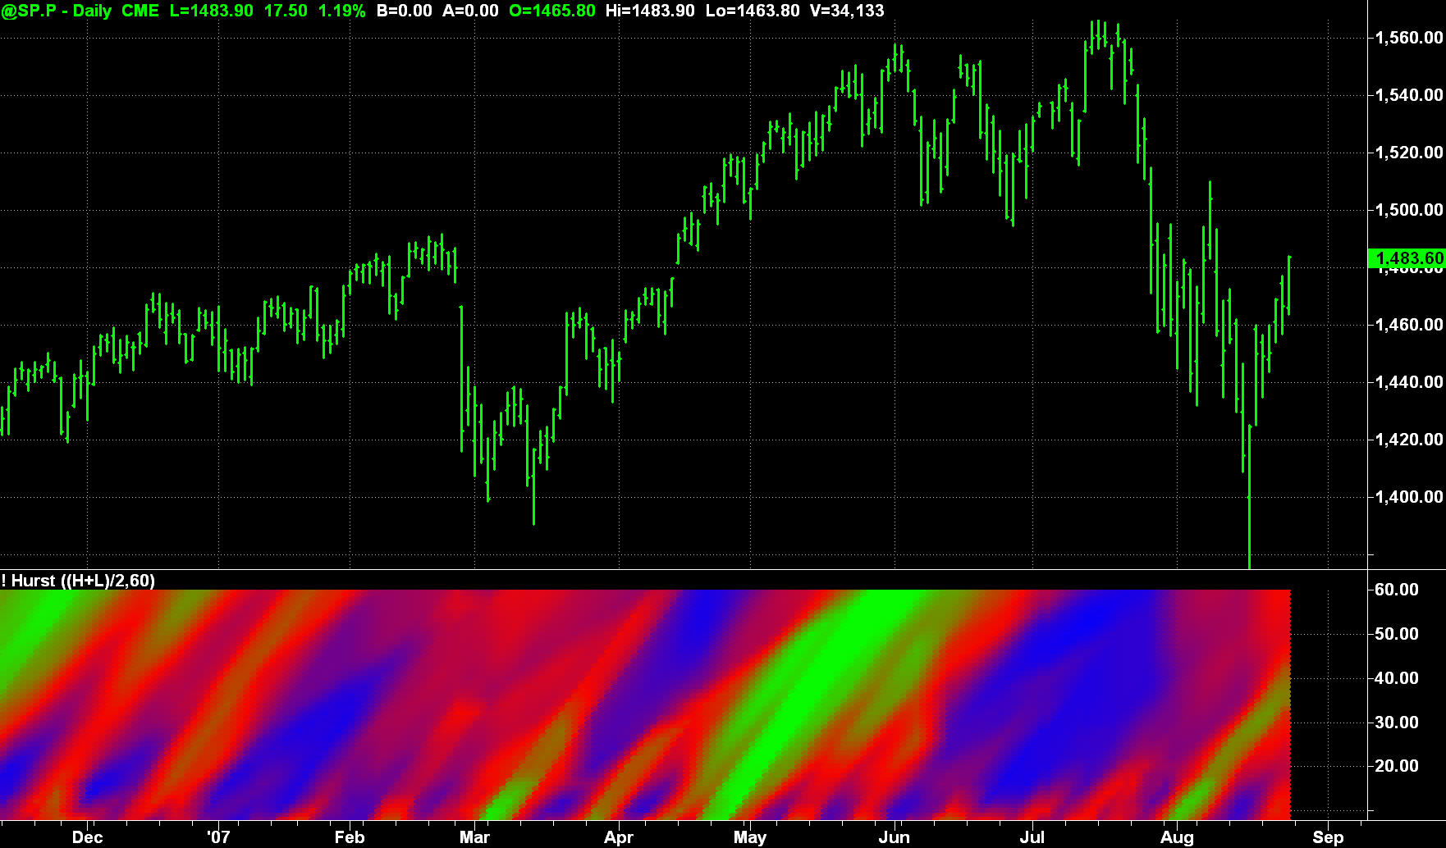
Hurst Coefficient Display
S&P Futures for 2007

Slide 10
Probability of Losing

Slide 11
Statistics Soapbox
A good trading system has, say, 60% winners
  Therefore it has 40% losing trades
  q = 0.4
q = r + 2r² + 3r³ + 4r⁴ + 5r⁵ + …….
If q = 0.4 then r = 0.2349
Probability of getting 4 losers in a row is 4r⁴=0.0122
If you trade 50 times per year, the probability of getting 4 losers in a row is 60.9%
  That’s almost a promise it will happen
The message is that traders should not abandon a winning system in times of adversity
Corollary: A trading system with high percentage winners is crucial for retaining customers

Slide 12
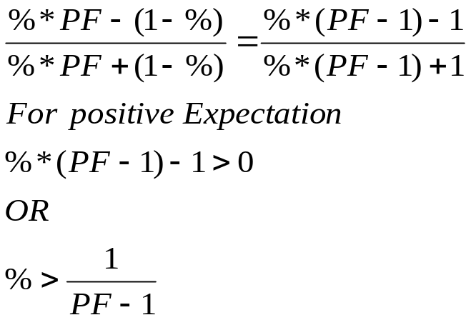
Bertrand’s Ballot Theorem
If candidate A ultimately gets “a” votes and candidate B ultimately gets “b” votes (a>b), then the probability of Candidate A leading throughout the ballot counting process is (a-b) / (a+b)
In our case, let a = %*PF and b = (1-%). That is, if you win, you win by the Profit Factor. If you lose, you lose 1.
PF must be greater than 2 (even then % must be certainty)
Conclusion: It is almost a promise your account will go underwater some time after you start trading!

Slide 13
Probability Density Functions

Slide 14
Technical Analysis is Based on Probability
“The market is oversold because the Stochastic has been high, so when it crosses through 80 then . . . . . .”
“When the head-and-shoulders pattern is complete then . . . . . .”
“When the market breaks above the upper channel then . . . . . .”
Why fool around with rules?
Let’s attack probability directly

Slide 15
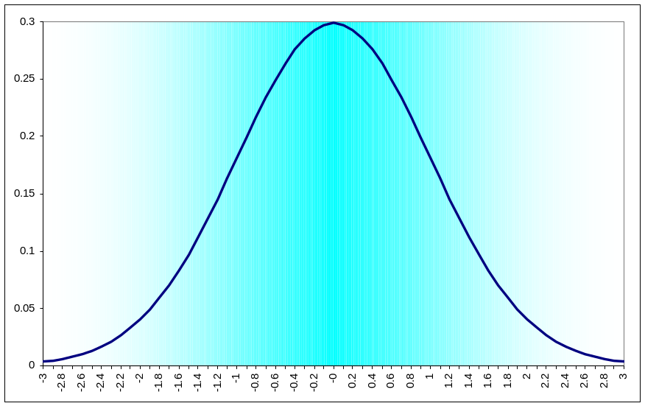
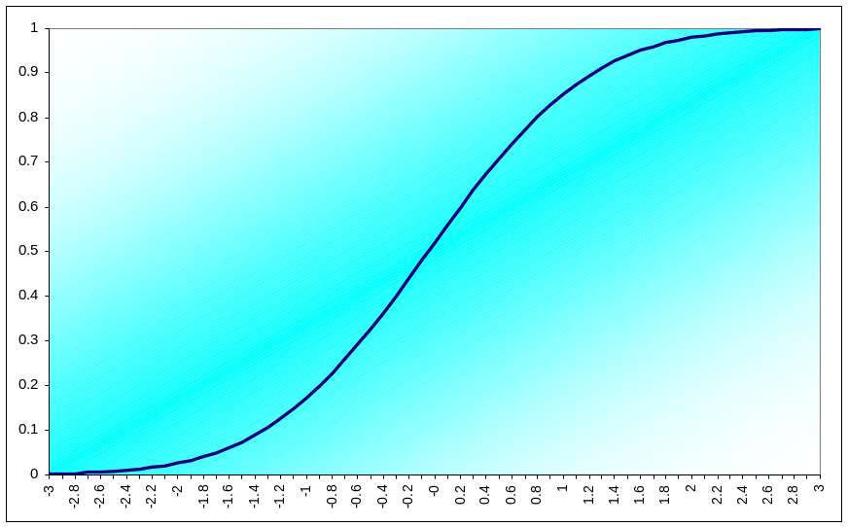
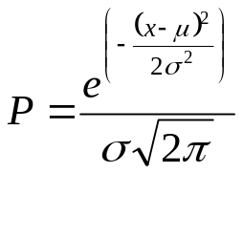
Normal (Gaussian) Probability Distribution Function (PDF) is Commonly Assumed for Market Data
Normal PDF
Cumulative Normal PDF
0 = 50%
+1σ = 85%
+2σ = 98%
+3σ = 99.9%
Normal PDF is attractive because it can be achieved
using several random variables due to the central limit theorem
But is Normal the right PDF for market data?

Slide 16
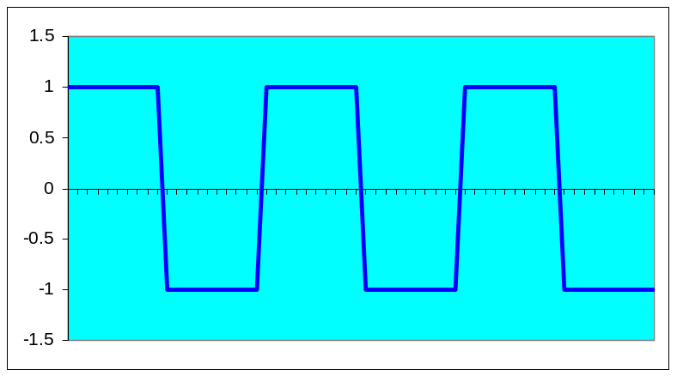
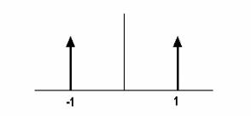
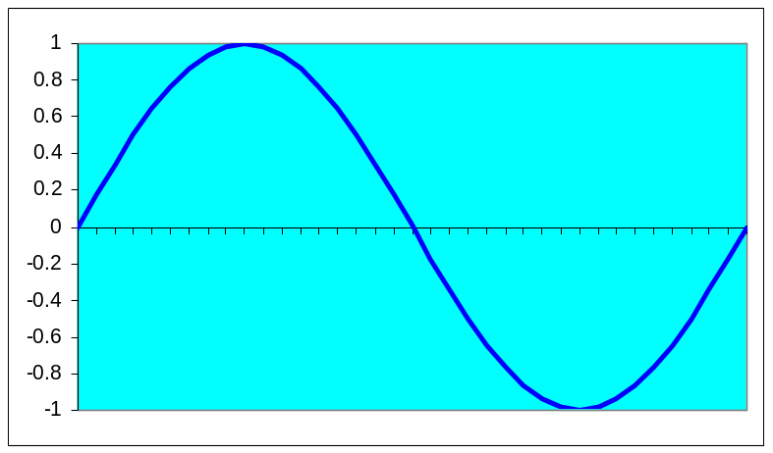
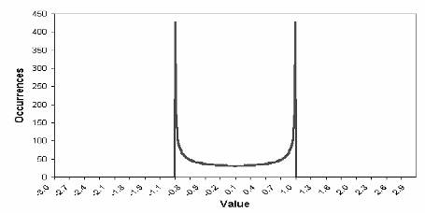
The PDF Depends on the Market Waveshape
Square Wave
Binary PDF of Square Wave
Sine Wave
Sine Wave PDF

Slide 17
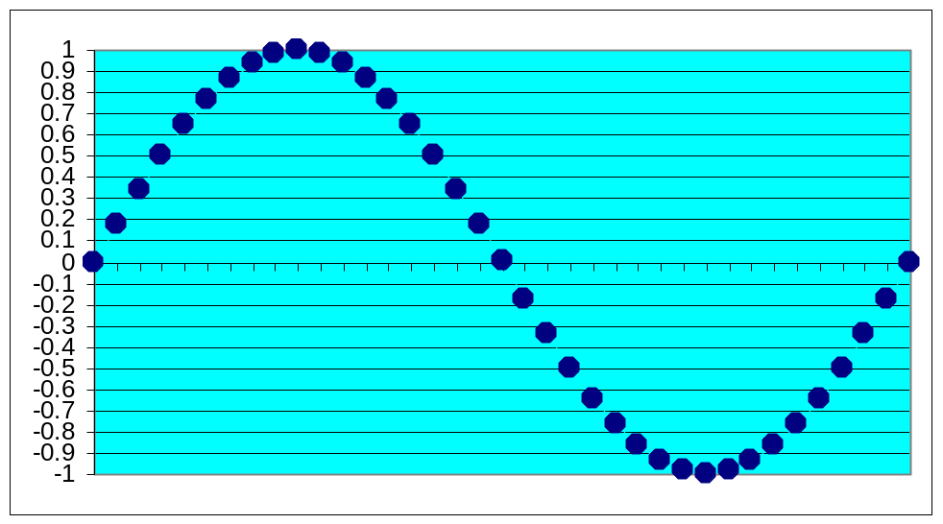
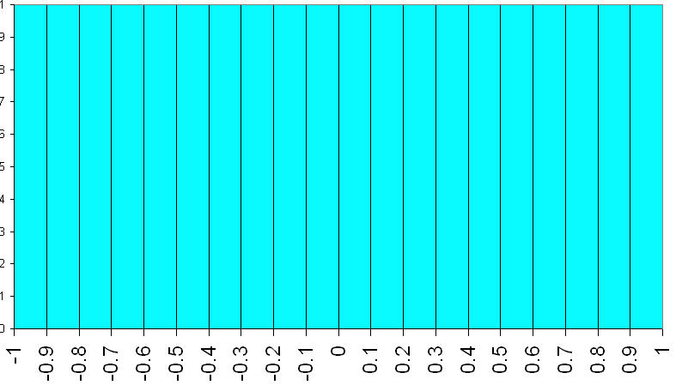
How Do We Determine the Market PDF?
Create the waveform by
stringing beads on a
horizontal wire frame
Rotate wire frame to
enable beads to
stack up
Height of the bead
stacks is the PDF
of the Waveform

Slide 18
Channel Limited PDF Generator Code
Inputs:
Length(20);
Vars:
HH(0),
LL(0),
J(0),
I(0);
Arrays:
Filt[2000](0),
Bin[100](0);
HH = Close;
LL = Close;
For I = 0 to Length -1 Begin
If Close[I] > HH then HH = Close[I];
If Close[I] < LL then LL = Close[I];
End;
If HH <> LL Then Value1 = (Close - LL) / (HH - LL);
Filt[CurrentBar] = (Value1 + 2*Value1[1] + Value1[2]) / 4;
For I = 0 to 100 Begin
If Filt[J] >= I/100 and Filt[J] < (I + 1)/100 Then Bin[I] = Bin[I]+1;
End;
For I = 0 to 99 Begin
Print(File("c:\tsgrowth\pdf.csv"), I, ",", Bin[I]);
End;
Plot1(Filt[CurrentBar]);

Slide 19
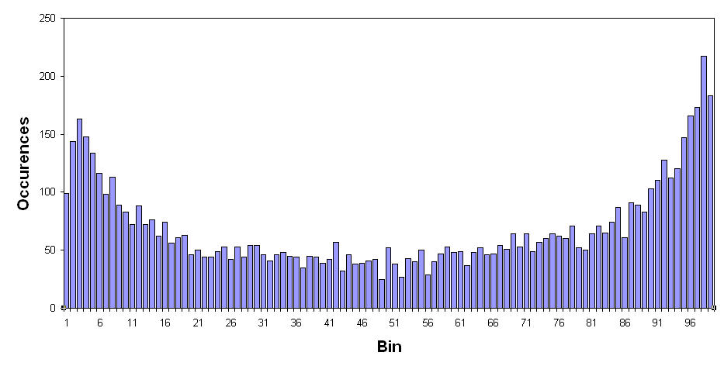
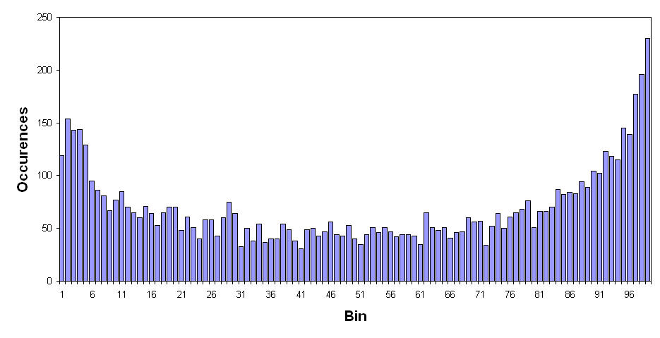
Channel PDF for Treasury Bonds
20 Bar Channel over 30 Years
40 Bar Channel over 30 Years

Slide 20
Highpass Filter PDF Generator Code
Inputs:
HPPeriod(40);
Vars:
alpha(0), HP(0), HH(0), LL(0), Count(0), Psn(0), I(0);
Arrays:
Bin[100](0);
alpha = (1 - Sine (360 / HPPeriod)) / Cosine(360 / HPPeriod);
HP = .5*(1 + alpha)*(Close - Close[1]) + alpha*HP[1];
IF CurrentBar = 1 THEN HP = 0;
If CurrentBar > HPPeriod Then Begin
HH = HP;
LL = HP;
For Count = 0 to HPPeriod -1 Begin
If HP[Count] > HH Then HH = HP[Count];
If HP[Count] < LL Then LL = HP[Count];
End;
If HH <> LL Then Value1 = 100*(HP - LL) / (HH - LL);
Psn = (Value1 + 2*Value1[1] + Value1[2]) / 4;
For I = 1 to 100 Begin
If Psn > I - 1 and Psn <= I Then Bin[I] = Bin[I] + 1;
End;
Plot1(Psn);
End;
If LastBarOnChart Then Begin
For I = 1 to 99 Begin
Print(File("C:\TSGrowth\PDF_HP.CSV"), I, ",", Bin[I]);
End;
End;

Slide 21
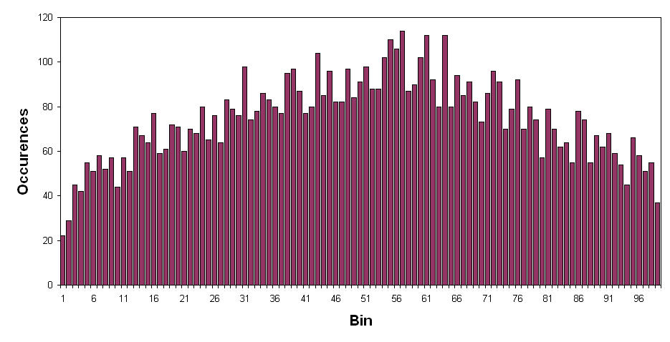
HP Filtered PDF for Treasury Bonds
40 Bar Cutoff over 30 Years

Slide 22
MyRSI PDF Generator Code
Inputs:
Length(10);
Vars:
CU(0), CD(0), I(0), MyRSI(0), Psn(0);
Arrays:
Bin[100](0),
PDF[100](0);
If CurrentBar > Length Then Begin
CU = 0;
CD = 0;
For I = 0 to Length -1 Begin
If Close[I] - Close[I + 1] > 0 Then CU = CU + Close[I] - Close[I + 1];
If Close[I] - Close[I + 1] < 0 Then CD = CD + Close[I + 1] - Close[I];
End;
If CU + CD <> 0 Then MyRSI = 50*((CU - CD) / (CU + CD) + 1);
Psn = (MyRSI + 2*MyRSI[1] + MyRSI[2]) / 4;
For I = 1 to 100 Begin
If Psn > I - 1 and Psn <= I Then Bin[I] = Bin[I] + 1;
End;
End;
If LastBarOnChart Then Begin
For I = 1 to 99 Begin
Print(File("C:\TSGrowth\PDF_RSI.CSV"), I, ",", PDF[I]);
End;
End;

Slide 23
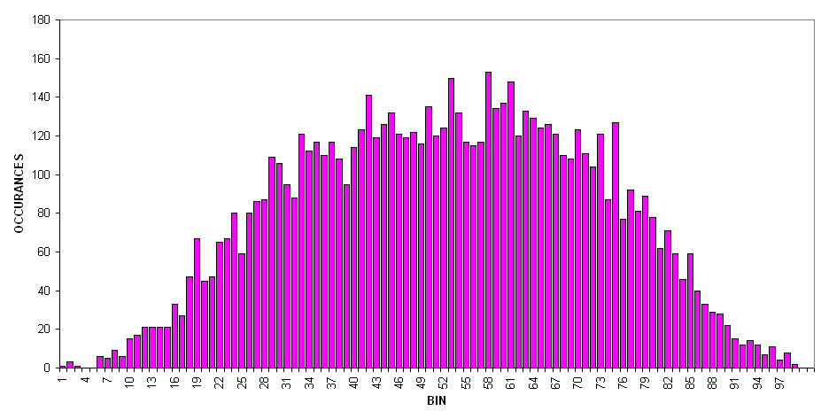
MyRSI PDF for Treasury Bonds
10 Bar RSI over 30 Years

Slide 24
PDF Conclusions
Probability Density Functions can vary widely, depending on the preprocessing used
A practical and useful trading system can be developed by anticipating turning points knowing further excursions are low probability events

Slide 25
Fisher Transform
A PDF of virtually any processed data can be converted to a Normal PDF using the Fisher Transform

Slide 26
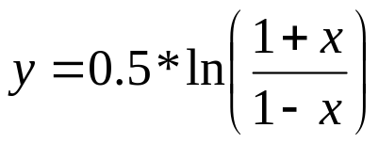
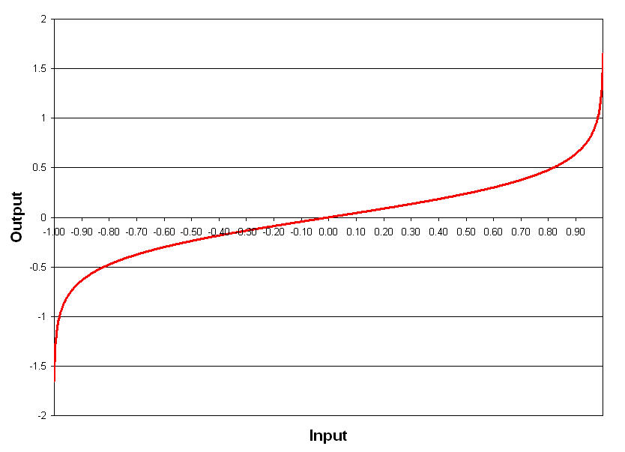
Fisher Transform
A Fisher Transform has no lag – it expands range near the endpoints

Slide 27
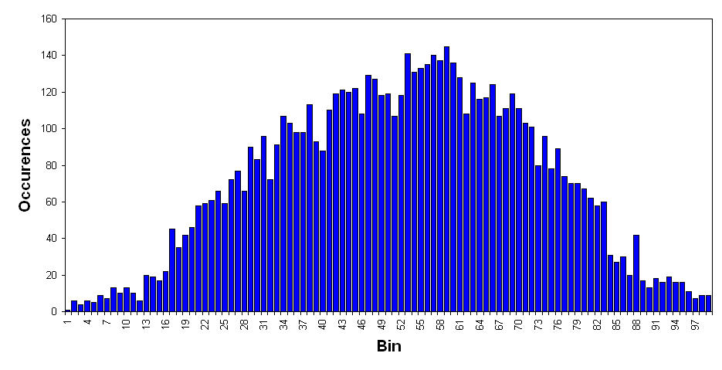
Fisherized Channel PDF for Treasury Bonds
20 Bar Fisherized Channel over 30 Years
Original PDF

Slide 28
Simple Trading System
{>>>>>>>>>>>>>>>>>>>>>>>>>>>>>>>>>>>>>>>>>>>>>>>>>>>>>>>>>>
Normalized Channel with Fisher Transform Trading System
(c) 2007 John F. Ehlers
<<<<<<<<<<<<<<<<<<<<<<<<<<<<<<<<<<<<<<<<<<<<<<<<<<<<<<<<<<<}
Inputs:
Length(8), UBound(.5), LBound(-.5);
Vars:
HH(0), LL(0), FH(0), FL(0), Fisher(0), Count(0), Psn(0);
If CurrentBar > Length Then Begin
HH = Close;
LL = Close;
For Count = 0 to Length - 1 Begin
If Close[Count] > HH Then HH = Close[Count];
If Close[Count] < LL Then LL = Close[Count];
End;
If HH <> LL Then Value1 = 2*((Close - LL) / (HH - LL) - .5);
Psn = (Value1 + 2*Value1[1] + Value1[2]) / 4;
If Psn > .999 Then Psn = .999;
If Psn < -.999 Then Psn = -.999;
Fisher = .5*Log((1 + Psn) / (1 - Psn));
End;
If Fisher Crosses Over UBound Then Sell Short Next Bar on Open;
If Fisher Crosses Under LBound Then Buy Next Bar on Open;

Slide 29
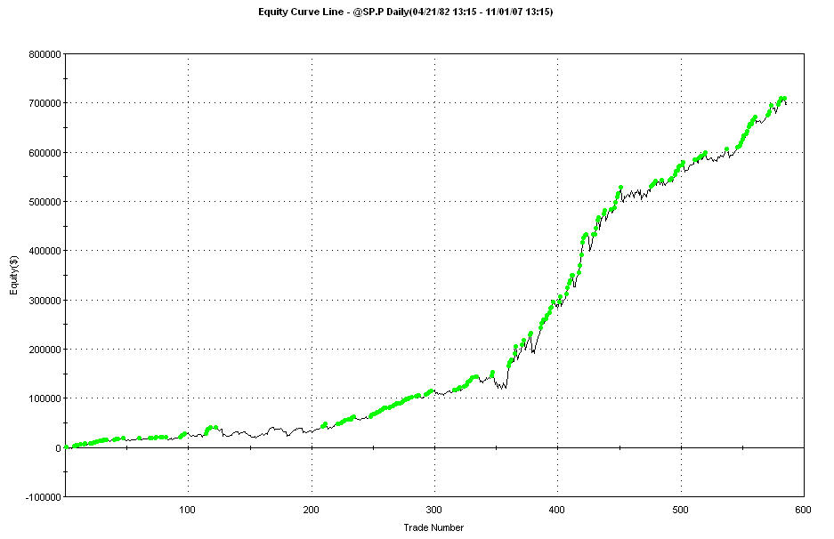
Trading System Results
@SP.P for the life of the contract (from April 1982)
608 Trades (about once every two weeks)
68.9% Profitable Trades
Profit Factor = 1.75

Slide 30
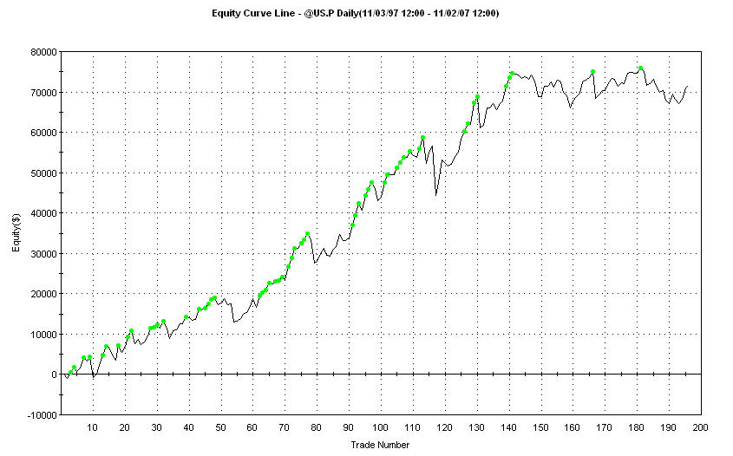
Trading System Results (2)
@US.P for last 10 years
196 Trades (about once every two and a half weeks)
63.8% Profitable Trades
Profit Factor = 1.60

Slide 31
Conclusions
Hurst Coefficient can be used for a global view of the data
Stick with a trading system through its adversity
Probability Density Functions of data can vary widely depending on preprocessing
The Fisher Transform can produce Normal PDF-shaped probability functions regardless of preprocessing
Simple but elegant trading systems can be developed just from Probability Density Function considerations

Slide 32
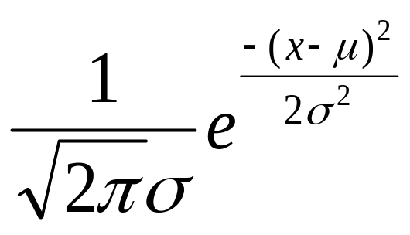
Above All, Remember
ENGINEERS ARE AS
AS ANYONE

Slide 33
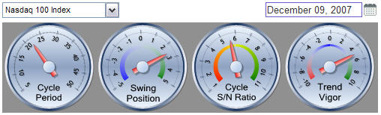
For More Information
Trading sites coming in January
  www.eminiz.com
  www.indicez.com
Meanwhile, try the indicator dashboard at
  www.isignals.com/preview

