Slide 1
The Instantaneous Trendline
AfTA
20 May 2003
John Ehlers

Slide 2
Philosophical Background
Technical Analysts must model the market to attack it
  Ellioticians
  Patterns
  Fibanacci
My models are based on a variant of the Random Walk
My models consist of a Trend Mode and a Cycle Mode

Slide 3
Diffusion Equation
“Drunkard’s Walk” is a special form of the random walk problem
  The drunk flips a coin to determine right or left with each step forward
  The random variable is direction
The Diffusion equation is the solution
  describes smoke coming from a smokestack
The smoke plume is analogous to market conditions
  Breeze bends the plume to an average trendline
  Plume widens with distance - distant predictions are less accurate
  Smoke density is analogous to prediction probability - the best estimator is the average

Slide 4
Telegrapher’s Equation
Modify the “Drunkard’s Walk” problem
  Coin flip decides whether the drunk will reverse his direction, regardless of the direction of the last step
  The random variable is now momentum, not direction
Solution is now the Telegrapher’s Equation
  Describes the electric wave on a telegraph wire
  Also describes a meandering river
A river meander is a short term cycle
  Random probability exists (Diffusion Equation) IF:
    Individual meanders are overlaid
    Or a long data span is taken

Slide 5
The Market is Similar to a Meandering River
Both follow the path of least resistance
Market Forces (greed, fear, profit, loss, etc.) are similar to physical forces, producing paths of uniform resistance.
Think about how the masses ask the question:
Will the market change?
OR
Will the trend continue?

Slide 6
Establishing Market Modes
Historically, I have measured the cycles and subtracted the Cycle components from the total to find the Trend
Tonight, I will parse the two modes directly by filtering
You will also see a successful trading strategy developed
The Trend and Cycle components will be compared

Slide 7
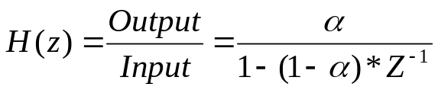
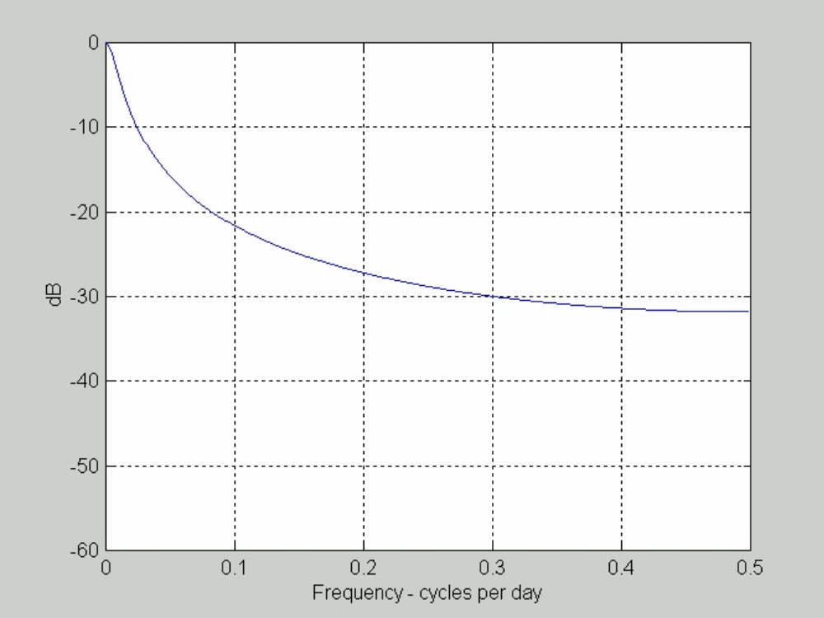
Exponential Moving Average
In EasyLanguage notation
Output = α*Input + (1 - α)*Output[1];
Using Z Transforms:

Slide 8
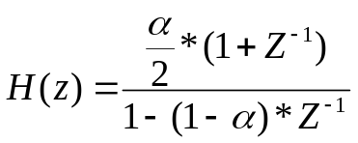
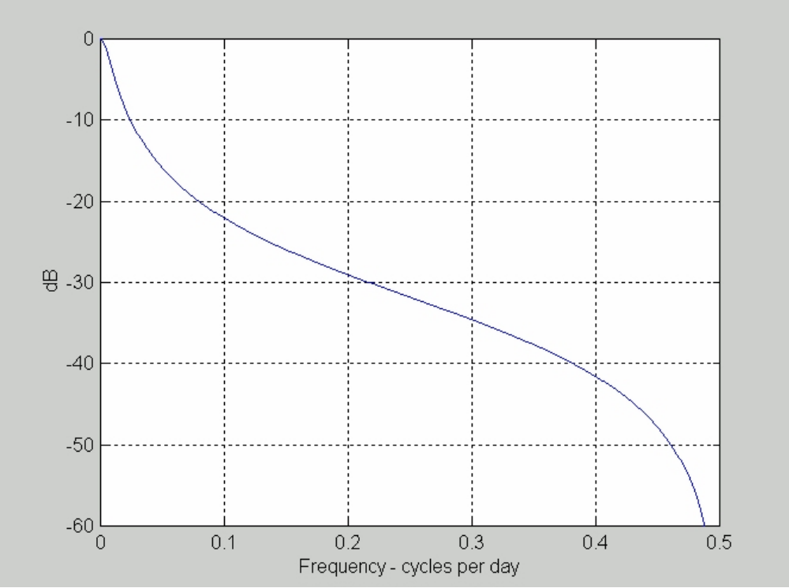
Improved Attenuation
Averaging over 2 samples dramatically improves attenuation

Slide 9
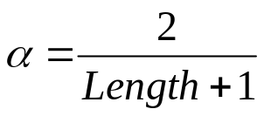
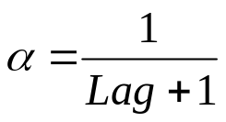
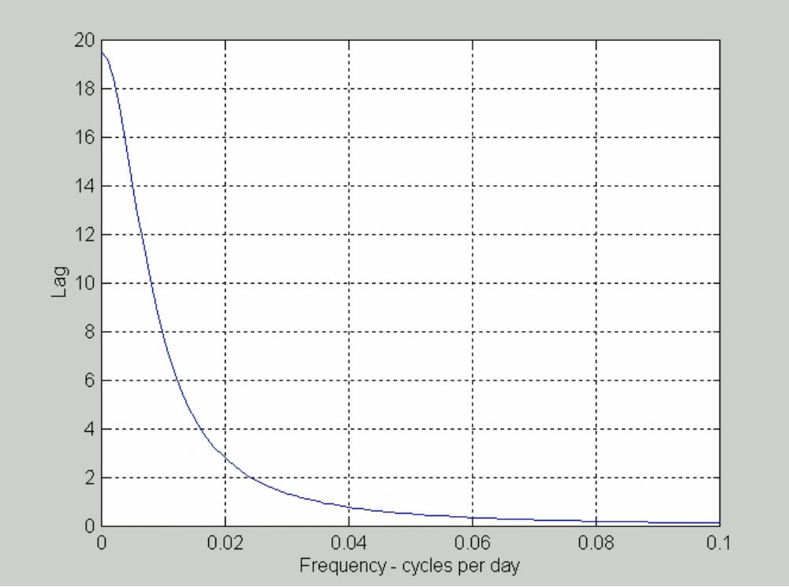
Moving Average Lag
Lag of Moving Averages is the enemy of technical analysts

Slide 10
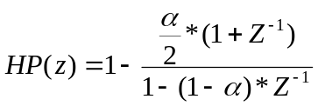
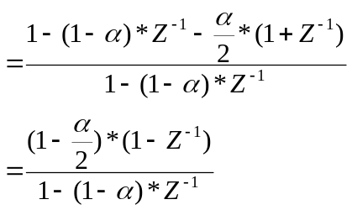
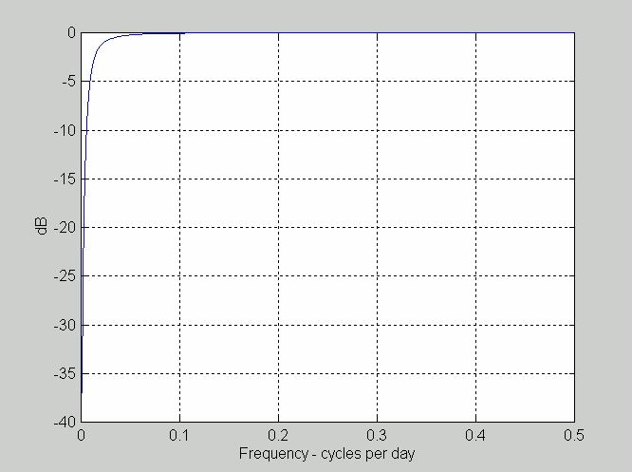
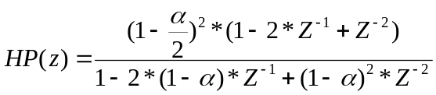
High Pass Filter Removes the Trend
Create by subtracting EMA Trend from an Allpass (unity)
Square to improve sharpness
In EasyLanguage notation:

Slide 11
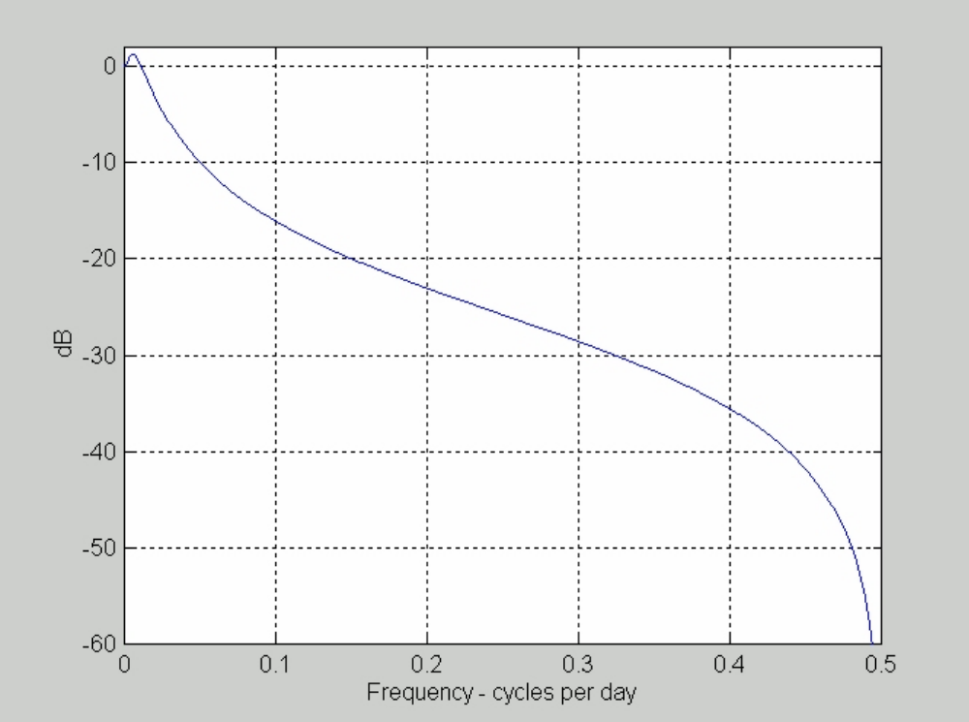
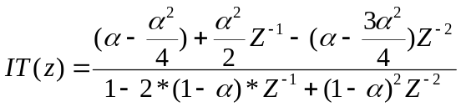
Instantaneous Trendline
Created by subtracting the High Pass Filter (Cycle Mode) from an Allpass
Attenuation is similar to an EMA
Skipping the algebra:
In EasyLanguage:

Slide 12
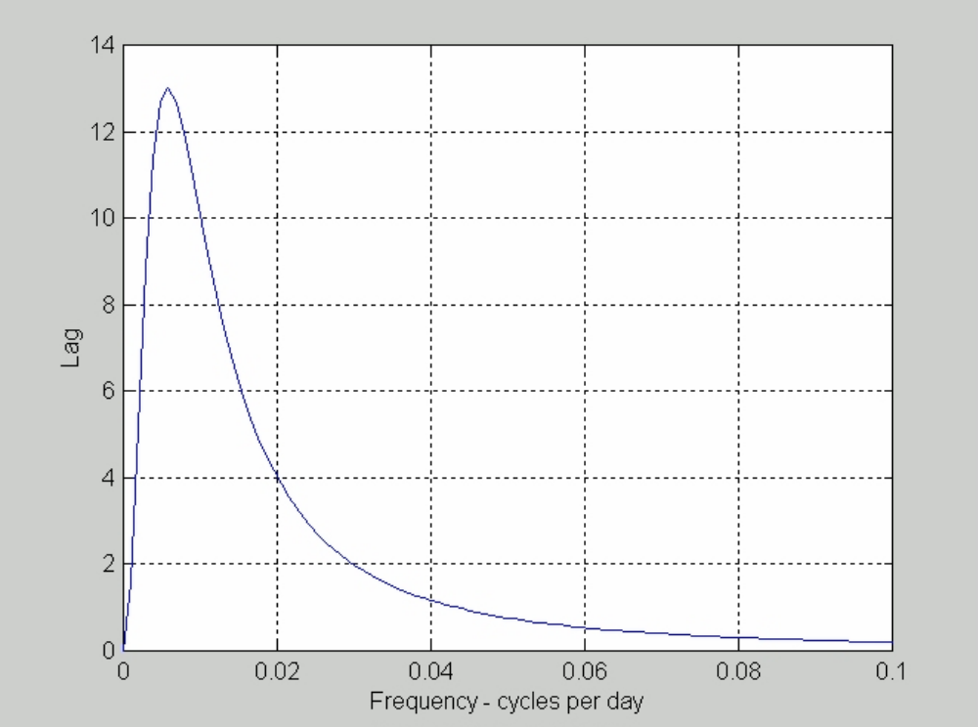
Zero Frequency Lag is Removed

Slide 13
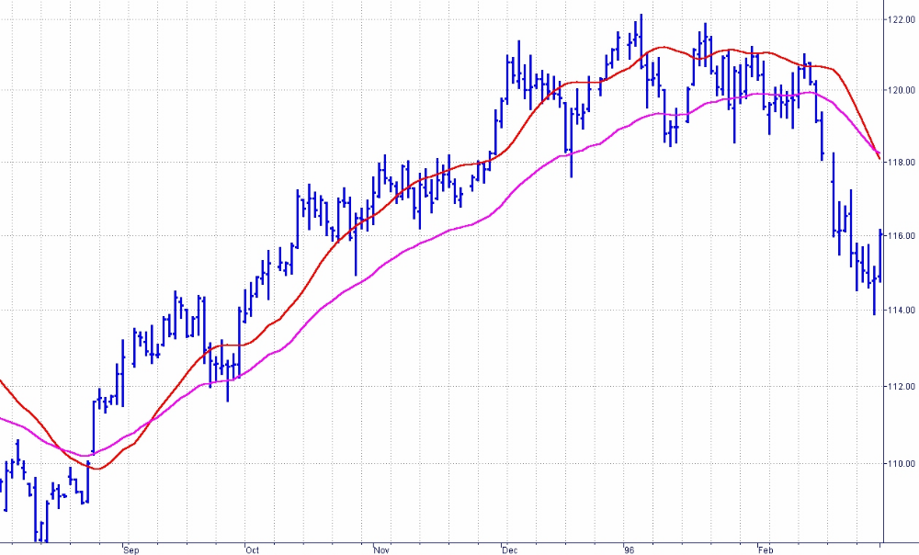
Instantaneous Trendline - EMA Comparison
Instantaneous
Trendline
EMA
α = .05

Slide 14
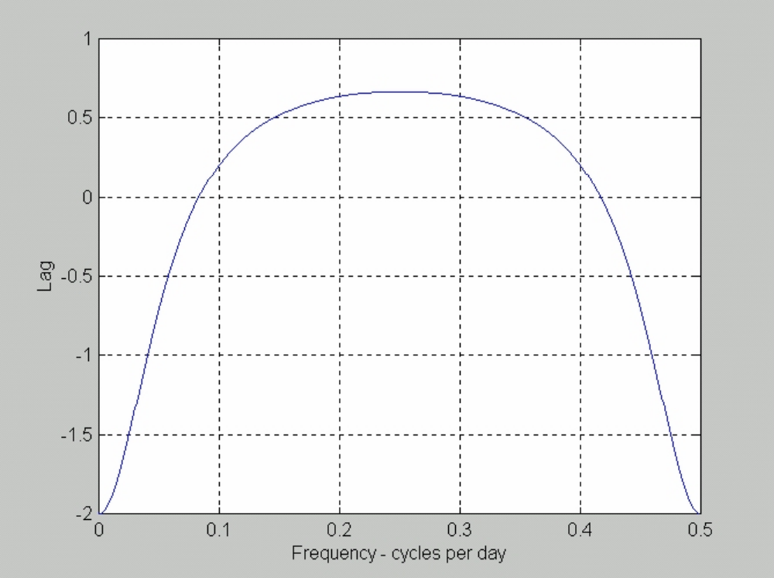
Trading Needs a Leading Signal
Add a 2 day momentum to the Instantaneous Trendline to get a 2 bar lead

Slide 15
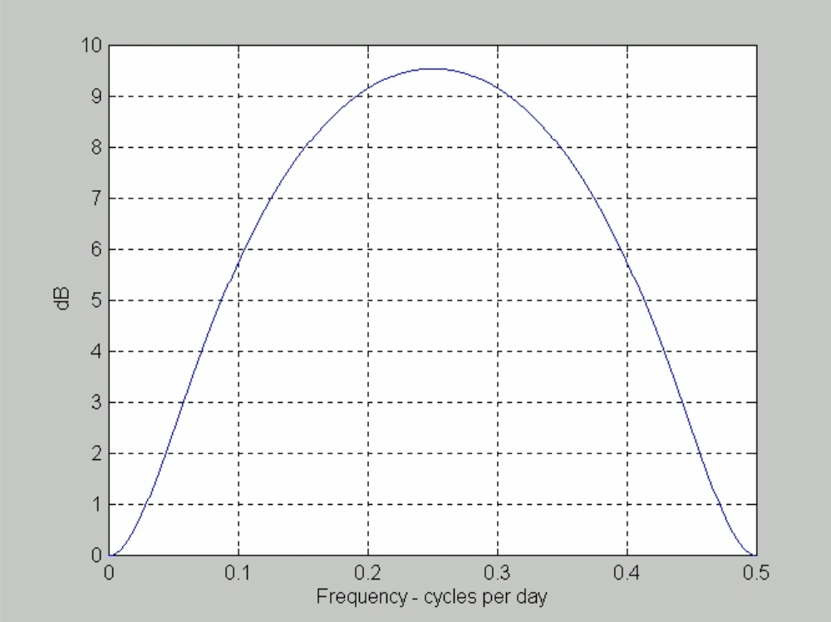
Momentum Advancing Comes with a Penalty
Nearly a 10 dB filter gain
for a 4 bar cycle
Gain is unimportant to the Instantaneous Trendline
because it has a 25 dB attenuation at a 4 bar cycle

Slide 16
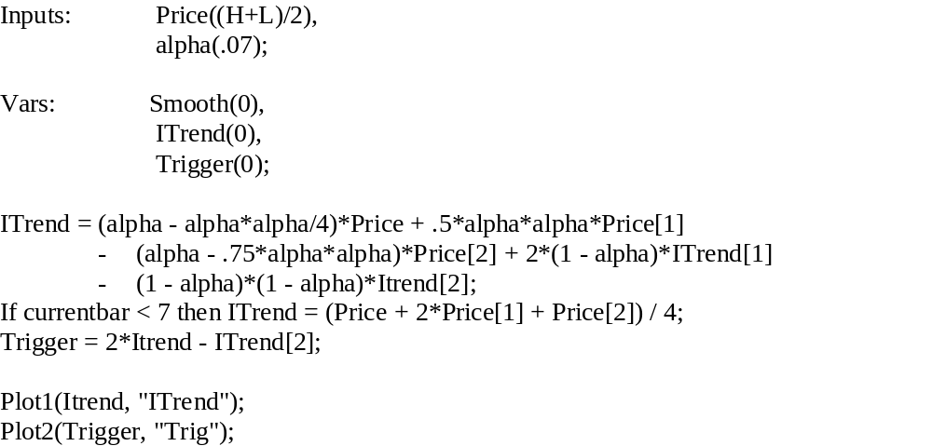
Simple Instantaneous Trendline Strategy

Slide 17
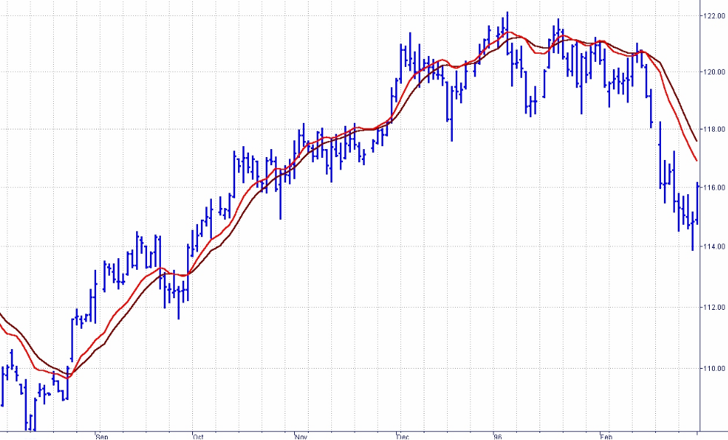
Strategy Trades on Line Crossings

Slide 18
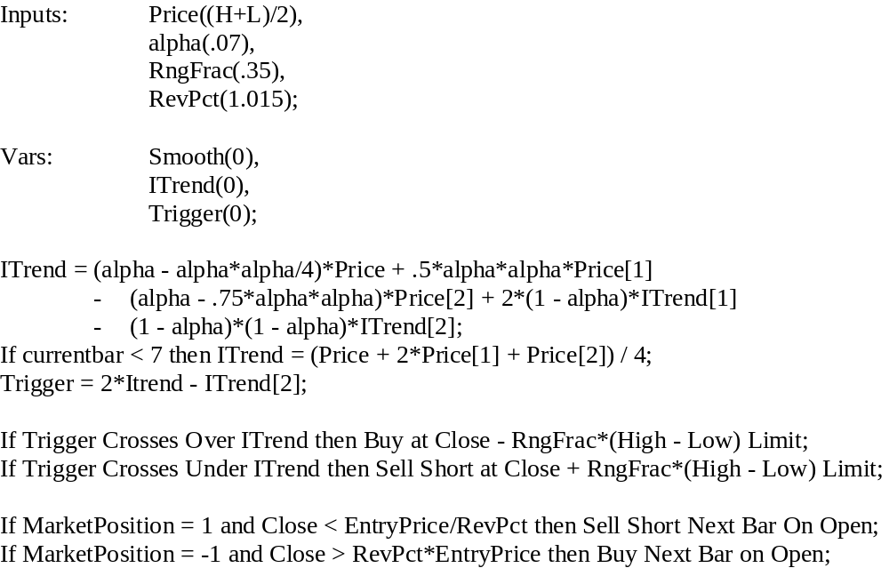
Practical Strategy Enhancements
1) Buy/Sell on a limit after the price has gone against the anticipated position by a
factor related to current volatility
2) Provide reversal if market has an adverse excursion

Slide 19
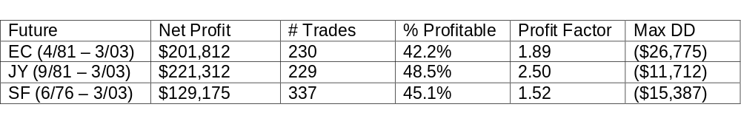
Results Are Comparable to Strategies Costing $1000 Or More

Slide 20
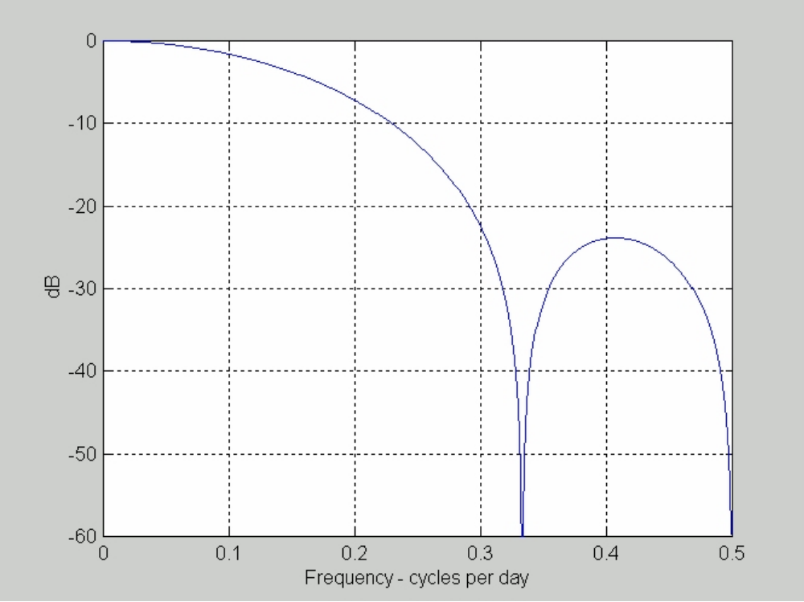
A Low Lag Smoothing Filter
In EasyLanguage notation:
Used to remove the high frequency content of the High Pass Filter

Slide 21
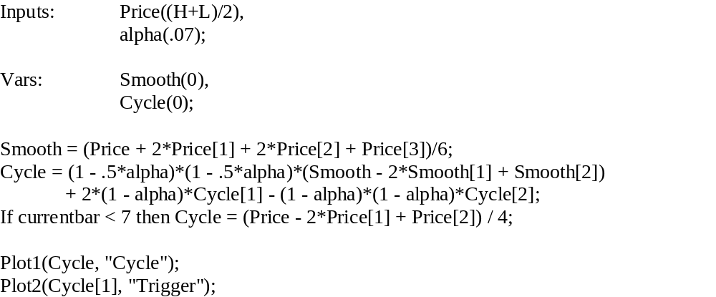
A Simple Cycle Indicator
The trading indicator is when
the Cycle Component crosses itself delayed by one bar

Slide 22
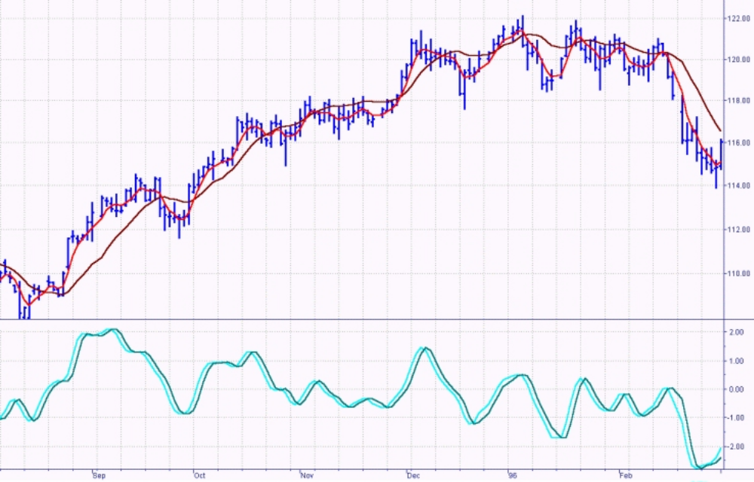
Cycle and Trend Mode Indicators are Complementary
A low lag smoothing line crossed the Instantanteous Trendline at the same time
the Cycle crosses zero - THIS IS A FIRST!

Slide 23
SUMMARY
You have learned how to create an Instantaneous Trendline (Zero Lag)
You have a trend-following trading strategy comparable to commercial strategies
You have an excellent Cycle Mode indicator (an oscillator)
You understand how profound a philosophical model of the market can be

