Slide 1
ANTICIPATING TURNING POINTS
Left-Brained Concepts for Traders in their Right Minds

Slide 2
This Webinar is an excerpt from my Runner Up Paper for the 2008 MTA Charles H. Dow Award
www.mta.org
Activities Tab – Charles H. Dow Award
also
www.stockspotter.com
Help / FunStuff / For Math Geeks Only / Technical Papers
The webinar slides (including code) can be found at:
www.stockspotter.com
Help / FunStuff / For Math Geeks Only / Webinars

Slide 3
This webinar can be used at several levels:
  Just apply the concepts to conventional indicators
  Gain a deeper understanding of how indicators work.
  Apply detailed code to improve the performance of your indicators

Slide 4
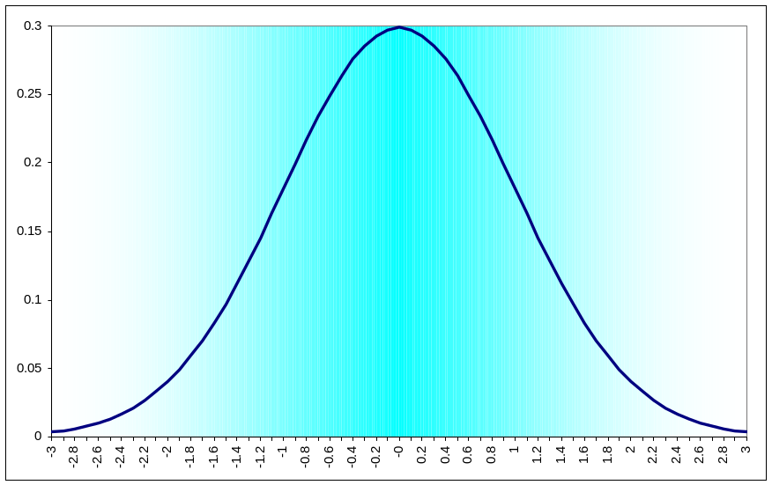
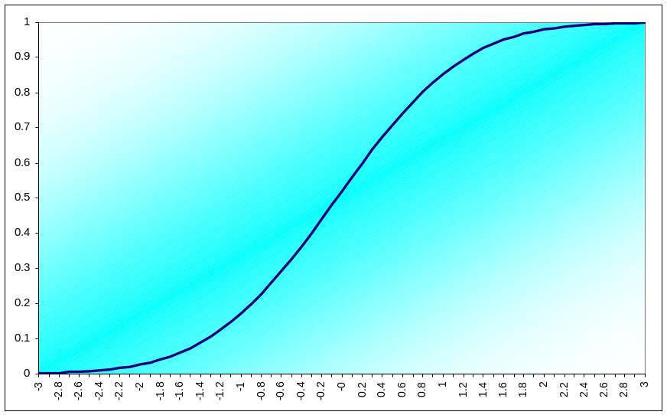
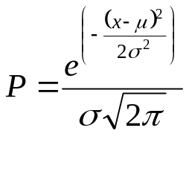
Normal (Gaussian) Probability Distribution Function (PDF) is Commonly Assumed for Market Data
Normal PDF
Cumulative Normal PDF
0 = 50%
+1σ = 85%
+2σ = 98%
+3σ = 99.9%
Normal PDF is attractive because it can be achieved
using several random variables due to the central limit theorem
But is Normal the right PDF for market data?

Slide 5
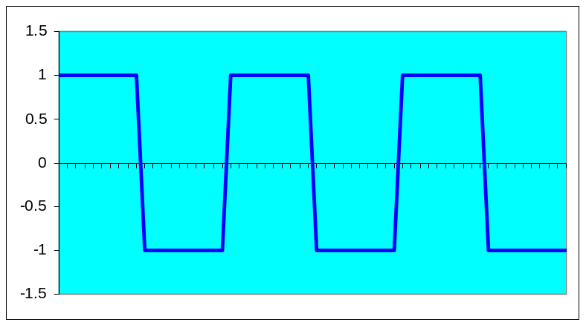
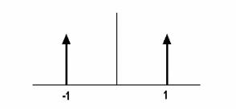
CONSIDER A THEORETICAL SQUAREWAVE
Square Wave
Binary PDF of Square Wave
A Square Wave cannot be traded with conventional indicators
because the move is over before any indicator can show the move

Slide 6
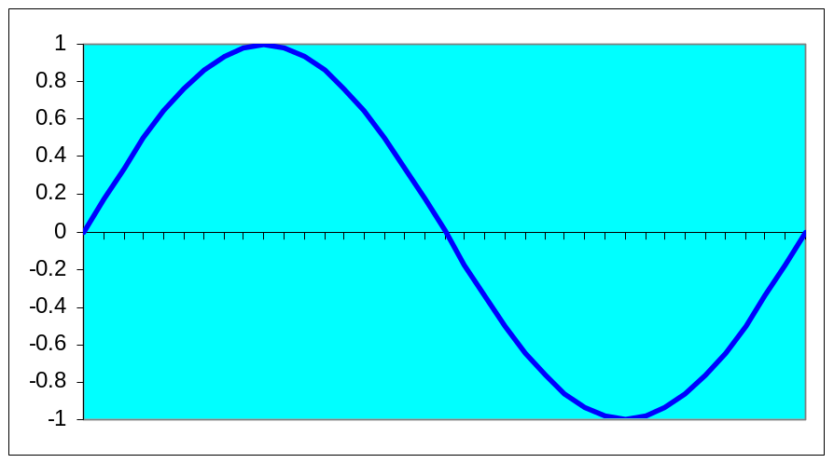
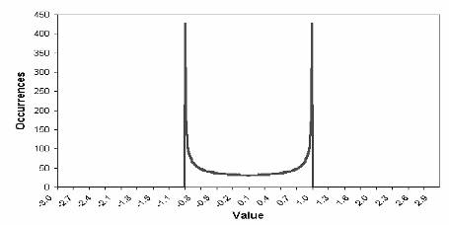
NEXT - CONSIDER A SINEWAVE
Sine Wave
Sine Wave PDF
The Probability Distribution of a Sinewave
is similar to that of a Squarewave
This is why most traders have trouble trading with cycles
The cyclic turning point must be anticipated

Slide 7
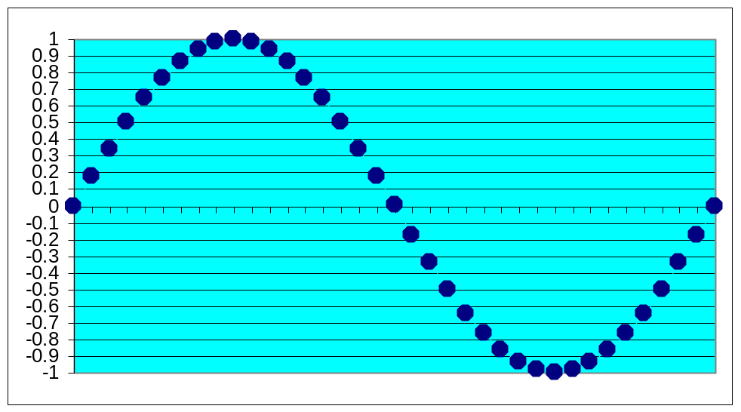
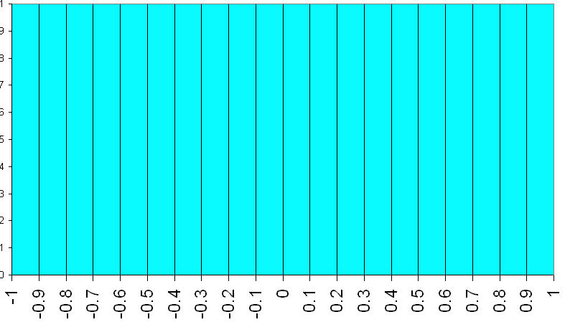
How Do We Determine the Market PDF?
Create the waveform by
stringing beads on a
horizontal wire frame
Rotate wire frame to
enable beads to
stack up
Height of the bead
stacks is the PDF
of the Waveform

Slide 8
Channel Limited PDF Generator Code
Inputs:
Length(20);
Vars:
HH(0),
LL(0),
I(0);
Arrays:
Filt[2000](0),
Bin[100](0);
HH = Close;
LL = Close;
For I = 0 to Length -1 Begin
If Close[I] > HH then HH = Close[I];
If Close[I] < LL then LL = Close[I];
End;
If HH <> LL Then Value1 = (Close - LL) / (HH - LL);
Filt[CurrentBar] = (Value1 + 2*Value1[1] + Value1[2]) / 4;
For I = 0 to 100 Begin
If Filt[CurrentBar] >= I/100 and Filt[CurrentBar] < (I + 1)/100 Then Bin[I] = Bin[I]+1;
End;
For I = 0 to 99 Begin
Print(File("c:\tsgrowth\pdf.csv"), I, ",", Bin[I]);
End;
Plot1(Filt[CurrentBar]);

Slide 9
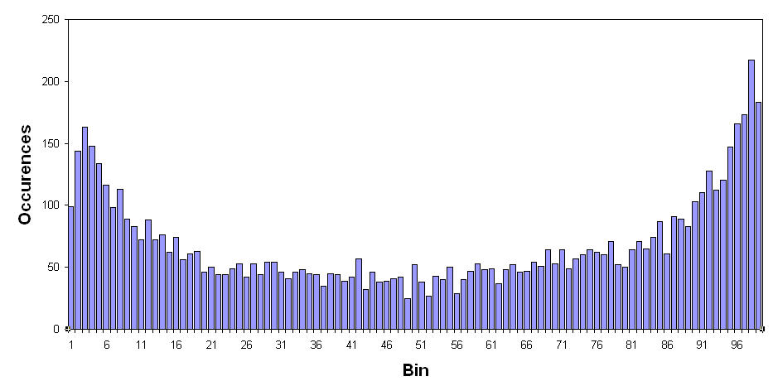
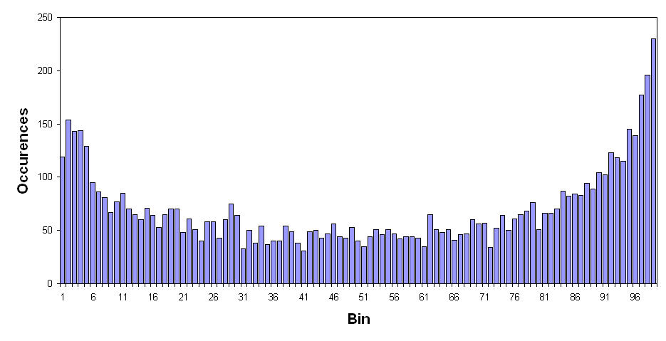
Channel PDF for Treasury Bonds
20 Bar Channel over 30 Years
40 Bar Channel over 30 Years
Clearly, Channel Limited Detrending produces Sinewave-Like PDFs

Slide 10
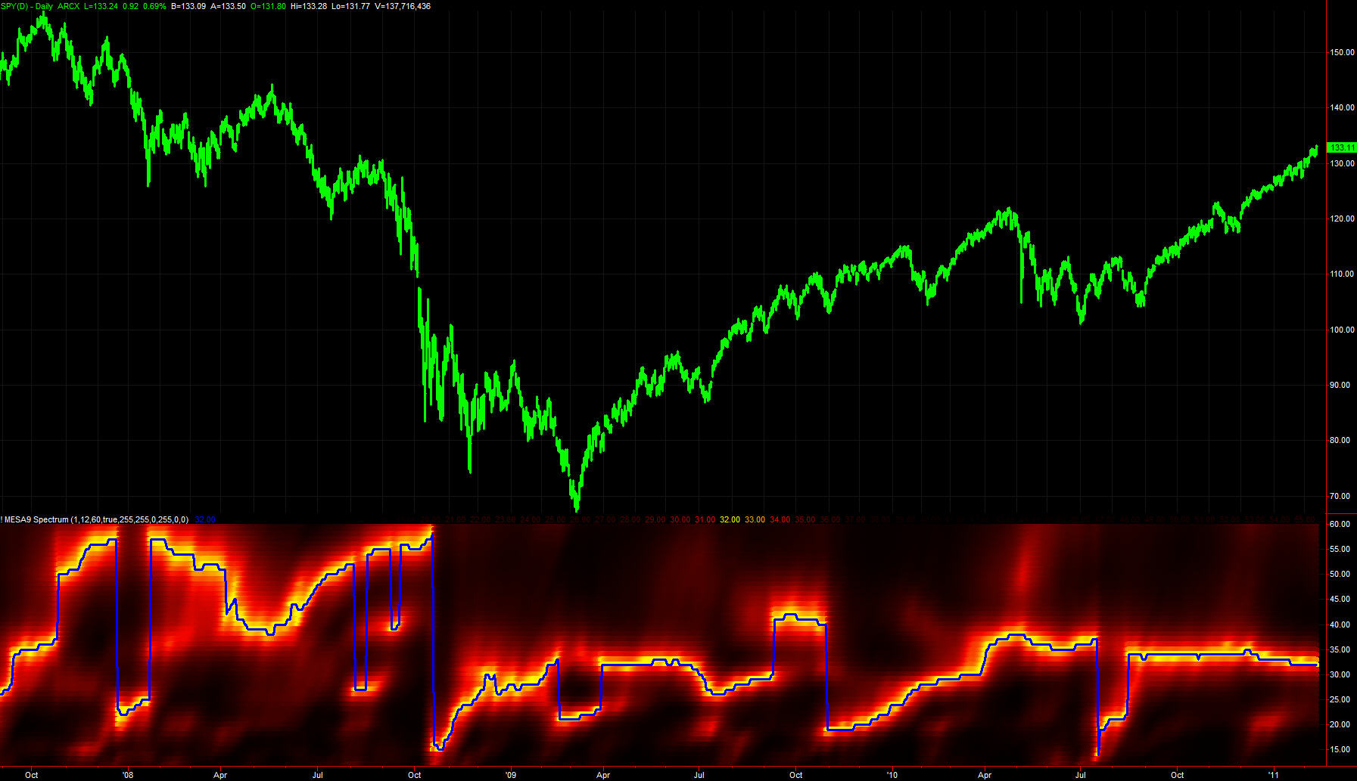
SPY for Last Five Years
MESA-Measured Cycles Exist
Cycle Periods Vary

Slide 11
CONVINCED THERE ARE TRADEABLE CYCLES?
Market Cycles have been measured
  With Probability Distribution Functions
  With Spectral Analysis
Trading with Cycles is difficult because the turning points MUST be anticipated
  Common Indicators applied with conventional wisdom are basically useless because of lag

Slide 12
Probability Distribution Varies with Detrending
Channel Limited detrending (Stochastic) generally yields PDFs similar to the PDF of a Sine Wave
Two more detrending approaches will be described where that is not necessarily true
  HighPass Filtering
  RSI

Slide 13
Highpass Filter PDF Generator Code
Inputs:
HPPeriod(40);
Vars:
alpha(0), HP(0), HH(0), LL(0), Count(0), Psn(0), I(0);
Arrays:
Bin[100](0);
alpha = (1 - Sine (360 / HPPeriod)) / Cosine(360 / HPPeriod);
HP = .5*(1 + alpha)*(Close - Close[1]) + alpha*HP[1];
IF CurrentBar = 1 THEN HP = 0;
If CurrentBar > HPPeriod Then Begin
HH = HP;
LL = HP;
For Count = 0 to HPPeriod -1 Begin
If HP[Count] > HH Then HH = HP[Count];
If HP[Count] < LL Then LL = HP[Count];
End;
If HH <> LL Then Value1 = 100*(HP - LL) / (HH - LL);
Psn = (Value1 + 2*Value1[1] + Value1[2]) / 4;
For I = 1 to 100 Begin
If Psn > I - 1 and Psn <= I Then Bin[I] = Bin[I] + 1;
End;
Plot1(Psn);
End;
If LastBarOnChart Then Begin
For I = 1 to 99 Begin
Print(File("C:\TSGrowth\PDF_HP.CSV"), I, ",", Bin[I]);
End;
End;

Slide 14
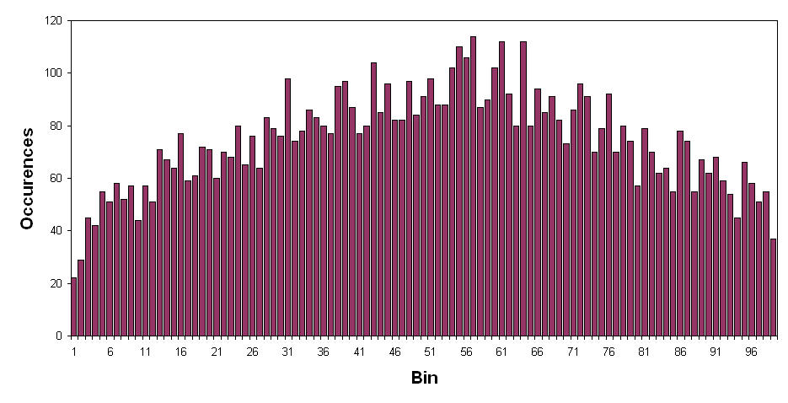
HP Filtered PDF for Treasury Bonds
40 Bar Cutoff over 30 Years
PDFs produced by filtering have nearly uniform probability

Slide 15
MyRSI PDF Generator Code
Inputs:
Length(10);
Vars:
CU(0), CD(0), I(0), MyRSI(0), Psn(0);
Arrays:
Bin[100](0),
PDF[100](0);
If CurrentBar > Length Then Begin
CU = 0;
CD = 0;
For I = 0 to Length -1 Begin
If Close[I] - Close[I + 1] > 0 Then CU = CU + Close[I] - Close[I + 1];
If Close[I] - Close[I + 1] < 0 Then CD = CD + Close[I + 1] - Close[I];
End;
If CU + CD <> 0 Then MyRSI = 50*((CU - CD) / (CU + CD) + 1);
Psn = (MyRSI + 2*MyRSI[1] + MyRSI[2]) / 4;
For I = 1 to 100 Begin
If Psn > I - 1 and Psn <= I Then Bin[I] = Bin[I] + 1;
End;
End;
If LastBarOnChart Then Begin
For I = 1 to 99 Begin
Print(File("C:\TSGrowth\PDF_RSI.CSV"), I, ",", PDF[I]);
End;
End;

Slide 16
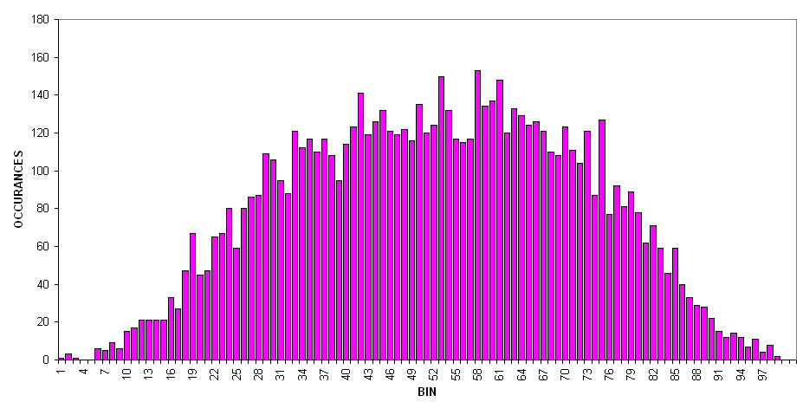
MyRSI PDF for Treasury Bonds
10 Bar RSI over 30 Years
RSI Detrending yields PDFs that appear Gaussian-Like

Slide 17
RSI PDF Suggests a Trading Strategy
The RSI PDF appears to be Gaussian-Like
Probability of events at the amplitude extremes are very low
Strategy is based on the higher probability of prices reversing
  Sell Short when prices cross over some upper threshold
  Buy when prices cross under some lower threshold
Note! This strategy is NOT the same as conventional RSI trading systems – we are anticipating the turning points before they happen.

Slide 18
RSI Strategy
Compute RSI
Buy when RSI crosses below 30%
Sell when RSI crosses above 70%
Conventional RSI waits for confirmation:
  Buy when RSI crosses above 20% (delays entry)
  Sell when RSI crosses below 80% (delays entry)

Slide 19
Fisher Transform
A PDF of virtually any processed data can be converted to a Normal PDF using the Fisher Transform

Slide 20
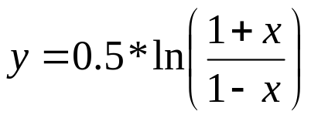
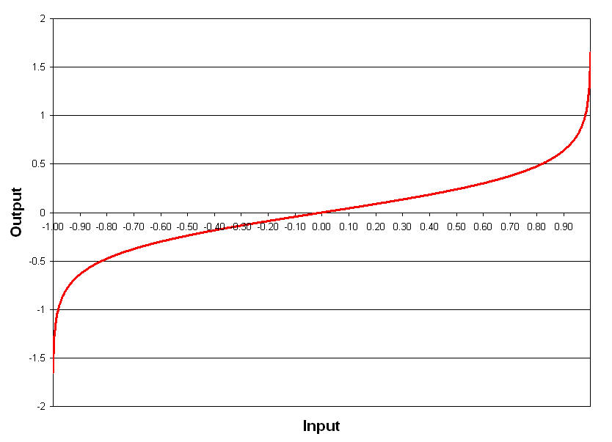
Fisher Transform
A Fisher Transform has no lag – it expands range near the endpoints

Slide 21
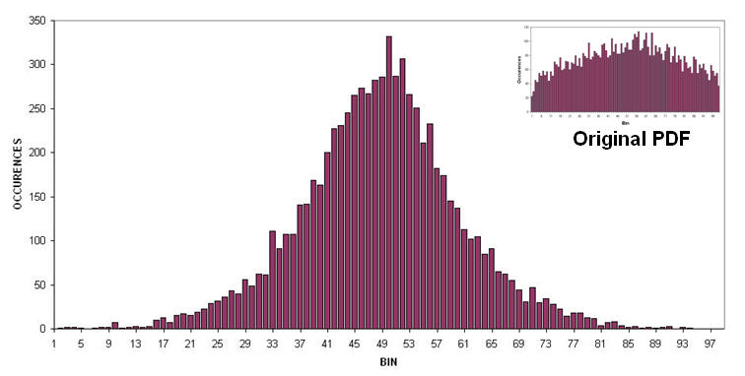
Fisherized PDF for Treasury Bonds
Fisherized Detrended Signal Over 30 Years
(Slide 14)
The Fisher Transform enables the use of the same kind of strategy as before
Where we reverse position when extreme amplitude thresholds are exceeded

Slide 22
Fisher Transform System
Highpass Filter prices
Normalize between -.999 and +.999 using a Stochastic-like approach
Buy when transformed prices cross below an optimizable lower bound
Sell when transformed prices cross above an optimizable lower bound

Slide 23
TRADING SYSTEM RESULTS

Slide 24
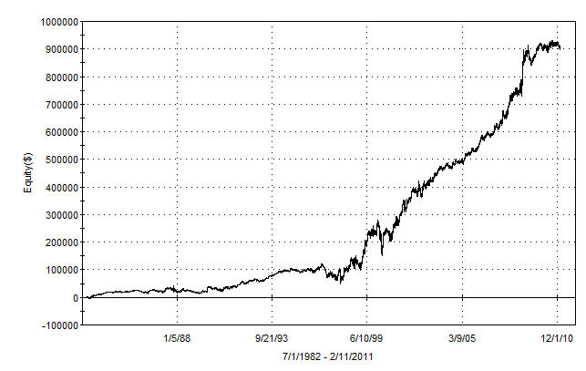
RSI Trading System Results
@SP.P for the life of the contract (from April 1982)
745 Trades (about once every two weeks)
65.4% Profitable Trades
Profit Factor = 1.65
The strategy is robust across the entire life of the contract!

Slide 25
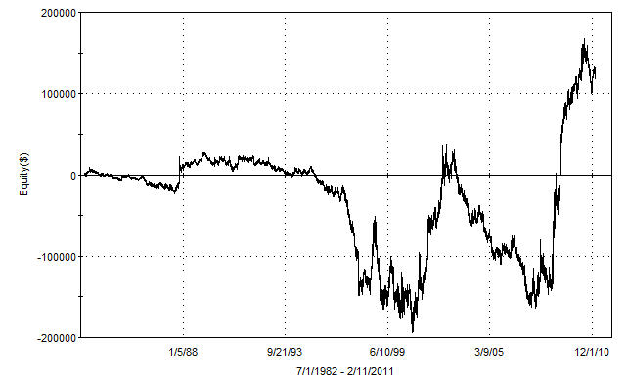
CONVENTIONAL RSI @SP.P EQUITY
Waiting for confirmation is not a good plan!

Slide 26
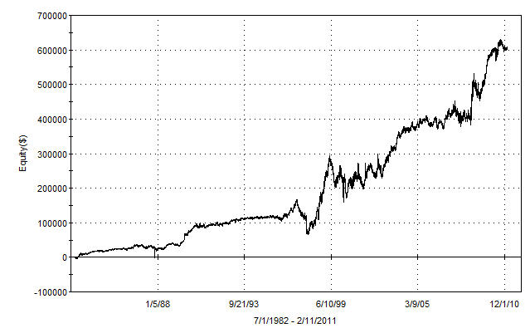
Fisher Transform System Results
@SP.P for the life of the contract (from April 1982)
574 Trades (about 2.5 weeks per trade)
66.7% Profitable Trades
Profit Factor = 1.55
The strategy is robust across the entire life of the contract!

Slide 27
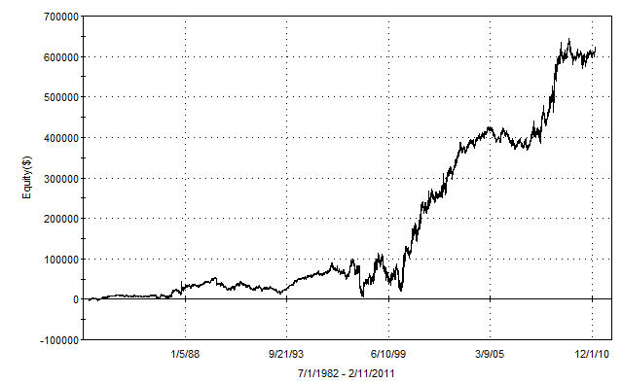
BandPass Filter Trading System Results
Bandpass Filtered Signal Anticipates Turning Points
The strategy is reasonably robust
Proving that anticipating turning points works

Slide 28
TRADING STRATEGY COMMENTS
The concepts are provided for educational purposes only
There was no allowance for slippage and commission
Results were shown using in-sample optimization
No stops or disaster reversals were used
The strategies are not adaptive to current market conditions

Slide 29
REAL WORLD CONSIDERATIONS
Trading results must be viewed “out-of-sample” to ensure realistic evaluation
No single trading strategy will work in all market conditions
  A combination of strategies are needed to ensure robustness
All entries and exits should be made on the open of the bar following the signal
  Stop and Limit orders give unrealistic expectations due to slippage

Slide 30
WWW.STOCKSPOTTER.COM
StockSpotter uses these principles to generate daily trading signals for over 3000 stocks
StockSpotter uses an overarching algorithm to select only the highest probability trades.
All StockSpotter results are verifiable.
View StockSpotter results for FREE
I offer a “30 days for 30 dollars” introductory price. Use promo code MESA311 to get a 20% discount thereafter ($95 per month).
  Seminar Promotion valid until 1 April 2011

Slide 31
THANK YOU FOR ATTENDING THIS WEBINAR
QUESTIONS?

