Slide 1
Colleagues In Trading Seminar
17 Feb 2007
John Ehlers
805-927-3065
ehlers@mesasoftware.com
mesasoftware.com
eMiniZ.com
IndiceZ.com
ISignals.com

Slide 2
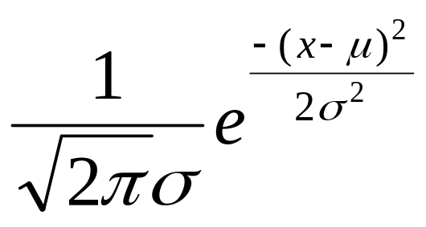
ENGINEERS ARE AS
AS ANYONE

Slide 3
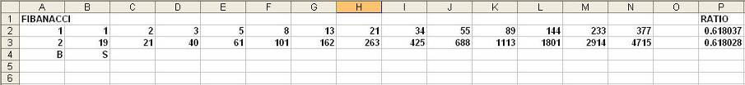
Fibanacci Ratios

Slide 4
Patterns
Thousands of patterns have been catalogued
  Double Bottom, Head & Shoulder, Flags, Pennants, etc.
  All are anecdotal or within the probability of chance
Tune your TV to an unused channel and stare at the screen intently
  I guarantee you will see patterns formed out of pure noise
If seeing is believing, check out www.mesasoftware.com/optical.htm
  Very interesting optical illusions

Slide 5
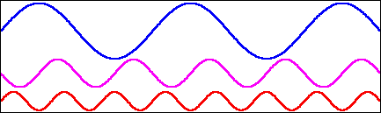
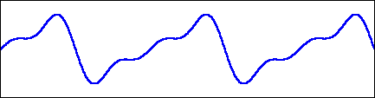
Wave Synthesis
Sinewaves are the primitives to synthesize more complex waves
wave = SIN(F*T) - SIN(2*F*T)/2 + SIN(3*F*T)/3
Combined Waveform: Elliott Wave?
Why not just deal with measurable primitives?

Slide 6
Momentum Functions
T = 0
RAMP
FUNCTION
1st derivative
(Momentum)
STEP
IMPULSE
2nd derivative
(Acceleration)
JERK
3rd derivative
CONCLUSIONS:
1. Momentum can NEVER lead the function
2. Momentum is always more disjoint (noisy)

Slide 7
Moving Averages
c.g.
Window
Moving Average
Lag
CONCLUSIONS:
1. Moving Averages smooth the function
2. Moving Averages Lag by the center of gravity of the observation window
3. Using Moving Averages is always a tradeoff between smoothing and lag

Slide 8
Relating Lag to the EMA Constant
An EMA is calculated as:
  g(z) = α*f(z) + (1 - α )*g(z - 1)
      where g() is the output
      f() is the input
      z is the incrementing variable
Assume the following for a trend mode
  f() increments by 1 for each step of z
    has a value of “i” on the “i th” day
  k is the output lag
  i - k = α *i + (1 - α)*(i - k - 1)
  = α *i + (i - k) - 1 - α *i + α *(k + 1)
  0 = α *(k + 1) - 1
  Then k = 1/α -1 OR α = 1/(k + 1)

Slide 9
Relationship of Lag and EMA Constant
α k (Lag)
.5 1
.4 1.5
.3 2.33
.25 3
.2 4
.1 9
.05 19
Small α cannot be used for short term analysis due to excessive lag

Slide 10
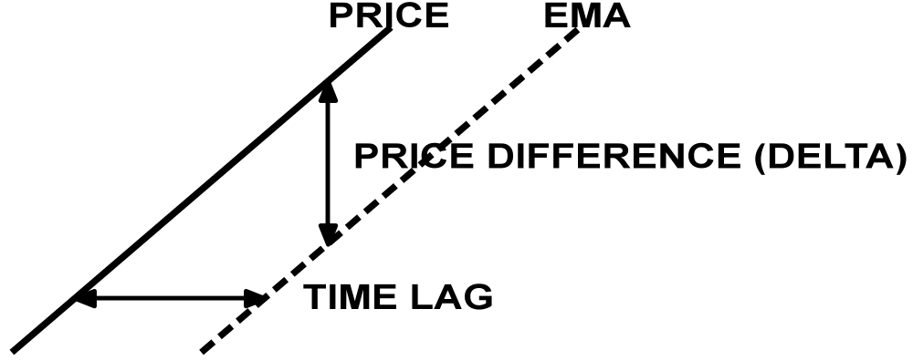
Concept of Predictive Filters
In the trend mode price difference is directly related to time lag
Procedure to generate a predictive line:
  Take an EMA of price
  Take the difference ( delta) between the price and its EMA
  Form the predictor by adding delta to the price
    equivalent to adding 2*delta to EMA

Slide 11
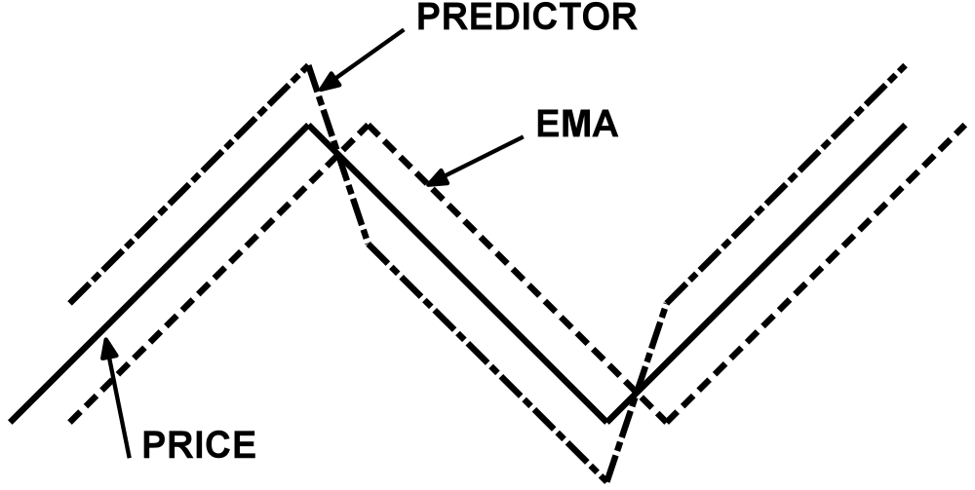
Simple Predictive Trading System
Rules:
  Buy when Predictor crosses EMA from bottom to top
  Sell when Predictor crosses EMA from top to bottom
Usually produces too many whipsaws to be practical
Crossover ALWAYS happens after the turning point

Slide 12
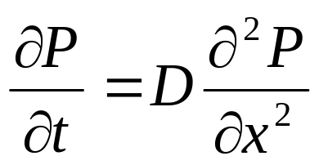
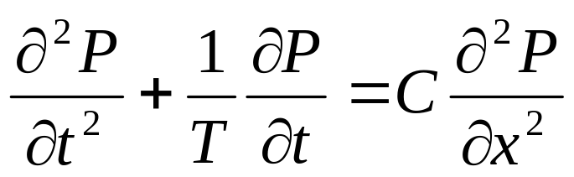
Drunkard’s Walk
Position as the random variable
Results in Diffusion Equation
Momentum as the random variable
Results in Telegrapher’s Equation

Slide 13
Efficient Market
Meandering river is a real-world example of the Drunkard’s walk
  Random over a long stretch
  Coherent in a short stretch
Hurst Exponent converges to 0.5 over several different spans
  However I used it to create an adaptive moving average based on fractals over a short span (FRAMA)

Slide 14
Coherent Behavior Example
F = -kx
Therefore: ma = -kx
F = ma
dx/dt = v
dv/dt = a
Therefore: a = d²x / dt²
And: m*d²x / dt² = -kx
Assume: x = Sin(ωt)
Then: dx/dt = ω*Cos(ωt)
d²x/dt² = -ω²*Sin(ωt)
Assumption is true if: ω² = k/m
CONCLUSION: One can create a leading function by taking a derivative when the market is coherent (in a cycle mode).
i.e. Cosine(x) leads Sine(x)

Slide 15
Many Indicators Assume a
Normal Probability Distribution
Example - CCI
  by Donald Lambert in Oct 1980 Futures Magazine
CCI = (Peak Deviation) / (.015* Mean Deviation)
Why .015?
  Because 1 / .015 = 66.7
  66.7% is (approximately) one standard deviation
    IF THE PROBABILITY DENSITY FUNCTION IS NORMAL

Slide 16
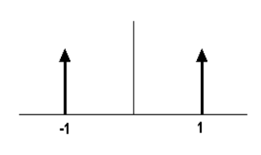
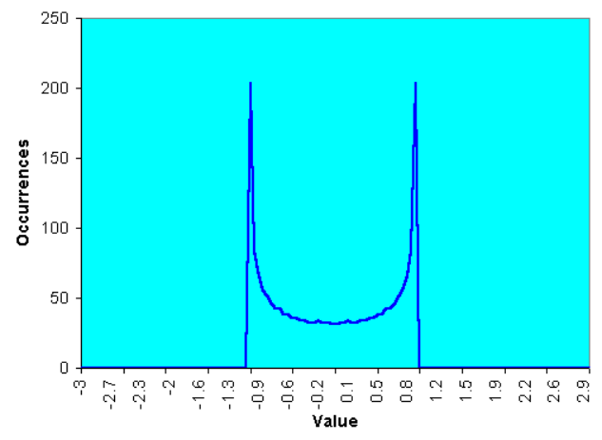
What are Probability Density Functions?
A PDF can be created by making the waveform with beads on parallel horizontal wires. Then, turn the frame sideways to see how the beads stack up.
A Square Wave only has two values
A Square Wave is untradeable with conventional
Indicators because the switch to the other value
has occurred before action can be taken
A Sinewave PDF is not much different from
a Squarewave PDF

Slide 17
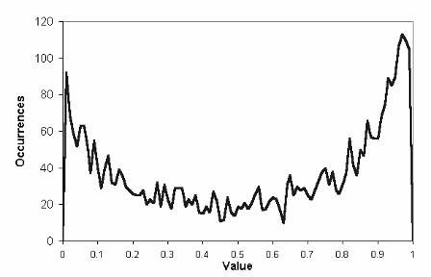
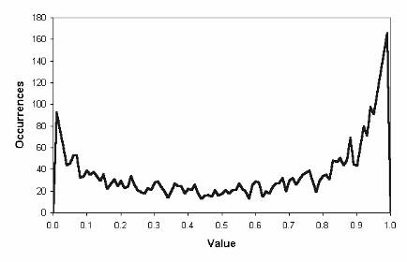
Real Probabilities are NOT Gaussian
Probability Distribution of a 10 Bar Channel
Over 15 years of Treasury Bond data
Probability Distribution of a 30 Bar Channel
Over 15 years of Treasury Bond data

Slide 18
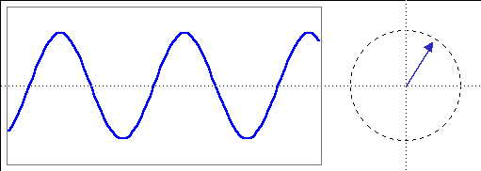
A Phasor Describes a Cycle
Cycle
Phasor
Phase Angle
Quadrature
θ
InPhase
Cycle Amplitude (Pythagorean Theorem)
Amplitude² = (InPhase)² + (Quadrature)²
Phase Angle = ArcTan(Quadrature / InPhase)
Cycle Period when Σ Phase Angles = 360⁰

Slide 19
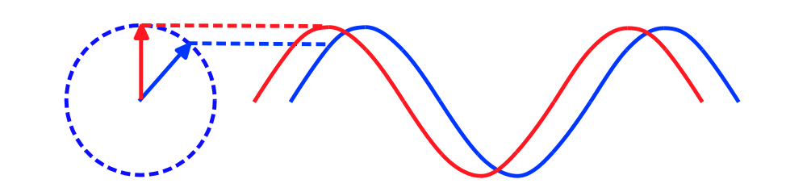
Sinewave Indicator Advantages
Line crossings give advance warning of cyclic turning points
Advancing phase does not increase noise
Indicator can be “tweaked” using theoretical waveforms
No false whipsaws when the market is in a trend mode

Slide 20
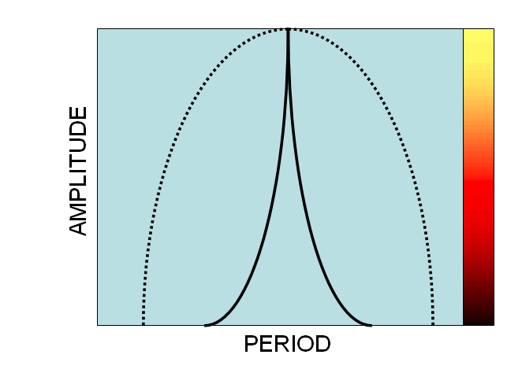
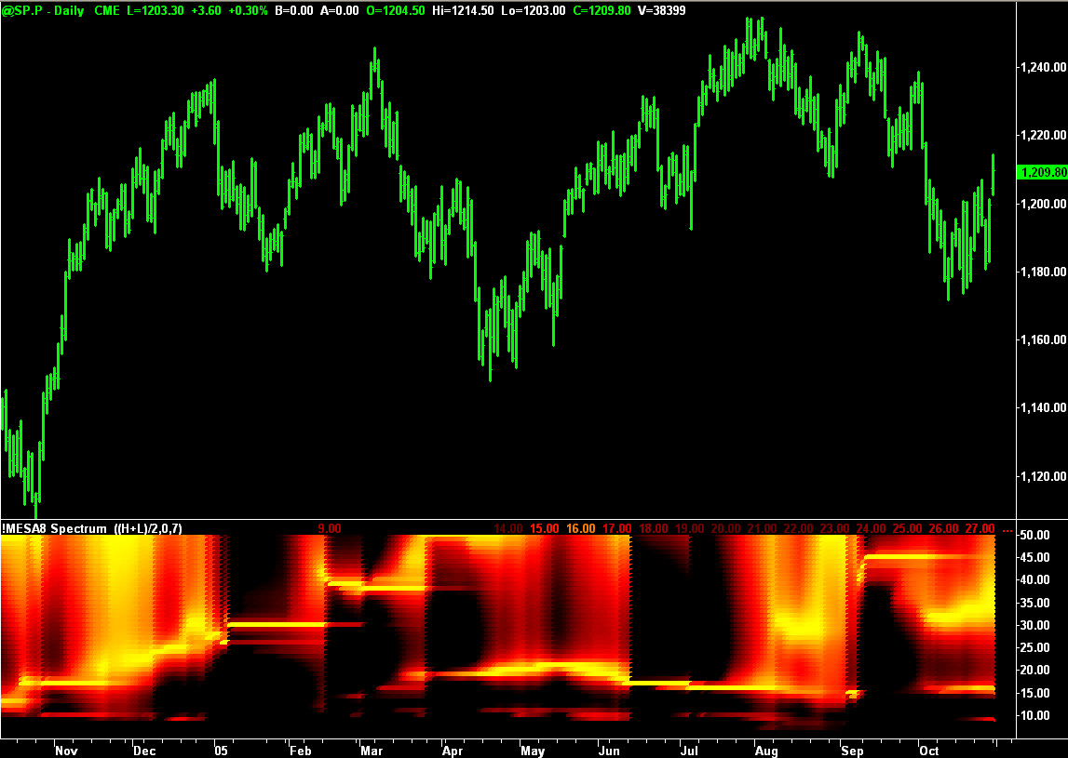
Cycle Measurement Techniques
Convert Amplitude to Color
so spectrum can be plotted
in sync with prices
MESA8 Spectral Estimate
(standard against which
other techniques will be
measured)

Slide 21
FFT
Constraints:
  Data is a representative sample of an infinitely long wave
  Data must be stationary over the sample time span
  Must have an integer number of cycles in the time span
Assume a 64 day time span
  Longest cycle period is 64 days
  Next longest is 64 / 2 = 32 days
  Next longest is 64 / 3 = 21.3 days
  Next longest is 64 / 4 = 16 days
Result is poor resolution - gaps between measured cycles

Slide 22
FFT (continued)
Paradox:
  The only way to increase resolution is to increase the data length
  Increased data length makes realization of the stationarity constraint highly unlikely
    256 data points are required to realize a 1 bar resolution for a 16 bar cycle (right where we want to work)
Conclusion:
FFT measurements are not suitable for market analysis

Slide 23
Sliding DFT
Requires spacing of spectral lines just like a FFT
Therefore the resolution of a Sliding DFT is too poor to be used for trading

Slide 24
Frequency Discriminators
I described 3 different discriminators in “Rocket Science for Traders”
Measure phase differences between successive samples
  For example Δθ = 36 degrees describes a 10 bar cycle period
  Discriminators respond rapidly to frequency changes
Problem: long cycles have a small change in phase per sample
  For example 40 Bar cycle phase change is only 9 degrees
  Result: Long signal cycles are swamped by noise
I no longer recommend Frequency Discriminators

Slide 25
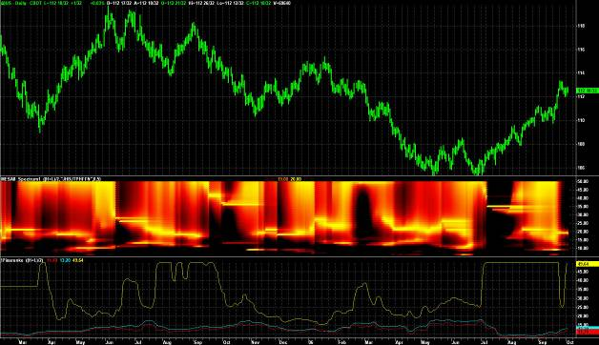
Pisarenko Harmonic Decomposition
Similar to Phase Discriminators except that autocorrelation is used to reduce noise
Decimation does not improve cycle measurements

Slide 26
Chirped Z Transform (CZT)
Hopeless

Slide 27
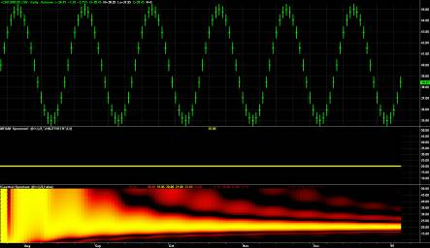
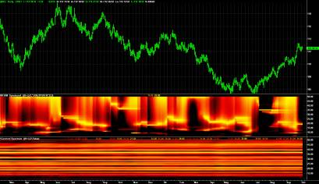
Goertzel
Used to detect two-tone phone dial codes
Depends on LMS convergence
Goertzel measurements do not converge on market data

Slide 28
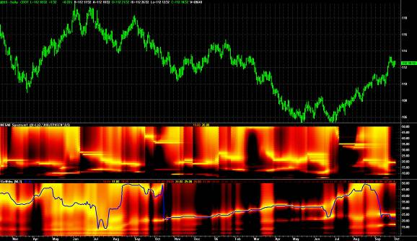
Griffiths
Griffiths is a sliding algorithm that also depends on LMS convergence
No kewpie doll for accuracy

Slide 29
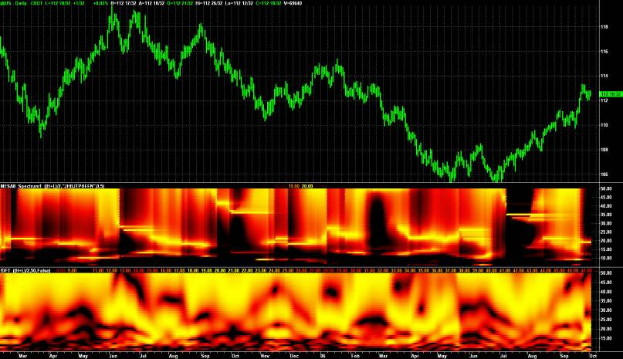
DFT
Discrete Fourier Transform (DFT) has poor resolution

Slide 30
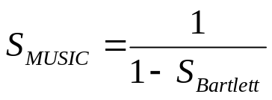
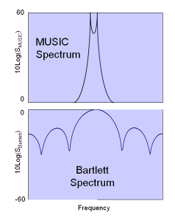

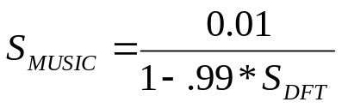
MUSIC
MUltiple Signal Identifcation and Classification (MUSIC)
Kay & Demeure* showed that the resolution of the Bartlett spectrum (a DFT) and a MUSIC spectrum (a MESA) are related by the transform
where
I use this transform to enhance the resolution of the DFT
* Steven Kay and Cedric Demeure, “The High-Resolution Spectrum Estimator – a Subjective Entity”, Proceedings IEEE, Vol 72, Dec 1984, pp1815-1816

Slide 31
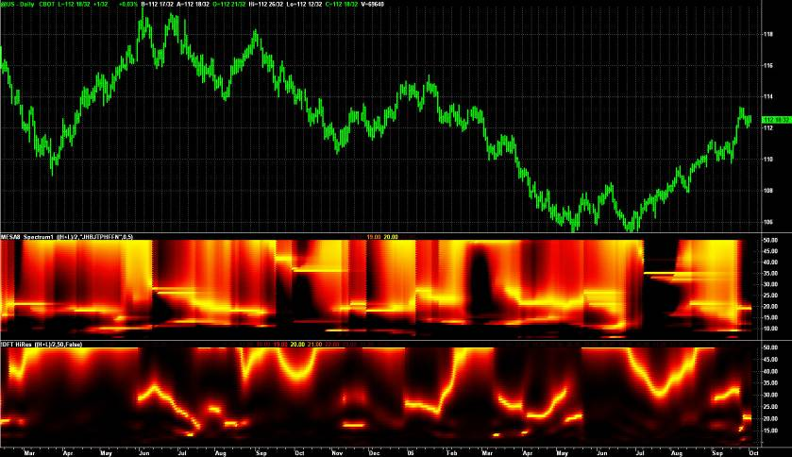
MUSIC

Slide 32
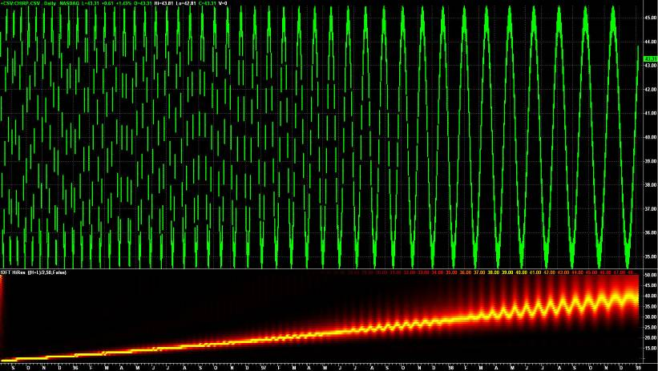
DFT Chirp Response
High Resolution DFT Accurately Measures Cycle Periods

Slide 33
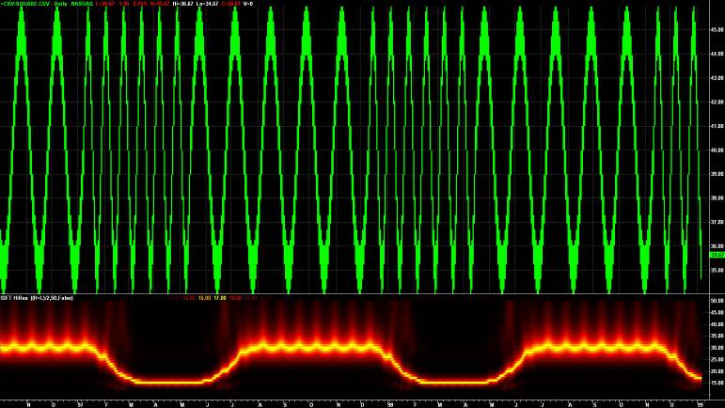
DFT Square Wave Response
High Resolution DFT has a quick transient response
Chart switches between a 15 and 30 bar cycle

Slide 34
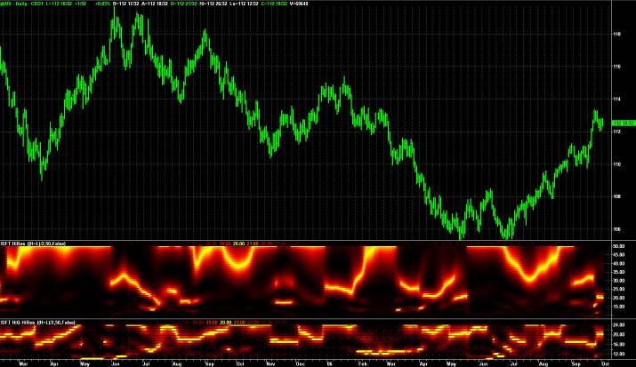
The Market is Fractal
Longer cycles will always dominate
Limit the cycle measurement to the cycle periods of interest

Slide 35
BandPass Filter
Since frequency is known, a leading signal can be created from the derivative of a Bandpass filtered signal
  From calculus: d(Sin(ωt) / dt = ω*Cos(ωt)
  Therefore: Lead = (Period / 6.28318)*(BP – BP[1])
Single channel code is simple
Inputs:Price((H+L)/2), Period(20), Delta(.25);
Vars: gamma(0), alpha(0), beta(0), BP(0), Lead(0);
beta = Cosine(360 / Period);
gamma = 1 / Cosine(720*delta / Period);
alpha = gamma - SquareRoot(gamma*gamma - 1);
BP = .5*(1 - alpha)*(Price - Price[2]) + beta*(1 + alpha)*BP[1] - alpha*BP[2];
Lead = (Period / 6.28318)*(BP - BP [1]);
Plot1(BP,"bp");
Plot2(Lead, "lead");

Slide 36
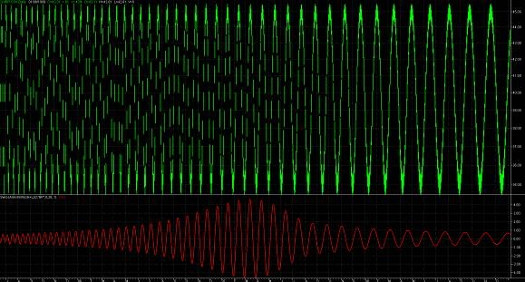
BandPass Filter
Eliminates both high frequency and low frequency noise
Design is a tradeoff between selectivity and transient response

Slide 37
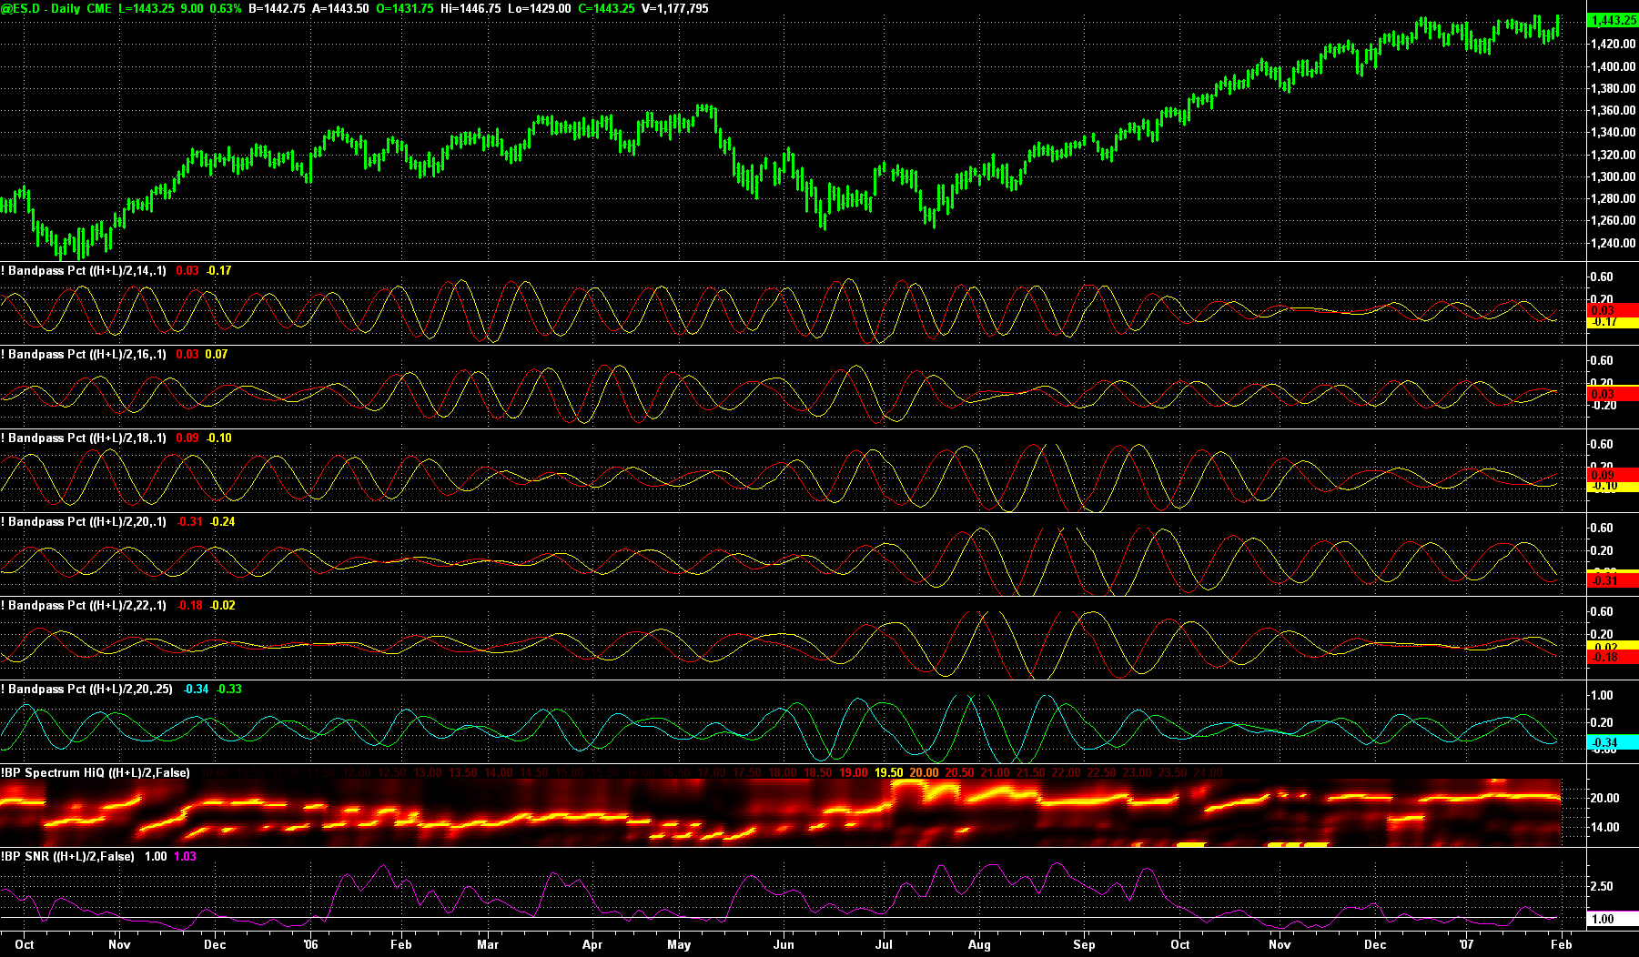
BandPass Response Study

Slide 38
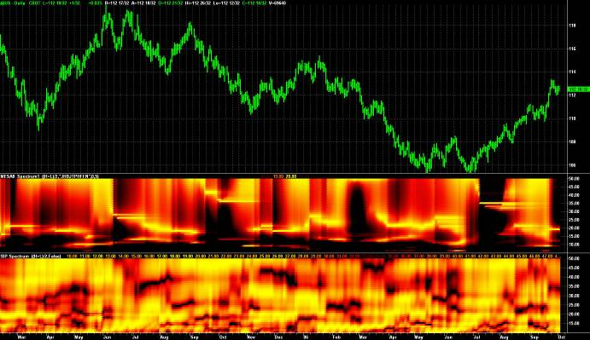
Channelized Receiver
Uses a bank of contiguous bandpass filters
Spacing and bandwidth are controllable
Detect the amplitude at the output of each filter
Can use resolution enhancement transform also

Slide 39
How to Use Measured Cycles
Replace fixed-length parameters with dominant cycle fraction
  Makes these indicators adaptive to current market conditions
Examples
  RSI: 0.5*dominant cycle
  Stochastic: 0.5*dominant cycle
  CCI: dominant cycle
  MACD: 0.5*dominant cycle & dominant cycle
By definition, trends have low cycle content
  Cycle peaks or valleys can be used to pick the best entry in the direction of the trend

Slide 40
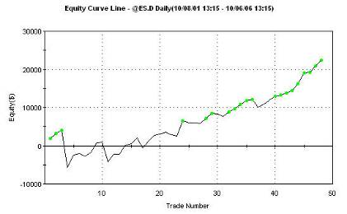
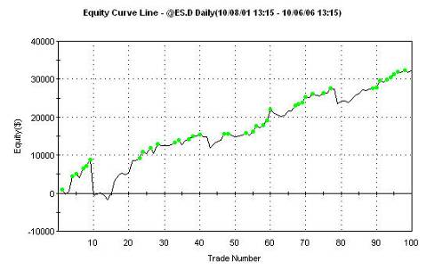
Adaptive Strategy Improvement
Fixed-Length RSI
(and length optimized)
DFT-Tuned RSI

Slide 41
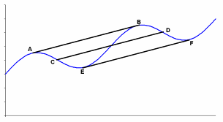
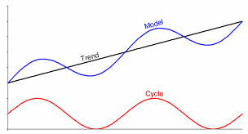
Trends
Slope is constant across one full cycle period
  This defines a trend for me
I model the market as an “instantaneous trendline” plus the dominant cycle
Best to trade the trend if the slope is greater than the cycle peak-to-peak amplitude
Trends can also be defined on the basis of cycle length for mode-switching strategies

Slide 42
Strategy Design
KISS
Base strategy on some sound principle
Establish orthogonal parameters
Use at least 30 trades per parameter in testing
  Minimizes curve-fitting
ALWAYS evaluate using out-of-sample tests
Optimize on percent profitable trades
  (in TradeStation)
  Better to optimize on (ProfitFactor) * (% Profitable)

Slide 43
Voting Systems
Systems that have voting components can be effective
  Example: Elder’s Triple Screen System
System components should be uncorrelated to avoid weighted votes
  RSI and Stochastic are highly correlated, for example
  A moving average and oscillator tend to be uncorrelated
  5:1 time spread is adequate to use the same indicator in two timeframes to produce a valid vote

Slide 44
Trading Your IRA
Cannot sell short or trade Futures in most IRAs
Create “synthetic” shorts and longs using options
  In the money options have a delta = 1 (theoretically, 0.8 practically)
  In the money option is better than having a built-in stop loss
    You cannot lose more than you paid for the option
    A worthless option can possibly be revived before expiration
  Options produce leverage
    A $4 option on a $130 index gives 0.8*(130/4) = 26:1 leverage
Trade ProShares for 2X leverage both long and short
  www.ISignals.com will soon be available to do this
  QLD Ultra QQQ
  SSO Ultra S&P500
  DDM Ultra DOW30
  MVV Ultra MidCap 400
  UWM Ultra Russell
  QID UltraShort QQQ
  SDS UltraShort S&P500
  DXD UltraShort Dow30
  MZZ UltraShort MidCap 400
  TWM UltraShort Russell

Slide 45
How to Optimize Strategies
Start with orthogonal parameters
Optimize one parameter at a time
View Strategy Optimization Report
  Display should be a gentle “mound” around the optimal parameter value
  An “erratic” display shows the parameter is not optimizing anything – just different performance for different parameter values
Iterate optimization through the parameter set to reduce optimization time
  This is called a “hillclimb” optimization
  If the parameter values change much your parameters are not orthogonal

Slide 46
Portfolio Diversification
All issues within the portfolio should be uncorrelated to reduce risk
If so, each doubling of issues reduces variation from mean equity growth by .707
Portfolio reaches a point of diminishing returns
  4 issues cuts variance in half
  16 issues cuts variance in half again
  64 issues required to reduce variance by half again
Better strategy is to trade indices to get the benefit of their averaging

Slide 47
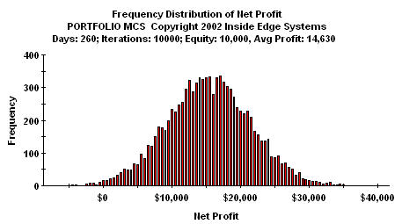
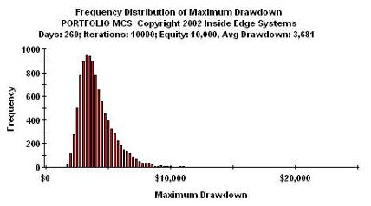
Monte Carlo Analysis
Shows statistics of a large number of trades
  Enables the use of recent, more relevant trades
Enables statistical evaluation of risk and reward/risk ratio

Slide 48
Trading System Evaluation
Profit Factor and % Profitable Trades are all you need to know to evaluate trading systems
These are analogous to Payout and Probability of Winning in gaming
Glossary:
$W = gross winnings
#W = number of winning trades
$L = gross losses (usually normalized to 1)
#L = number of winning trades
PF = Profit Factor = $W / $L
% = Percent Winning Trades {(1-%) = Percent Losing Trades} ….as fractions

Slide 49
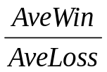
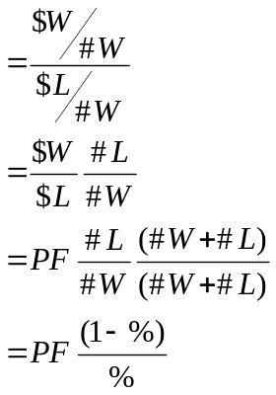

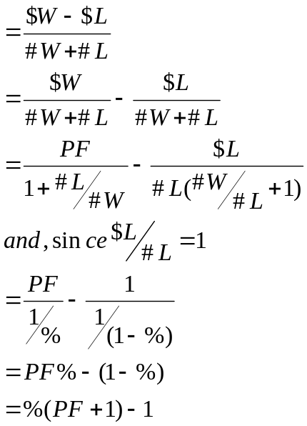
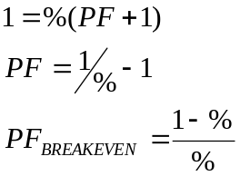
Some Interesting Relationships
Breakeven occurs when T = 0. In this case:

Slide 50

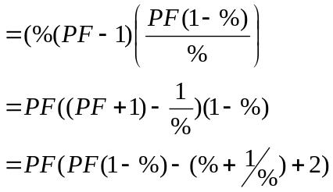
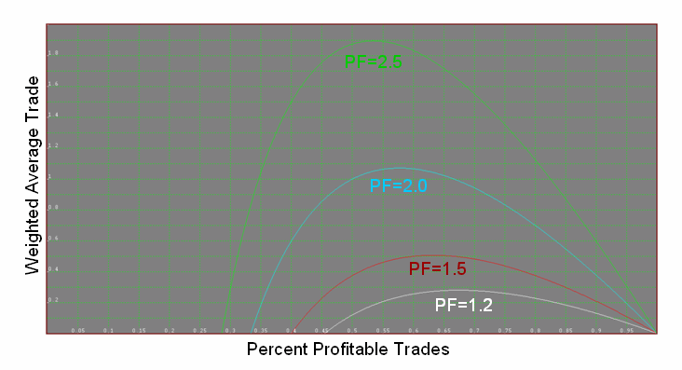
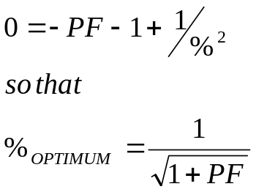
Weighted Average Trade
Optimize by setting that derivative to zero (zero slope at the inflection point). Doing this, we get:

Slide 51
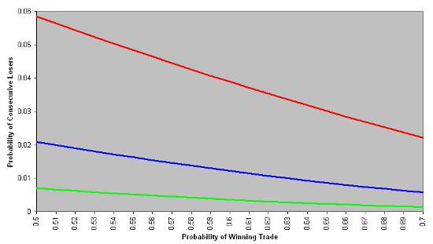
Consecutive Losing Trades
Probability of a losing trade is (1-%)
Probability of a second losing trade is (1-%)²
Probability of N consecutive losing trades is (1-%)^{N}
A good trading system has, say, 60% winners
  Therefore it has 40% losing trades
  q = 0.4
q = r + 2r² + 3r³ + 4r⁴ + 5r⁵ + …….
If q = 0.4 then r = 0.2349
Probability of getting 4 losers in a row is 4r⁴=0.0122
If you trade 50 times per year, the probability of getting 4 losers in a row is 60.9%
  That’s almost a promise it will happen
N=3
N=4
N=5

Slide 52
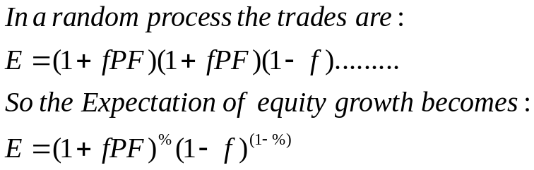
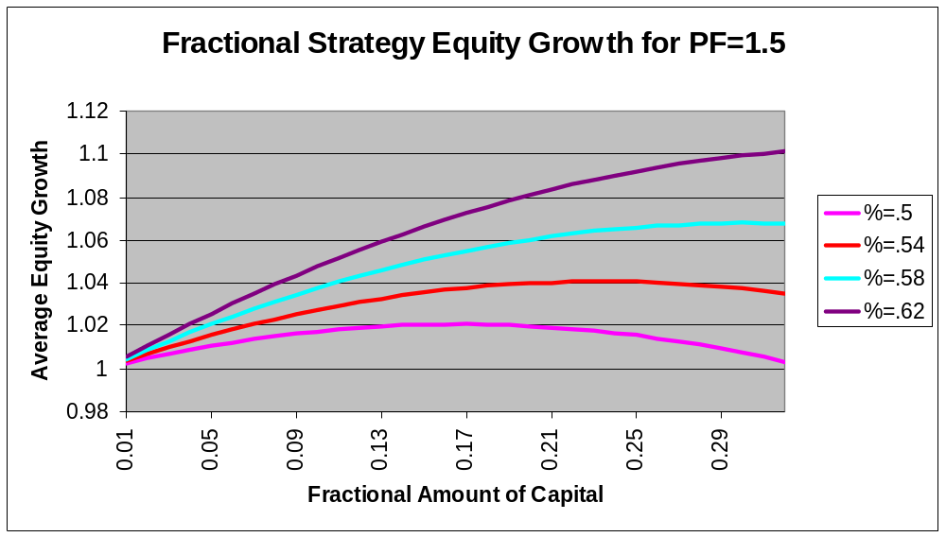
Fractional Strategy Equity Growth
Idea is to commit a fractional part of current capital to each trade rather than a fixed trade amount

Slide 53
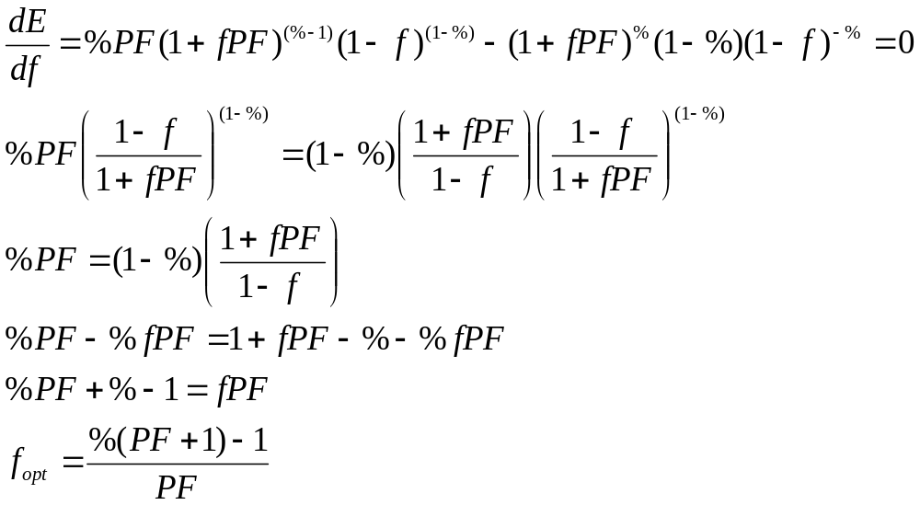
Optimal f
Optimize f by setting the derivative of Expectation to zero (zero slope)
This is exactly Ralph Vince’s Optimal f
  Kaufman formulation should use (Gross Wins) / (Gross Losses) = PF

Slide 54
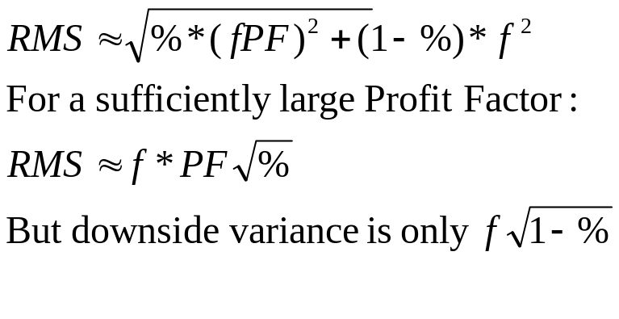
Sharpe Ratio, etc
RMS is synonymous with 1 Sigma variation (for a Normal probability distribution)
fPF
-f
Since Expectation is only slightly greater than unity:
Sharpe Ratio = (E-I) / σ ≈ 1 / RMS
Trading System Simulation

Slide 55
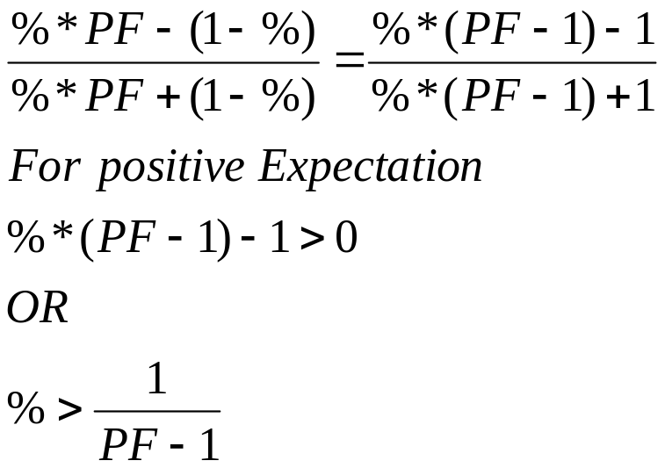
Bertrand’s Ballot Theorem
If candidate A ultimately gets “a” votes and candidate B ultimately gets “b” votes (a>b), then the probability of Candidate A leading throughout the ballot counting process is (a-b) / (a+b)
In our case, let a = %*PF and b = (1-%)
PF must be greater than 2 (even then % must be certainty)
Conclusion: It is almost a promise your account will go underwater some time after you start trading!

Slide 56
SVD
Single Value Decomposition (SVD)
Must be done in C or BASIC
  Generate a callable DLL in EasyLanguage
Code is available in Numeric Recipes
Use only the first EigenValue
  Orthogonalizes Signal and Noise
Sensitive to length of data used
Still is a causal filter
  System signals are always late
  I have not yet been able to create a gangbusters system

Slide 57
Recommended Resources
“New Trading Systems and Methods”, 4th Edition
  Perry J. Kaufman
  John Wiley & Sons
MCSPro (Monte Carlo Simulator)
  Inside Edge Systems – Bill Brower
  1000mileman@mindspring.com
  (203) 454-2754
My Websites:
  www.mesasoftware.com
  www.eMiniZ.com
  www.IndiceZ.com
  www.ISignals.com

Slide 58
Discount Opportunities
20 Percent discounts
www.eMiniZ.com
  Sign up for 30 day free trial using code XQP4135
www.IndiceZ.com
  Sign up for 30 day free trial using code XQH3065

Slide 59
And In Conclusion . . .
I know you believe you understood
what you think I said,
but I am not sure you realize
that what you heard is not what I meant

