Slide 1


Futures West 99
John Ehlers
MESA Software
P.O. Box 1801
Goleta, CA 93108
ehlers@mesasoftware.com
www.mesasoftware.com
www.mesa-systems.com

Slide 2
RISK STATEMENT
There is no guarantee that technical analysis will result in profits or that it will not result in losses. Past performance is not a guarantee of future results. All investments and trades carry risk and all trading decisions of an individual remain the responsibility of that individual. The use of any concepts presented does not constitute trading advice in any way.

Slide 3
Why You Should Not Attend this Showcase
Postulate 1: Time is Money
Postulate 2: Knowledge is Power
Work / Time = Power
substituting:
Work / Money = Knowledge
solving for Money:
Money = Work / Knowledge
Conclusion: Regardless of work done, Money decreases as Knowledge increases

Slide 4
AGENDA
Key Technical Analysis Aspects
How to read tomorrow’s newspaper today
  (a 1986 Futures Magazine description of MESA)
  Cycle Theory Overview
Adaptive Trading Systems
  Performance
  Descriptions
Software Demonstrations
All Key Punchlines are in Red

Slide 5
Momentum Functions
T = 0
RAMP
FUNCTION
1st derivative
(Momentum)
STEP
IMPULSE
2nd derivative
(Acceleration)
JERK
3rd derivative
CONCLUSIONS:
1. Momentum can NEVER lead the function
2. Momentum is always more disjoint (noisy)

Slide 6
Moving Averages
c.g.
Window
Moving Average
Lag
CONCLUSIONS:
1. Moving Averages smooth the function
2. Moving Averages Lag by the center of gravity of the observation window
3. Using Moving Averages is always a tradeoff between smoothing and lag

Slide 7
Cycle Measurements
Cycle Finders
FFT (Fast Fourier Transform)
MESA (Maximum Entropy Spectral Analysis)

Slide 8
FFT
Constraints:
  Data is a representative sample of an infinitely long wave
  Data must be stationary over the sample time span
  Must have an integer number of cycles in the time span
Assume a 64 day time span
  Longest cycle is 64 days
  Next longest is 64 / 2 = 32 days
  Next longest is 64 / 3 = 21.3 days
  Next longest is 64 / 4 = 16 days
Result is poor resolution - gaps between measured cycles

Slide 9
FFT (continued)
Paradox:
  The only way to increase resolution is to increase the data length
  Increased data length makes realization of the stationarity constraint highly unlikely
    256 data points are required to realize a 1 bar resolution for a 16 bar cycle (right where we want to work)
Conclusion:
FFT measurements are not suitable for market analysis

Slide 10
Spectrum Amplitude

Slide 11
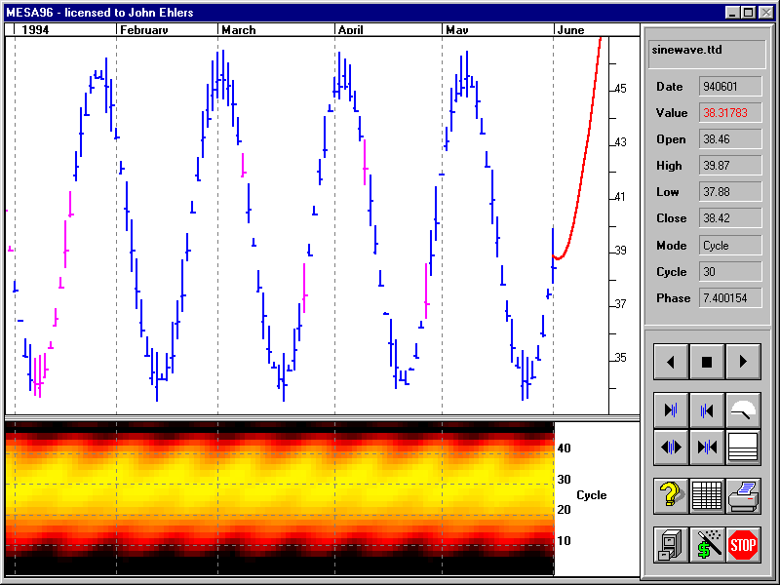
Fourier Transform of a 24 Bar Cycle

Slide 12
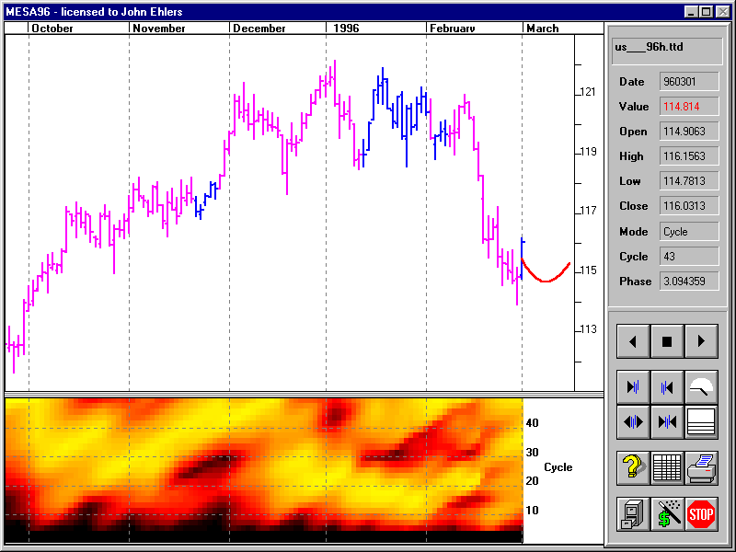
Fourier Transform for Mar 96 Bonds

Slide 13
MESA Cycle Measurement
Feedback optimally adjusts filter so the filter output is the same as the data waveform
  Pattern matching in the time domain
  No intrinsic resolution limitation or frequency distortions
Feedback
White
Noise
Adaptive
Filter
Comparitor
Waveform

Slide 14
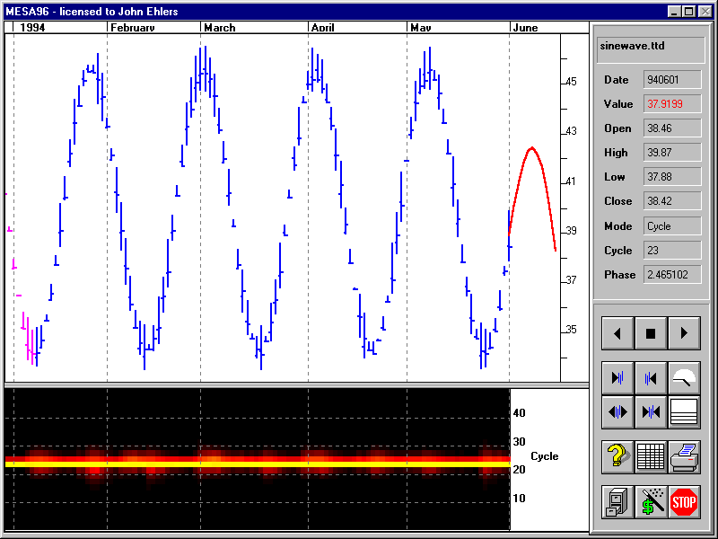
MESA Resolution of a 24 Bar Cycle

Slide 15
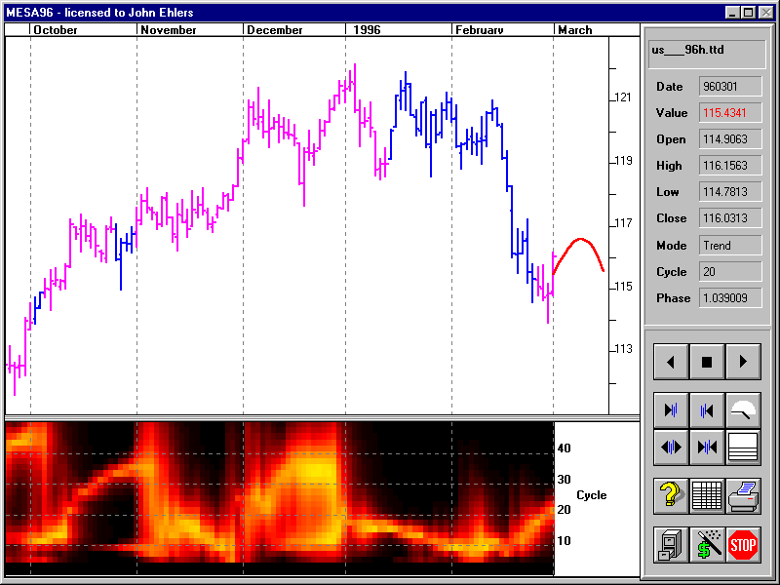
MESA Resolution for Mar 96 Bonds

Slide 16
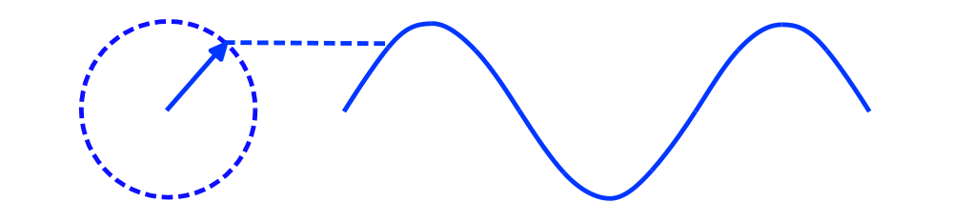
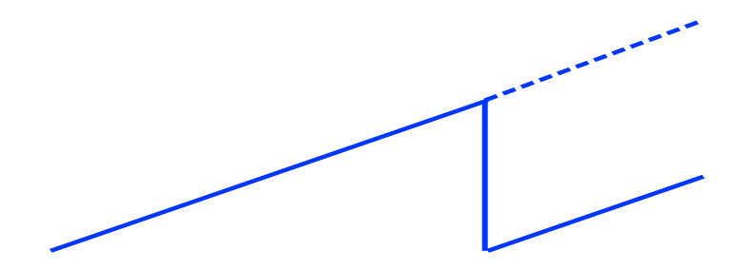
Sinewaves
A sinewave can be generated by connecting a pen to the arrow and pulling a piece of paper
Phase angles increase uniformly
Cycle mode exists when the rate change of phase is near the theoretical rate change of phase of the measured cycle
360
0

Slide 17
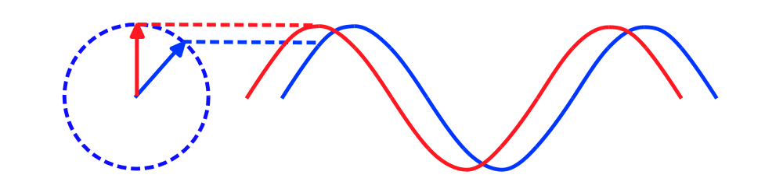
Phase Advance Produces a
Leading Indicator Oscillator
Conventional Sinewave
Crossover Trading Signals using phase lead to anticipate cyclic turning points
Phase does not change in a trend - this oscillator does not give false whipsaws

Slide 18
Application of Cycles to Trading
Strategy
  Use a trend follower when the market is in a trend mode
  Use an oscillator when the market is in a cycle mode
Approach
  Determine the mode of the market
  Implement a trading system for each mode

Slide 19
Applying Theory to Software
THEORY
EASY TO USE
MESA is the best way to measure cycles
Phase is an important parameter
Phase lead anticipates cycle turning points
Cycle is constant rate change of phase
Moving Averages can remove the cycle component
Dominant Cycle provides the means to develop adaptive trading systems
Measured Phase isolates location within a cycle
Sinewave Indicator provides clear crossover signals
Trend Mode signaled by failure of constant rate change
Dominant Cycle moving average indicates trend direction

Slide 20
Applying Cycles to Trading Systems
Measured Dominant Cycle is an ideal way to dynamically adapt to current market conditions
Used in indicator-based systems by adjusting periods of the indicator (e.g. RSI length)
Used in pattern-based systems to adjust trigger levels
  Easier to buy at the bottom of a cycle
  Easier to sell at the top of a cycle

Slide 21
To Affinity - and Beyond
S&P500
  R-MESA
  MESA ARCS
  Big Blue MESA
  MESA Cyclone
BONDS
  US30MESA
DOW
  MESA DOW
E-MINI
  MESA MINI
CURRENCIES & POSITION TRADING
  SIERRA HOTEL
  MESA COMPASS

Slide 22
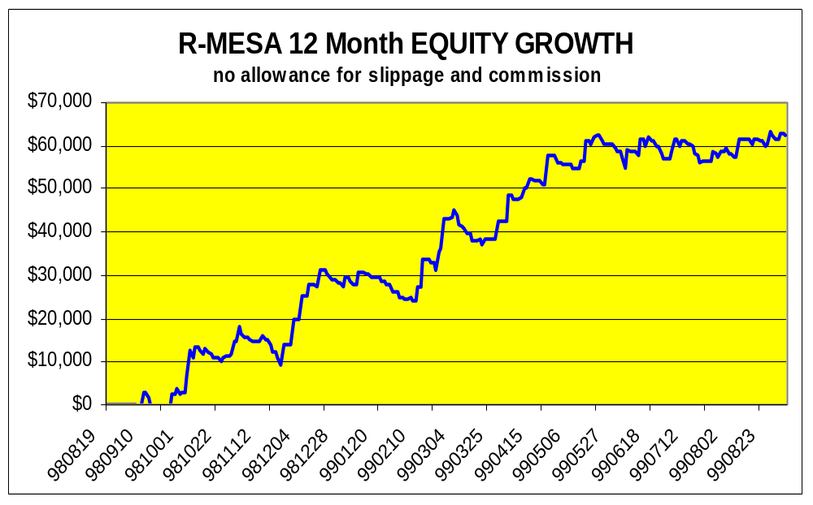
R-MESA
MESA-enhanced version of R-BREAKER
R-BREAKER rated as one of the top ten systems of all time
R-MESA is the #2 System since release - 134% growth
Uses 45 minute bars - strict daytrader
Trades about every other day
Purchase - $2995
Lease Signals - $200 per month

Slide 23
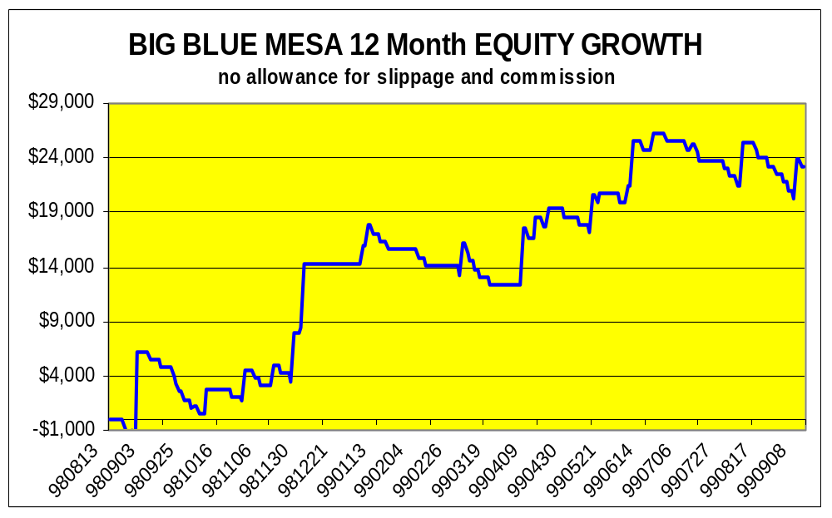
Big Blue MESA
MESA-enhanced version of The Big Blue
The Big Blue is rated as one of the top ten systems of all time
Uses 45 minute bars - strict daytrader
Trades about once a week
Purchase - $1500
Lease Signals - $100 per month

Slide 24
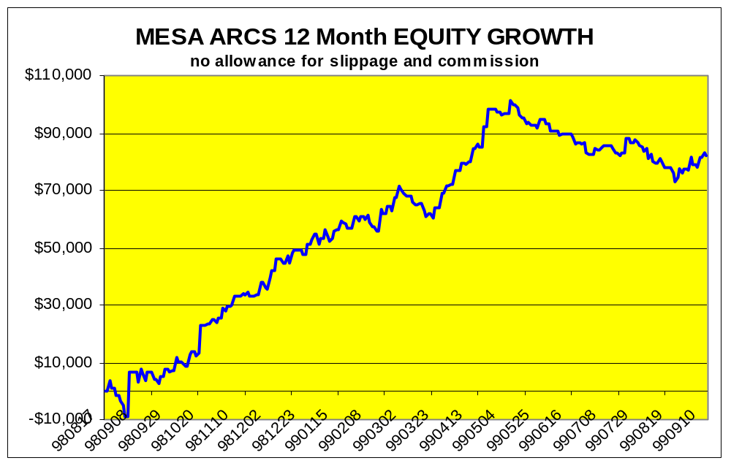
MESA ARCS
MESA-enhanced version of ARCS
ARCS is currently rated the #1 S&P System
Uses 5 minute bars - strict daytrader
Trades about once a day
Purchase - $2995
Lease Signals - $200 per month

Slide 25
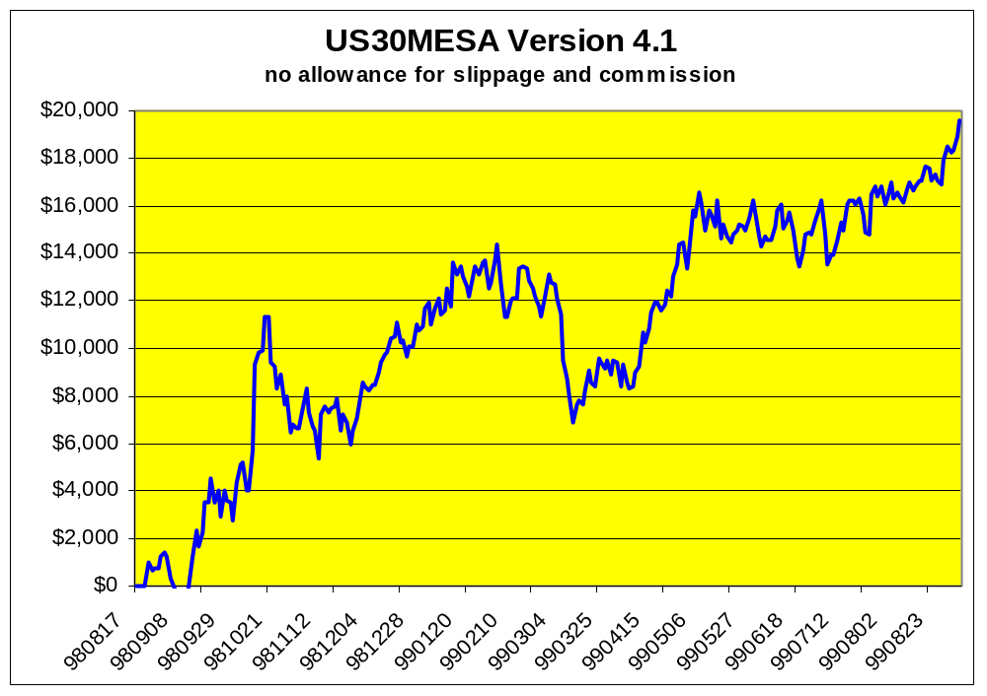
US30MESA
Proven 100% growth in real (not hypothetical) trading
Uses 30 minute bars - holds positions overnight
Purchase - $1000
Lease Signals - $100 per month

Slide 26
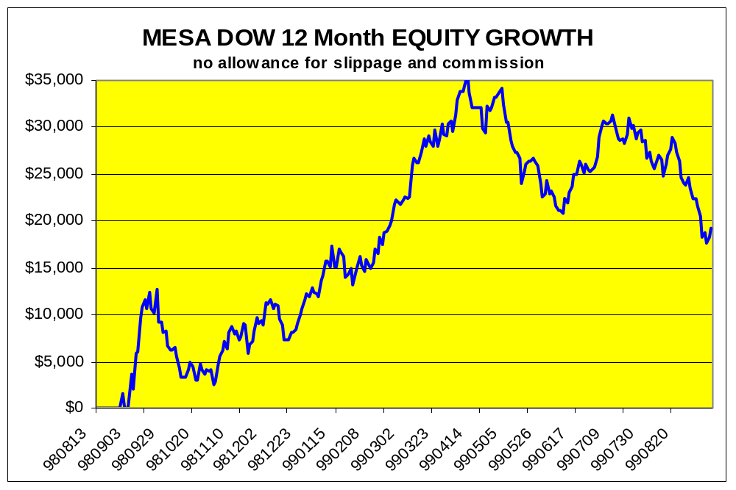
MESA DOW
Pattern-based system developed on 14 years of S&P data
Uses 45 minute bars - holds positions overnight
Trades about once a week
Purchase - $1,500
Lease Signals - $100 per month

Slide 27
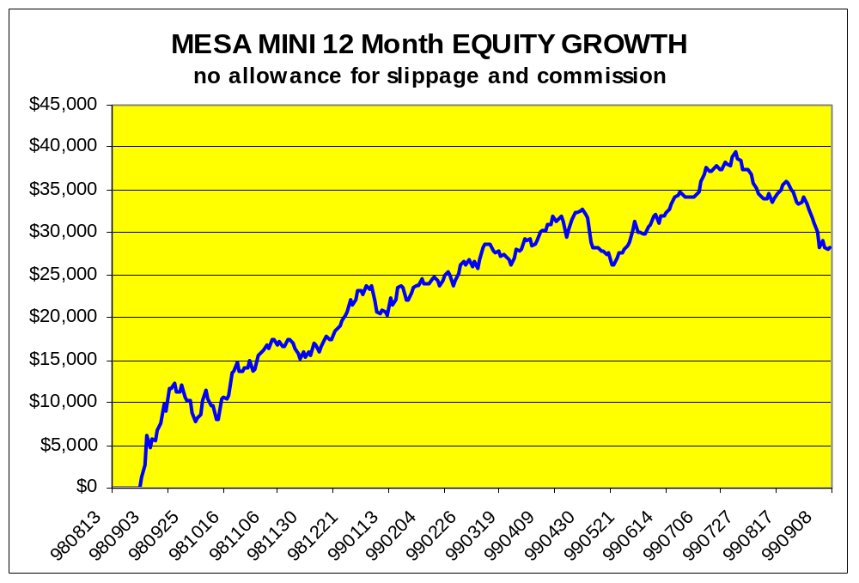
MESA MINI
Pattern-based system used to trade the e-mini contract
Developed on 14 years of S&P data
Uses 45 minute bars - holds positions overnight
Trades about once a week
Purchase - $995
Lease Signals - $75 per month

Slide 28
SIERRA HOTEL
Portfolio position trader - particularly successful trading currencies
Typically rated #1 Japanese Yen system, often ranked #1 in DM and SF
Channel Breakout System using daily bars
Trades 4 to 12 times per year
Purchase - $995

Slide 29
MESA COMPASS
MESA-enhanced version of COMPASS
COMPASS has been rated #1 in the Dollar Index
Most suitable as a portfolio position trader
Performance is similar to Sierra Hotel
  Technology is indicator-based rather than channel breakout
Purchase - $995

