Slide 1
MESA96
MESA SOFTWARE
e-mail ehlers@mesasoftware.com
home page www.mesasoftware.com

Slide 2
Are There Cycles in the Market?
My Experience
  Tradeable cycles are present only 15% - 30% of the time
  Randomness is related to timing and the length of observation
A trading system must include procedures for the other 70% - 85% of the time
I relate the market to known physical phenomena
  Smoke plume for Trend Modes
  Meandering river for Cycle Modes

Slide 3
Theoretical Problem Solution
Both randomness and short term cycles can arise from the solution to the random walk problem
Solution is the “Diffusion Equation” for Trend Modes
Solution is the “Telegraphers Equation” for Cycle Modes

Slide 4
Diffusion Equation
“Drunkard’s Walk” is a special form of the random walk problem
  The drunk flips a coin to determine right or left with each step forward
  The random variable is direction
The Diffusion equation is the solution
  describes smoke coming from a smokestack
The smoke plume is analogous to market conditions
  Breeze bends the plume to an average trendline
  Plume widens with distance - distant predictions are less accurate
  Smoke density is analogous to prediction probability - the best estimator is the average

Slide 5
Telegrapher’s Equation
Modify the “Drunkard’s Walk” problem
  Coin flip decides whether the drunk will reverse his direction, regardless of the direction of the last step
  The random variable is now momentum, not direction
Solution is now the Telegrapher’s Equation
  Describes the electric wave on a telegraph wire
  Also describes a meandering river
A river meander is a short term cycle
  Random probability exists (Diffusion Equation) IF:
    Individual meanders are overlaid
    Or a long data span is taken

Slide 6
The Market is Similar to a
Meandering River
Both follow the path of least resistance
Rivers attempt to keep a constant water slope - maintains the conservation of energy.
Conservation of Energy produces the path of least resistance
  Paths of uniform resistance look like pieces of sinewaves
Market Forces (greed, fear, profit, loss, etc.) are similar to physical forces, producing paths of uniform resistance.
Think about how the masses ask the question:
Will the market change?
OR
Will the trend continue?

Slide 7
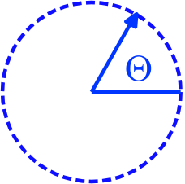
What is a cycle?
A cycle is a variation where the point of observation returns to its point of origin
Frequency is the repetition rate of the cycle
  An engine turns at 2000 rpm, each rotation is a cycle
Period is the reciprocal of frequency
  For example: a 14 day market cycle
A simple cycle can be pictured as a rotating arrow
  A full rotation returns to the origin
  Fractions of a complete cycle are measured by phase angle

Slide 8
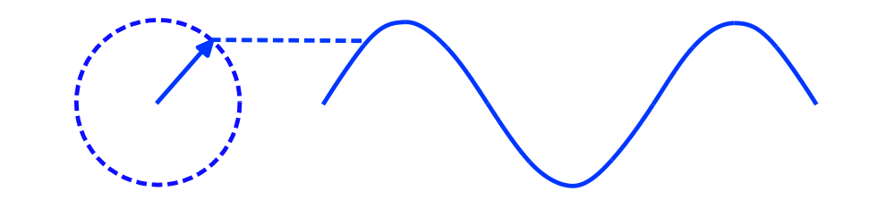
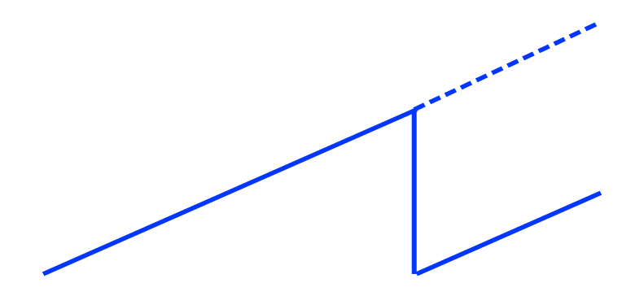
Sinewaves
A sinewave can be generated by connecting a pen to the arrow and pulling a piece of paper
Phase angles increase uniformly
o
360
o
0

Slide 9
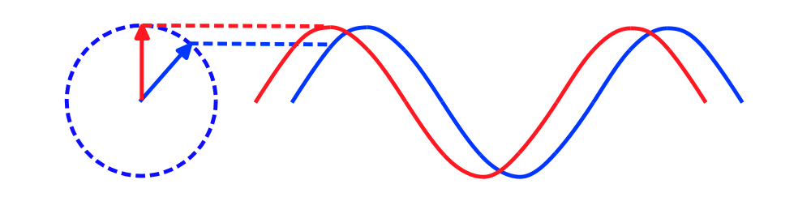
Phase Advance Produces a Leading Indicator
Conventional Sinewave
Crossover Trading Signals using phase lead

Slide 10
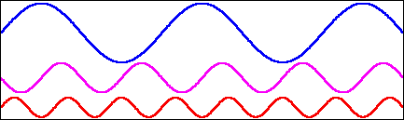
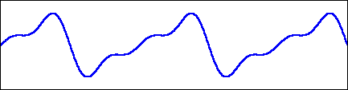
Wave Synthesis is Easy
Sinewaves are the primitives to synthesize more complex waves
wave = SIN(F*T) - SIN(2*F*T)/2 + SIN(3*F*T)/3
Combined Waveform: Elliott Wave?

Slide 11
Cycle Measurement
Cycle Finders
FFT (Fast Fourier Transform)
MESA (Maximum Entropy Spectral Analysis)

Slide 12
Cycle Finders
Basically count the number of bars between successive lowest lows or successive highest highs.
Ehrlich cycle finder is a pantograph that enables cycle count on paper charts
All software toolboxes have cycle finders
Disadvantages:
  Depend on a long term correlation - therefore assume the cycle is continuously present
  Even the shortest measurement is discrete and cannot adjust for changing cycles

Slide 13
FFT
Constraints:
  Data is a representative sample of an infinitely long wave
  Data must be stationary over the sample time span
  Must have an integer number of cycles in the time span
Assume a 64 day time span
  Longest cycle is 64 days
  Next longest is 64/2 = 32 days
  Next longest is 64/3 = 21.3 days
  Next longest is 64/4 = 16 days
Result is poor resolution - gaps between measured cycles

Slide 14
FFT (Continued)
Paradox:
  The only way to increase resolution is to increase the data length
  Increased data length makes realization of the stationarity constraint highly unlikely
    256 data points are required to realize a 1 bar resolution for a 16 bar cycle (right where we want to work). This would require the 16 day cycle to be present and consistent for an entire year!
Conclusion: FFT measurements are not suitable for market analysis!

Slide 15
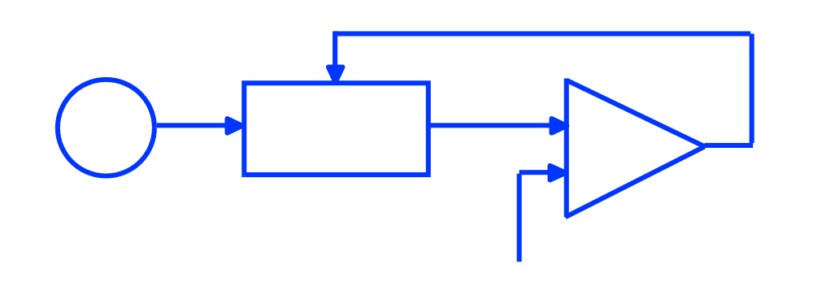
MESA Cycle Measurement
Feedback optimally adjusts filter so the filter output is the same as the data waveform
  Pattern matching in the time domain
  No intrinsic resolution limitation or frequency distortions
Feedback
White
Noise
Adaptive
Filter
Comparitor
Waveform

Slide 16
How MESA Works
The White Noise Source contains all frequencies
  The tuned filter output is the same as the real data
  The frequency response of the filter is the same as the frequency response of the data
The frequency response of the filter is examined after the filter is tuned
The digital clock can run into the future so the filter output forms a prediction. (If the cycles continue with the same amplitude and phase.)

Slide 17
Moving Averages
All moving averages smooth the data
  They are filters that remove the high frequency content (the shorter cycles)
  Longer averages provide more smoothing
All moving averages lag in the time domain
  Longer averages provide more Lag
Use of moving averages is always a tradeoff between desired smoothing and tolerable Lag

Slide 18
Kinds of Moving Averages
Simple Moving Average
  Simple algorithm
  Fast Computation
Exponential Moving Average
  Simple recursive algorithm
  Fast Computation
Weighted Moving Average
  Very small lag
  Approximates a Bessel Filter (equal time lag at all frequencies)
  Nonrecursive, but now reasonable to use with faster computers

Slide 19
Summary
THEORY
EASY TO USE
Practical MESA96 Displays
MESA is the best way to measure cycles
Phase is an important parameter
Phase lead anticipates cycle turning points
Cycle is constant rate change of phase
Weighted moving averages are superior
Dominant Cycle and Spectral Contour correlate to price bars
Measured Phase correlates to price bars
Sinewave Indicator provides clear crossover signals
Trend Mode signaled by price bar color change
Weighted Moving Averages indicate trend direction

Slide 20
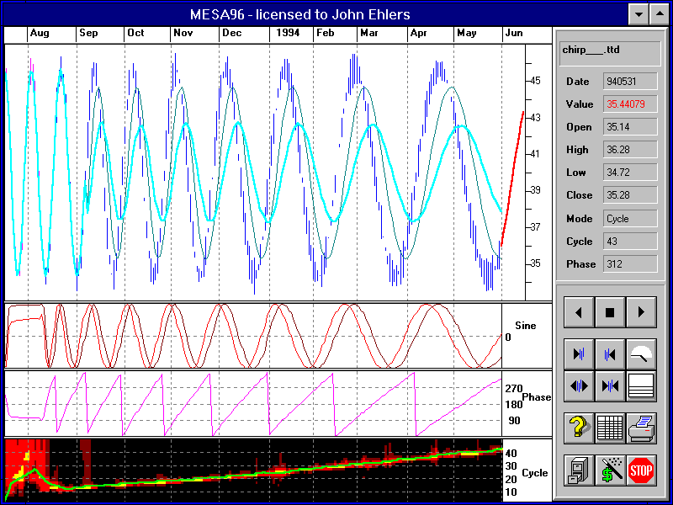
MESA96 Measurements

