Slide 1
The Profit Magic of Market Cycles
MESA SOFTWARE
e-mail ehlers@mesasoftware.com
home page http://www.mesasoftware.com

Slide 2
Risk Statement
There is no guarantee that technical analysis will result in profits or that it will not result in losses. Past performance is not a guarantee of future results. All investments and trades carry risk and all trading decisions of an individual remain the responsibility of that individual. The use of any concepts presented does not constitute trading advice in any way.

Slide 3
Agenda
Historical Performances
Why equity growth curves are important
Cycle Measurement Techniques
Theoretical Basis for Market Cycle Analysis
The Sinewave Indicator as a superior oscillator
Moving Averages in cycle analysis
First Time Ever! All new MESA98 Demo

Slide 4
Do Cycles Work for Trading?
MESA96 real-time track record
Started 1 July 1996 with $5,718
Ended 31 October 1996 with $99,971
SIERRA HOTEL real-time track record
Started 1 July 1997 with $6,105
Ended 31 October 1997 with $41,281

Slide 5
SIERRA HOTEL
A Trading System for TradeStation that adapts to the market. The 20 year performance, annualized, is:
Contract Net Profit Profit Factor # Trades
British Pound $ 9,832 2.22 9.15
Deutschemark $ 4,045 1.68 9.06
Japanese Yen $ 5,650 1.70 9.85
Swiss Franc $ 5,525 1.69 9.52
Treasury Bonds $ 5,716 1.63 10.09
Coffee $13,401 2.07 10.88
Soybeans $ 3,254 1.52 10.96

Slide 6
Futures Truth Co. Ranking
Feb/Mar 98
Commodity Rank Growth (3x margin)
DM 1 204%
JY 1 360%
BP 1 95%
KC 3 403%
S 3 10%
SF 5 80%
US 19 9%
Averaged portfolio growth = 235%
Only known program to be simultaneously ranked #1
in 3 different markets

Slide 7
R-MESA
Coauthored with Mike Barna: Daytrader, Omega Research Solution Provider, and TradeStation programmer.
A S&P500 daytrading system for TradeStation formed by merging the perennially top-rated R-Breaker and MESA96 programs. MESA96 adapts to current market conditions, making buying easier at the bottom of the cycle and selling easier at the top of the cycle.

Slide 8
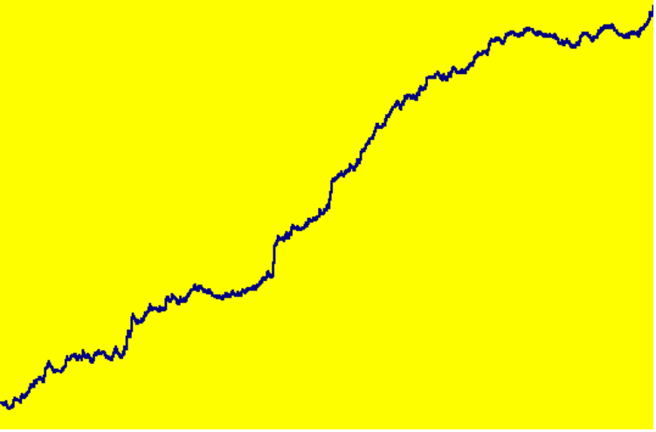
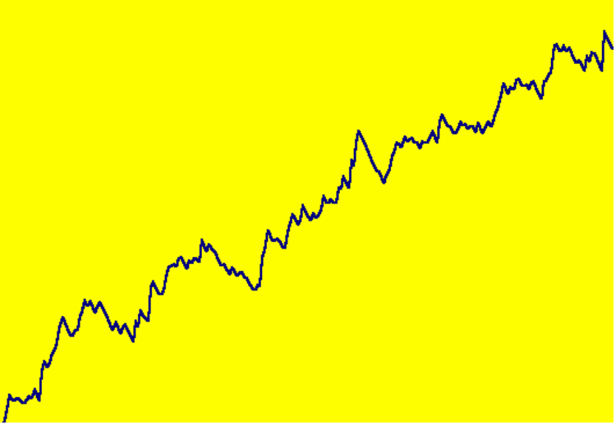
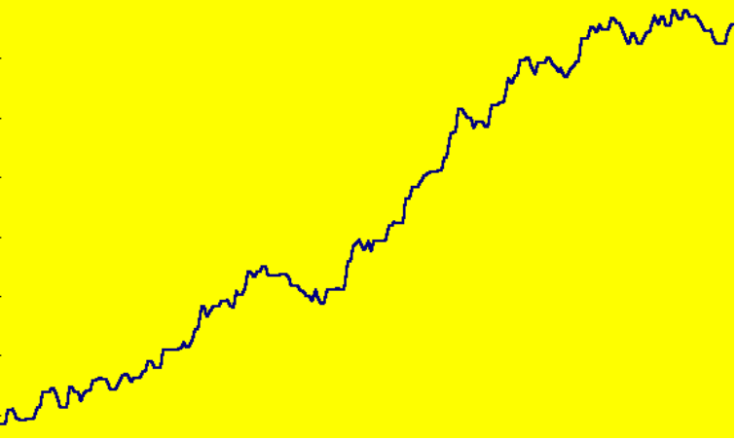
R-MESA EQUITY GROWTH
$200K
1985-1995
$80K
1996
$75 Slippage
$140K
$75 Slippage
1997
$150 Slippage

Slide 9
R-MESA FuturesTruth Rankings
For the last 6 months in a row:
#1 S&P system
#1 Daytrading system

Slide 10
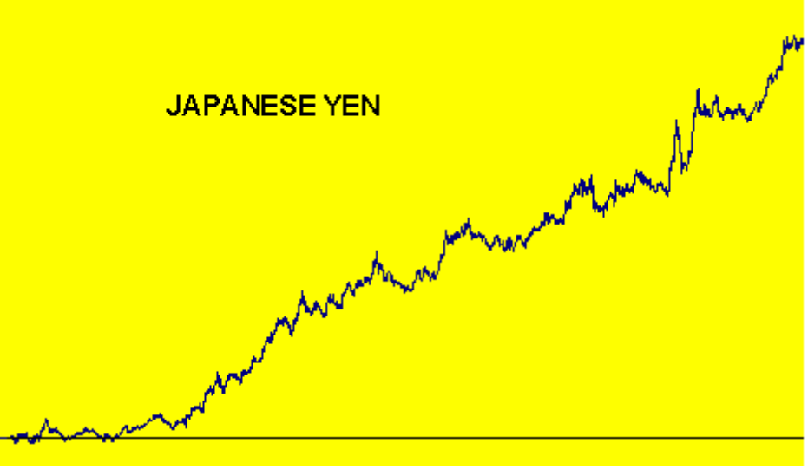
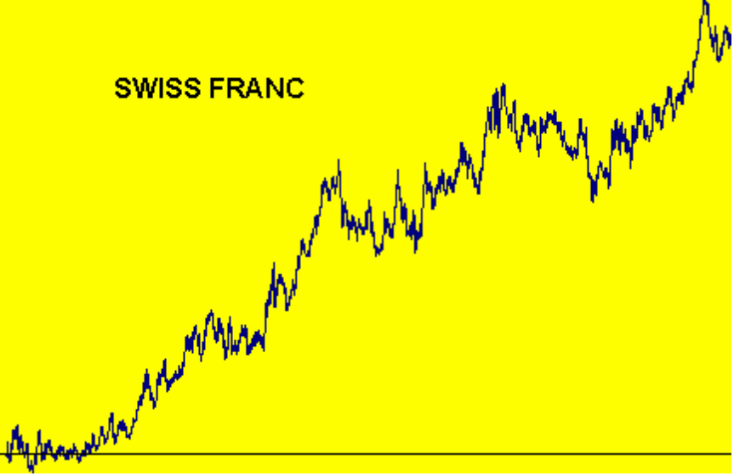
Equity Growth Curve
Generation and Displays
$160K
$75 allowance for
slippage & commission
($9,774 per year average)
$80K
($2,175 per year average)
1982 - 1997
1982 - 1997

Slide 11

July 1997 Futures Magazine

Slide 12
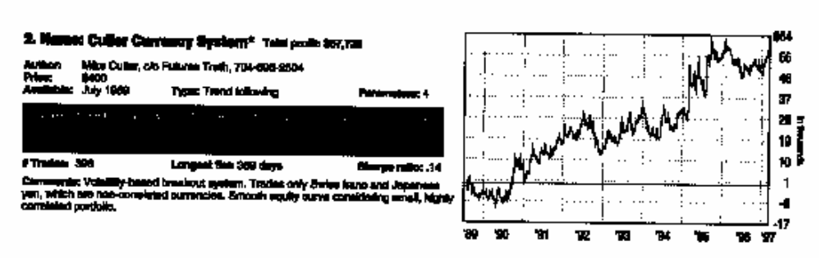
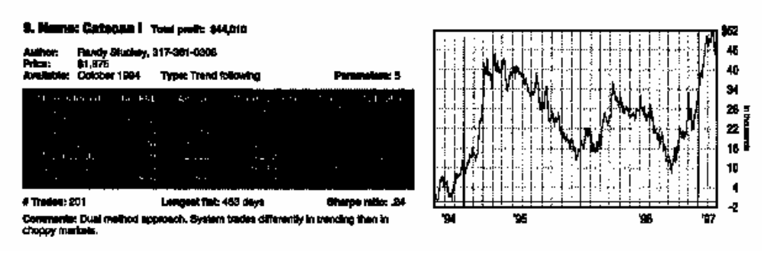
These are some of the best!
#2 Made $55K in 8 years in currencies with $19.3K drawdown
Average per year
#2 Sierra Hotel
JY $6,406 $9,774
SF $1,123 $2,175
#9 Had $36K Drawdown

Slide 13
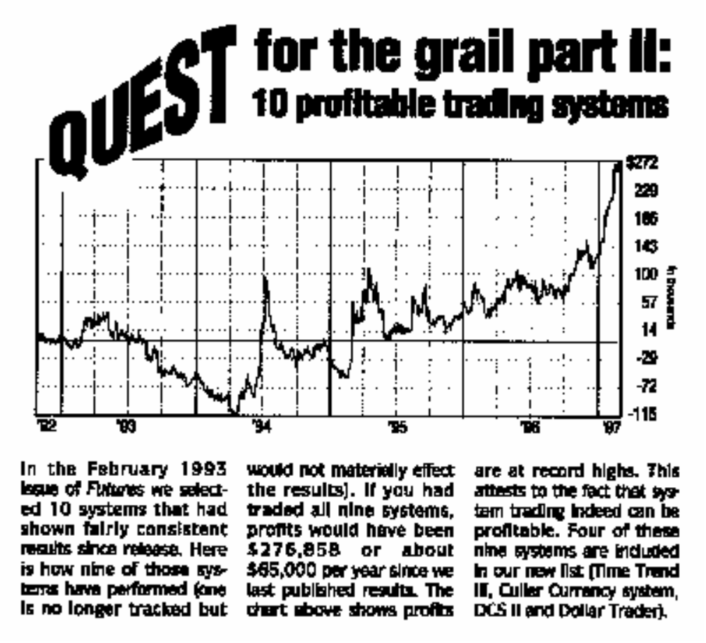
9 Systems selected in 1993 suffered $115K drawdown

Slide 14
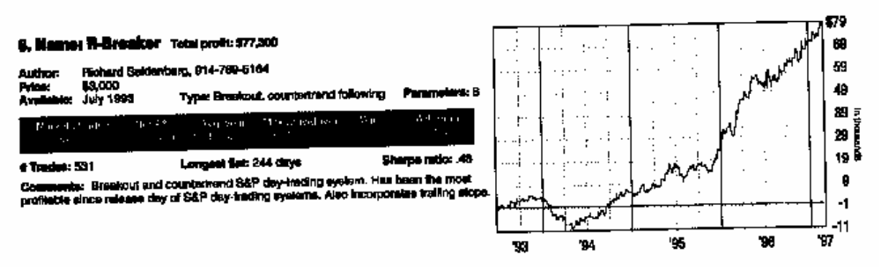
Consistency is Crucial

Slide 15
Cycle Measurement
Cycle Finders
FFT (Fast Fourier Transform)
MESA (Maximum Entropy Spectral Analysis)

Slide 16
Cycle Finders
Basically count the number of bars between successive lowest lows or successive highest highs.
Ehrlich cycle finder is a pantograph that enables cycle count on paper charts
All software toolboxes have cycle finders
Disadvantages:
  Depend on a long term correlation - therefore assume the cycle is continuously present
  Even the shortest measurement is discrete and cannot adjust for changing cycles

Slide 17
FFT
Constraints:
  Data is a representative sample of an infinitely long wave
  Data must be stationary over the sample time span
  Must have an integer number of cycles in the time span
Assume a 64 day time span
  Longest cycle is 64 days
  Next longest is 64/2 = 32 days
  Next longest is 64/3 = 21.3 days
  Next longest is 64/4 = 16 days
Result is poor resolution - gaps between measured cycles

Slide 18
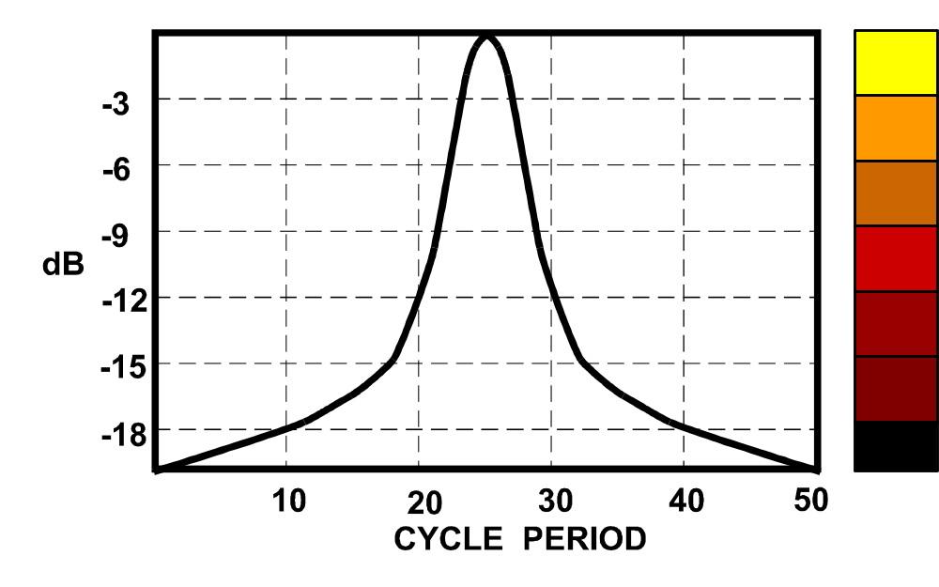
SPECTRUM AMPLITUDE

Slide 19
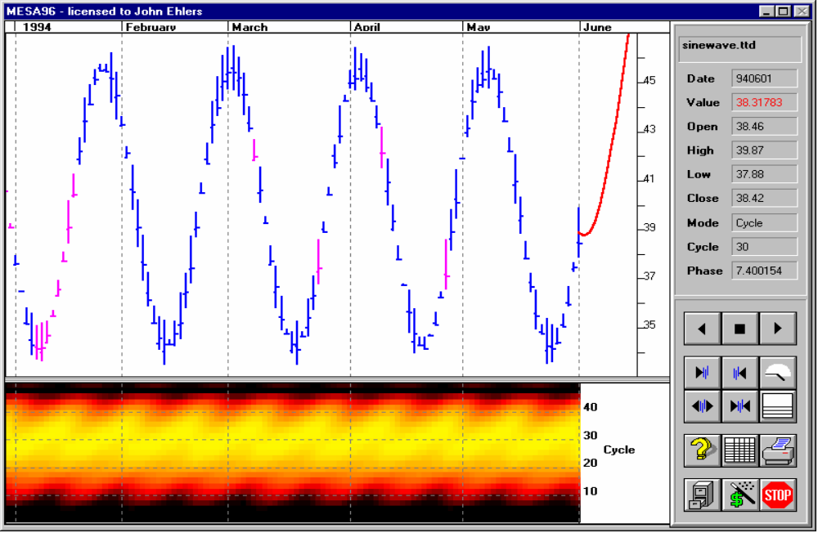
Fourier Transform Resolution of a 24 Bar Cycle

Slide 20
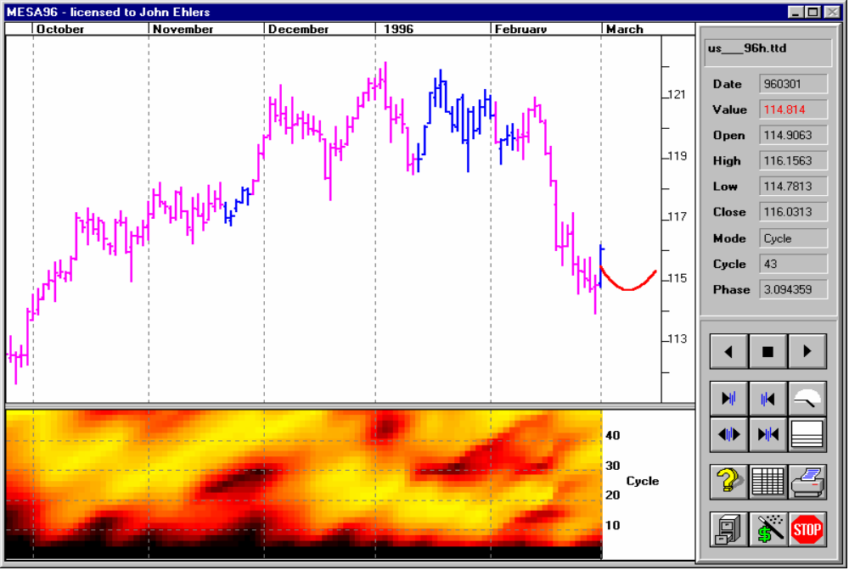
Fourier Transform Resolution for Mar 96 T-Bonds

Slide 21
FFT (Continued)
Paradox:
  The only way to increase resolution is to increase the data length
  Increased data length makes realization of the stationarity constraint highly unlikely
    256 data points are required to realize a 1 bar resolution for a 16 bar cycle (right where we want to work). This would require the 16 day cycle to be present and consistent for an entire year!
Conclusion: FFT measurements are not suitable for market analysis!

Slide 22
MESA Cycle Measurement
Feedback optimally adjusts filter so the filter output is the same as the data waveform
  Pattern matching in the time domain
  No intrinsic resolution limitation or frequency distortions
Feedback
White
Noise
Adaptive
Filter
Comparitor
Waveform

Slide 23
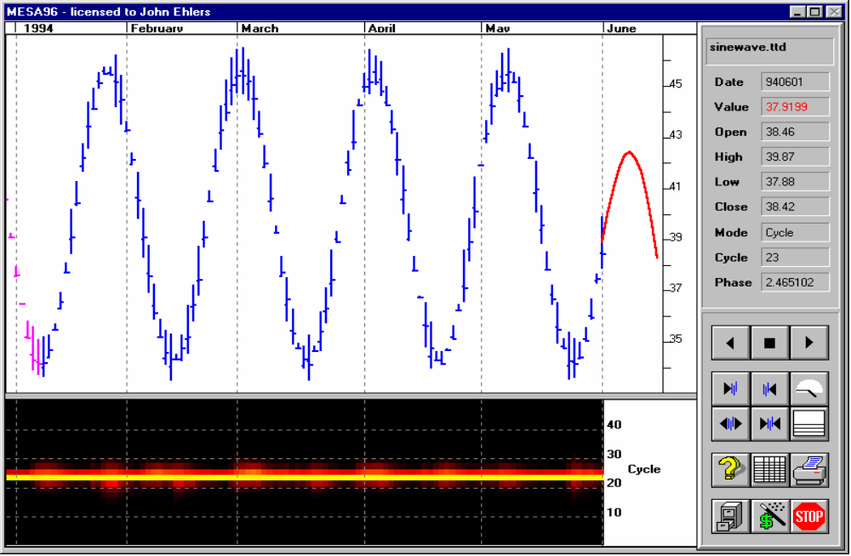
MESA96 Spectral Resolution of a 24 Bar Cycle

Slide 24
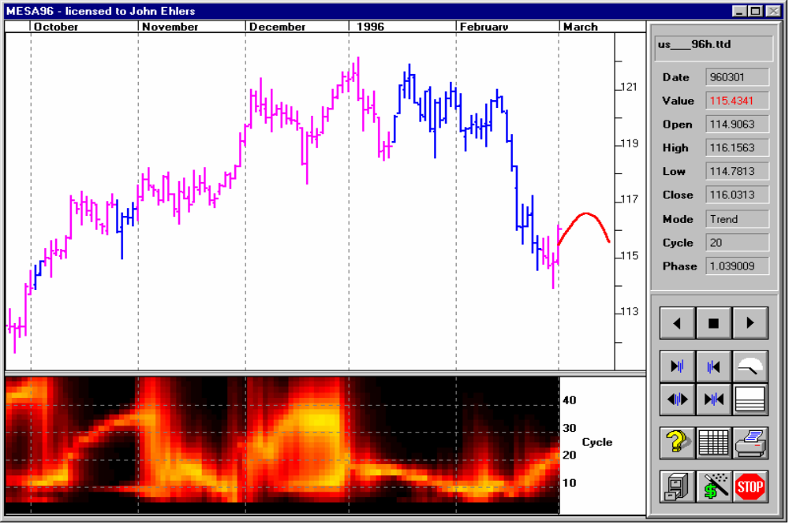
MESA96 Spectral Resolution for Mar 96 T-Bonds

Slide 25
Philosophical Background
Both randomness and short term cycles can arise from the solution to the random walk problem
Solution is the “Diffusion Equation” for Trend Modes
Solution is the “Telegraphers Equation” for Cycle Modes

Slide 26
The Market is Similar to a
Meandering River
Both follow the path of least resistance
Rivers attempt to keep a constant water slope - maintains the conservation of energy.
Conservation of Energy produces the path of least resistance
  Paths of uniform resistance look like pieces of sinewaves
Market Forces (greed, fear, profit, loss, etc.) are similar to physical forces, producing paths of uniform resistance.
Think about how the masses ask the question:
Will the market change?
OR
Will the trend continue?

Slide 27
Application to Trading
STRATEGY
Use a trend follower when the market is in a trend mode
Use an oscillator when the market is in a cycle mode
  APPROACH
Determine the mode of the market
Implement a trading system for each mode

Slide 28
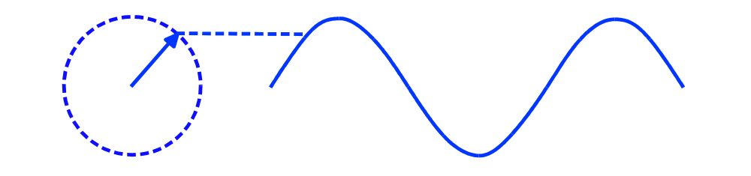
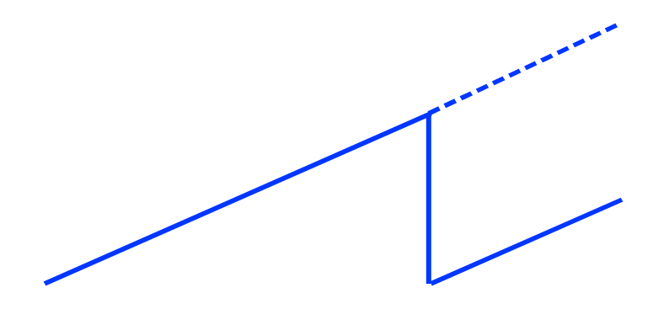
Sinewaves
A sinewave can be generated by connecting a pen to the arrow and pulling a piece of paper
Phase angles increase uniformly
Cycle mode exists when the rate change of phase is near the theoretical rate change of phase of the measured cycle
360
0

Slide 29
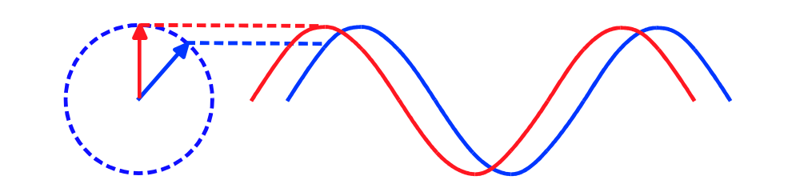
Phase Advance Produces a Leading Indicator Oscillator
Conventional Sinewave
Crossover Trading Signals using phase lead to anticipate cyclic turning points
Phase does not change in a trend - this oscillator does not give false whipsaws

Slide 30
Moving Averages
A Simple Average over the dominant cycle period eliminates the cycle component
  There are exactly as many points above the midpoint as below it.
A moving average can be created by connecting successive simple averages together
The lag of a moving average is determined by the centroid of its weighting function
  Therefore, a half dominant cycle moving average lags the price by a quarter cycle

Slide 31
Applying Theory to Software
THEORY
EASY TO USE
MESA is the best way to measure cycles
Phase is an important parameter
Phase lead anticipates cycle turning points
Cycle is constant rate change of phase
Moving Averages can remove the cycle component
Dominant Cycle provides the means to develop adaptive trading systems
Measured Phase isolates location within the cycle
Sinewave Indicator provides clear crossover signals
Trend Mode signaled by failure of constant rate change
Dominant Cycle Moving Averages indicate trend direction

Slide 32
MESA98 Trading Approach
Strategy
Identify Trend Modes and Cycle Modes using rate change of phase
Tactics
Trade the Moving Averages when in the Trend Mode
Trade the Sinewave Indicator when then the Cycle Mode
Live MESA98 Demonstration

Slide 33
Summary
It ain’t bragging if you can really do it
  R-MESA is the #1 S&P Daytrader
  SIERRA HOTEL was the #1 system in 3 markets
  MESA98 is the premier package for discretionary trading
Truth & Science triumphs over ignorance and superstition
  Application of cycle theory has proven trading performance
  Equity curves are crucial for confidence in real-world trading
  Cycles come and go - They are best measured using MESA
  Sinewave Indicator anticipates cyclic turning points without false whipsaws in trends
  A Dominant Cycle moving average eliminates the cycle component to best display the residual trend

Slide 34
And In Conclusion . . . . .
I know you believe you understood what you think I said, but I am not sure you realize that what you heard is not what I meant.

