Slide 1
Profitable Adaptive Trading Systems
MESA SOFTWARE
e-mail ehlers@mesasoftware.com
home page www.mesasoftware.com
www.mesa-systems.com

Slide 2
Risk Statement
There is no guarantee that technical analysis will result in profits or that it will not result in losses. Past performance is not a guarantee of future results. All investments and trades carry risk and all trading decisions of an individual remain the responsibility of that individual. The use of any concepts presented does not constitute trading advice in any way.

Slide 3
Agenda
Philosophical Background Justifying Market Cycles
Measuring Cycles
Cycle Characteristics
MESA2000 Indicator Demonstration
Write an Adaptive Trend Mode Trading System in TradeStation2000i
Write an Adaptive Cycle Mode Trading System in TradeStation2000i

Slide 4
Philosophical Background
Both randomness and short term cycles can arise from the solution to the random walk problem
Solution is the “Diffusion Equation” for Trend Modes
Solution is the “Telegraphers Equation” for Cycle Modes

Slide 5
The Market is Similar to a
Meandering River
Both follow the path of least resistance
Rivers attempt to keep a constant water slope - maintains the conservation of energy.
Conservation of Energy produces the path of least resistance
  Paths of uniform resistance look like pieces of sinewaves
Market Forces (greed, fear, profit, loss, etc.) are similar to physical forces, producing paths of uniform resistance.
Think about how the masses ask the question:
Will the market change?
OR
Will the trend continue?

Slide 6
Cycle Measurement
Cycle Finders
FFT (Fast Fourier Transform)
MESA (Maximum Entropy Spectral Analysis)

Slide 7
Cycle Finders
Basically count the number of bars between successive lowest lows or successive highest highs.
Ehrlich cycle finder is a pantograph that enables cycle count on paper charts
All software toolboxes have cycle finders
Disadvantages:
  Depend on a long term correlation - therefore assume the cycle is continuously present
  Even the shortest measurement is discrete and cannot adjust for changing cycles

Slide 8
FFT
Constraints:
  Data is a representative sample of an infinitely long wave
  Data must be stationary over the sample time span
  Must have an integer number of cycles in the time span
Assume a 64 day time span
  Longest cycle is 64 days
  Next longest is 64/2 = 32 days
  Next longest is 64/3 = 21.3 days
  Next longest is 64/4 = 16 days
Result is poor resolution - gaps between measured cycles

Slide 9
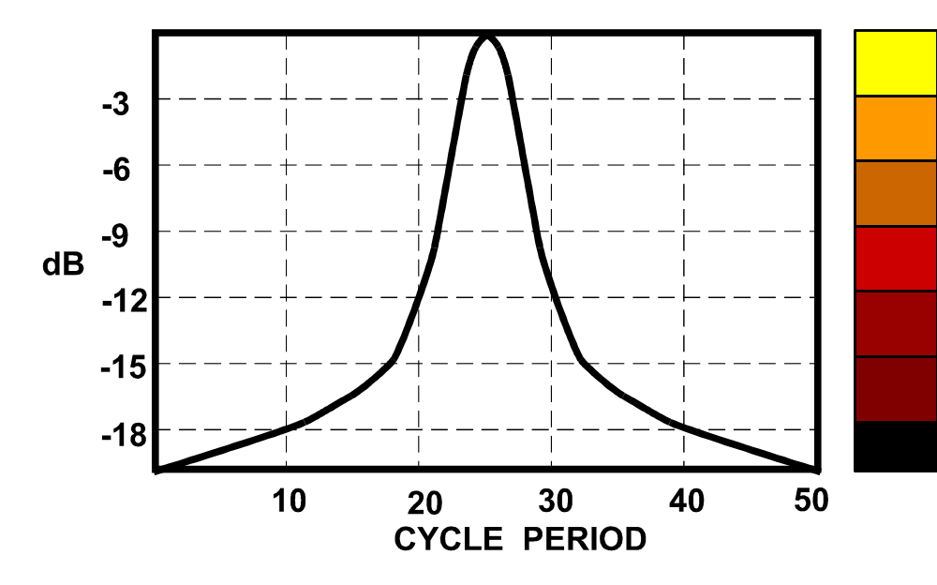
SPECTRUM AMPLITUDE

Slide 10
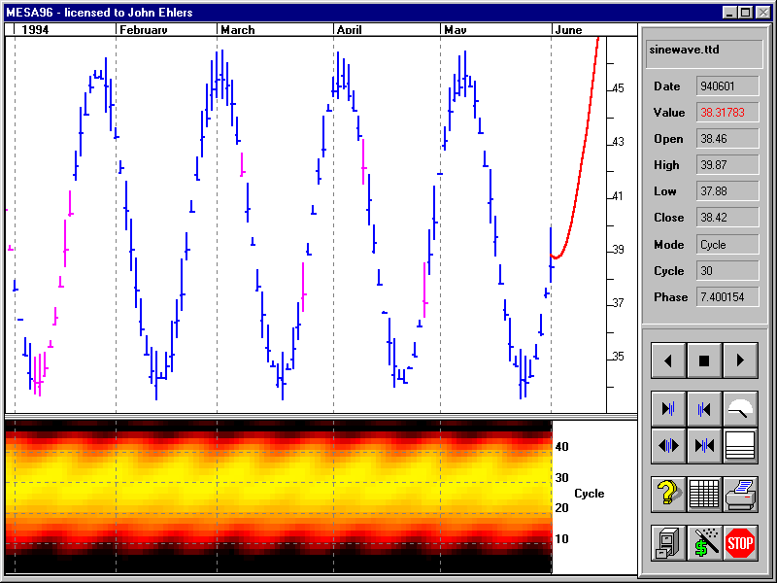
Fourier Transform Resolution of a 24 Bar Cycle

Slide 11
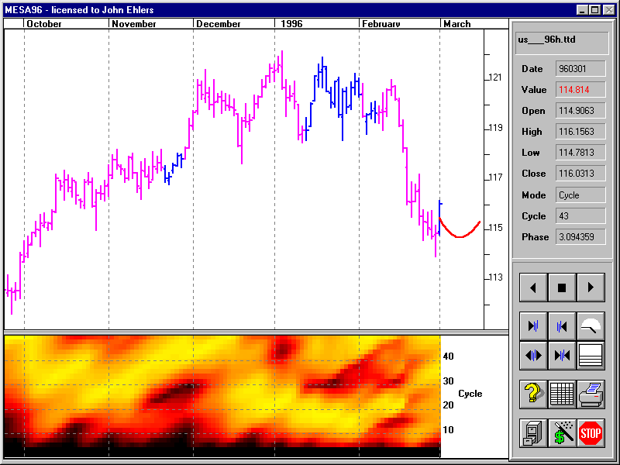
Fourier Transform Resolution for Mar 96 T-Bonds

Slide 12
FFT (Continued)
Paradox:
  The only way to increase resolution is to increase the data length
  Increased data length makes realization of the stationarity constraint highly unlikely
    256 data points are required to realize a 1 bar resolution for a 16 bar cycle (right where we want to work). This would require the 16 day cycle to be present and consistent for an entire year!
Conclusion: FFT measurements are not suitable for market analysis!

Slide 13
MESA Cycle Measurement
Feedback optimally adjusts filter so the filter output is the same as the data waveform
  Pattern matching in the time domain
  No intrinsic resolution limitation or frequency distortions
Feedback
White
Noise
Adaptive
Filter
Comparitor
Waveform

Slide 14
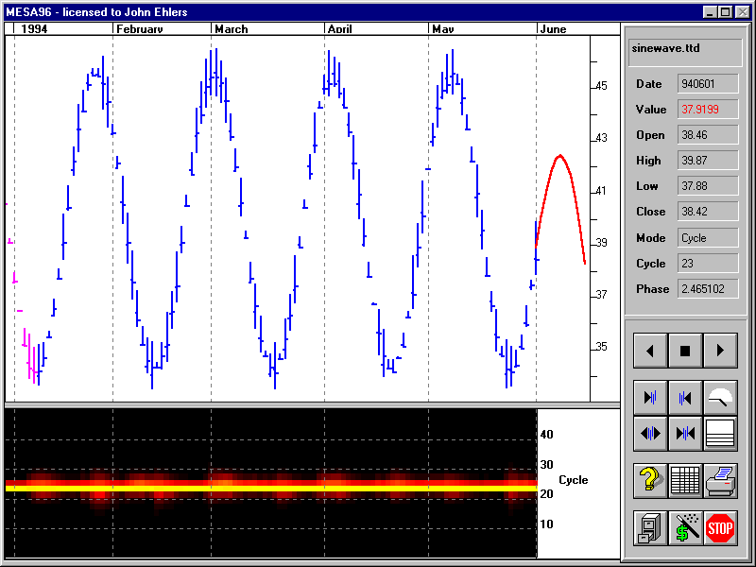
MESA Spectral Resolution of a 24 Bar Cycle

Slide 15
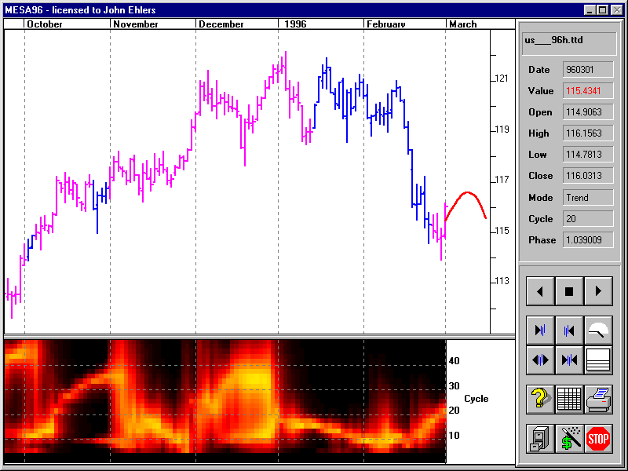
MESA Spectral Resolution for Mar 96 T-Bonds

Slide 16
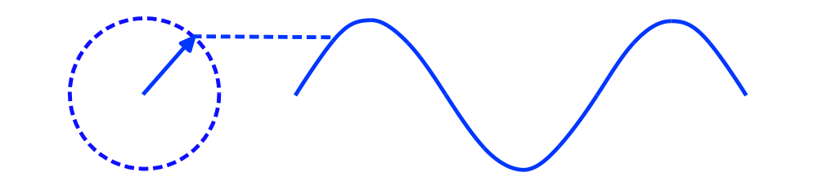
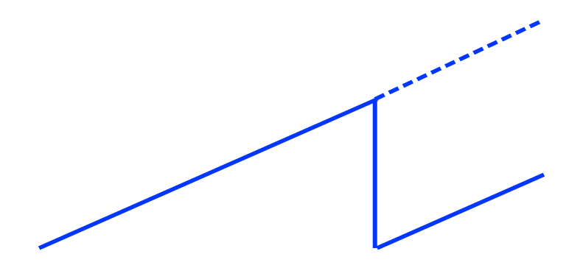
Sinewaves
A sinewave can be generated by connecting a pen to the arrow and pulling a piece of paper
Phase angles increase uniformly
Cycle mode exists when the rate change of phase is near the theoretical rate change of phase of the measured cycle
360
0

Slide 17
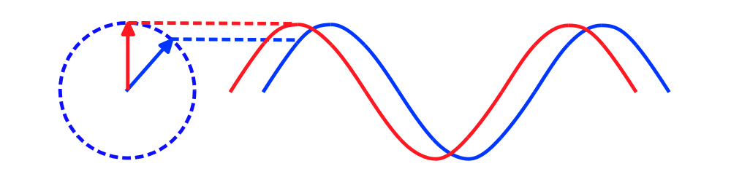
Phase Advance Produces a Leading Indicator Oscillator
Conventional Sinewave
Crossover Trading Signals using phase lead to anticipate cyclic turning points
Phase does not change in a trend - this oscillator does not give false whipsaws

Slide 18
Moving Averages
A Simple Average over the dominant cycle period eliminates the cycle component
  There are exactly as many points above the midpoint as below it.
A moving average can be created by connecting successive simple averages together
An adaptive moving average is an “Instantaneous Trendline”
  The dominant cycle has been completely removed, leaving only the trend (and other cycle component residuals)
The Instantaneous Trendline lags the real price by a a half dominant cycle

Slide 19
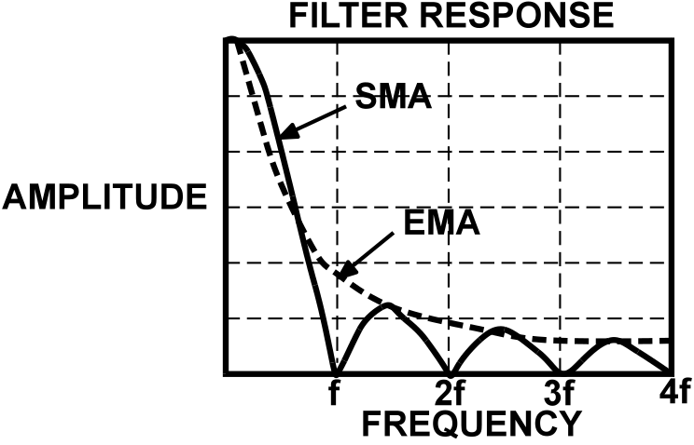
SMA and EMA Relationships
EMA constant is usually related to the length of an SMA
  “Filter Price Data”, J.K. Hutson, TASAC Vol. 2, page 102
  The equation is α = 2 / (Length +1)
An EMA can never remove the Dominant Cycle Component

Slide 20
Application to Trading
STRATEGY
Use a trend follower when the market is in a trend mode
Use an oscillator when the market is in a cycle mode
  APPROACH
Determine the mode of the market
Implement a trading system for each mode

Slide 21
Applying Theory to Software
THEORY
EASY TO USE
MESA is the best way to measure cycles
Phase is an important parameter
Phase lead anticipates cycle turning points
Cycle is constant rate change of phase
Moving Averages can remove the cycle component
Dominant Cycle provides the means to develop adaptive trading systems
Measured Phase isolates location within the cycle
Sinewave Indicator provides clear crossover signals
Trend Mode signaled by failure of constant rate change
Dominant Cycle Moving Averages indicate trend direction

Slide 22
A Useful Code Fragment
(Enables Excel Manipulation of Equity Curves)
If Date>Date[1] then Print(File(“c:\tsgrowth\test.txt”),date,”,”, netprofit + positionprofit(0));
Prints an ASCII file called TEST.TXT
The file is your day-by-day equity curve
Located in the C:\TSGROWTH directory. You must have previously created this directory
You can call this file and manipulate the data with Excel

Slide 23
Adaptive System Design
Strategy
Identify Trend Modes and Cycle Modes using rate change of phase
Tactics
Trade the Moving Averages when in the Trend Mode
Trade the Sinewave Indicator when then the Cycle Mode
Live MESA2000 Demonstration
Live Writing of Adaptive Systems
Trend Following System
Cycle Mode System

Slide 24
TREND MODE SYSTEM
(Requires MESA DLLs)
{**************************************************************
MESA Trend System - Instantaneous Trendline
Copyright (c) 1999 MESA Software
***************************************************************}
inputs: Price(Close),
Window(1),
Registry(9413938);
vars: dc(0),
maa(0),
ph(0),
TrndSig(0),
ITrend(0),
alpha1(.07),
alpha2(.4);

Slide 25
TREND MODE SYSTEM
(Continued)
defineDllFunc: "c:\mesadll\mesa99.dll",int,"INIT",int;
defineDllFunc: "c:\mesadll\mesa99.dll",int,"DomCycle",int, float, long, float, lpfloat;
defineDllFunc: "c:\mesadll\mesa99.dll",int,"MATRIX",long;
defineDllFunc: "c:\mesadll\mesa99.dll",int,"FindPhase", float, lpfloat;
defineDllFunc: "c:\mesadll\mesa99.dll",int,"FindMA",float, float, lpfloat, lpfloat;
Matrix(blocknumber);
if currentbar = 1 then begin
init(1);
end;
DomCycle(Window, price, Blocknumber, Registry, &dc);
FindPhase(Price, &ph);
FindMA(price, dc, &TrndSig, &ITrend);
if currentbar <= 51 then begin
TrndSig = price;
ITrend = price;
end;

Slide 26
TREND MODE SYSTEM
(Concluded)
If CurrentBar > 51 then begin
if TrndSig crosses over ITrend or TrndSig crosses under ITrend then begin
if checkalert then alert = true;
end;
value1 = alpha1*ITrend + (1 - alpha1)*value1[1];
value2 = alpha2*value1 + (1 - alpha2)*value2[1];
If value1 Crosses Over value2 then buy;
If value1 Crosses Under value2 then sell;
end;

Slide 27
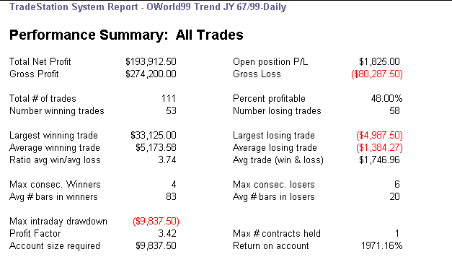
TREND MODE SYSTEM RESULTS
(Japanese Yen 1976-1998)

Slide 28
CYCLE MODE SYSTEM
(Requires MESA DLLs)
{*************************************************************************
MESA Sinewave System - SineWave Indicator
Copyright (c) 1999 MESA Software
**************************************************************************}
inputs: Price(Close),
Window(1),
Registry(9413938);
vars: dc(0),
ph(0),
LeadSine(0),
Sinewave(0);
defineDllFunc: "c:\mesadll\mesa99.dll",int,"INIT",int;
defineDllFunc: "c:\mesadll\mesa99.dll",int,"DomCycle",int, float, long, float, lpfloat;
defineDllFunc: "c:\mesadll\mesa99.dll",int,"MATRIX",long;
defineDllFunc: "c:\mesadll\mesa99.dll",int,"FindPhase", float, lpfloat;
defineDllFunc: "c:\mesadll\mesa99.dll",int,"FindSine",lpfloat, lpfloat;

Slide 29
CYCLE MODE SYSTEM
(Concluded)
Matrix(blocknumber);
if currentbar = 1 then begin
init(1);
end;
DomCycle(Window, price, Blocknumber, Registry, &dc);
if currentbar > 1 then begin
FindPhase(Price, &ph);
FindSine(&Sinewave, &LeadSine);
end;
if LeadSine crosses over Sinewave or LeadSine crosses under Sinewave then begin
if checkalert then alert = true;
end;
If LeadSine Crosses Over SineWave then Buy;
If LeadSine Crosses Under SineWave then Sell;
If MarketPosition = -1 and Close > EntryPrice then buy;
If MarketPosition = 1 and PositionProfit <0 and BarsSinceEntry > 3 then ExitLong;

Slide 30
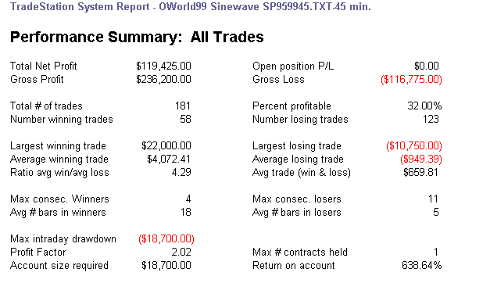
CYCLE MODE SYSTEM RESULTS
(S&P500 for 1998)

Slide 31
And In Conclusion . . . . .
I know you believe you understood what you think I said, but I am not sure you realize that what you heard is not what I meant.

