Slide 1


Rocket Science for Trading
John Ehlers
MESA Software
ehlers@mesasoftware.com
www.mesasoftware.com
www.mesa-systems.com

Slide 2
RISK STATEMENT
There is no guarantee that technical analysis will result in profits or that it will not result in losses. Past performance is not a guarantee of future results. All investments and trades carry risk and all trading decisions of an individual remain the responsibility of that individual. The use of any concepts presented does not constitute trading advice in any way.

Slide 3
AGENDA
The character of Momentum Functions
The character of Moving Averages
Hilbert Transforms
Signal to Noise Indicator
Measuring Cycle Periods
Signal Phase
Sinewave Indicator
Instantaneous Trendline

Slide 4
Momentum Functions
T = 0
RAMP
FUNCTION
1st derivative
(Momentum)
STEP
IMPULSE
2nd derivative
(Acceleration)
JERK
3rd derivative
CONCLUSIONS:
1. Momentum can NEVER lead the function
2. Momentum is always more disjoint (noisy)

Slide 5
Moving Averages
c.g.
Window
Moving Average
Lag
CONCLUSIONS:
1. Moving Averages smooth the function
2. Moving Averages Lag by the center of gravity of the observation window
3. Using Moving Averages is always a tradeoff between smoothing and lag

Slide 6
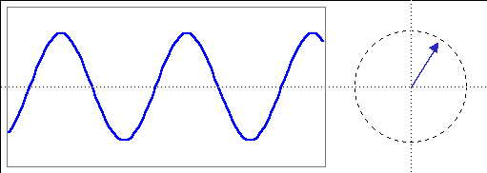
A Phasor Describes a Cycle
Cycle
Phasor
Phase Angle
Quadrature
θ
InPhase
Cycle Amplitude (Pythagorean Theorem)
Amplitude² = (InPhase)² + (Quadrature)²
Phase Angle = ArcTan(Quadrature / InPhase)
Cycle Period when Σ Phase Angles = 360⁰
So, the trick is to find the InPhase and Quadrature Components

Slide 7
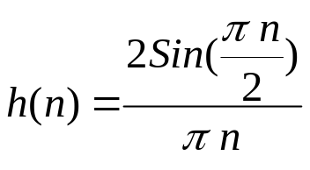
Hilbert TransformsYield I & Q
Frequency response is exactly zero in the lower half of the unit circle
Implemented as a folded FIR Filter
X(n)
Z⁻¹
Z⁻²
I(n)
Z⁻²
Z⁻¹
+
-
+
-
.25
+
.75
Q(N)
+

Slide 8
Hilbert Transforms (cont)
InPhase Component must have zero at zero frequency
  Detrend Inphase component over the filter length
Smooth Transform outputs with unequal alphas to compensate for amplitude differences (from detrending and filter truncation)
EasyLanguage Code is:
Value1 = Price - Price[6];
Value2 = Value1[3];
Value3 =.75*(Value1 - Value1[6]) + .25*(Value1[2] - Value1[4]);
InPhase = .33*Value2 + .67*InPhase[1];
Quadrature = .2*Value3 + .8*Quadrature[1];

Slide 9
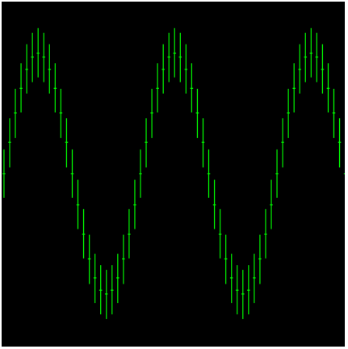
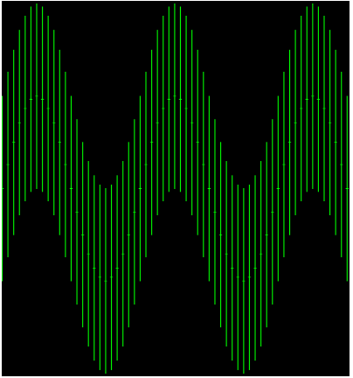
Signal-to-Noise Indicator
Noise is the uncertainty of a price sample
  Can be pictured as the daily range on a chart
Trading should only be done when signal is large relative to the noise
0 dB S/N occurs when the lowest low of a high signal point is equal to the highest high of a low signal point
High S/N
0 dB S/N

Slide 10
Signal-to-Noise Indicator Code
Price: (High + Low) / 2;
Vars: InPhase(0),
Quadrature(0),
Amplitude(0),
Range(0);
If CurrentBar > 8 then begin
{Compute "Noise" as the average range}
Range = .2*(H - L) + .8*Range[1];
{Compute Hilbert Transform outputs}
Value1 = Price - Price[6];
Value2 =Value1[3];
Value3 =.75*(Value1 - Value1[6]) + .25*(Value1[2] - Value1[4]);
InPhase = .33*Value2 + .67*InPhase[1];
Quadrature = .2*Value3 + .8*Quadrature[1];
{Compute smoothed signal amplitude}
Value2 = .2*(InPhase*InPhase + Quadrature*Quadrature) + .8*Value2[1];
{Compute smoothed SNR in Decibels, guarding against a divide by zero error, and compensating for filter loss}
If Value2 < .001 then Value2 = .001;
If Range > 0 then Amplitude = .25*(10*Log(Value2/(Range*Range))/Log(10) + 4.7) + .75*Amplitude[1];
{4.7dB is a fudge factor to account for EMA signal attenuation}
{Plot Results}
Plot1(Amplitude, "Amp");
Plot2(6, "Ref");
end;

Slide 11
Measuring Cycle Period
Inputs: Price((H+L)/2);
Vars: InPhase(0),
Quadrature(0),
Phase(0),
DeltaPhase(0),
count(0),
InstPeriod(0),
Period(0);
If CurrentBar > 5 then begin
{Compute InPhase and Quadrature components}
Value1 = Price - Price[6];
Value2 =Value1[3];
Value3 =.75*(Value1 - Value1[6]) + .25*(Value1[2] - Value1[4]);
InPhase = .33*Value2 + .67*InPhase[1];
Quadrature = .2*Value3 + .8*Quadrature[1];
{Use ArcTangent to compute the current phase}
If AbsValue(InPhase +InPhase[1]) > 0 then Phase = ArcTangent(AbsValue((Quadrature+Quadrature[1]) / (InPhase+InPhase[1])));
{Resolve the ArcTangent ambiguity}
If InPhase < 0 and Quadrature > 0 then Phase = 180 - Phase;
If InPhase < 0 and Quadrature < 0 then Phase = 180 + Phase;
If InPhase > 0 and Quadrature < 0 then Phase = 360 - Phase;

Slide 12
Cycle Period (Continued)
{Compute a differential phase, resolve phase wraparound, and limit delta phase errors}
DeltaPhase = Phase[1] - Phase;
If Phase[1] < 90 and Phase > 270 then DeltaPhase = 360 + Phase[1] - Phase;
If DeltaPhase < 7 then DeltaPhase = 7;
If DeltaPhase > 60 then Deltaphase = 60;
{Sum DeltaPhases to reach 360 degrees. The sum is the instantaneous period.}
InstPeriod = 0;
Value4 = 0;
For count = 0 to 40 begin
Value4 = Value4 + DeltaPhase[count];
If Value4 > 360 and InstPeriod = 0 then begin
InstPeriod = count;
end;
end;
{Resolve Instantaneous Period errors and smooth}
If InstPeriod = 0 then InstPeriod = InstPeriod[1];
Period = .25*InstPeriod + .75*Period[1];
Plot1(Period, "DC");
end;

Slide 13
Measuring Phase
Inputs: Price((H+L)/2);
Vars: InPhase(0), Quadrature(0), Phase(0), DeltaPhase(0), count(0), InstPeriod(0), Period(0), DCPhase(0), RealPart(0), ImagPart(0);
If CurrentBar > 5 then begin
{Compute InPhase and Quadrature components}
Value1 = Price - Price[6];
Value2 =Value1[3];
Value3 =.75*(Value1 - Value1[6]) + .25*(Value1[2] - Value1[4]);
InPhase = .33*Value2 + .67*InPhase[1];
Quadrature = .2*Value3 + .8*Quadrature[1];
{Use ArcTangent to compute the current phase}
If AbsValue(InPhase +InPhase[1]) > 0 then Phase = ArcTangent(AbsValue((Quadrature+Quadrature[1]) / (InPhase+InPhase[1])));
{Resolve the ArcTangent ambiguity}
If InPhase < 0 and Quadrature > 0 then Phase = 180 - Phase;
If InPhase < 0 and Quadrature < 0 then Phase = 180 + Phase;
If InPhase > 0 and Quadrature < 0 then Phase = 360 - Phase;
{Compute a differential phase, resolve phase wraparound, and limit delta phase errors}
DeltaPhase = Phase[1] - Phase;
If Phase[1] < 90 and Phase > 270 then DeltaPhase = 360 + Phase[1] - Phase;
If DeltaPhase < 1 then DeltaPhase = 1;
If DeltaPhase > 60 then Deltaphase = 60;
{Sum DeltaPhases to reach 360 degrees. The sum is the instantaneous period.}
InstPeriod = 0;
Value4 = 0;
CONTINUED ON NEXT CHART

Slide 14
Measuring Phase (continued)
For count = 0 to 40 begin
Value4 = Value4 + DeltaPhase[count];
If Value4 > 360 and InstPeriod = 0 then begin
InstPeriod = count;
end;
end;
{Resolve Instantaneous Period errors and smooth}
If InstPeriod = 0 then InstPeriod = InstPeriod[1];
Value5 = .25*InstPeriod + .75*Period[1];
{Compute Dominant Cycle Phase}
Period = IntPortion(Value5);
RealPart = 0;
ImagPart = 0;
For count = 0 To Period - 1 begin
RealPart = RealPart + Sine(360 * count / Period) * (Price[count]);
ImagPart = ImagPart + Cosine(360 * count / Period) * (Price[count]);
end;
If AbsValue(ImagPart) > 0.001 then DCPhase = Arctangent(RealPart / ImagPart);
If AbsValue(ImagPart) <= 0.001 then DCPhase = 90 * Sign(RealPart);
DCPhase = DCPhase + 90;
If ImagPart < 0 then DCPhase = DCPhase + 180;
If DCPhase > 315 and DCPhase <= 360 then DCPhase = DCPhase - 360;
Plot1(DCPhase, "Phase");
end;

Slide 15
Using Phase - The Sinewave Indicator
Code is exactly the same as the Phase Measurement except the Sine of the Phase Angle is Plotted
Sine of Phase Angle plus 45 degrees is also plotted
Plot1(Sine(DCPhase), "Sine");
Plot2(Sine(DCPhase + 45), "LeadSine");

Slide 16
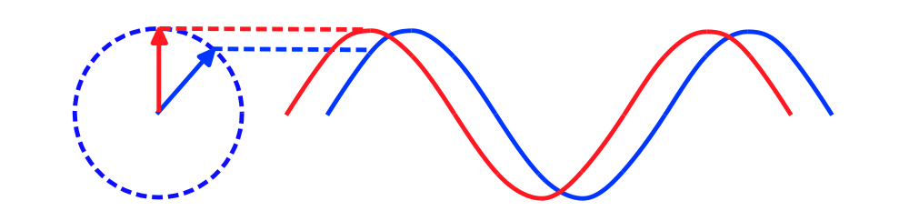
Sinewave Indicator Advantages
Line crossings give advance warning of cyclic turning points
Advancing phase does not increase noise
Indicator can be “tweaked” using theoretical waveforms
No false whipsaws when the market is in a trend mode

Slide 17
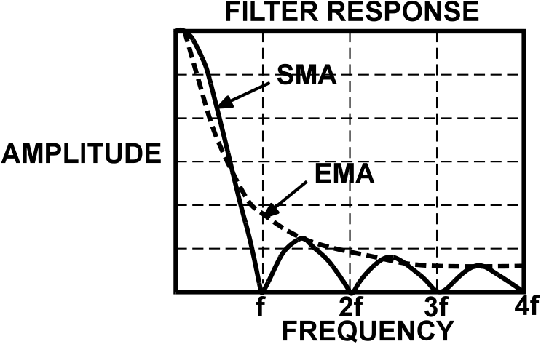
Instantaneous Trendline
Trend Mode exists when the phasor ceases to rotate - no rate change of phase
Objective is to remove any dominant cycle component
  Use a Simple Moving Average over the Dominant Cycle Period

Slide 18
Instantaneous Trendline Code
Add this code to the Cycle Period code
Trendline Lags Price by half the Dominant Cycle
{Compute Trendline as simple average over the measured dominant cycle period}
Period = IntPortion(Period);
Trendline = 0;
For count = 0 to Period + 1 begin
Trendline = Trendline + Price[count];
end;
If Period > 0 then Trendline = Trendline / (Period + 2);
{Compute Zero Lag Kalman Filter}
Value11 = .33*(Price + .5*(Price - Price[3])) + .67*Value11[1];
if CurrentBar < 26 then begin
Trendline = Price;
Value11 = Price;
end;
Plot1(Trendline, "TR");
Plot2(Value11, "ZL");

Slide 19
And In Conclusion . . .
I know you believe you understood
what you think I said,
but I am not sure you realize
that what you heard is not what I meant

