Slide 1


Stock Systems that Work
John Ehlers
MESA Software
ehlers@mesasoftware.com
www.mesasoftware.com
www.mesa-systems.com

Slide 2
RISK STATEMENT
There is no guarantee that technical analysis will result in profits or that it will not result in losses. Past performance is not a guarantee of future results. All investments and trades carry risk and all trading decisions of an individual remain the responsibility of that individual. The use of any concepts presented does not constitute trading advice in any way.

Slide 3
AGENDA
The character of Momentum Functions
The character of Moving Averages
Some Trading Truths
Cycle Modes and Trend Modes
Popular Moving Average System
Moving Average Crossovers
Channel Breakouts
Asymmetrical Entry and Exit
Volatility Breakout System
MACD System

Slide 4
Momentum Functions
T = 0
RAMP
FUNCTION
1st derivative
(Momentum)
STEP
IMPULSE
2nd derivative
(Acceleration)
JERK
3rd derivative
CONCLUSIONS:
1. Momentum can NEVER lead the function
2. Momentum is always more disjoint (noisy)

Slide 5
Moving Averages
c.g.
Window
Moving Average
Lag
CONCLUSIONS:
1. Moving Averages smooth the function
2. Moving Averages Lag by the center of gravity of the observation window
3. Using Moving Averages is always a tradeoff between smoothing and lag

Slide 6
Technical Analysis for Stocks
One of the biggest problems is the selection of the stock to be traded
Technical Analysis concepts have been honed and perfected in Commodities
  Selection of the issue to be traded is not a problem
Commodities have about a 5:1 time compression relative to Stock Cycles
  Gerry Appel originally developed the MACD Indicator using the 13 and 26 week stock market cycles
Trading Frequency should be related to major periodicities
  Take what the market gives you

Slide 7
Basic Truths
You can’t make money if the price doesn’t move
Always backtest a system on a given stock
  The system may not fit the character of the stock movement
  Backtest several years (in-sample testing to set variables)
    Should have at least 30 trades per variable
      Keep the system simple to avoid curve fitting
  Use variables in out-of-sample test for robustness
    Rolling updates are OK, but time consuming
Cut Your Losses!
  Easiest to do following a system
Make sufficient average gross profit to cover transaction costs
  Typical Slippage and Commission Costs are $0.30 per round turn

Slide 8
Cycle Modes and Trend Modes
Two solutions to a constrained Random Walk Problem
  Diffusion Equation
  Telegraphers Equation
Diffusion Equation applies to Market Trends
  Moving Average and Channel Systems are most appropriate
Telegraphers Equation applies to Cycle Modes
  Oscillators are used to top pick and bottom fish
  Reaction speed is important

Slide 9
Popular Moving Average System
Enters long when Close crosses above the Moving Average
Exits a trade when Close crosses below the Moving Average
Inputs: Price(Close),
Period(10);
Vars: MA(0);
MA = Average(Price, Period);
If MarketPosition = 0 and Close > MA then Buy;
If MarketPosition = 1 and Close < MA then ExitLong;

Slide 10
Double MA has Fewer Whipsaws
Smoothed trigger signal is less erratic
Inputs: Price((H+L)/2),
Period1(10),
Period2(30);
Vars: alpha1(0),
alpha2(0),
EMA1(0),
EMA2(0);
{compute alphas for Exponential Moving Averages}
alpha1 = 2 / (Period1 + 1);
alpha2 = 2 / (Period2 + 1);
{compute Exponential Moving Averages (EMA)}
EMA1 = alpha1*Price + (1 - alpha1)*EMA1[1];
EMA2 = alpha2*Price + (1 - alpha2)*EMA2[1];
If MarketPosition = 0 and EMA1 Crosses Over EMA2 then Buy;
If MarketPosition = 1 and EMA1 Crosses Under EMA2 then ExitLong;

Slide 11
Channel Breakout Systems
Buy Channel
  Find the Highest High over the Entry LookBack Period
Exit Channel
  Find the Lowest Low over the Exit LookBack Period
LookBack Periods control trading frequency
  Entry and Exit LookBacks may be different

Slide 12
CHANNEL BREAKOUT CODE
Inputs: Price((H+L)/2),
EntryLookBack(15),
ExitLookBack(15);
Vars: count(0),
EntryChannel(0),
ExitChannel(0);
EntryChannel = 0;
for count = 1 to EntryLookBack begin
if EntryChannel < High[count] then EntryChannel = High[count];
end;
ExitChannel = 100000;
for count = 1 to ExitLookBack begin
if ExitChannel > Low[count] then ExitChannel = Low[count];
end;
If MarketPosition = 0 and High > EntryChannel then buy;
If MarketPosition =1 and Low < ExitChannel then ExitLong;

Slide 13
Asymmetrical Entry and Exit
You can let the market come to you on the entry - nothing is at risk
Faster Entry Channel enables earlier entry

Slide 14
Volatility Breakout System
True Range is the largest of:
  High - Low
  High - Close[1]
  Close[1] - Low
Uses a multiplier of Average True Range as entry and exit signals
  Entry and Exit multipliers can be different

Slide 15
Volatility Breakout System Code
Inputs: EntryFactor(1),
ExitFactor(1.5),
AveLength(14);
Vars: counter(0),
TR(0),
ATR(0);
If CurrentBar > AveLength then begin
TR = High - Low;
if High - Close[1] > TR then TR = High - Close[1];
if Close[1] - Low > TR then TR = Close[1] - Low;
ATR = 0;
For counter = 0 to AveLength - 1 begin
ATR = ATR + TR[counter];
end;
ATR = ATR / AveLength;
If MarketPosition = 0 then buy at Close[1] + EntryFactor*ATR[1] stop;
If MarketPosition = 1 then ExitLong at Close[1] - ExitFactor*ATR[1] stop;
end;

Slide 16
MACD System
Built-In TradeStation 2000i Strategy
Enters on MACD line crossings
Exits on ADX signal (selectable criteria)

Slide 17
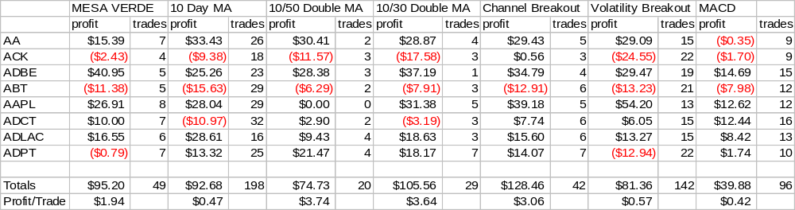
Channel Breakout is Preferred

Slide 18
And In Conclusion . . .
I know you believe you understood
what you think I said,
but I am not sure you realize
that what you heard is not what I meant

