Slide 1
Predictive Indicators
MESA Software
John Ehlers
e-mail: ehlers@mesasoftware.com

Slide 2
AGENDA
Exponential Moving Averages
  Why lag is important
  How to compute the EMA constant to produce a given lag
Higher order filters
  Let your computer do a superior job of smoothing
Essence of Predictive Filters
Linear Kalman Filters
Nonlinear Kalman Filters
Theoretically Optimum Predictive Filters
Zero Lag smoothing

Slide 3
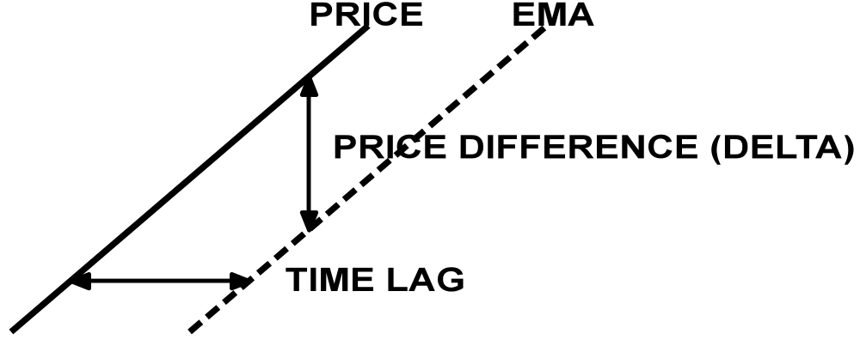
Fundamental Concept of Predictive Filters
In the trend mode price difference is directly related to time lag
Procedure to generate a predictive line:
  Take an EMA of price (better, a 3 Pole filter)
  Take the difference ( delta) between the price and its EMA
  Form the predictor by adding delta to the price
    equivalent to adding 2*delta to EMA

Slide 4
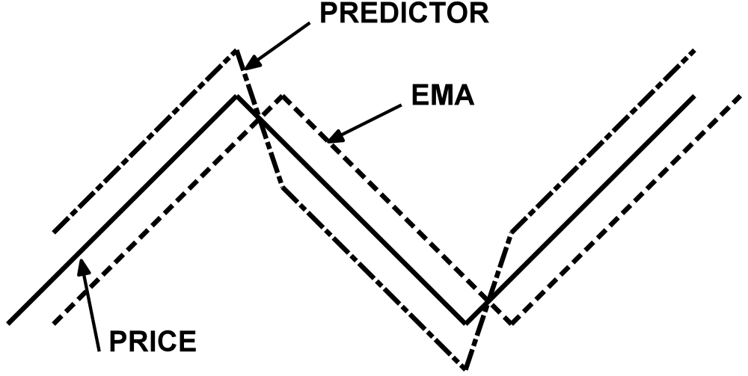
A Simple
Predictive Trading System
Rules:
  Buy when Predictor crosses EMA from bottom to top
  Sell when Predictor crosses EMA from top to bottom
Usually produces too many whipsaws to be practical

Slide 5
Secrets of Predictive Filters
All averages lag (and smooth)
All differences lead (and are more noisy)
The objective of filters is to eliminate the unwanted frequency components
The range of trading frequencies makes a single filter approach impractical
A better approach divides the market into two modes
  Cycle Mode
  Trend Mode
    A Trend can be a piece of a longer cycle

Slide 6
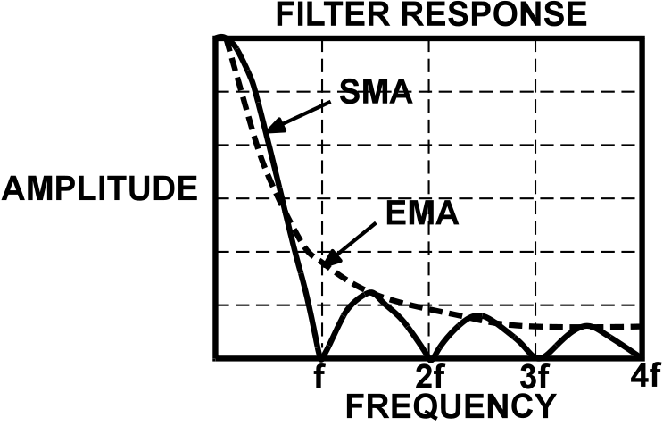
Simple and Exponential
Moving Averages
EMA constant is usually related to the length of an SMA
  “Filter Price Data”, J.K. Hutson, TASAC Vol. 2, page 102
  The equation is α = 2 / (Length +1)
Only delay and amplitude smoothing are important
  Delay is the most important criteria for traders
  An EMA has superior rejection for a given delay

Slide 7
Relating Lag to the EMA Constant
An EMA is calculated as:
  g(z) = α*f(z) + (1 - α )*g(z - 1)
      where g() is the output
      f() is the input
      z is the incrementing variable
Assume the following for a trend mode
  f() increments by 1 for each step of z
    has a value of “i” on the “i th” day
  k is the output lag
  i - k = α *i + (1 - α)*(i - k - 1)
  = α *i + (i - k) - 1 - α *i + α *(k + 1)
  0 = α *(k + 1) - 1
  Then k = 1/α -1 OR α = 1/(k + 1)

Slide 8
Relationship of Lag and EMA Constant
α k (Lag)
.5 1
.4 1.5
.3 2.33
.25 3
.2 4
.1 9
.05 19
Small α cannot be used for short term analysis due to excessive lag

Slide 9
EMA is a Low Pass Filter
g(z) = α*f(z) + (1 - α)*g(z - 1)
Use Z Transform notation (unit lag = 1/z)
g = α *f + (1 - α)*g/z
Solving the algebra: g = α *f*z / (z - (1 - α))
Output is related to input by a first order polynomial
Called 1 Pole filter because response goes to infinity when z = 1 - α
Higher order polynomials produce better filtering
  Second order: g = kf / (z² + az + b)
  Third order: g = kf / (z³ + az² + bz +c)

Slide 10
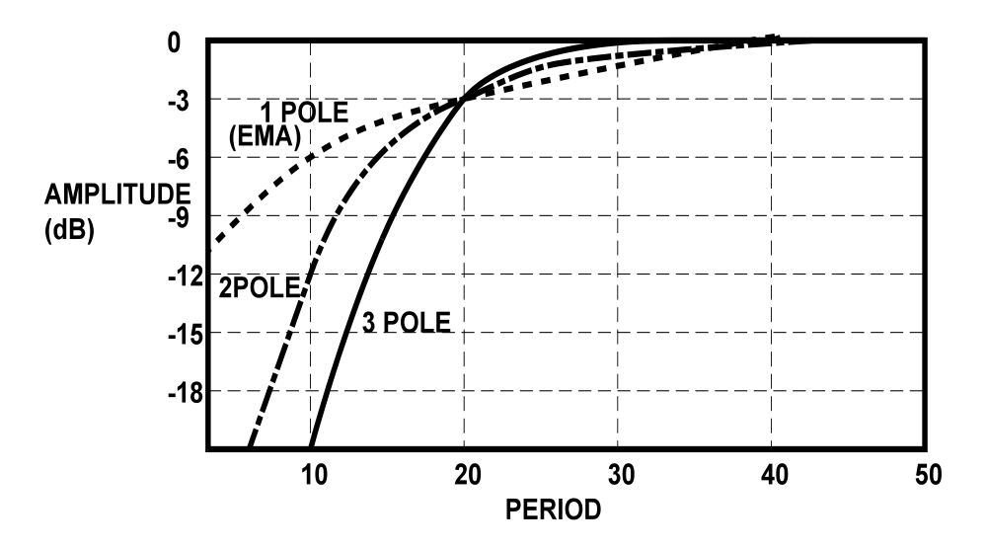
Higher Order Filters
Give Better Filtering
Smoothing increases with filter order
High Frequencies (short cycles) are more sharply rejected

Slide 11
Higher Order Filter
Design Equations
Delay = N * P / π² (N is order, P is cutoff period)
Second Order Butterworth equations:
a = exp(-1.414*π/P)
b = 2*a*Cos(1.414*π/P)
g = b*g[1] - a*a*g[2] + ((1 - b + a*a)/4)*(f + 2*f[1] + f[2])
Third Order Butterworth equations:
a = exp(-π/P)
b = 2*a*Cos(1.732*π/P)
c = exp(-2*π/P)
g = (b + c)*g[1] - (c + b*c)*g[2] + c*c*g[3]
+ ((1 - b + c)*(1 - c) / 8)*(f + 3*f[1] + 3*f[2] + f[3])
where g is output, f is input

Slide 12
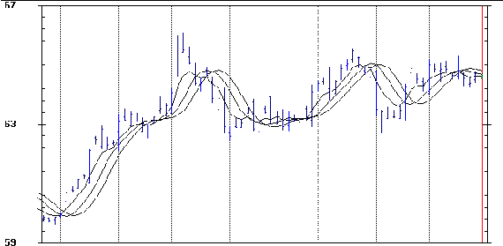
14 Bar Cutoff
1, 2, & 3 Pole LowPass Filters
DM__94z.ttd
940922
1 Pole
2 Pole
3 Pole
Increased Lag is the penalty for increased smoothing

Slide 13
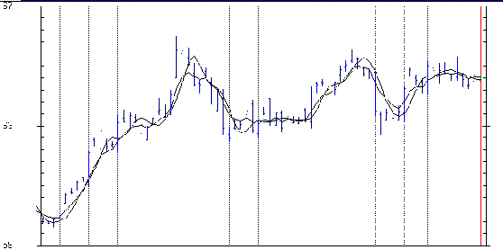
1 & 3 Pole LowPass Filters
Equalized for 2 Bar Lag
DM___94z.ttd
940922
Three Pole Response
Higher Order filters give better fidelity for an equal amount of lag

Slide 14
Linear Kalman Filters
Originally used to predict ballistic trajectories
Basic ideal is to correct the previous estimate using the current error to modify the estimate
Procedure for a Linear Kalman Filter:
  Previous estimate is the EMA
  Estimate Lag error based on price change
  Multiply the price rate of change by the lag-related constant
g(z) = α∗f(z) + (1 - α)∗g(z - 1) + γ∗(f(z) - f(z - 1))

Slide 15
Computing Kalman Coefficients
As before, increment f() by 1 for each step of z
  i - k = α *i + (1 - α)*(i - k - 1) + γ*(i - (i -1))
  = α *i + (i - k) - 1 - α *i + α *(k + 1) + γ
  0 = α *(k + 1) - 1 + γ
  γ = 1 - α *(k + 1)
  ___K___ ___γ__
   1 (Lag) 1 - 2*α
  0 1 - α
  -1 (Lead) 1
  -2 1 + α
Now lag is under control for any EMA constant
Leading functions are too noisy to be useful

Slide 16
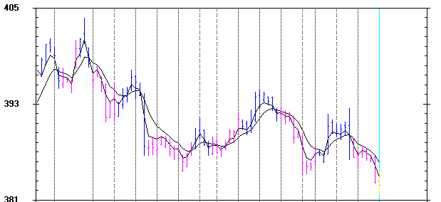
Linear Kalman Filter
1 Day Lag
GC___95Q.TTD
950728
Kalman γ = .5
EMA α = .25

Slide 17
Nonlinear Kalman Filter
Take EMA of price (better, a 3 Pole filter)
Take the difference (delta) between Price and its EMA
Take an EMA of delta (or a 3 Pole filter)
  Smoothing will help reduce whipsaws
  Ideally, smoothing introduces no major trend mode lag because delta is detrended
Add the smoothed delta to EMA for a zero lag curve.
Add 2*(smoothed delta) to EMA for a smoother predictive line

Slide 18
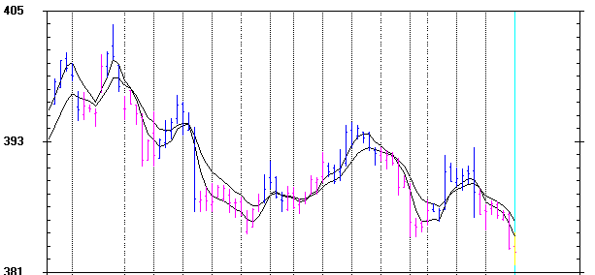
Zero Lag
Nonlinear Kalman Filter Example
GC___95Q.TTD
950728
Nonlinear Kalman Response
EMA α = .25

Slide 19
Theoretically Optimum
Predictive Filters
Optimum predictive filters are solutions to the generalized Wiener-Hopf integral equation
  “Statistical Theory of Communication”, Y.W. Lee, John Wiley and Sons, 1960
Optimum Predictive filters pertain only to the market cycle mode (Must use detrended waveforms)
Two solutions are of interest to traders
  Pure predictor (noise free case)
    See “The BandPass Indicator”, John Ehlers, TASAC, September 1994, page 51
  Predicting in the presence of noise
    See “Optimum Predictive Filters”, John Ehlers, TASAC, June 1995, Page 38

Slide 20
Pure Predictor
Calculations start by taking two 3 Pole Low Pass filters for smoothing
  Period1 = .707 * Dominant Cycle
  Period2 = 1.414 * Dominant Cycle
Ratio of the two periods is 2:1
  The second filter has twice the lag of the first
Take the difference of the two filter outputs
  The difference detrends the information
  The resultant is in phase with the cycle component of the price
A very smooth (noise-free) replica of the cycle component of the price is established. This is the BandPass Filter output.

Slide 21
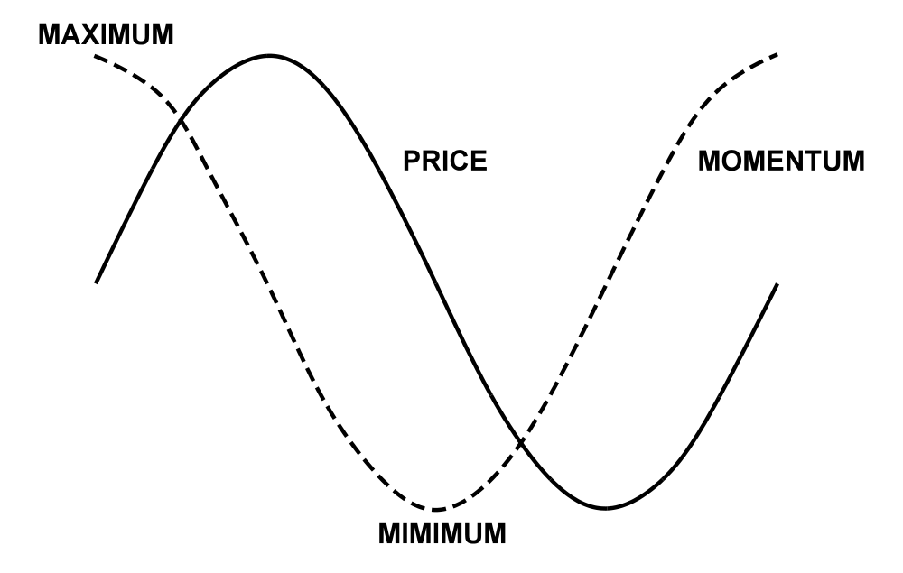
Sinewave “momentum” phase leads by 90 degrees
“Momentum” is similar to a calculus derivative.
d (Sin(ω*t)) / dt = ω * Cos(ω*t)
1/ω = P/(2*π) must be used as an amplitude normalizer.

Slide 22
Computing the
Noise-Free Predictor
Take the “momentum” of the BandPass Filter output (simple one day difference).
Normalize amplitude by multiplying the “momentum” by P_{o} / (2*π )
Produce 30 degree leading function
  Multiply normalized “momentum” by .577 (tan(30) = .577)
  Add product to BandPass Filter output
Reduce leading function amplitude
  Multiply by .87 to normalize vector amplitude
  Multiply again by .75 to reduce amplitude below BandPass amplitude.
    Crossover entry signal always leads by 1/8th of a cycle

Slide 23
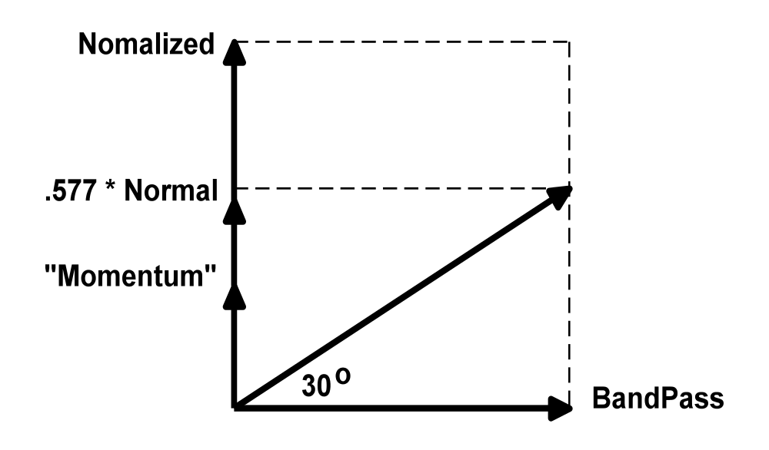
Noise-Free Predictor
Vector Construction

Slide 24
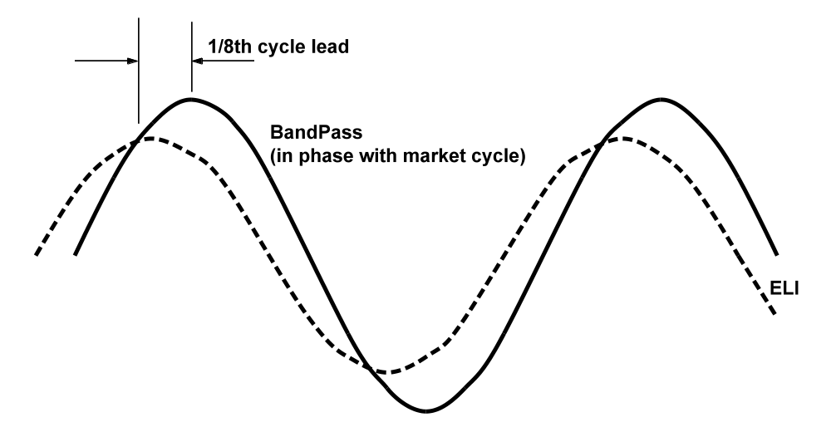
The Complete
BandPass Indicator
The BandPass Indicator is automatically tuned in:
MESA for Windows
3D for Windows

Slide 25
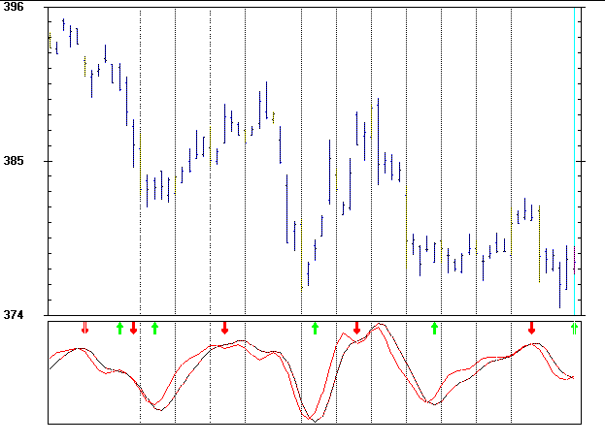
BandPass Indicator Crossings
Give Buy/Sell Signals
GC___95J.TTD
950303

Slide 26
Optimum Predictive Filter in the Presence of Noise
Start with RSI or Stochastic Indicator
  Provides detrended waveform
  Adjust length until the waveform resembles a sinewave
Technique is useful only when the waveform has a Poisson probability distribution
  The midpoint crossings must be relatively regular
Take an EMA of the RSI
  α = .25 is nominally correct (gives a 3 day lag)
Subtract the EMA from the RSI to produce the predictor
  Remember the fundamental premise in constructing predictive filters?

Slide 27
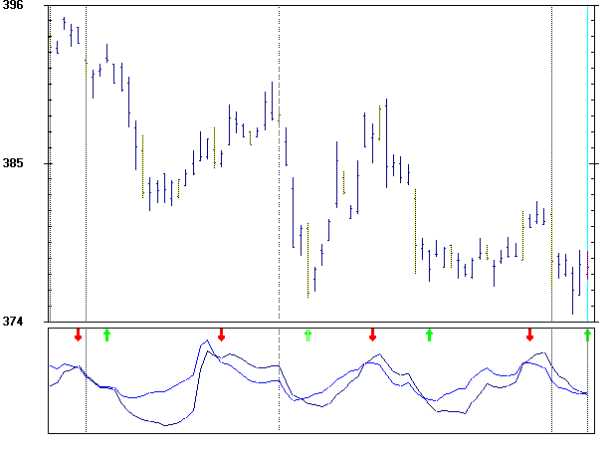
RSI and
Optimum Predictive Filter
GC___95J.TTD
950303

Slide 28
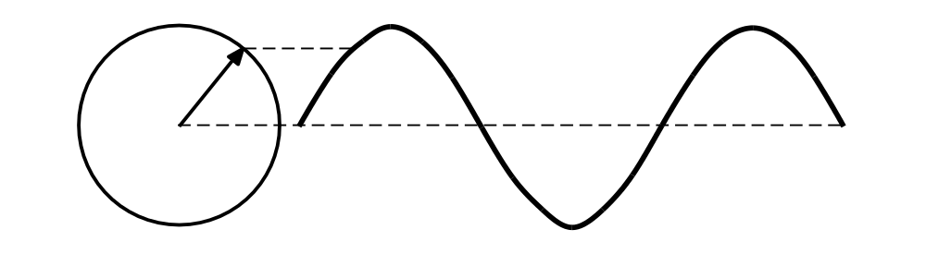
Zero Lag Filters
Zero Lag filters are constructed using cycle theory
A phasor accurately depicts cyclic amplitude and phase characteristics
Phasors ignore the cyclic rotation and examine only relative lead and lag relationships
phasor
θ
sinewave

Slide 29
Zero Lag Filter Construction
Phasor A has a lag of DominantCycle/16
Phasor B has twice the lag of Phasor A
Subtract B from A by reversing B and adding
Resultant is detrended leading angle Phasor C
Vector add C to A
Resultant is zero lag, non-detrended Phasor D
A
B
-B
C
A
C
D
A

Slide 30
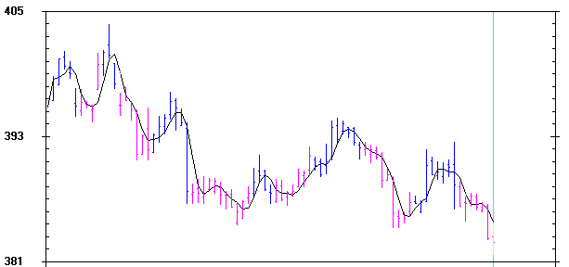
Zero Lag Filter Example
GC___95Q.TTD
950728

Slide 31
A Zero Lag Filter Application
Take a 3 Pole zero lag filter of price highs
Take a 3 Pole zero lag filter of price lows
Calculate statistics of the high and low variations
  Add 2 Standard Deviations to the Highs Zero Lag Filter
  Subtract 2 Standard Deviations to the Lows Zero Lag Filter
Resultant channels can be used as stop values for a stop-and-reverse system
Remove the +/- Std Deviations near cycle turns
SUMMIT for Windows uses this procedure

Slide 32
SUMMARY
What you have learned:
  How to relate filter lag to EMA constant
  How to compute Higher Order Butterworth Filters
  How to control lag using a Linear Kalman Filter
  How to compute a Nonlinear Kalman Filter
    Possible start for a crossover system
  How to compute Optimum Predictive Filters for the cycle mode
    Pure Predictor (Noise-Free, using higher order filters)
    With RSI or Stochastics
  How to compute a zero lag filter

