Slide 1
TAOTN 2002
www.mesasoftware.com
www.mesa-systems.com
ehlers@mesasoftware.com

Slide 2
John Ehlers
  Pioneer of MESA studies
  FuturesTruth has ranked his S&P, Bond, and Currency trading systems #1
  Winner 27 Readers’ Choice Awards from Stocks & Commodities magazine
  Author of MESA and Trading Market Cycles
  Author of Rocket Science for Traders

Slide 3
Agenda
Theory
  Random Walk and the Basis for Market Modes
  Basic Tools - Averages and Momentums
How MESA Trades the Market Modes
How MESA can make good indicators better by making them adaptive
Fisher Transform
  How to enhance your current indicators

Slide 4
Drunkard’s Walk
I relate the market to known physical phenomena
  Smoke plume for Trend Modes
  Meandering river for Cycle Modes
Both randomness and short term cycles can arise from the solution to the random walk problem
Solution is the “Diffusion Equation” for Trend Modes
Solution is the “Telegraphers Equation” for Cycle Modes

Slide 5
Diffusion Equation
“Drunkard’s Walk” is a special form of the random walk problem
  The drunk flips a coin to determine right or left with each step forward
  The random variable is direction
The Diffusion equation is the solution
  describes smoke coming from a smokestack
The smoke plume is analogous to market conditions
  Breeze bends the plume to an average trendline
  Plume widens with distance - distant predictions are less accurate
  Smoke density is analogous to prediction probability - the best estimator is the average

Slide 6
Telegraphers’ Equation
Modify the “Drunkard’s Walk” problem
  Coin flip decides whether the drunk will reverse his direction, regardless of the direction of the last step
  The random variable is now momentum, not direction
Solution is now the Telegrapher’s Equation
  Describes the electric wave on a telegraph wire
  Also describes a meandering river
A river meander is a short term cycle
  Random probability exists (Diffusion Equation) IF:
    Individual meanders are overlaid
    Or a long data span is taken

Slide 7
The Market is similar to a meandering river
Both follow the path of least resistance
Rivers attempt to keep a constant water slope - maintains the conservation of energy.
Conservation of Energy produces the path of least resistance
  Paths of uniform resistance look like pieces of sinewaves
Market Forces (greed, fear, profit, loss, etc.) are similar to physical forces, producing paths of uniform resistance.
Think about how the masses ask the question:
Will the market change?
OR
Will the trend continue?

Slide 8
Market Modes
My market model only has two modes
  Trend Mode
  Cycle Mode
Market Cycles can be measured
If the cycles are removed from the data, the residual must be the Trend

Slide 9
Measuring Spectra is Difficult
Must Measure a Triple infinity of Variables Simultaneously
  Frequency
  Amplitude
  Phase
Potential measurement techniques:
  Count bars between successive highs (or lows)
  FFT
  MESA
  Hilbert Transform

Slide 10
FFT
Constraints:
  Data is a representative sample of an infinitely long wave
  Data must be stationary over the sample time span
  Must have an integer number of cycles in the time span
Assume a 64 day time span
  Longest cycle period is 64 days
  Next longest is 64 / 2 = 32 days
  Next longest is 64 / 3 = 21.3 days
  Next longest is 64 / 4 = 16 days
Result is poor resolution - gaps between measured cycles

Slide 11
FFT (continued)
Paradox:
  The only way to increase resolution is to increase the data length
  Increased data length makes realization of the stationarity constraint highly unlikely
    256 data points are required to realize a 1 bar resolution for a 16 bar cycle (right where we want to work)
Conclusion:
FFT measurements are not suitable for market analysis

Slide 12
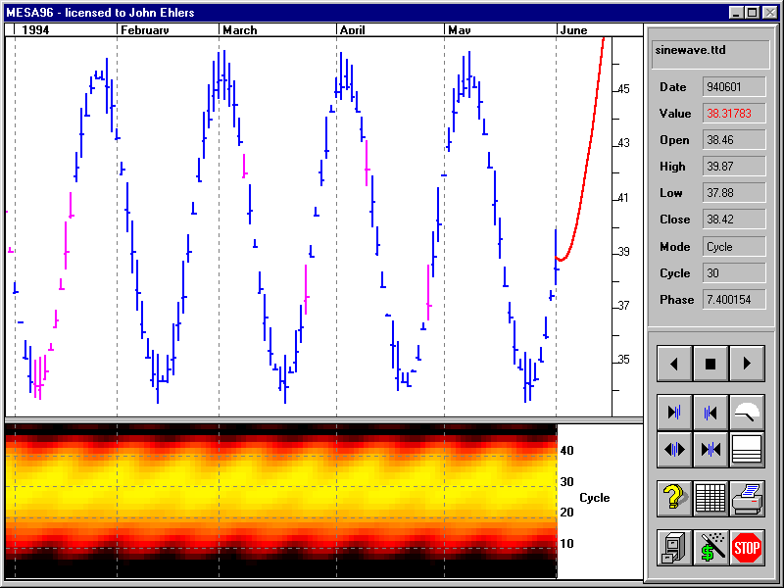
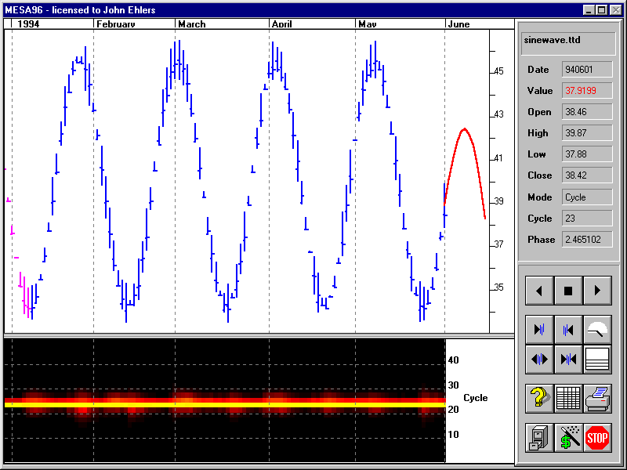
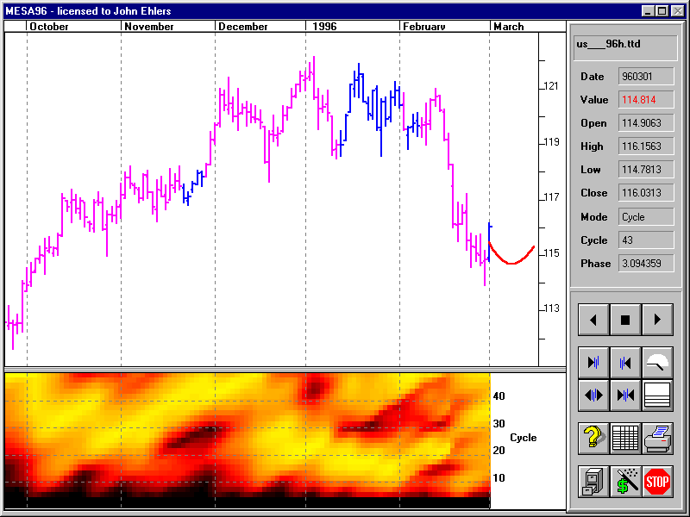
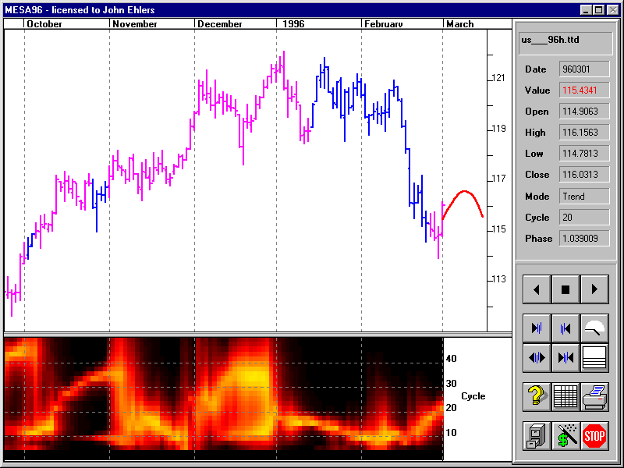
Still Not Convinced?
Spectrum Amplitude
is converted to color
FFT
MESA
Theoretical 24 Bar Cycle
Treasury Bonds

Slide 13
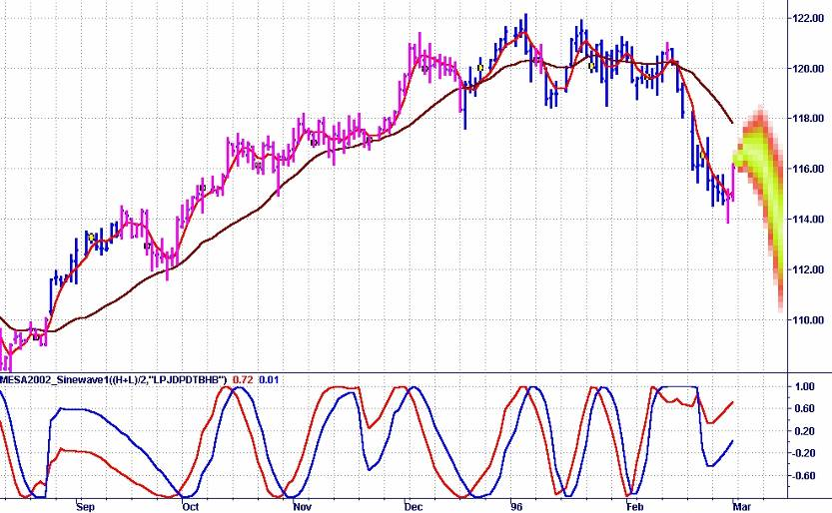
MESA Indicates and Trades
Both Market Modes
Trade Trend when Kalman Filter
Line fails to cross the Instantaneous
Trendline within a half cycle
Trade the Sinewave Indicator
in the Cycle Mode
Instantaneous Trendline
is created by removing
the dominant cycle
Prediction

Slide 14
MESA Customer Feedback
“The results I have achieved are very impressive. In the course of my investigations, I’ve discovered that most stocks can be traded in the cycle-mode *OR* trend-mode - rarely both.”
Peter S. Campbell

Slide 15
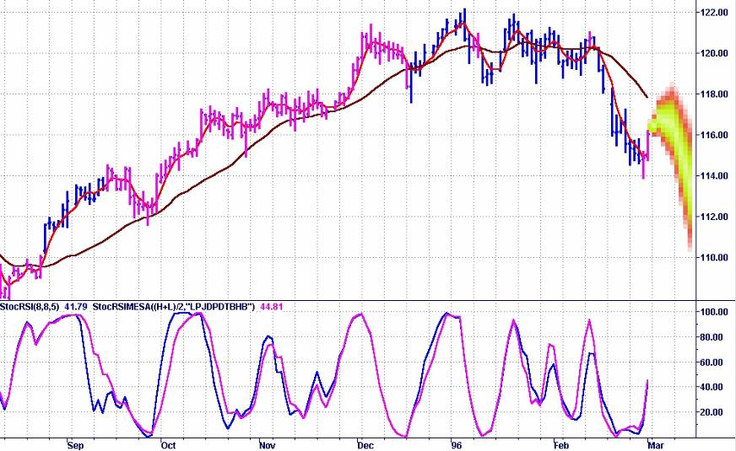
MESA Can Improve Even the Best Indicators by Making Them Adaptive

Slide 16
Basic Technical Tools
Moving Averages
  Smooth the data
  Analogous to the Integral in Calculus
Momentum Functions (Differences)
  Sense rate of change
  Analogous to the Derivative in Calculus
All indicators are combinations of these tools

Slide 17
Moving Averages
c.g.
Window
Moving Average
Lag
CONCLUSIONS:
1. Moving Averages smooth the function
2. Moving Averages Lag by the center of gravity of the observation window
3. Using Moving Averages is always a tradeoff between smoothing and lag

Slide 18
Momentum Functions
T = 0
RAMP
FUNCTION
1st derivative
(Momentum)
STEP
IMPULSE
2nd derivative
(Acceleration)
JERK
3rd derivative
CONCLUSIONS:
1. Momentum can NEVER lead the function
2. Momentum is always more disjoint (noisy)

Slide 19
FIR Filters

Slide 20
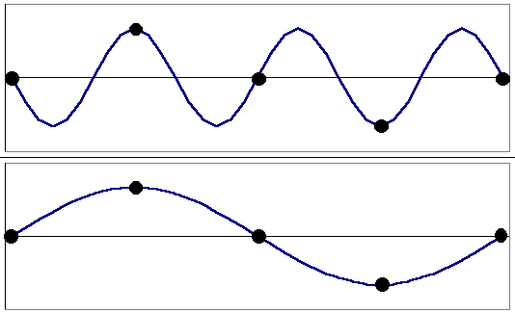
Frequency is the Reciprocal of Cycle Period
Must have at least 2 samples per cycle
  Nyquist Criteria
Shortest period allowed is a 2 bar cycle
  This is the Nyquist Frequency
Normalized frequency is 2 / Period
Alias
Correct

Slide 21
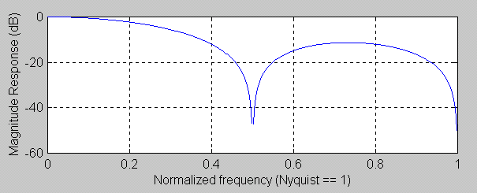
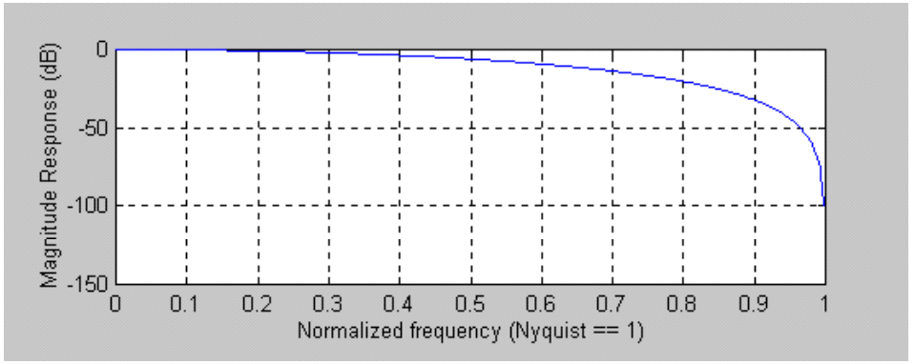
FIR Filters
Symmetrical FIR Filter Lag is (N - 1) / 2 for all frequencies
Simple 4 bar moving average
where a = [1 1 1 1] / 4
Delay is 1.5 bars
Notches out 2 & 4 bar cycles
Tapering the coefficients reduces the sidelobe amplitude
For a 3 tap filter
where a = [ 1 2 1] / 4
Delay is 1 bar
Notches out only a 2 bar cycle

Slide 22
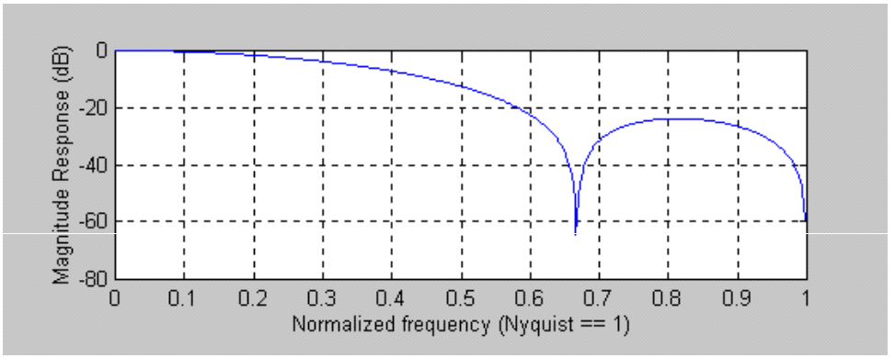
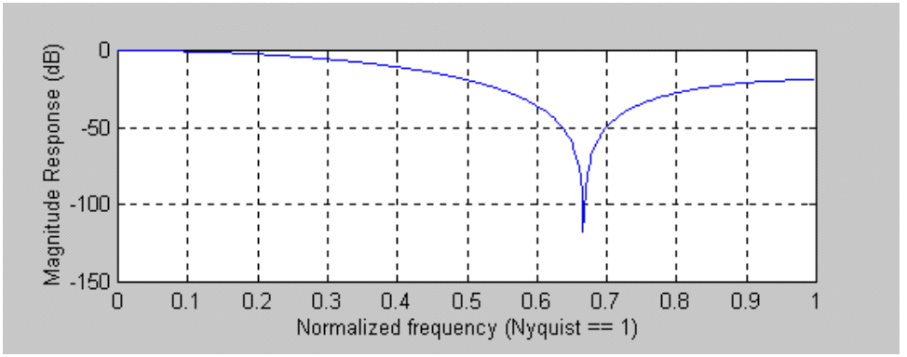
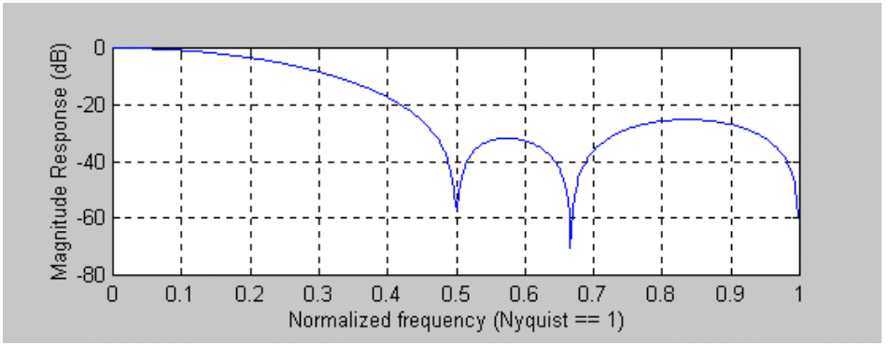
Special FIR Filters of Interest to Traders
Four tap filter
a = [1 2 2 1] /6
lag is 1.5 bars
notches 2 & 3 bar cycles
Five tap filter
a = [1 2 3 2 1] /9
lag is 2 bars
notches only 3 bar cycle
Six tap filter
a = [1 2 3 3 2 1] /12
lag is 2.5 bars
notches 2, 3, & 4 bar cycles

Slide 23
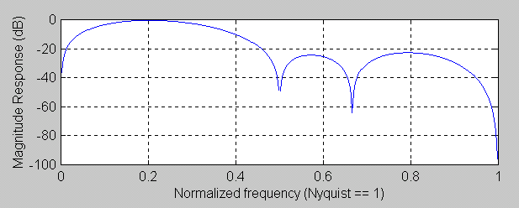
Isolating the Cycle Component
Create a Bandpass filter
Low Pass for Smoothing
High Pass to remove the Trend
Method: Take a two bar momentum of a 6 bar Tapered FIR Filter
[1 2 3 3 2 1] / 12
-[1 2 3 3 2 1] / 12
[1 2 2 1 -1 -2 -2 -1] / 12

Slide 24
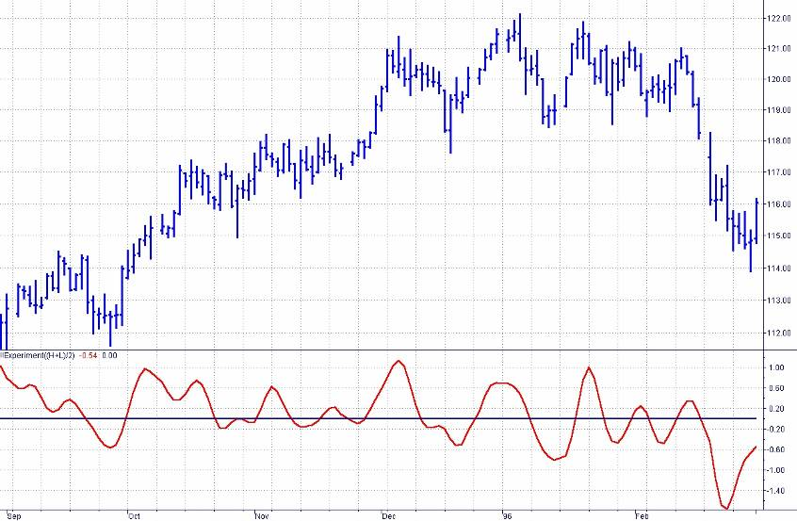
How the Cycle Component Looks

Slide 25
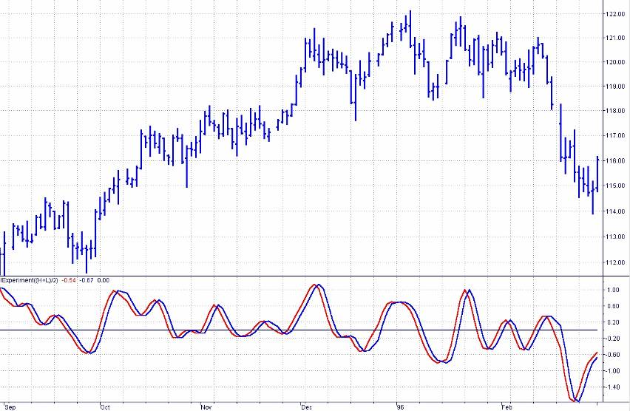
Capture the Cycle Turning Points with the Cycle Delayed One Bar

Slide 26
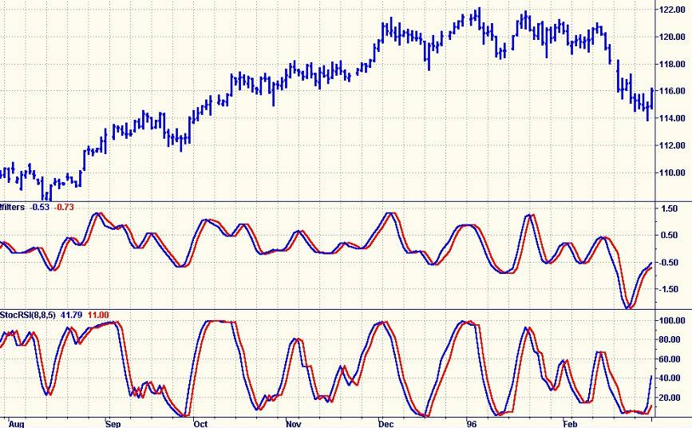
Cycle Does Not Require
Adjustable Parameters

Slide 27
Fisher Transformation

Slide 28
Many Indicators Assume a
Normal Probability Distribution
Example - CCI
  by Donald Lambert in Oct 1980 Futures Magazine
CCI = (Peak Deviation) / (.015* Mean Deviation)
Why .015?
  Because 1 / .015 = 66.7
  66.7 is (approximately) one standard deviation
    IF THE PROBABILITY DENSITY FUNCTION IS NORMAL

Slide 29
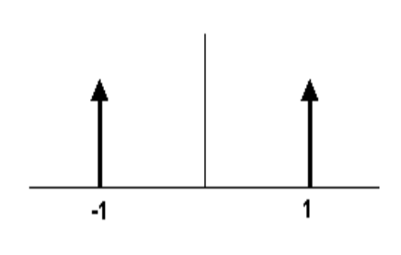
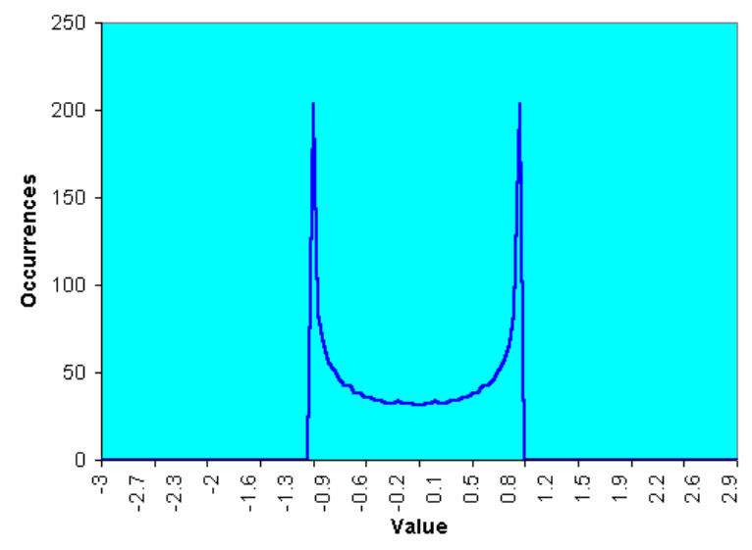
What are Probability Density Functions?
A Square Wave only has two values
A Square Wave is untradeable with conventional
Indicators because the switch to the other value
has occurred before action can be taken
A PDF can be created by making the waveform
with beads on parallel horizontal wires. Then,
turn the frame sideways to see how the beads
stack up.
A Sinewave PDF is not much different from
a Squarewave PDF
Probably one reason why trading cycles has
such a bad reputation.

Slide 30
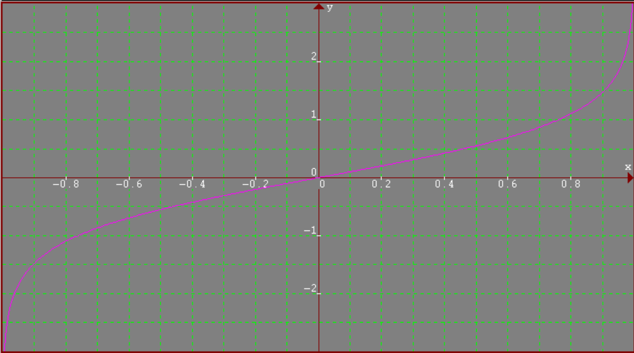
The Fisher Transform Generates Waves Having Nearly a Normal PDF
Y = .5*ln((1 + X) / (1 - X))
where -1 <= X <= 1

Slide 31
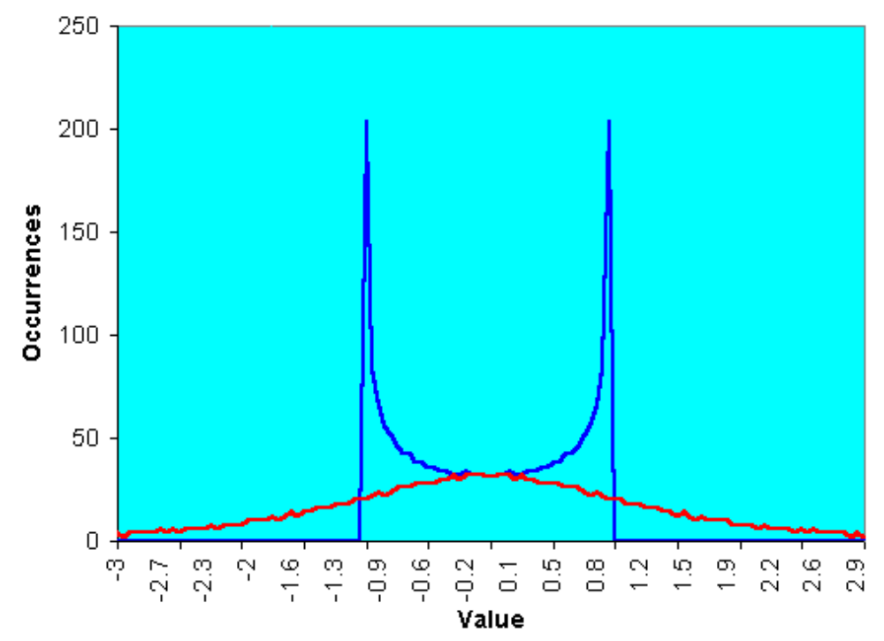
Fisher Transform Converts a
Sinewave PDF to a Normal PDF

Slide 32
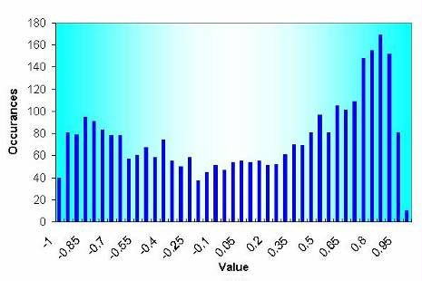
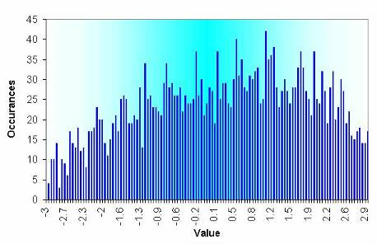
Real World Fisher Transform PDFs
12 Year PDF of
Treasury Bond Futures
Fisher Transform PDF of
12 Year Treasury Bond Data

Slide 33
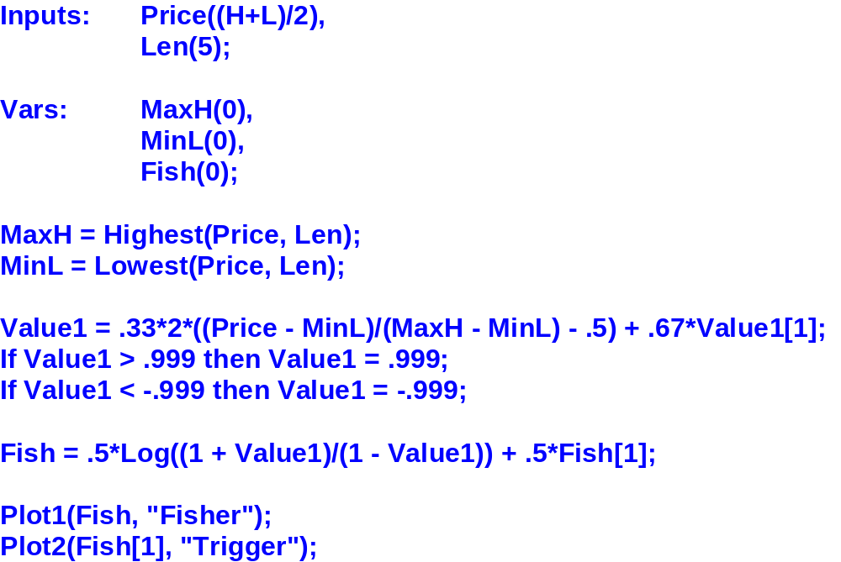
Fisher Transform Code is Simple
Compute Normalized Price Channel
Apply Transform

Slide 34
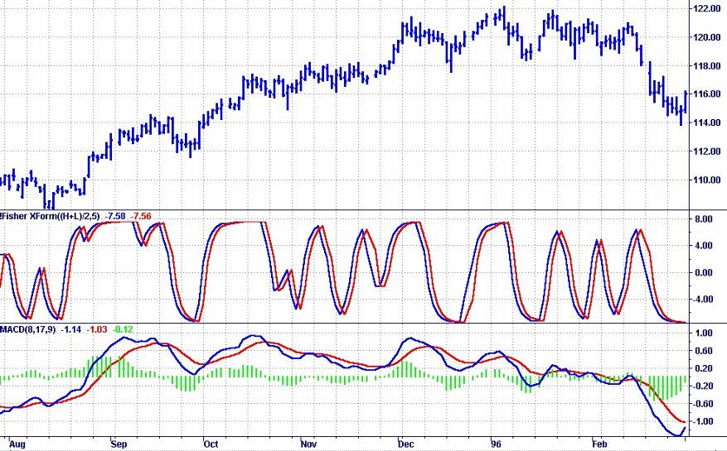
Fisher Transform Turning Points are Sharper and Have Less Lag

Slide 35
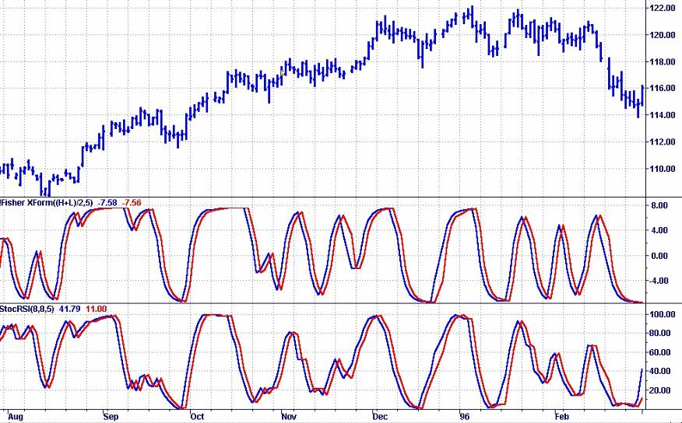
Fisher Transform Channel Has Fewer Whipsaws Than StochasticRSI

Slide 36
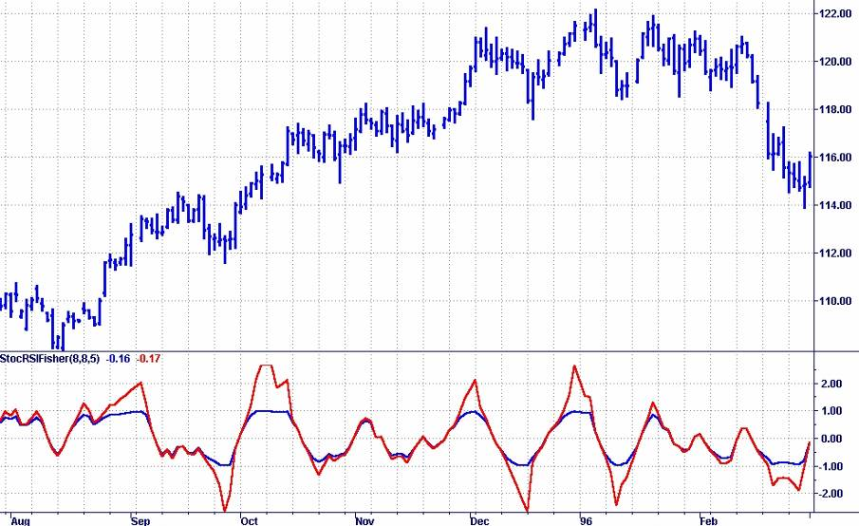
Fisher Transform Can Sharpen the Real StochasticRSI Turning Points

Slide 37
Conclusions
The Drunkard’s Walk is the underpinning for identifying inefficiencies in the Trend Mode and Cycle Mode
You have seen how MESA trades both Modes
Your indicators and systems can be improved by making them adaptive to the measured cycles
You have Simple FIR Filters for data smoothing in your Toolbox
  You have a simple way to see the Cycle Component
You can more accurately identify turning points by modifying the PDF using the Fisher Transform

