Slide 1

Sharpen Your Trading with the Fisher Transform
Presented by John Ehlers

Slide 2
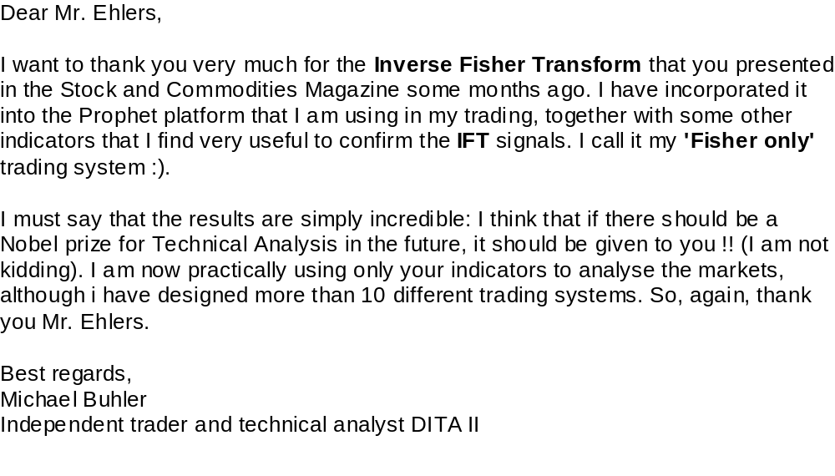

Slide 3
Technical Analysis is Based on Probability
“The market is oversold because the Stochastic has been high, so when it crosses through 80 then . . . . . .”
“When the head-and-shoulders pattern is complete then . . . . . .”
“When the market breaks above the upper channel then . . . . . .”
Why fool around with rules?
Let’s attack probability directly

Slide 4
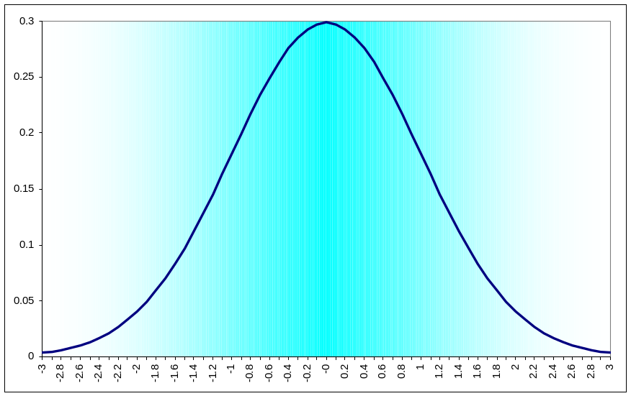
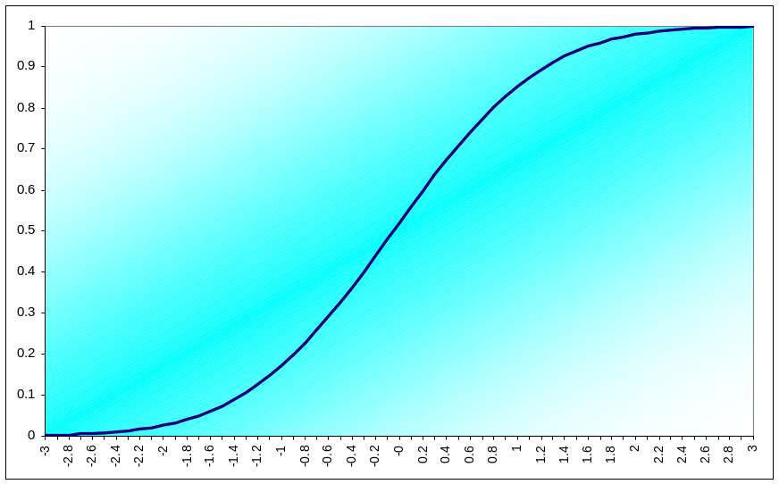
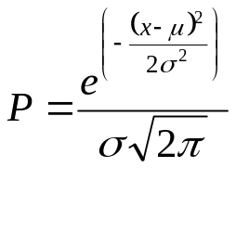
Gaussian Probability Distribution Function is Commonly Assumed for Market Data
Gaussian PDF
CumulativeGaussian PDF
0 = 50%
+1σ = 85%
+2σ = 98%
+3σ = 99.9%
Gaussian PDF is attractive because it can be achieved
using several random variables due to the central limit theorem
But is Gaussian the right PDF for market data?

Slide 5
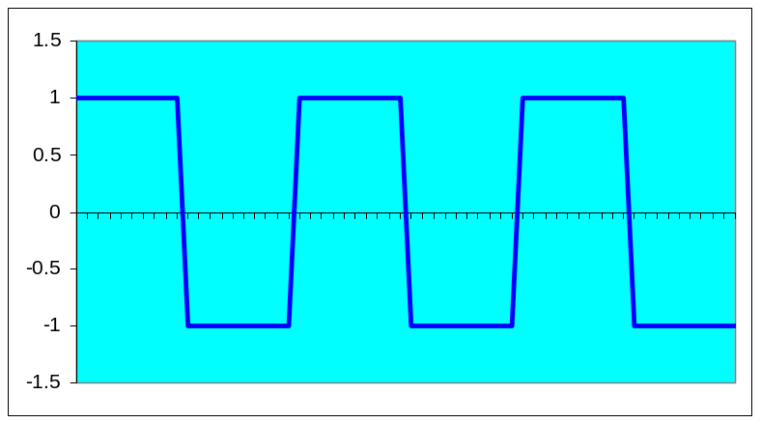
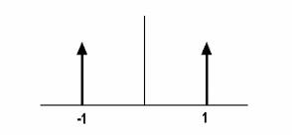
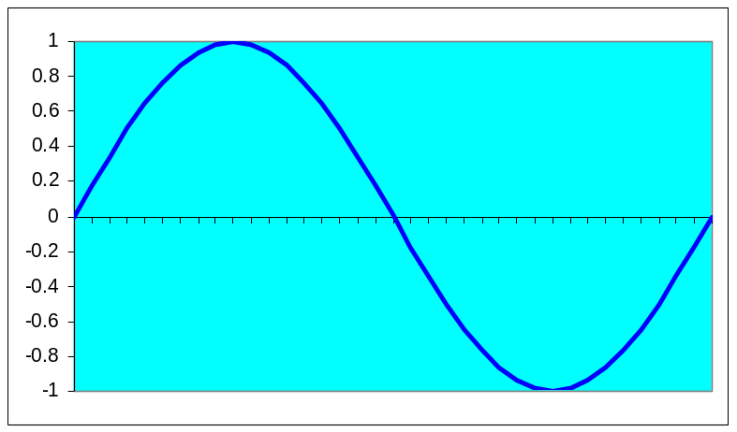
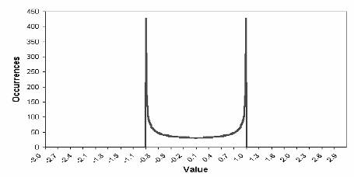
The PDF Depends on the Market Waveshape
Square Wave
Binary PDF of Square Wave
Sine Wave
Sine Wave PDF

Slide 6
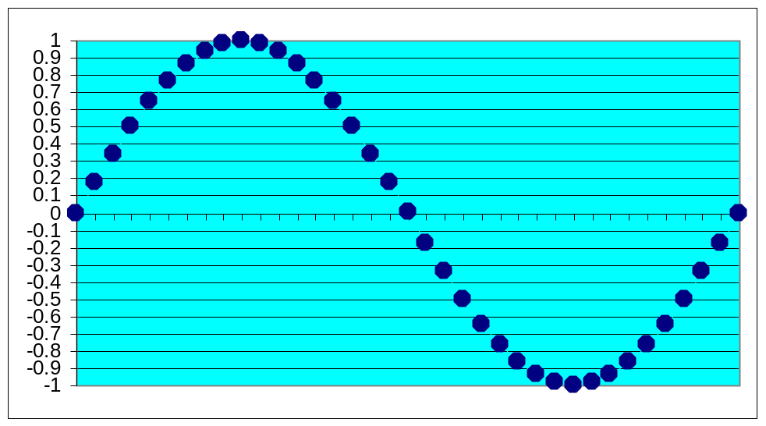
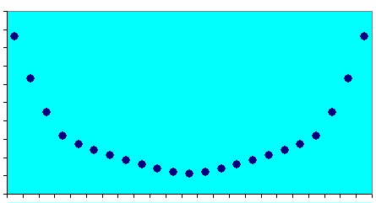
How Do We Determine the Market PDF?
Create the waveform by
stringing beads on a
horizontal wire frame
Rotate wire frame to
enable beads to
stack up
Height of the bead
stacks is the PDF
of the Waveform

Slide 7
Code to Generate PDF
Inputs: Price((H+L)/2),
Len(10);
Vars: MaxH(0),
MinL(0),
count(0),
I(0);
Arrays: PDF[100](0);
MaxH = Price;
MinL = Price;
For count = 0 to Len - 1 begin
If Price[count] > MaxH then MaxH = Price[count];
If Price[count] < MinL then MinL = Price[count];
End;
Value1 = .5*((Price - MinL)/(MaxH - MinL)) + .5*Value1[1];
For I = 0 to 100 begin
If Value1 >= I/100 and Value1 < I/100 +.01 then PDF[I] = PDF[I] + 1;
End;
If LastBarOnChart then begin
For I = 0 to 100 begin
Print(File("C:\TSGrowth\USPDF.CSV"), I/100, ",", PDF[I]);
End;
End;

Slide 8
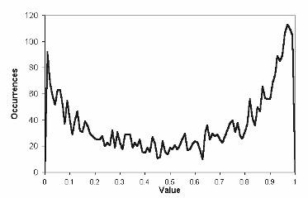
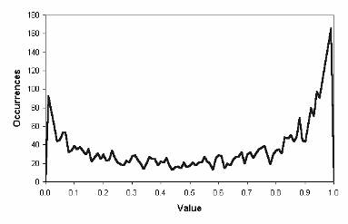
PDF for Treasury Bonds
10 Bar Channel over 15 Years
30 Bar Channel over 15 Years

Slide 9
The Fisher Transform

Slide 10
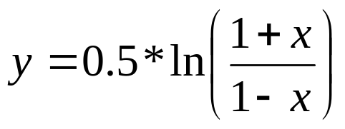
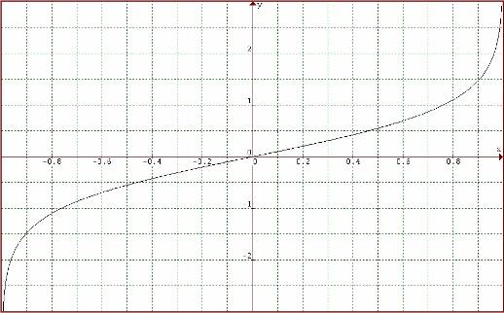
The Purpose of the Fisher Transform is to Change Values that Result In a Gaussian PDF
The Fisher Transform Equation
The Fisher Transform inputs must be limited between -1 and +1
The Fisher Transform Transfer Response is Expansive

Slide 11
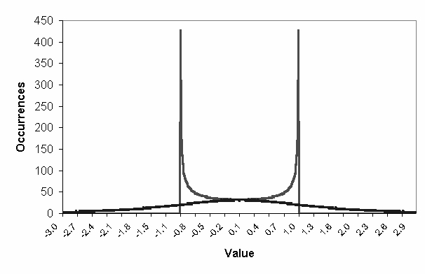
Sinewave PDF is Converted To Be
Nearly Gaussian by the Fisher Transform

Slide 12
Fisher Transform Code
Inputs: Price((H+L)/2),
Len(10);
Vars: MaxH(0),
MinL(0),
count(0),
Fish(0);
MaxH = Price;
MinL = Price;
For count = 0 to Len - 1 begin
If Value2[count] > MaxH then MaxH = Price[count];
If Value2[count] < MinL then MinL = Price[count];
End;
Value1 = .5*2*((Price - MinL)/(MaxH - MinL) - .5) + .5*Price[1];
If Value1 > .999 then Value1 = .999;
If Value1 < -.999 then Value1 = -.999;
Fish = .25*Log((1 + Value1)/(1 - Value1)) + .5*Fish[1];
{Plot1(Fish, "Fisher");
Plot2(.9*Fish[1], ”Trigger");

Slide 13
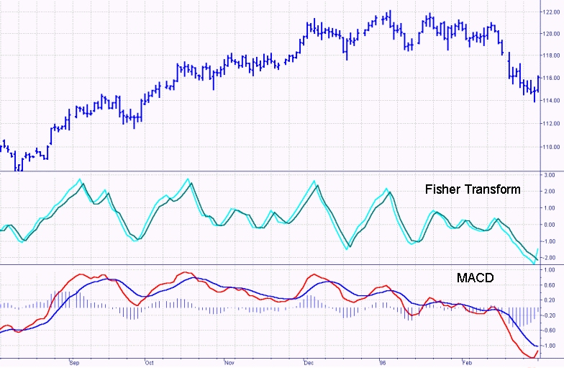
The Fisher Transform Indicator Gives Sharper and More Timely Turning Point Signals than Most Other Indicators

Slide 14
Fisher Transform Strategy
Inputs: Price((H+L)/2),
Len(10);
Vars: MaxH(0),
MinL(0),
count(0),
Fish(0);
Value2 = Price;
MaxH = Value2;
MinL = Value2;
For count = 0 to Len - 1 begin
If Value2[count] > MaxH then MaxH = Value2[count];
If Value2[count] < MinL then MinL = Value2[count];
End;
Value1 = .5*2*((Value2 - MinL)/(MaxH - MinL) - .5) + .5*Value1[1];
If Value1 > .9999 then Value1 = .9999;
If Value1 < -.9999 then Value1 = -.9999;
Fish = .5*Log((1 + Value1)/(1 - Value1)) + .5*Fish[1];
If Fish[1] < -3 and Fish Crosses Over .9*Fish[1] then Sell Next Bar on Open;
If Fish[1] > 3 and Fish Crosses Under .9*Fish[1] then Buy Next Bar on Open;
Idea is to find a trend and then enter a pop in the direction of the trend

Slide 15
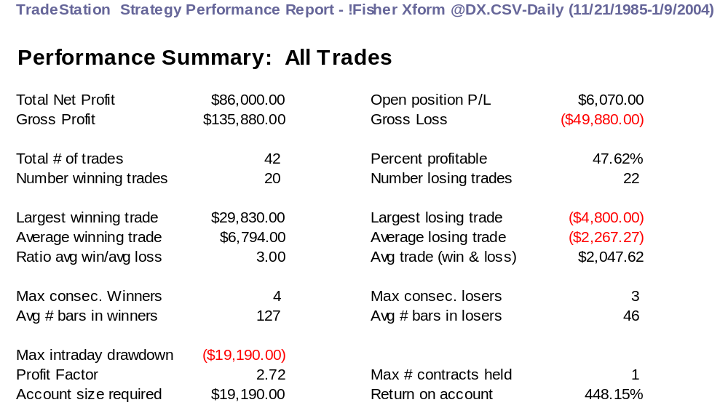
DX Performance - Len=4

Slide 16
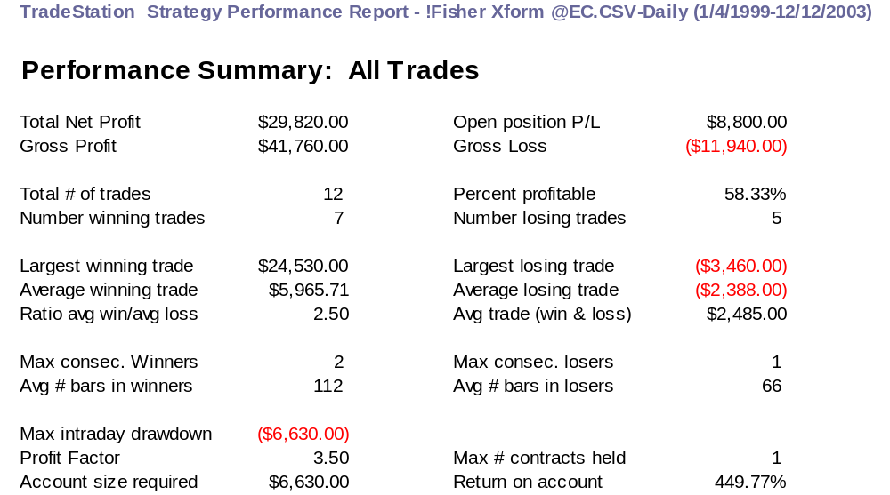
EC Performance - Len=24

Slide 17
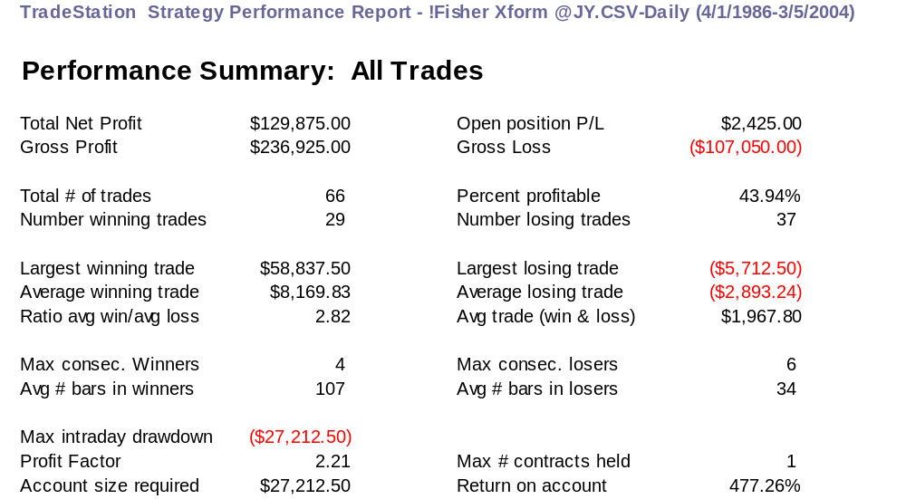
JY Performance - Len=11

Slide 18
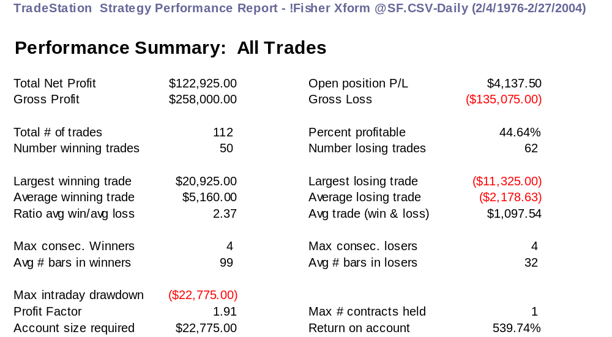
SF Performance - Len=7

Slide 19
The Inverse Fisher Transform

Slide 20
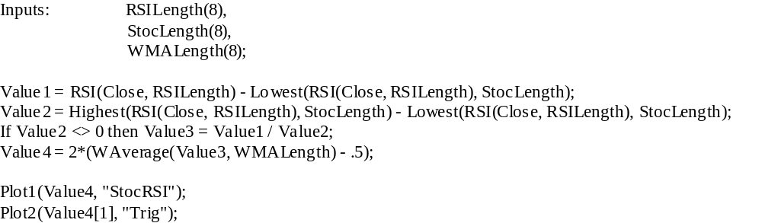
The Stochastic RSI is a Popular Indicator
First take a standard RSI
Next, compute the Stochastic of that RSI
Smooth the result with a Weighted Moving Average
Typical parameters are: 8, 8, 5
Stochastic RSI EasyLanguage Code

Slide 21
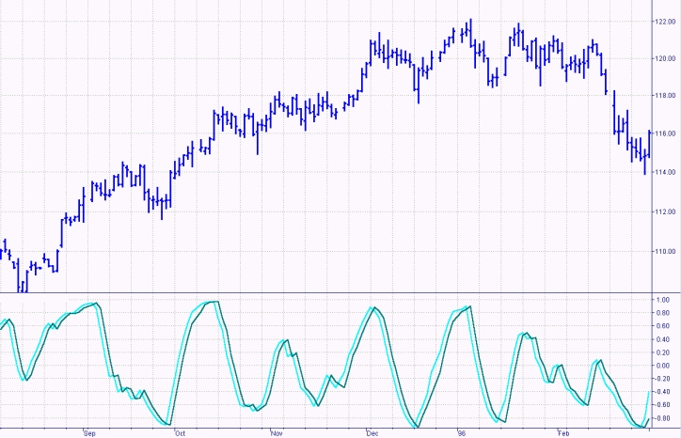
The Stochastic RSI Gives Signals in a Timely Manner

Slide 22
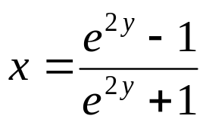
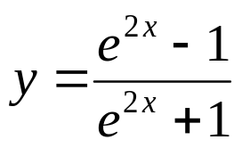
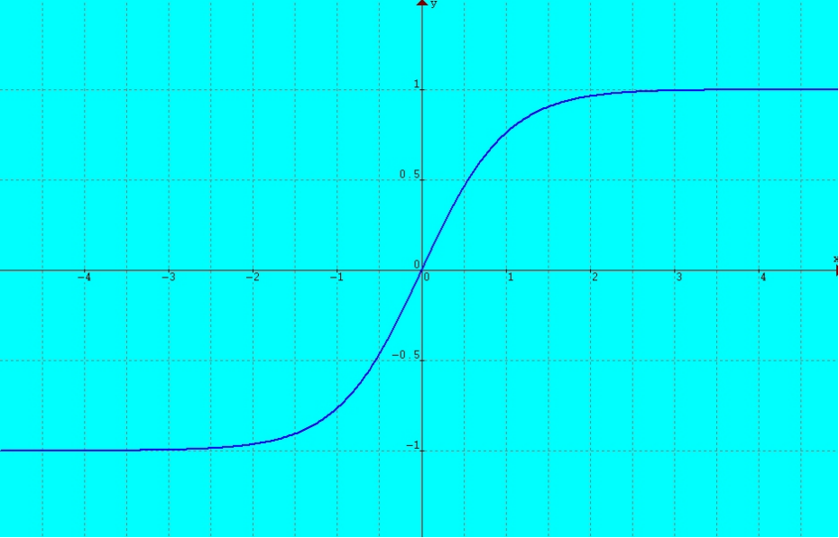
Deriving the Inverse Fisher Transform
The original Fisher Transform
Take the inverse by exponentiating both sides
and rearranging for X
Interchange x and y for conventional notation of input and output
The Inverse Fisher Transform is Compressive

Slide 23
Inverse Fisher RSI Code
Inverse Fisher Transform requires the input amplitude be reasonably limited
A recentered and rescaled RSI fills the bill
Vars: IFish(0);
Value1 = .1*(RSI(Close, 5) - 50);
Value2 = WAverage(Value1, 9);
IFish = (ExpValue(2*Value2) - 1) / (ExpValue(2*Value2) + 1);
Plot1(IFish, "IFish");
Plot2(0.5, "Sell Ref");
Plot3(-0.5, "Buy Ref");

Slide 24
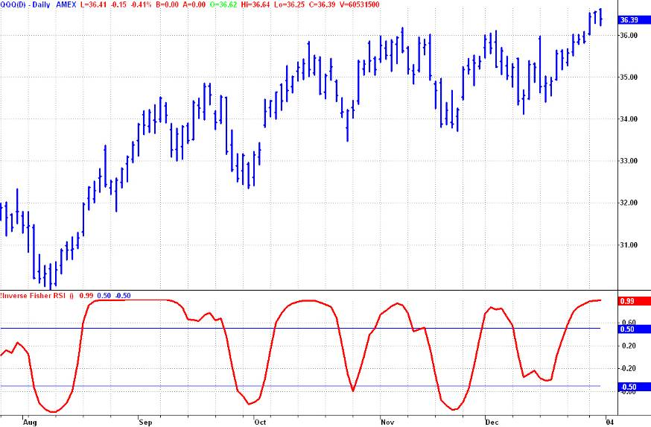
The Inverse Fisher Transform Crossing the Trigger Levels
Gives Consistently Profitable Trades

Slide 25
The Inverse Fisher Transform Can Also Be Applied to a Variety of Other Indicators
My CyberCycle is just one such example
  from “Cybernetic Analysis for Stocks and Futures”
Inputs: Price((H+L)/2),
alpha(.07);
Vars: Smooth(0),
Cycle(0),
ICycle(0);
Smooth = (Price + 2*Price[1] + 2*Price[2] + Price[3])/6;
Cycle = (1 - .5*alpha)*(1 - .5*alpha)*(Smooth - 2*Smooth[1] + Smooth[2])
+ 2*(1 - alpha)*Cycle[1] - (1 – alpha)*(1 - alpha)*Cycle[2];
If currentbar < 7 then Cycle = (Price - 2*Price[1] + Price[2]) / 4;
ICycle = (ExpValue(2*Cycle) - 1) / (ExpValue(2*Cycle) + 1);
Plot1(ICycle, "Cycle");
Plot2(0.5, "Sell Ref");
Plot3(-0.5, "Buy Ref");

Slide 26
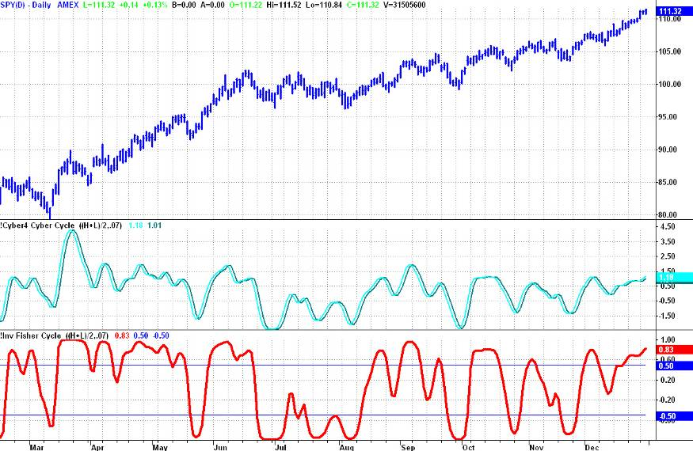
The Inverse Fisher Transform Helps Eliminate Some Whipsaw Trades

Slide 27
SUMMARY
The Fisher Transform and Inverse Fisher Transform introduce no lag
The Fisher Transform readjusts the data PDF to give sharp turning point indications
The Fisher Transform Strategy identifies trends and pops in the direction of the trend
The Inverse Fisher Transform is an elegant means to improve many existing indicators

