Slide 1

Building Trading Systems
On NonLinear Filters
Presented by John Ehlers

Slide 2
Disclaimer
Each speaker at the TradeStationWorld Conference acts independently, and no speaking topic, session, seminar or content is affiliated with, or approved, sponsored or endorsed by, TradeStation Technologies, Inc. or any of its affiliates. Topics, sessions and seminars are solely for educational purposes. The speaker roster and session/seminar content are subject to change without notice. No investment or trading advice regarding any security, group of securities, market segment or market is intended or shall be given. Any examples used in sessions, seminars or speaking topics are for illustrative purposes only -- they should never be construed as recommendations or endorsements of any kind. No particular trading strategy, technique, method or approach discussed will guarantee profits, increased profits or the minimization of losses. Past performance, whether actual or indicated by simulated historical tests, is no guarantee of future performance or success.
Testimonials may not be representative of the experiences of other customers and are not indicative of future performance or success.
TradeStation Technologies, Inc., the host of the conference, and TradeStation Securities, Inc. (Member NASD, SIPC and NFA), the conference's premier sponsor, are affiliated companies. "TradeStation," as used in this presentation, refers to the trading analysis software products, platforms and services that have been developed by TradeStation Technologies.

Slide 3
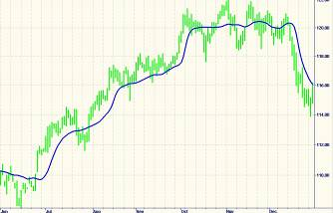
System Design Approach
Pick nonlinear moving averages as the base technology to react to major moves and avoid whipsaws in sideways markets
Survey available nonlinear moving averages
Select a time-based event
Include volatility guards
Add loss escape mechanism

Slide 4
Nonlinear Moving Average Survey
Eight Approaches are considered
  KAMA (Kaufman Adaptive Moving Average)
  VIDYA (Variable Index Dynamic Average)
  MAMA (MESA Adaptive Moving Average)
  Ehlers Filter
  Median Filter
  Median-MA Difference Filter
  FRAMA (Fractal Adaptive Moving Average)
  Nonlinear Laguerre Filter
Notes:
KAMA -

Slide 5
KAMA (Kaufman Adaptive Moving Average)
Describe by Perry Kaufman in “Trading Systems and Methods”, Third Edition, John Wiley & Sons, pp 436-438
Adjusts the alpha of an EMA according to volatility
  Ratios the price difference over a time span to the sum of the bar-to-bar price differences over the time span
Alpha is limited to range between a lower and upper bound

Slide 6
KAMA Indicator EL Code
Inputs: Price((H+L)/2), Len(10),FastLen(2), SlowLen(30);
Vars: count(0), Num(0), Denom(0),ER(0), Fastest(0), Slowest(0), alpha(0), Filt(0);
Num = AbsValue(Price - Price[Len]);
Denom = 0;
For count = 0 to Len begin
Denom = Denom + AbsValue(Price[count] - Price[count + 1]);
End;
If Denom <> 0 then ER = Num / Denom;
Fastest = 2 / (FastLen + 1);
Slowest = 2 / (SlowLen + 1);
alpha = Square(ER*(Fastest - Slowest) + Slowest);
Filt = alpha*Price + (1 - alpha)*Filt[1];
If CurrentBar = 1 then Filt = Price;
Plot1(Filt, "KAMA");

Slide 7
VIDYA (Variable Index Dynamic Average)
Developed by Tushar Chande and Stanley Kroll in “The new Technical Trader”, John Wiley & Sons, 1984
Dynamically adjusts the alpha of an EMA according the the ratio of the Standard Deviation of prices over a period to the Standard Deviation of prices over a longer period
  Modifies the alpha of a suggested 9 bar EMA
    alpha = 2 / (length + 1)

Slide 8
VIDYA Indicator EL Code
Inputs: M(30), N(9);
Vars: k(0), VIDYA(0);
If StdDev(Close, M) <> 0 then k = StdDev(Close, N) / StdDev(Close, M);
Filt = .2*k*Close + (1 - .2*k)*Filt[1];
If CurrentBar = 1 then Filt = Close;
Plot1(Filt, "VIDYA");

Slide 9
MAMA (MESA Adaptive Moving Average)
Uses the Hilbert Transform to measure the current dominant cycle period
Computes the phase of the dominant cycle
Computes the alpha inversely proportional to the rate change of phase
  Shorter periods have higher rate changes of phase
    Large alpha - more responsive EMA
  Longer periods have lower rate changes of phase
    Smaller alpha - gives EMA more smoothing
High rate change of phase due to snap-back every 180 degrees ensures EMA will tightly follow price

Slide 10
MAMA Indicator EL Code
Inputs: Price((H+L)/2), speed(.8), FastLimit(.5), SlowLimit(.05);
Vars: Smooth(0), Detrender(0), I1(0), Q1(0), jI(0), jQ(0), I2(0), Q2(0), Re(0), Im(0), Period(0), SmoothPeriod(0), Phase(0),
DeltaPhase(0), alpha(0), Filt(0);
If CurrentBar > 5 then begin
Smooth = (4*Price + 3*Price[1] + 2*Price[2] + Price[3]) / 10;
Detrender = (.0962*Smooth + .5769*Smooth[2] - .5769*Smooth[4] - .0962*Smooth[6])*(.075*Period[1] + .54);
{Compute InPhase and Quadrature components}
Q1 = (.0962*Detrender + .5769*Detrender[2] - .5769*Detrender[4] - .0962*Detrender[6])*(.075*Period[1] + .54);
I1 = Detrender[3];
{Advance the phase of I1 and Q1 by 90 degrees}
jI = (.0962*I1 + .5769*I1[2] - .5769*I1[4] - .0962*I1[6])*(.075*Period[1] + .54);
jQ = (.0962*Q1 + .5769*Q1[2] - .5769*Q1[4] - .0962*Q1[6])*(.075*Period[1] + .54);
{Phasor addition for 3 bar averaging)}
I2 = I1 - jQ;
Q2 = Q1 + jI;
{Smooth the I and Q components before applying the discriminator}
I2 = .2*I2 + .8*I2[1];
Q2 = .2*Q2 + .8*Q2[1];
{Homodyne Discriminator}
Re = I2*I2[1] + Q2*Q2[1];
Im = I2*Q2[1] - Q2*I2[1];
Re = .2*Re + .8*Re[1];
Im = .2*Im + .8*Im[1];
If Im <> 0 and Re <> 0 then Period = 360/ArcTangent(Im/Re);
If Period > 1.5*Period[1] then Period = 1.5*Period[1];
If Period < .67*Period[1] then Period = .67*Period[1];
If Period < 6 then Period = 6;
If Period > 50 then Period = 50;
Period = .2*Period + .8*Period[1];
SmoothPeriod = .33*Period + .67*SmoothPeriod[1];
If I1 <> 0 then Phase = (ArcTangent(Q1 / I1));
DeltaPhase = Phase[1] - Phase;
If DeltaPhase < 1 then DeltaPhase = 1;
alpha = Speed / DeltaPhase;
If alpha < SlowLimit then alpha = SlowLimit;
If alpha > FastLimit then alpha = FastLimit;
Filt = alpha*Price + (1 - alpha)*Filt[1];
End;
If CurrentBar <= 5 then Filt= Price;
Plot1(Filt, "MAMA");

Slide 11
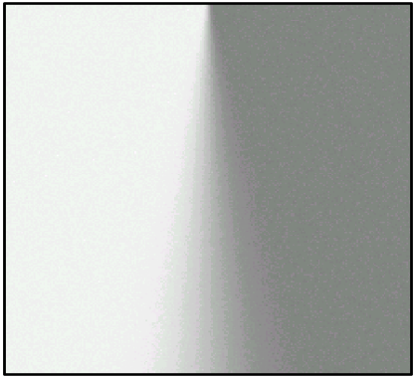
Ehlers Filter
Unlike most nonlinear filters, it is a FIR filter
Analogous to determining sharpness of a piece of paper creased and draped over the edge of a table
FIR coefficients are computed as “distance” vectors - squared price differences are summed
Coefficients are normalized to their sum for unity gain

Slide 12
Ehlers Filter EL Code
Inputs: Price((H+L)/2), Length(20);
Vars: Smooth(0), count(0), LookBack(0), SumCoef(0), Num(0), Filt(0);
Array: Coef[50](0), Distance2[50](0);
Smooth = (Price + 2*Price[1] + 2*Price[2] + Price[3]) / 6;
For count = 0 to Length -1 begin
Distance2[count] = 0;
For Lookback = 1 to Length-1 begin
Distance2[count] = Distance2[count] + (Smooth[count] - Smooth[count + Lookback])*(Smooth[count]
- Smooth[count + Lookback]);
End;
Coef[count] = Distance2[count];
End;
Num = 0;
SumCoef = 0;
For count = 0 to Length -1 begin
Num = Num + Coef[count]*Smooth[count];
SumCoef = Sumcoef + Coef[count];
End;
If SumCoef <> 0 then Filt = Num / SumCoef;
Plot1(Filt, "Ehlers");

Slide 13
Median Filter
Rank-order filter
Easy to compute
Often used to sharpen video images
Useful to smooth impulsive type noise by ignoring outliers

Slide 14
Median Filter EL Code
Inputs: Price((H+L)/2), Len(4);
Vars: Filt(0);
Filt = Median(Price, 2*Len + 1);
Plot1(Filt, "Median");

Slide 15
Median-MA Difference Filter
Adjusts the alpha of an EMA according to the differential responses of Median and MA filters
Consider a price string of ten 1s
  Both the Median and MA is 1
New price data point has a value of 10
  Median output is still 1 (new price value is ignored)
  Simple MA value is 1.9
Searches for a filter length where the output differences fall below a selected threshold
  Fast moving markets produce the shortest (most responsive) filter

Slide 16
Median-MA Difference Filter EL Code
Inputs: Price((H+L)/2), Threshold(.0025);
Vars: Smooth(0), Length(30), alpha(0), Filt(0);
Smooth = (Price + 2*Price[1] + 2*Price[2] + Price[3]) / 6;
Length = 39;
Value3 = 1;
While Value3 > Threshold begin
alpha = 2 /(Length + 1);
Value1 = Median(Smooth, Length);
Value2 = alpha*Smooth + (1 - alpha)*Value2[1];
If Value1 <> 0 then Value3 = AbsValue(Value1 - Value2) / Value1;
Length = Length - 2;
End;
If Length < 3 then Length = 3;
alpha = 2 /(Length + 1);
Filt = alpha*Smooth + (1 - alpha)*Filt[1];
If CurrentBar < 4 then Filt = Price;
Plot1(Filt, "Med-MA");

Slide 17

FRAMA (Fractal Adaptive Moving Average)
There is no argument that the market moves as a fractal
A period is selected to compute the fractal dimension
  The price difference over the first half of the range, second half of the range, and over the total range is used for the computation
Since the market prices move as log-normal, the fractal dimension is used to compute filter alpha as
  When Dimen = 1, α = 1 - a very fast filter
  When Dimen = 2, α = .01 - about a 200 bar filter

Slide 18
FRAMA Filter EL Code
Inputs: Price((H+L)/2), N(20);
Vars: count(0), N1(0), N2(0), N3(0), HH(0), LL(0), Dimen(0), alpha(0), Filt(0);
N3 = (Highest(High, N) - Lowest(Low, N)) / N;
HH = High;
LL = Low;
For count = 0 to N/2 - 1 begin
If High[count] > HH then HH = High[count];
If Low[count] < LL then LL = Low[count];
End;
N1 = (HH - LL)/(N/2);
HH = High[N/2];
LL = Low[N/2];
For count = N/2 to N - 1 begin
If High[count] > HH then HH = High[count];
If Low[count] < LL then LL = Low[count];
End;
N2 = (HH - LL)/(N/2);
If N1 > 0 and N2 > 0 and N3 > 0 then Dimen = (Log(N1 + N2) - Log(N3)) / Log(2);
{alpha = .02 when Dimen = .7 and alpha = .33 when Dimen = .05}
alpha = ExpValue(-4.6*(Dimen - 1));
If alpha < .01 then alpha = .01;
If alpha > 1 then alpha = 1;
Filt = alpha*Price + (1 - alpha)*Filt[1];
If CurrentBar < N + 1 then Filt = Price;
Plot1(Filt, "FRAMA");

Slide 19
NonLinear Laguerre
A Laguerre filter warps time in the filter coefficients
  Enables extreme smoothing with just a few filter terms
A NonLinear Laguerre filter measures the difference between the current price and the last computed filter output.
  Objective is to drive this “error” to zero
  The “error”, normalized to the error range over a selected period is the alpha of the Laguerre filter

Slide 20
Nonlinear Laguerre Filter EL Code
Inputs: Price((H+L)/2), Length(20);
Vars: Diff(0), HH(0), LL(0), count(0), alpha(0), L0(0), L1(0), L2(0), L3(0), Filt(0), FIR(0);
Diff = AbsValue(Price - Filt[1]);
HH = Diff;
LL = Diff;
For count = 0 to Length - 1 begin
If Diff[count] > HH then HH = Diff[count];
If Diff[count] < LL then LL = Diff[count];
End;
If CurrentBar > Length and HH - LL <> 0 then alpha = Median(((Diff - LL) / (HH - LL)), 5);
L0 = alpha*Price + (1 - alpha)*L0[1];
L1 = -(1 - alpha)*L0 + L0[1] + (1 - alpha)*L1[1];
L2 = -(1 - alpha)*L1 + L1[1] + (1 - alpha)*L2[1];
L3 = -(1 - alpha)*L2 + L2[1] + (1 - alpha)*L3[1];
Filt = (L0 + 2*L1 + 2*L2 + L3) / 6;
If CurrentBar < Length then begin
L0 = Price;
L1 = Price;
L2 = Price;
L3 = Price;
Filt = Price;
End;
Plot1(Filt, "Laguerre");

Slide 21
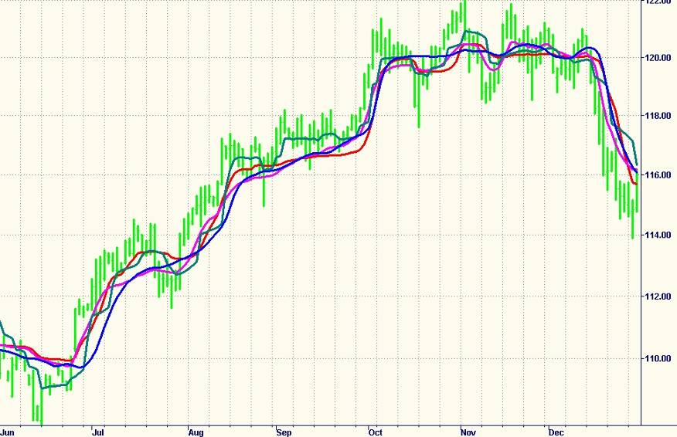
NonLinear Filter Comparison (1)
MAMA
KAMA
EHLERS
VIDYA

Slide 22
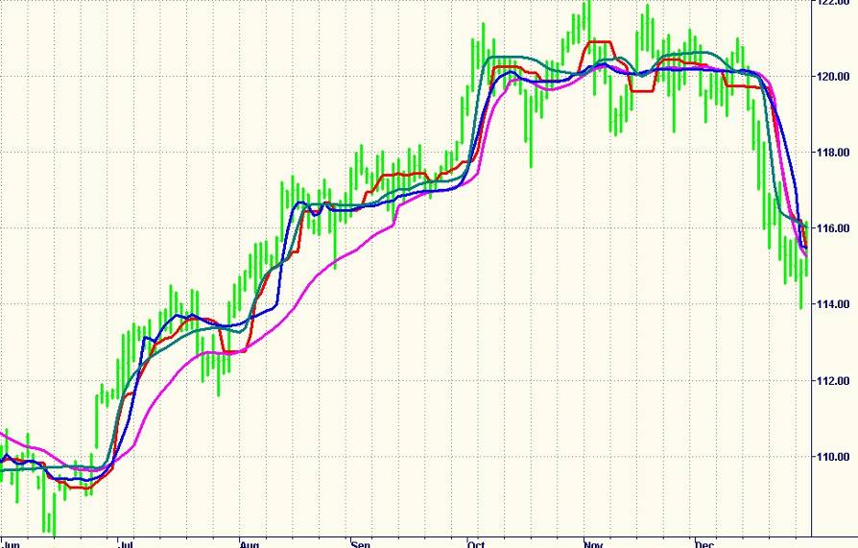
NonLinear Filter Comparison (2)
Laguerre
Median
FRAMA
Med-MA

Slide 23
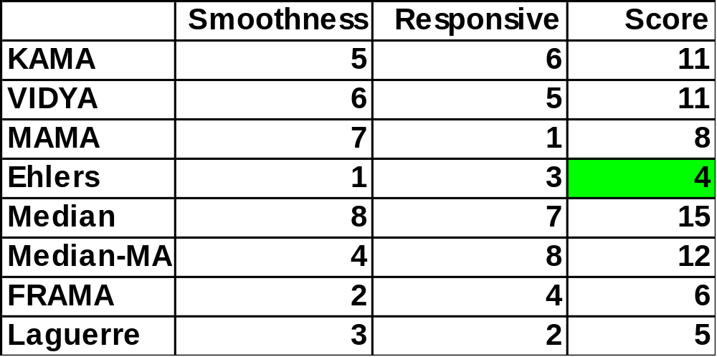
Filter Selection Process
Rank each filter according to smoothness on a scale from 1 to 8
Rank each filter according to responsiveness on a scale from 1 to 8
Add the rankings to obtain a score
  low score is the best filter for the job

Slide 24
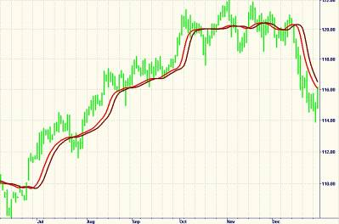
Time Based Event
Line crossings are distinctive events easily identified in automatic systems
Create a trigger by delaying the nonlinear filter by one bar
The problem is that crossings create whipsaws
in sideways markets - need hysteresis

Slide 25
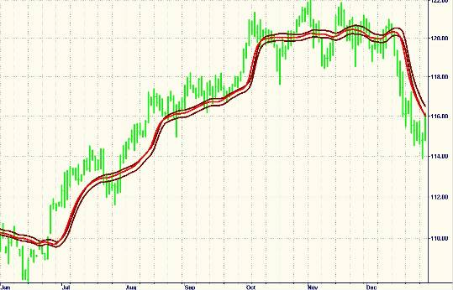
Volatility-Based Histeresis Channel
Measure the average range (can use Average True Range if desired)
Add and subtract a fraction of the average range to the NonLinear Filter

Slide 26
Trading Strategy Code
Any NonLinear Filter can be used
To NonLinear Filter code add:
  Also declare Rng variable and add Frac Input
Rng = .1*(High - Low) + .9*Rng[1];
Value1 = Filt[1] + Rng / Frac;
Value2 = Filt[1] - Rng / Frac;
If Filt Crosses Over Value1 Then Buy Next Bar on Open;
If Filt Crosses Under Value2 Then Sell Short Next Bar on Open;
Trading Rules are simple
  Contains time event trigger as Filt[1]
  Contains Hysteresis channel as ± Rng/Frac
Trading system is always in the market - reversing between long and short positions
  Excellent approach for Commodities and ETFs
  Long-Only positions for stocks can be taken

Slide 27
Efficiency Tips
Precede indicator or strategy name with a special character like “!” or “*” or “=“
  This moves your custom indicators and strategies to the top of the TradeStation list
Precede research indicators and strategies with double special characters like “!!” or “**” or “==“
  Avoids versionitis - you know you can delete one of these later without worrying about losing content
  Easy converts to a custom indicator or strategy simply by removing one of the special characters

Slide 28
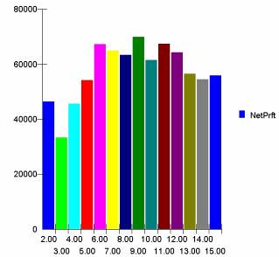
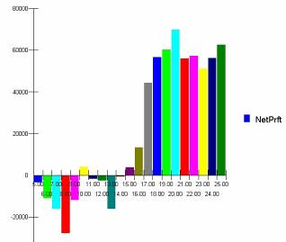
Optimization Tips
Optimize one parameter at a time for efficiency
  Iterate if necessary
A good optimization will have a gentle “mound”
Parameters should be robust over a wide range
Frac Optimization on EC
Length Optimization on EC

Slide 29
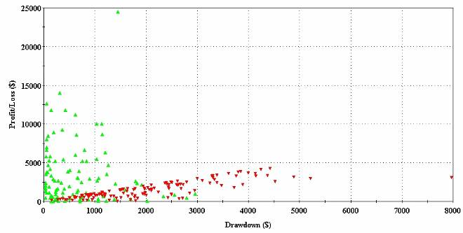
Maximum Adverse Excursion
Large losers indicate a loss escape is desirable
Add the following code to the system to reverse from a losing position
If MarketPosition = 1 then Sell Short at EntryPrice - PtStop Stop;
If MarketPosition = -1 then Buy at EntryPrice + PtStop Stop;

Slide 30
Complete System EL Code
Inputs: Price((H+L)/2), Length(20), Frac(5), PtStop(3);
Vars: Smooth(0), count(0), LookBack(0), SumCoef(0), Num(0), Filt(0), Rng(0);
Array: Coef[50](0), Distance2[50](0);
Smooth = (Price + 2*Price[1] + 2*Price[2] + Price[3]) / 6;
For count = 0 to Length -1 begin
Distance2[count] = 0;
For Lookback = 1 to Length-1 begin
Distance2[count] = Distance2[count] + (Smooth[count] - Smooth[count + Lookback])*(Smooth[count]
- Smooth[count + Lookback]);
End;
Coef[count] = Distance2[count];
End;
Num = 0;
SumCoef = 0;
For count = 0 to Length -1 begin
Num = Num + Coef[count]*Smooth[count];
SumCoef = Sumcoef + Coef[count];
End;
If SumCoef <> 0 then Filt = Num / SumCoef;
Rng = .1*(High - Low) + .9*Rng[1];
Value1 = Filt[1] + Rng / Frac;
Value2 = Filt[1] - Rng / Frac;
If Filt Crosses Over Value1 Then Buy Next Bar on Open;
If Filt Crosses Under Value2 Then Sell Short Next Bar on Open;
If MarketPosition = 1 then Sell Short at EntryPrice - PtStop Stop;
If MarketPosition = -1 then Buy at EntryPrice + PtStop Stop;

Slide 31
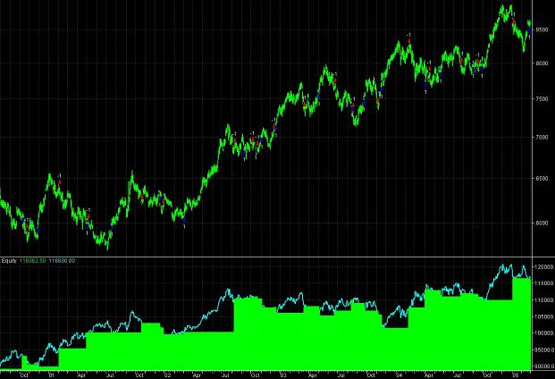
System Development Tip
Plot Open and Closed Equity to identify problematic trades
INDICATOR
Plot1(I_ClosedEquity, "Closed");
Plot2(I_OpenEquity, "Open");

Slide 32
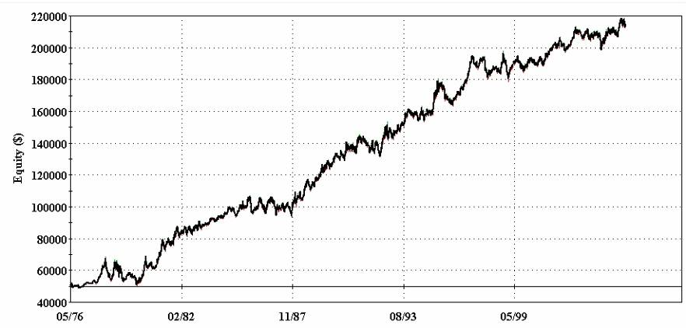
29 Year SF Equity Growth

Slide 33
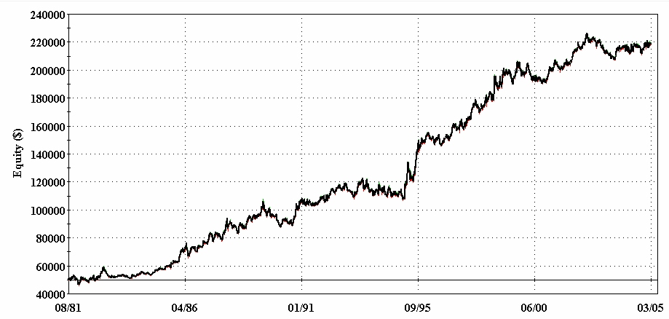
24 Year JY Equity Growth

Slide 34
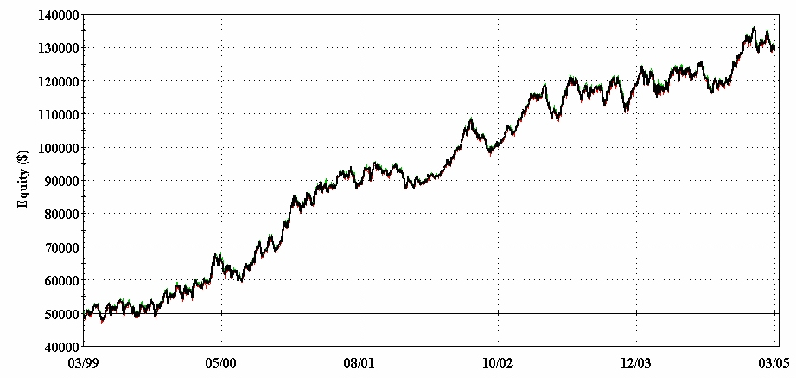
Six Year EC Equity Growth

Slide 35
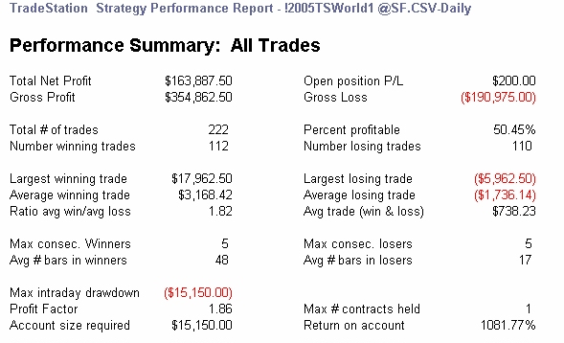
29 Year SF Performance

Slide 36
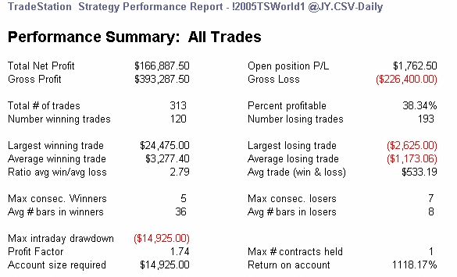
24 Year JY Performance

Slide 37
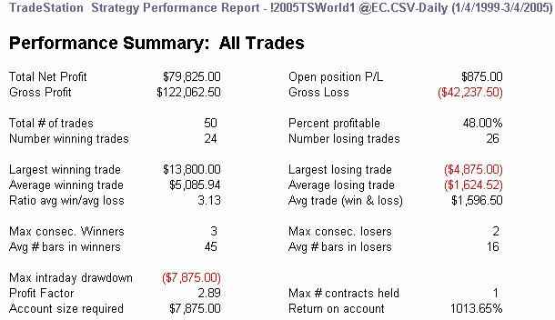
6 Year EC Performance

Slide 38
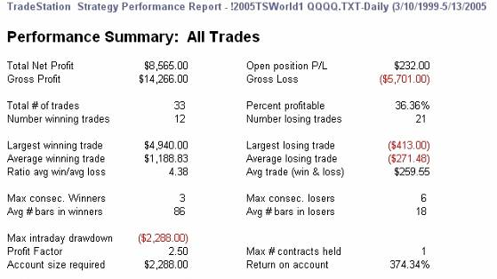
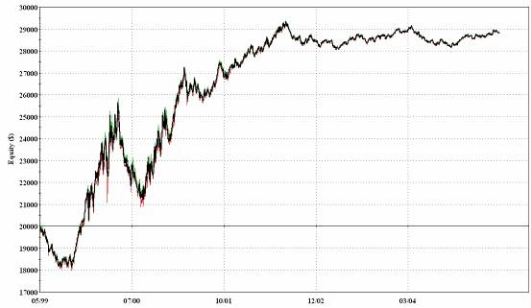
The System Works on ETFs
Object Lesson:
You can’t make money
unless the market moves

Slide 39
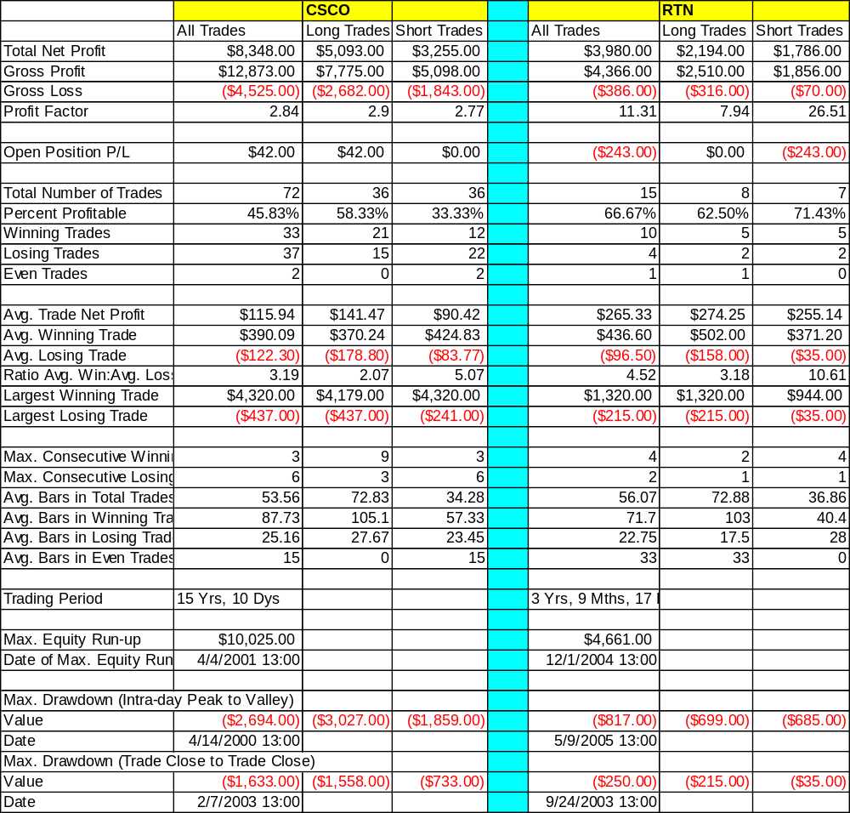
The System Works on Stocks, Too

Slide 40
SUMMARY
Eight (or more) systems can be created using NonLinear Moving Averages as a basis
The systems have four components
  NonLinear Moving Average
  Time Event
  Volatility Histeresis
  Loss Escape Mechanism
The systems are robust over long time spans
The systems are robust over vastly different trading instruments

